Slide 1
Important Resources to Help You Navigate Your Early Research Career
September 15, 2022

Slide 2
Resource Links
Career Guidance
Preparing an NIH Grant Application
Frequently Asked Questions
NIH Policies

Slide 3
Important Resources
Several key issues should be considered before, during, and after your application is written. These resources will help you navigate some of those issues and point you to other resources for developing your application.
Career Guidance
Find a scientific home and a NIH Program Officer
NIH Databook
NIH Reporter
NIH Matchmaker Tool
How to Apply
Application Guide
NIH Forms & Applications
Grant applications & more

Slide 4
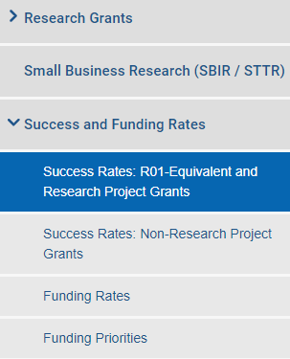
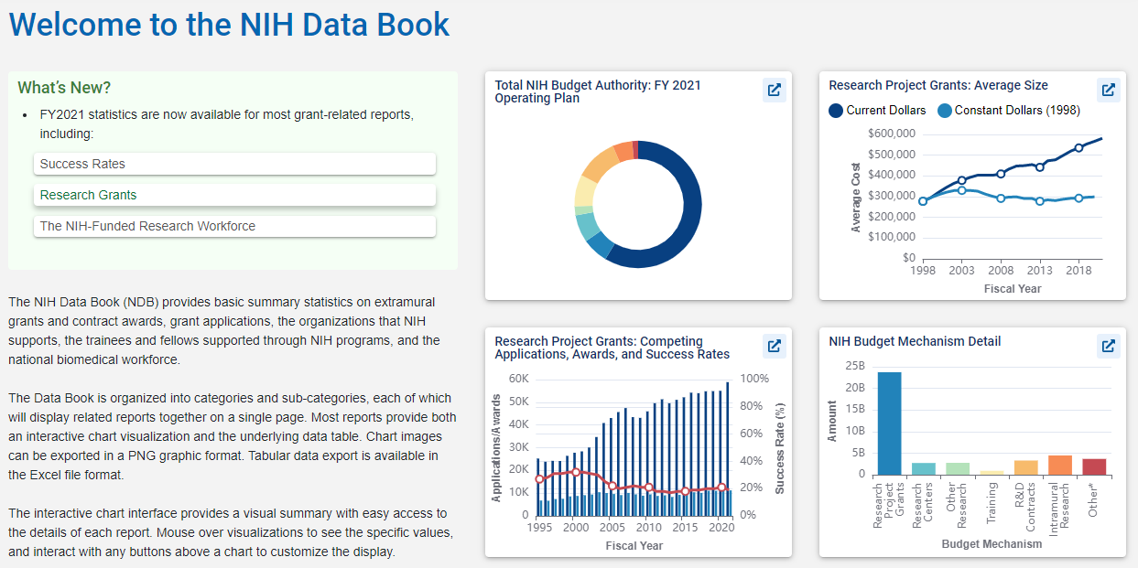
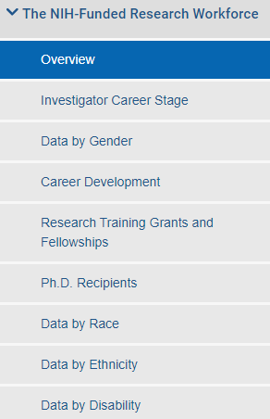
NIH Data Book
https://report.nih.gov/nihdatabook/
Notes:
The NIH Data Book (NDB) provides basic summary statistics on extramural grants and contract awards, grant applications, the organizations that NIH supports, the trainees and fellows supported through NIH programs, and the national biomedical workforce.

Slide 5
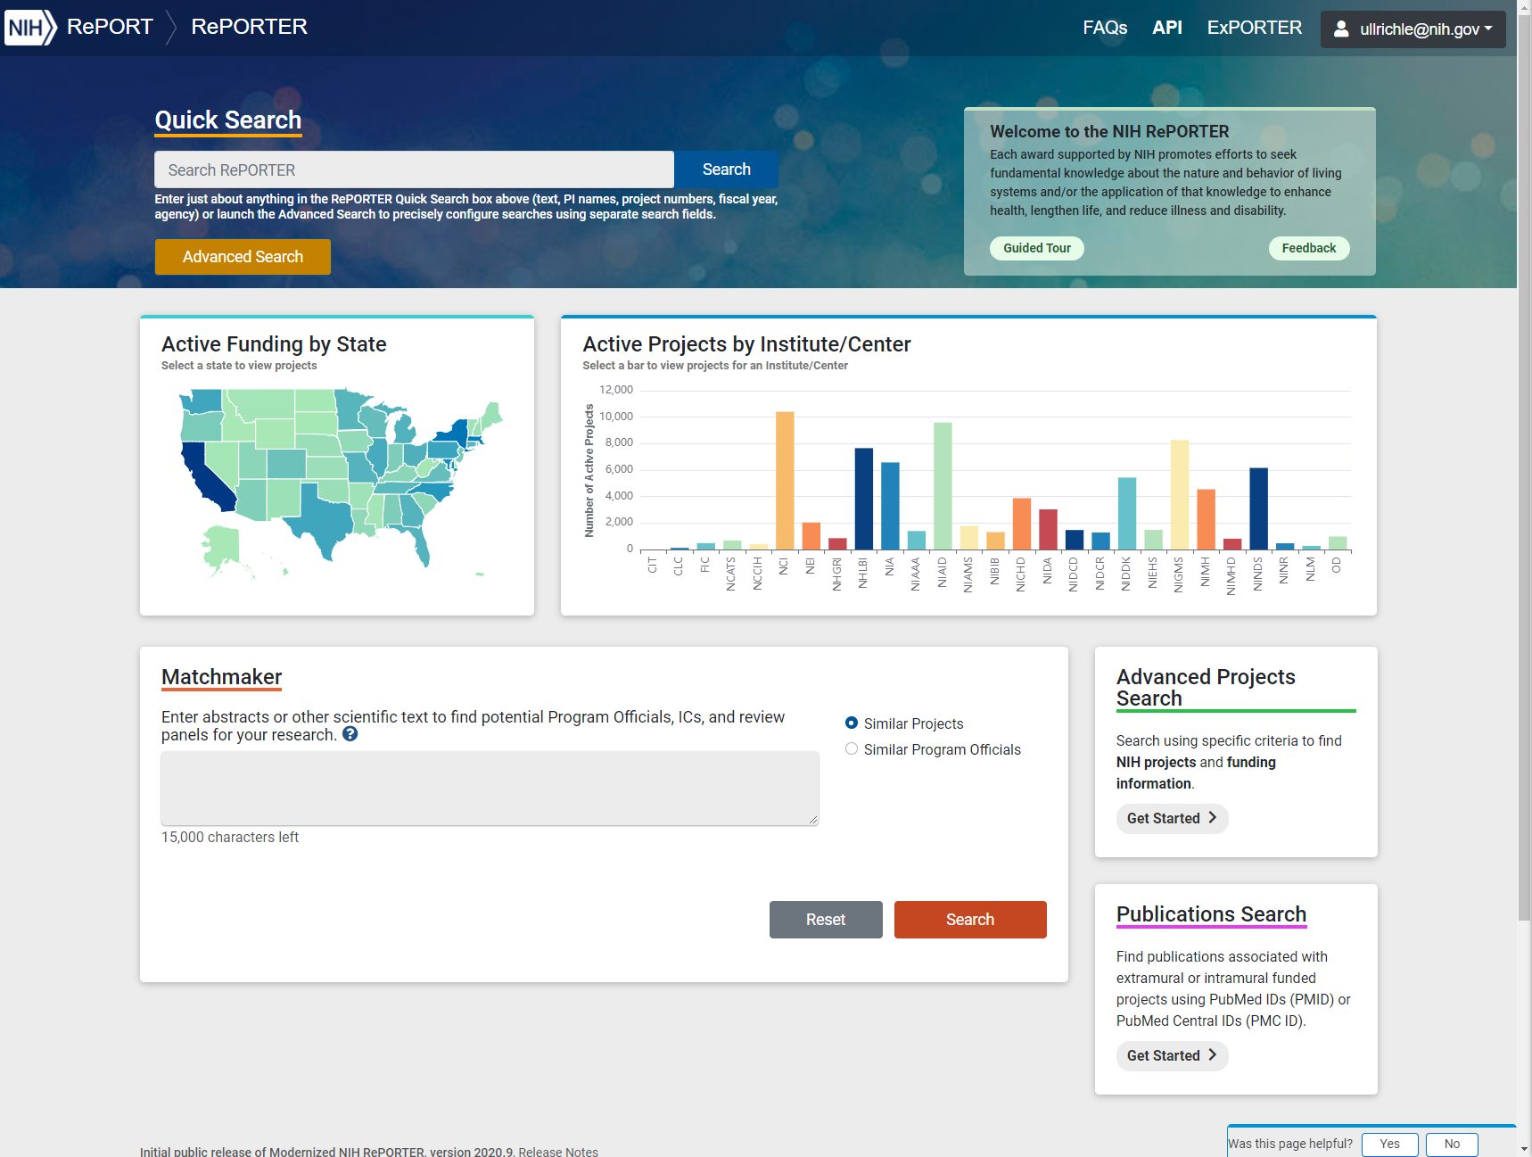
Preparing an NIH Grant Application
https://reporter.nih.
gov/matchmaker

Slide 6
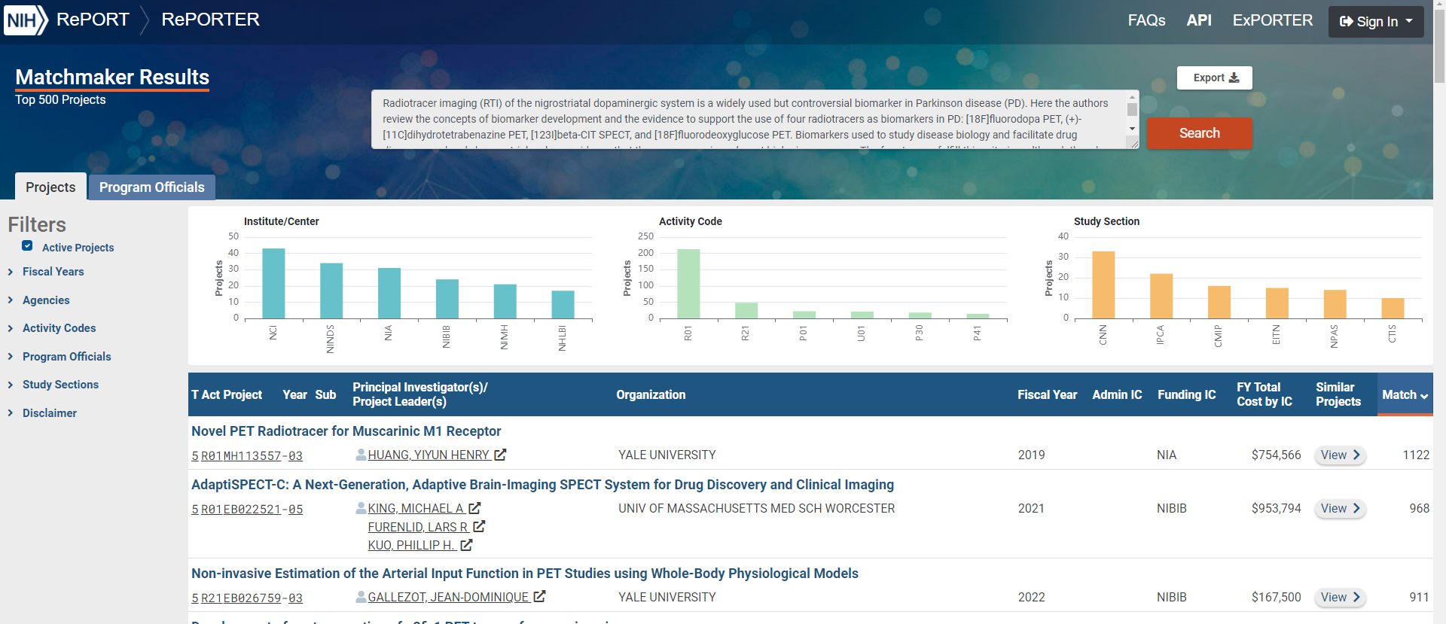
Matchmaker Results – Projects Tab

Slide 7
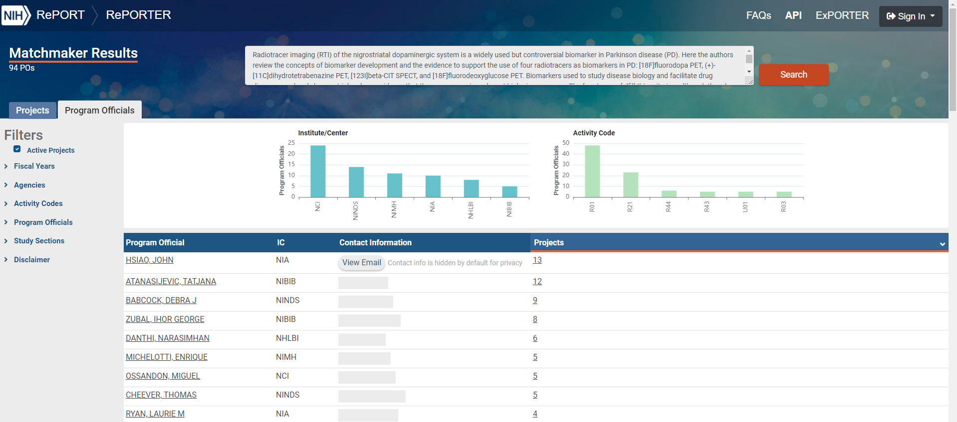
Matchmaker Results – Program Officials Tab

Slide 8
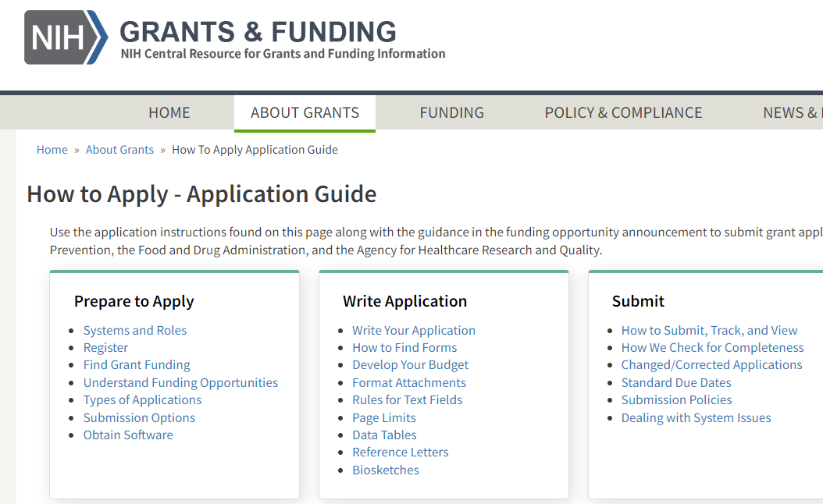
How to Apply!
How to Apply - Application Guide | grants.nih.gov

Slide 9
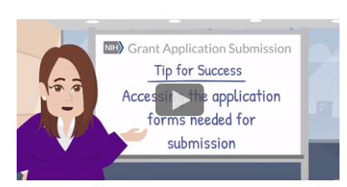
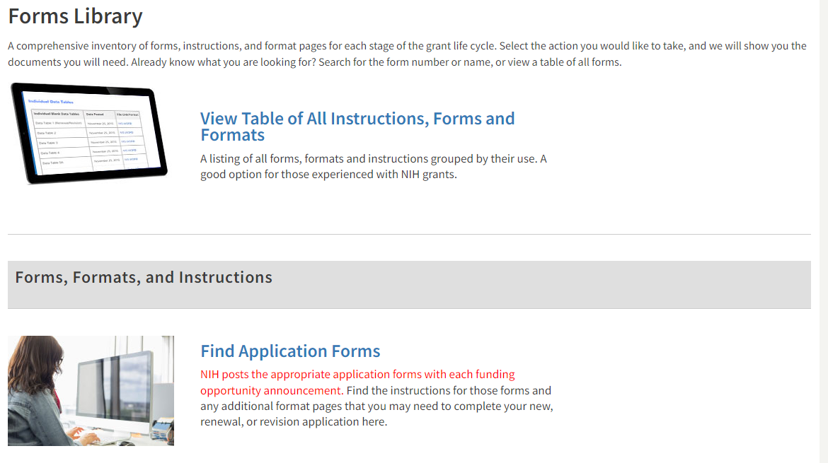
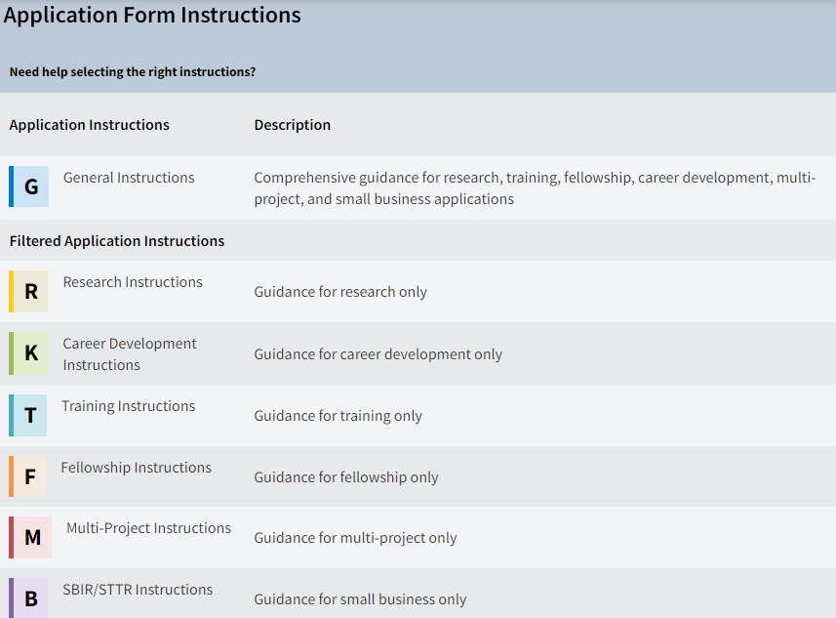
NIH Application Forms
NIH Forms & Applications | grants.nih.gov

Slide 10
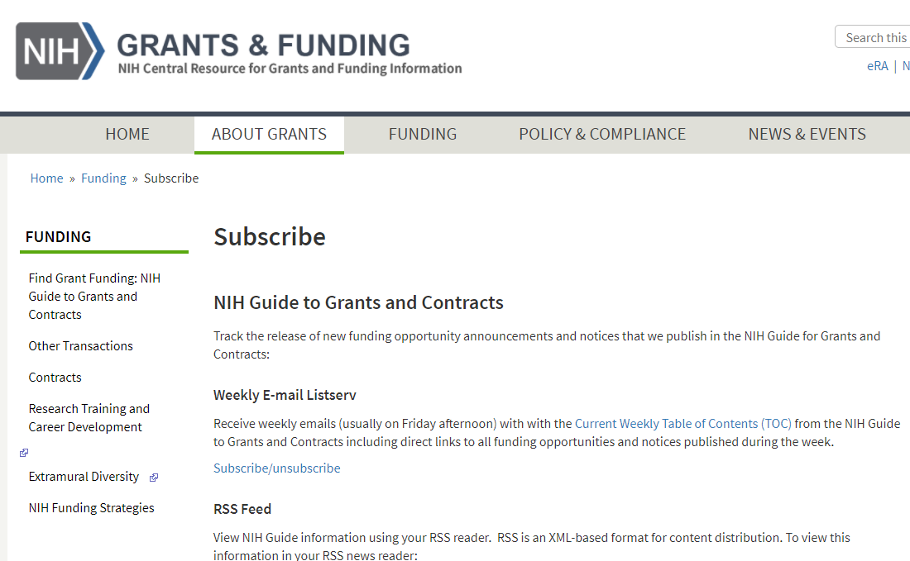
Subscribe to Receive the Weekly NIH Guide Table of Contents
NIH Guide is published daily.
Subscribe to listserv to receive table of contents each Friday…
or subscribe to our RSS feed or follow us on Twitter
http://grants.nih.gov/grants/guide/listserv_dev.htm

Slide 11
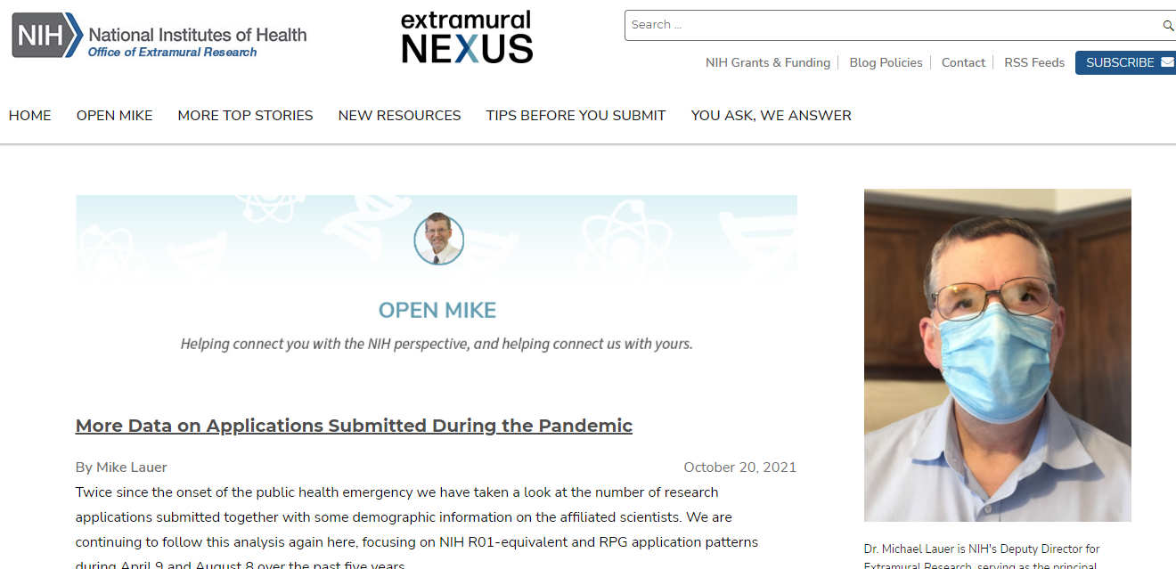
Extramural Nexus and Open Mike Blog
Subscribe to the monthly Nexus for a summary of NIH grant happenings, resources, events.
Provide comment, join the discussion!
http://nexus.od.nih.gov

Slide 12
More Important Resources
Early-Stage Investigator (ESI)
Notices (NOTs) of Policy Changes
Diversity
Research Training and Career Development
Loan Repayment Program (LRPs)

Slide 13
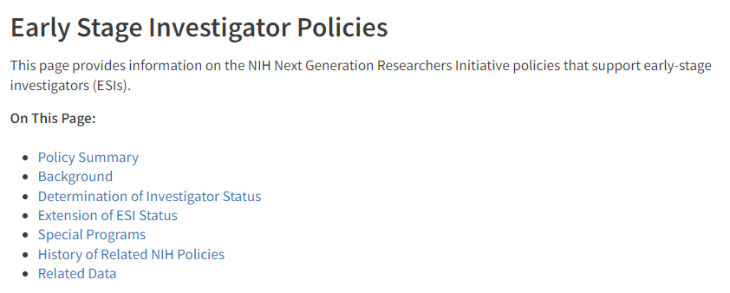
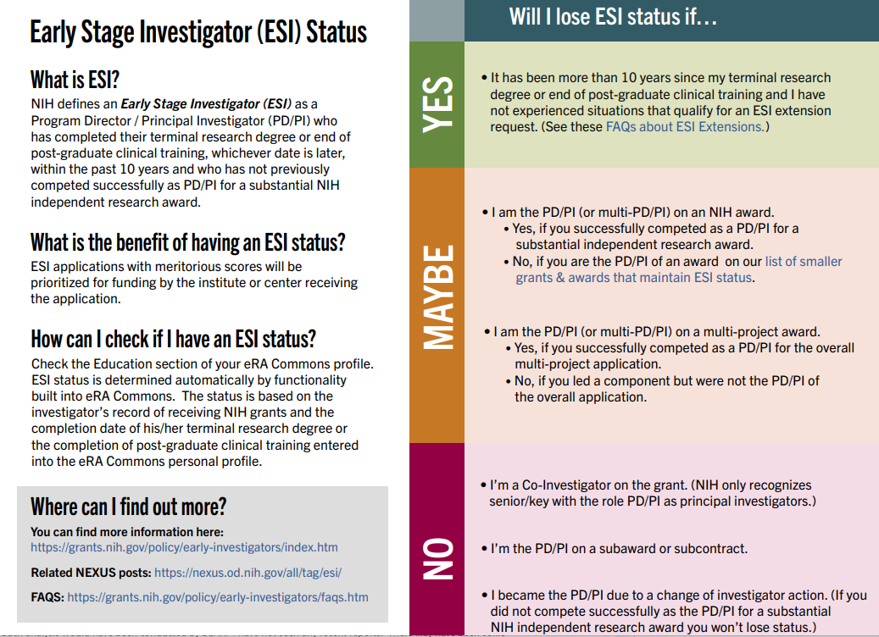
Early-Stage Investigator Policies
https://grants.nih.gov/policy/early-stage/index.htm
Notes:
An Early Stage Investigator (ESI) is a Program Director/Principal Investigator (PD/PI) who meets the following qualifications:
Completed terminal research degree or end of post-graduate clinical training, whichever date is later, within the past 10 years, and
Has not previously successfully competed as PD/PI for a substantial NIH independent research award.
ESI applications with meritorious scores will be prioritized for funding by the institute or center receiving the application.
Some ESIs will experience a lapse in their research or research training or periods of less than full-time effort during the 10-year ESI period. To accommodate such lapses, NIH will consider requests to extend the ESI period, on a case by case basis at the sole discretion of NIH.
Investigators should consult the FAQs, Section IV, Extension of Early State Investigator Status prior to submitting a request.

Slide 14
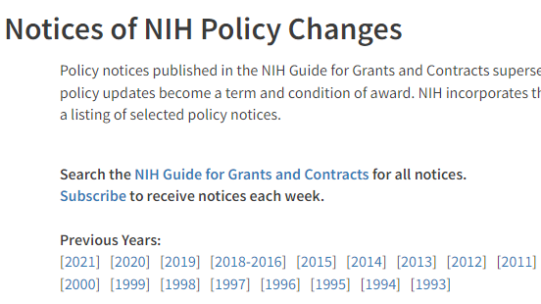
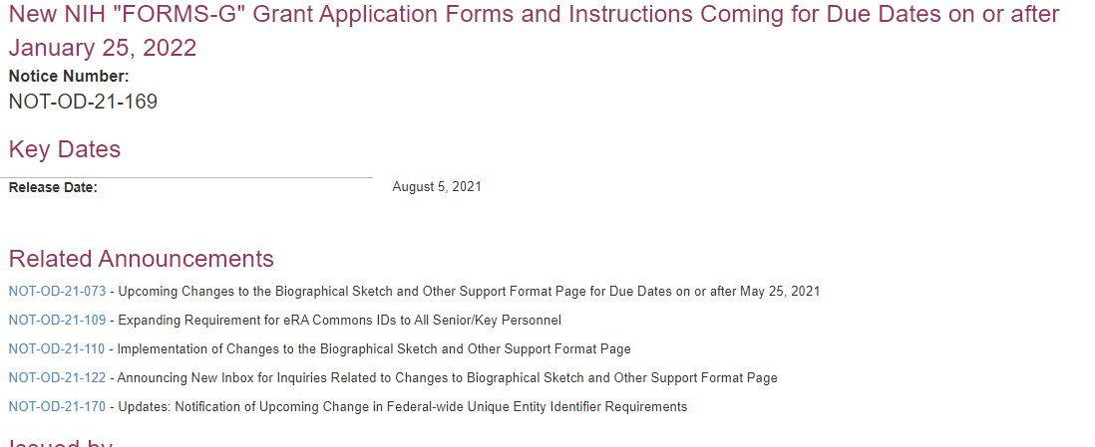
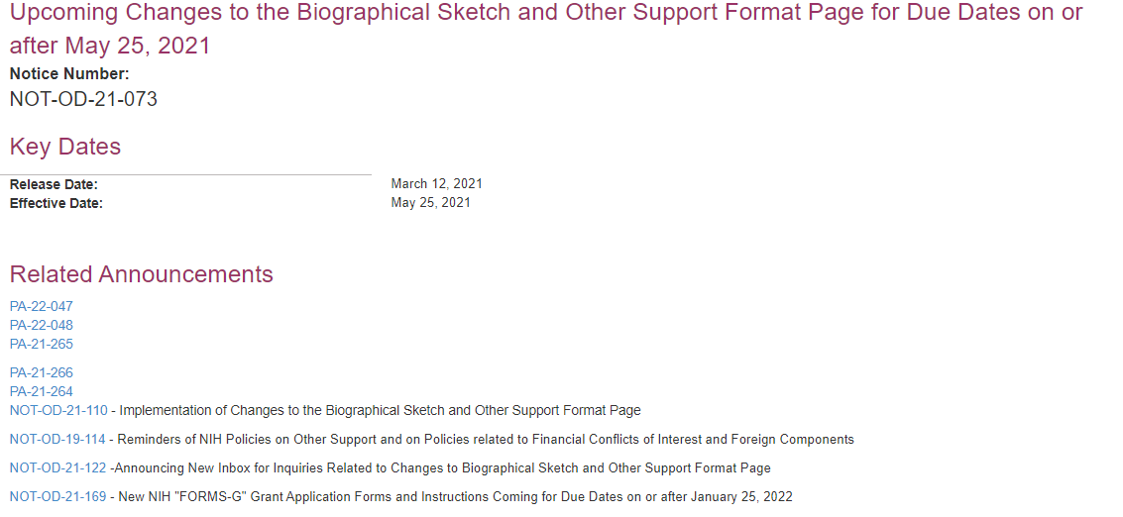
Notices of NIH Policy Changes
Notices of NIH Policy Changes | grants.nih.gov

Slide 15
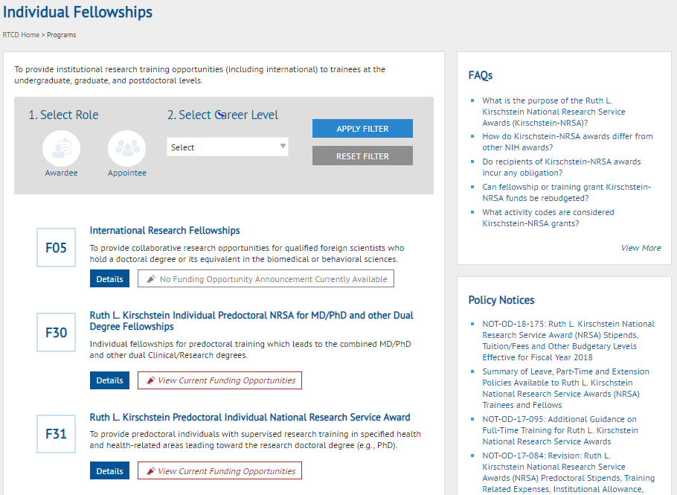
NIH Research Training Website
https://researchtraining.nih.gov
https://researchtraining.nih.gov
https://researchtraining.nih.gov
Notes:
You can also use the NIH research training website, which curates information specific to types of grants. If you click on the Fellowship Kiosk, you’ll see FOAs, policy notices, and FAQ specific to F applications.

Slide 16
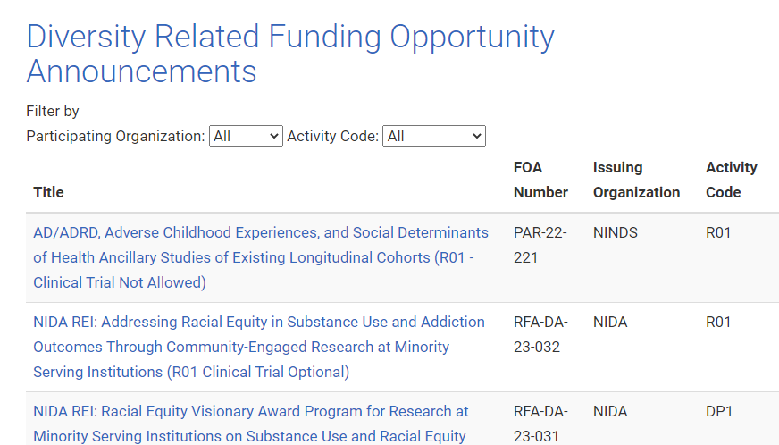
NIH Extramural Diversity
https://extramural-diversity.nih.gov/diversity-matters

Slide 17
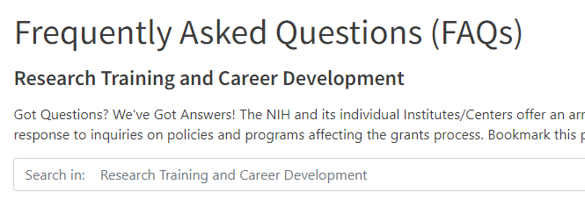
Got Questions?
Research Training Frequently Asked Questions (FAQs)

Slide 18
And one last important tip!

Slide 19
Got Student Loan Debt?
Got Student Loan Debt???
Are You Conducting Research @ A Non-Profit Institution??

Slide 20
The NIH LRPs Can Help!
Clinical Research
Patient-oriented research conducted with human subjects or materials of human origin (including cognitive phenomenon) on the causes and consequences of disease in humans
Pediatric Research
Research related to diseases or disorders in children
Health Disparities Research
Same as Clinical Research LRP
Contraception & Infertility Research
Clinical DB
Research focusing on minority and other health disparity populations
Research focusing on conditions impacting ability to conceive or bear children and provide new or improved methods of preventing pregnancy
Basic research allowed
Basic, clinical, social and behavioral research allowed
Available to clinical researchers from verifiable disadvantaged backgrounds
Applications reviewed by Eunice Kennedy Shriver NICHD
Applications reviewed NIH ICs
Reviewed by NIMHD
Research on Emerging Areas Critical to Human Health (REACH)
Available beginning September 2021
To recruit and retain researchers pursuing major opportunities or gaps in emerging areas of human health
NIH ICs determine gap/emerging areas of research priority areas
Notes:
Clinical Research
Patient-oriented research conducted with human subjects or materials of human origin (including cognitive phenomenon) on the causes and consequences of disease in humans
Pediatric Research
Research related to diseases or disorders in children
Basic research allowed
Health Disparities Research
Research focusing on minority and other health disparity populations
Basic, clinical, social and behavioral research allowed
Applications reviewed NIH ICs
Contraception & Infertility Research
Research focusing on conditions impacting ability to conceive or bear children and provide new or improved methods of preventing pregnancy
Applications reviewed by Eunice Kennedy Shriver NICHD
Clinical DB
Same as Clinical Research LRP
Available to clinical researchers from verifiable disadvantaged backgrounds
Reviewed by NIMHD
Research on Emerging Areas Critical to Human Health (REACH)
Available beginning September 2021
To recruit and retain researchers pursuing major opportunities or gaps in emerging areas of human health
NIH ICs determine gap/emerging areas of research priority areas

Slide 21
NIH LRPs will repay:
Up to $100K over 2 yrs in educational loan repayment
Depending on debt level
Coverage of most Federal taxes resulting from the NIH LRP
2-year initial contracts
1-or 2-year competitive renewals
50% application success rate overall
Extramural LRP Application Deadline
Nov 17, 2022

Slide 22
Funding Opportunities by Career Phase
Expected Training Outcomes:
Scientific knowledge, creativity, basic research skills, clinical research skills, technical writing, grantsmanship, publications, collaborations, mentorship
Undergraduate Graduate/ Clinical Training
Postdoctoral Training/Clinical Residency
Early Research Career
Established Investigator
T34, R25
T32, T35
T32
K01*, K07, K25
K08, K23
R03, R21*, DP2
R01, R35
R01*, R35
P01, P50
F99, K00, F32, DP5
R38 (K38), R25, K12
K22 K22
K99* R00 *
F30, F31*,
R36*
F32, DP5
K02, K24
Loan Repayment Programs
https://www.lrp.nih.gov/
Diversity Supplements: PA-20-166
Re-Entry Supplements: NOT-OD-20-054
Notes:
This is a well-seen representation of NIH funding opportunities by career stage. Outlined here are general programs and those that are diversity-targeted. While it seems that the pathway from training to career development to independence is well-prescribed, the biomedical research career trajectory from trainee to independence is anything but linear
Chart:
Undergraduate Graduate/Clinical Training: T34,T32, T35 as well as F30, F32, F36
Postdoctoral Training/Clinical Residency: T32, F99, K00, F32, DP5, R38 (K38), R25, K12, K01, K07, K25
Early Research Career: K08, K23, K22, R00, R03
Established Investigator: R21, DP2, R01, R35, P01, P50, K02, K24
Loan Repayment Programs: https://www.lrp.nih.gov/
Diversity Supplements: PA-20-166
Re-Entry Supplements: NOT-OD-20-054

Slide 23
Contact Info
THANK YOU!
Website:
https://researchtraining.nih.gov/dbrw
Email:
NIHTrain@nih.gov

