Slide 1
Ready, Set, Submit!
GRANT Application Preparation & Submission
Kasima Garst, OER/OPERA/DGSI/SPB
Laurie Roman, OER/eRA

Slide 2
Take Home Messages
PATSA- (think PASTA with a Boston accent) -Plan Ahead To Stay Ahead
Make sure all your registrations are in place and you know your commons ID and password
READ the Funding Opportunity Announcement! Application instructions guide<NOFO<Notices
Know what submission system your organization uses (ASSIST, workspace, S2S)
Build your team, establish responsibilities
Complete the application- NIH recommends submitted early to ensure on time submission- Early is on a calendar NOT a clock
If you can’t see the grant image, we can’t see the grant image, which means we can’t review it and can’t fund it- correct all errors!
NIH staff and reviewers also check for compliance to policies

Slide 3
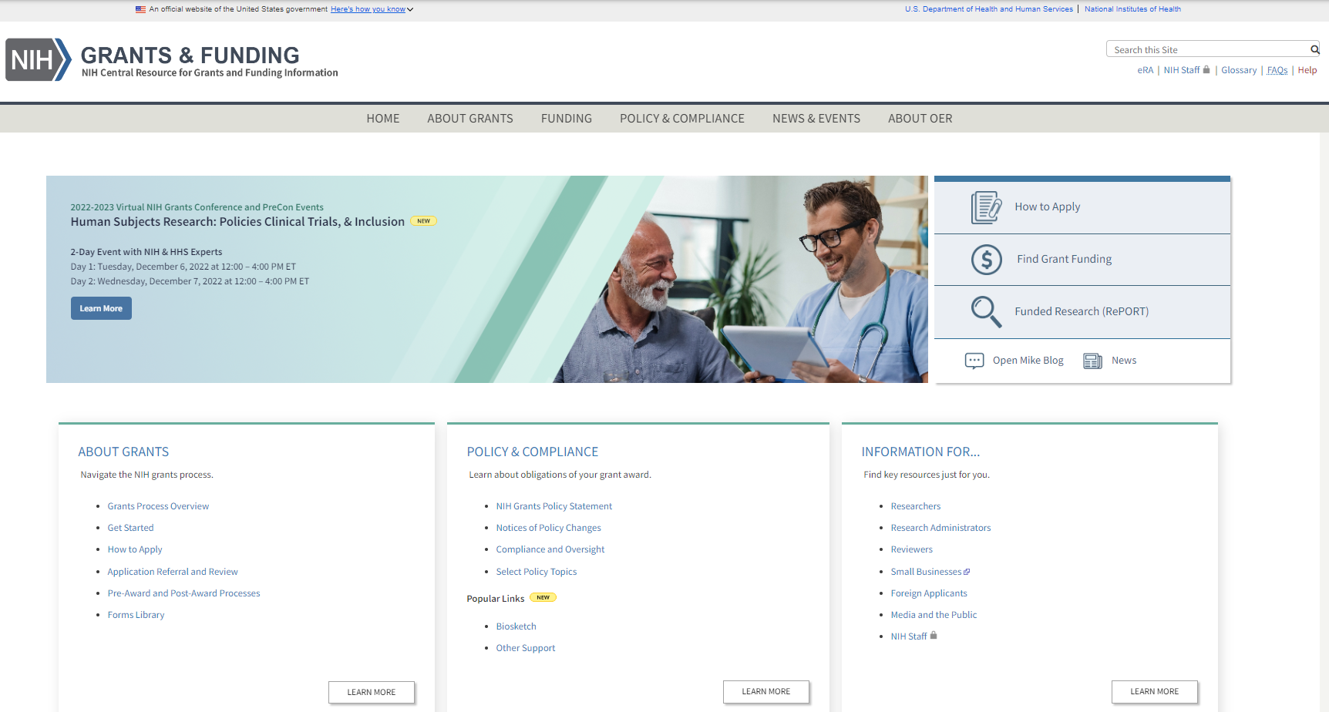
NIH Grants and Funding https://grants.nih.gov/
How to Apply- Application Guide

Slide 4
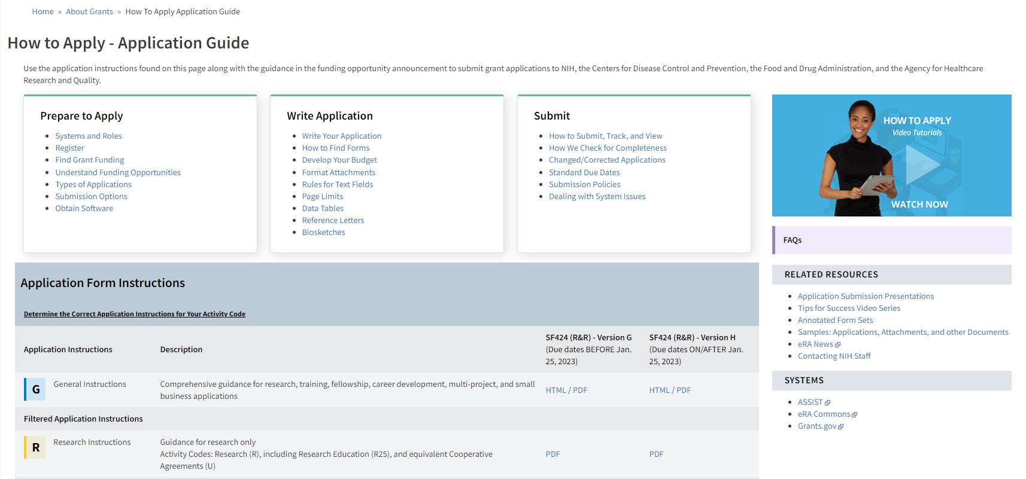
How to Apply – Application Guide https://grants.nih.gov/grants/how-to-apply-application-guide.html
General Application Process Information
Form Instructions
Resources

Slide 5
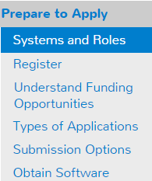
Understand Key Systems & Roles
https://grants.nih.gov/grants/how-to-apply-application-guide/prepare-to-apply-and-register/key-systems-and-roles.htm
Grants.gov
eRA Commons
E-Business Point of Contact (EBiz POC/ expanded AOR)
Authorized Organization Representative (AOR)
Signing Official (SO)
Principal Investigator (PI)

Slide 6
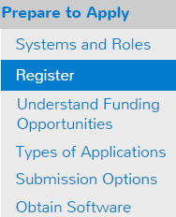
Organization Registration
https://grants.nih.gov/grants/how-to-apply-application-guide/prepare-to-apply-and-register/registration/org-representative-registration.htm
Your organization must be registered in multiple systems to submit. Start early – can take 6 weeks!
UEI (Unique Entity Identifier)- (replaced DUNS in 1/2022 (NOT-OD-21-170)
SAM (System for Award Management) – needed to do business with government
Requires annual renewal
Grants.gov – required to submit grants
eRA Commons – required to do business with NIH
SBA (Small Business Administration) – required for SBIR/STTR applications

Slide 7
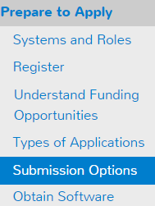
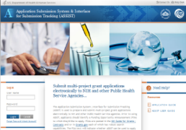
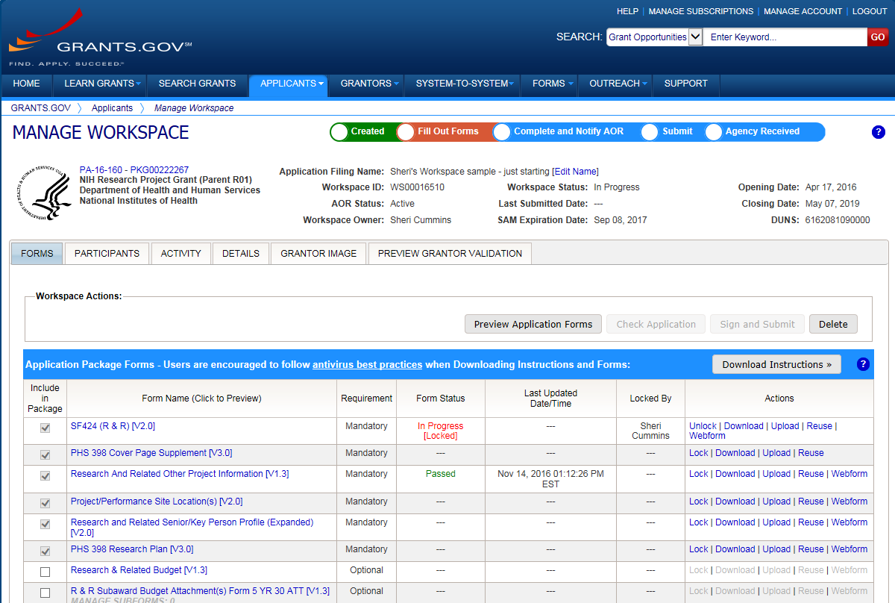
Application Submission Options
https://grants.nih.gov/grants/how-to-apply-application-guide/prepare-to-apply-and-register/choose-a-submission-option.htm
43%
52%
6%
ASSIST
System-to-System
Workspace
Managed by NIH
Leverages eRA Commons accounts
Pre-population from eRA Commons profiles
Track application status in single system
Supports all NIH competing applications
Pull study information from ClinicalTrials.gov
Integrated NIH messaging (tips, system alerts)
Managed by Grants.gov
Requires additional user registrations
No Pre-population from existing profiles
Must track application in multiple systems
Supports all NIH single- project competing applications (no multi-project support)

Slide 8
Your Application will be…
Subject to the same registration requirements
Completed with the same data items
Routed through Grants.gov
Validated against the same NIH business rules
Assembled in a consistent format for review consideration
Tracked in eRA Commons
…regardless of submission option used.

Slide 9
Application Forms
There is NOT a universal set of application forms that can be downloaded from our form library or websites
You must use the application form package attached to your funding opportunity announcement
Each application form package includes the customized subset of forms supported by NIH which are needed for that opportunity
Application forms are accessed using your chosen submission method

Slide 10
Now Let’s Talk About the Application Process
Step 1: Find
Step 2: Plan
Step 3: Initiate
Step 4: Build team
Step 5: Enter data
Step 6: Finalize
Step 7: Submit
Step 8: Track

Slide 11
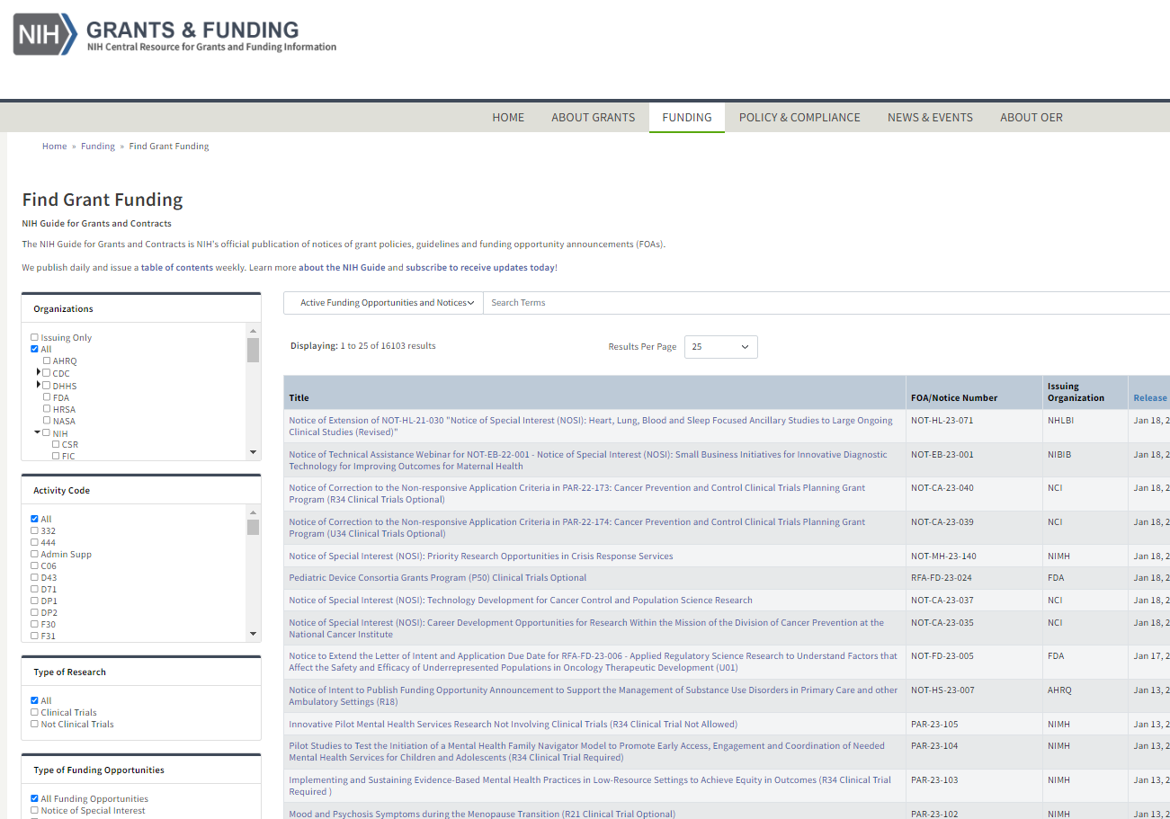
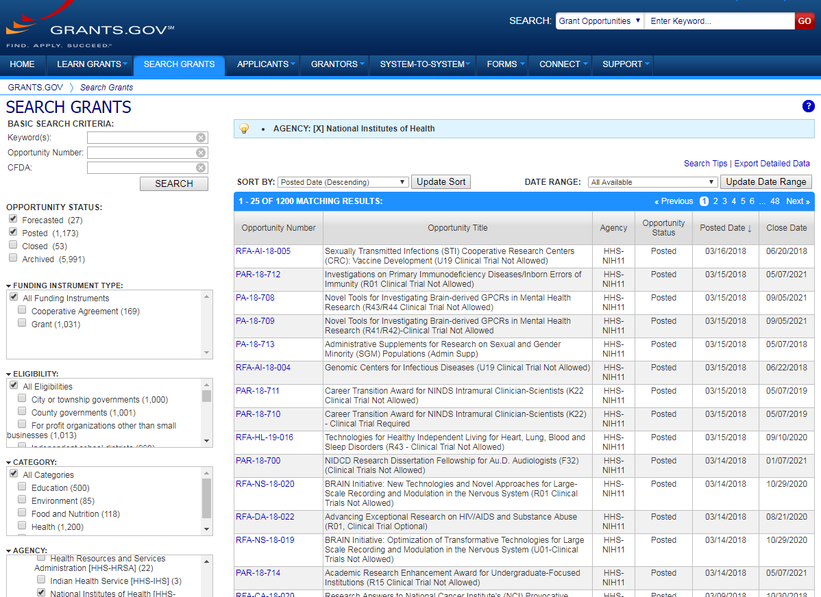
Step 1: Find an Opportunity of Interest
NIH Guide for Grants & Contracts
Grants.gov Search Grants

Slide 12
Carefully Read the Entire Notice of Funding Opportunity (NOFO)
Part 1- Overview Information
Participating Organizations
Related Notices
Key Dates
Part 2- Full Text of Announcement
Section I. Funding Opportunity Description
Section II. Award Information
Section III. Eligibility Information
Section IV. Application and Submission Information
Section V. Application Review Information
Section VI. Award Administration Information
Section VII. Agency Contacts
Section VIII. Other Information
Notes:
Plan for enhancing diverse perspective (PEDP) in section I, IV and V

Slide 13
Step 2: Plan for Your Submission
Identify team members
Verify registrations are in place and active
Choose submission method
Determine application preparation responsibilities
Who will – prepare budget, gather data, create attachments, do data entry
Make sure everyone is aware of process
Internal review & approval process
Post-submission responsibilities
How to deal with errors/warnings
Who will verify application in eRA Commons?

Slide 14
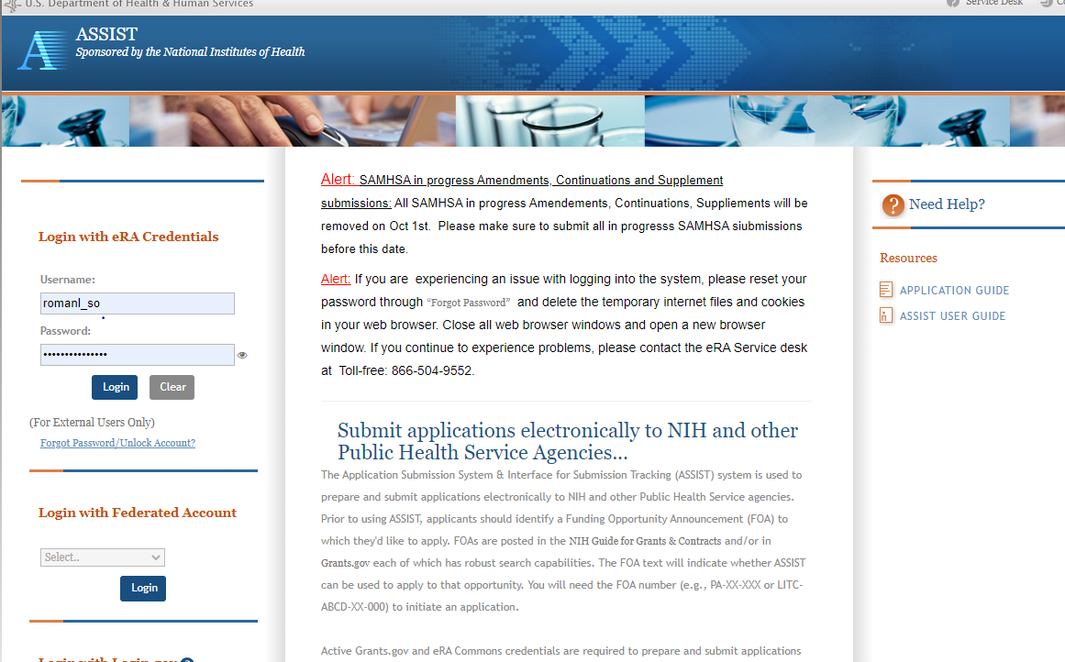
Step 3: Initiate Application
Login to your submission system and initiate your application and access the application forms
ASSIST | Workspace
Initiate Application | Create Workspace

Slide 15
Step 4: Build Your Team
Provide application access to appropriate team members
Gather eRA Commons usernames to include in your application for all individuals listed on the Sr Key Personnel form (NOT-OD-21-109) including:
Project Director/Principal Investigators (PD/PIs)
Component leads on a multi-project application
Sponsor on a fellowship application
Candidates for diversity and re-entry supplements
Primary mentor on individual mentored career development application
Can control access to specific sections of the application such as budgets
ASSIST | Workspace
Gather eRA Commons usernames and use Manage Access to give folks access | Gather Grants.gov usernames and use Participants tab to give folks access
Notes:
FAQ: https://grants.nih.gov/faqs#/applying-electronically.htm?anchor=56356

Slide 16
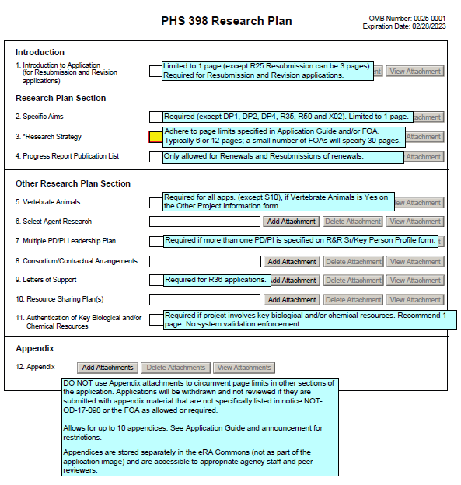
Step 5: Enter Data https://grants.nih.gov/grants/how-to-apply-application-guide.html
Follow All Guidance
Handy Resource
Notices in NIH Guide for Grants & Contracts including Notices of Special Interest (NOSIs)
Funding Opportunity Announcement/Notice of Funding Opportunity
Section IV. Application and Submission Information
How to Apply - Application Guide
Annotated form sets
Precedence / Importance

Slide 17
Application Attachments https://grants.nih.gov/grants/how-to-apply-application-guide/format-and-write/format-attachments.htm
Use simple PDF-formatted files for all attachments. Forms with fillable fields or signatures must be flattened
Disable security features such as password protection
Use most recent versions of Biosketch and Other Support Templates
Keep file names to 50 characters or less
Filenames must be unique within the application
Use meaningful filenames, especially for “Other Attachments”
Do not include headers or footers
Section headings as part of the text (e.g., Significance, Innovation, Approach) are encouraged
Follow specified page limits
Follow guidelines for fonts and margins
Follow guidelines for hyperlinks and URLs

Slide 18
New for FORMS-H Required for Due Dates On or After January 25, 2023
New 2023 NIH Data Management and Sharing (DMS) Policy
See https://sharing.nih.gov/data-management-and-sharing-policy; NIH GPS 8.2.3.1
Funding opportunity will specify if application is required to submit and address a Data Management and Sharing (DMS) Plan in the application
Applications required to address a DMS Plan:
“Other Plan(s)” Attachment: PHS 398 Research Plan form, PHS 398 Career Development Award Supplemental Form (PDF attachment)
Specify “Data Management and Sharing Costs” in the R&R Budget form and budget justification (detailed or modular budget forms)
eRA submission validations will prevent application submission if requirements not met
DMS Plan not evaluated as part of the peer review process and will not be included in the assembled application image unless otherwise specified in the funding opportunity and then it will be evaluated as part of the approach criteria
Notes:
No longer submitted as part of the Resource Sharing Plan attachment
DMS Plan will be available as a separate document in the Grant Folder
Additional updates to requirements for progress reporting will be communicated when details are finalized

Slide 19
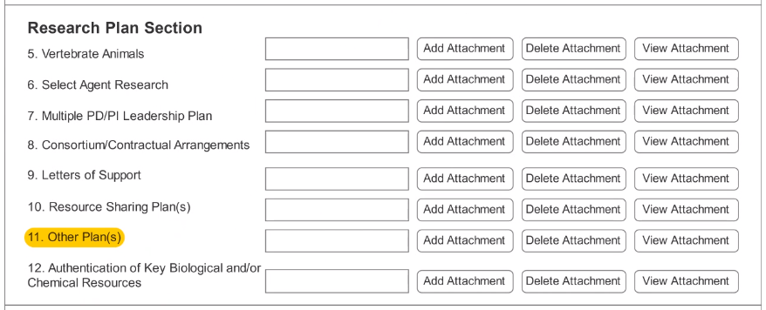
Data Management and Sharing (DMS) Application Requirements
A new “Other Plan(s)” field has been added 4 of the PHS 398 forms to collect a single PDF attachment
PHS 398 Research Plan
PHS 398 Career Development Award Supplemental Form
PHS Fellowship Supplemental Form*
PHS 398 Research Training Program Plan*
Direct costs to support the activities proposed in the DMS Plan must be indicated as “Data Management and Sharing Costs”
R&R Budget Form: line item in section F. Other Direct Costs. Must include a justification of the costs in the budget justification
PHS 398 Modular Budget Form: include within Additional Narrative Justification
Data Management and Sharing Costs
Notes:
Data Sharing Plans and Genomic Data Sharing Plans will no longer be submitted to the “Resource Sharing Plan(s)” field
Presence of attachment (inclusion and exclusion) enforced by validations

Slide 20
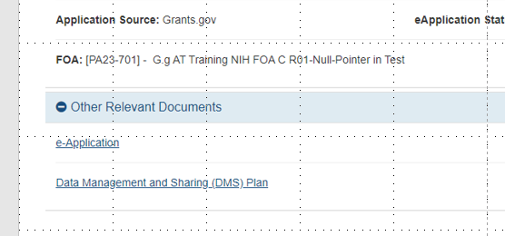
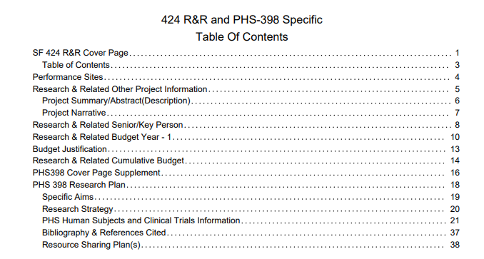
DMS Plan
The DMS plan will not be assembled into the application image
*unless specified in the funding opportunity to be evaluated as part of the approach criteria in peer review
The DMS plan will be visible in the internal and PI view of the grant folder
The DMS plan will not be visible in the grant folder accessible to reviewers*
The DMSP will display the same Grants.gov tracking number and time stamp as seen on the assembled image

Slide 21
Step 6: Finalize Your Application
Action | ASSIST | Workspace
6a. Run a pre-submission validation check | Validate Application | Preview Grantor Validation
6b. Generate a pre-submission image of your assembled application in the NIH format | Preview Application | Grantor Image
6c. Take any additional steps needed to prepare for Submission | Update Submission Status to “Ready to Submit” | Complete and Notify AOR (optional)

Slide 22
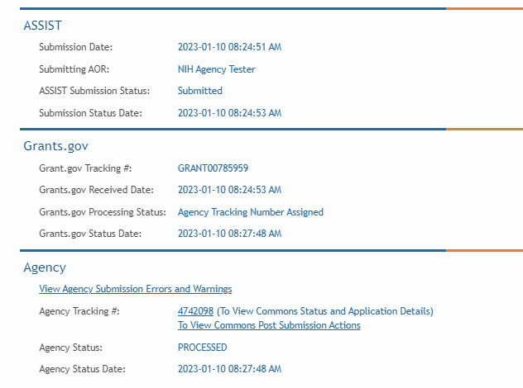
Step 7: Submit Your Application
Follow steps for your submission method
Only folks with Grants.gov AOR (Authorized Organization Representative) credentials can submit
All NIH applications route through Grants.gov
Your Grants.gov timestamp is used to determine “on-time” submission
Grants.gov Tracking #
Date/Time Stamp – always recorded in Eastern Time

Slide 23
On-time Submission
Deadline = 5 p.m. local time of submitting organization on the due date
All registrations and SAM renewal must be completed before the deadline
Application must be free of all federal system-identified errors (Grants.gov & eRA)
NIH’s late policy does not allow corrections after the deadline
NIH recommends submitting early to allow time to correct any unexpected errors or submission issues

Slide 24
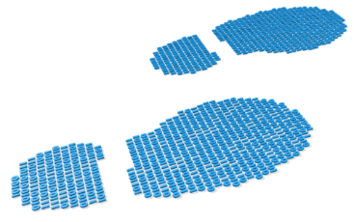
Step 8: Track Your Application
eRA Commons Status is an integral part of your submission
Applications that pass Grants.gov validations are picked up by eRA Commons and checked against many application guide and opportunity instructions
Authorized users can check eRA Commons Status for processing results
Signing Officials (SOs)
Administrative Officials (AOs)
Principal Investigators (PIs)
Delegated Assistants (ASSTs)
E-mail notifications sent
DO NOT depend solely on email notifications
It is YOUR responsibility to proactively check your application status in eRA Commons

Slide 25
Errors & Warnings
Corrective submissions must be made BEFORE the submission deadline and overwrite previous submissions
Errors stop application processing and must be corrected
Warnings do not stop application processing and are corrected at your discretion based on your circumstances

Slide 26
Correcting Errors Found After Submission https://grants.nih.gov/grants/how-to-apply-application-guide/submission-process/changed-corrected-application.htm
To correct system-identified errors found after submission:
Make corrections to local copy of the application
Update SF424 (R&R) form
Check “Changed/Corrected” as “Type of Submission”
Enter “Previous Grants.gov Tracking ID” (e.g., GRANT12345678) in field 4c
Submit the entire Changed/Corrected application back through Grants.gov before the deadline
Track submission through to eRA Commons
NOTE: Reviewers do not see applicant warnings, nor can they tell how many submission attempts were needed to complete the submission process

Slide 27
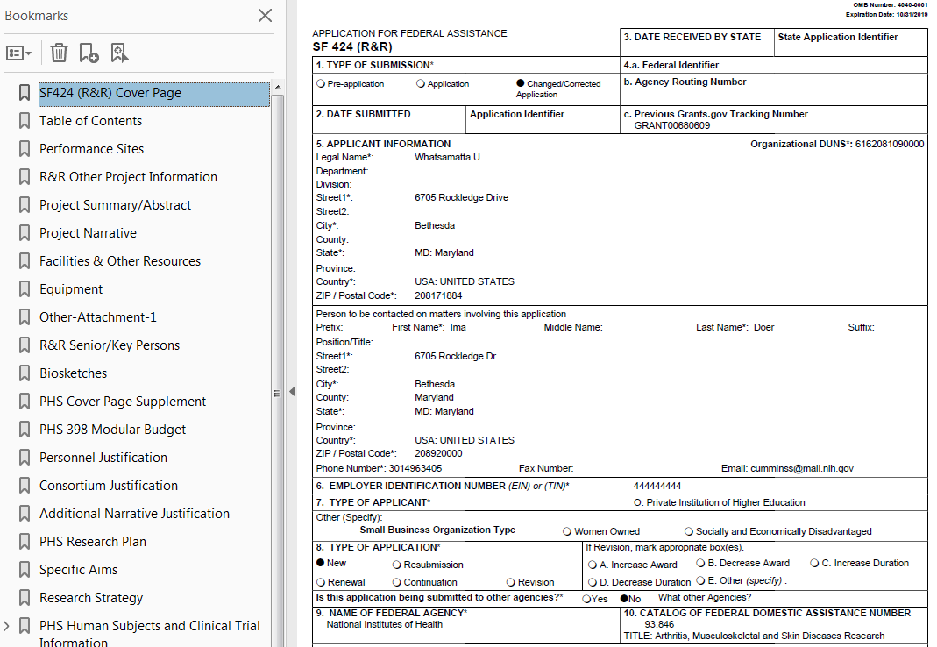
Application Assembled & Posted in eRA Commons
Once an error-free application is received by NIH, the eRA system will:
Assemble the grant application image
Insert headers (PI name) and footers (page numbers) on all pages
Generate Table of Contents and bookmark important sections
Post the assembled application image in the PD/PI’s eRA Commons account
Send notifications

Slide 28
Application Viewing Window https://public.era.nih.gov/commons
Applicants have two (2) business days to view the assembled application image before the application automatically moves forward for further processing
SO can Reject application within viewing window to prevent it from moving forward to NIH staff
Can submit a Changed/Corrected application before the submission deadline
ASSIST | Workspace
View Submission Status Details link | Must login to eRA Commons directly and access the application’s detailed status screen
Notes:
Option for bypassing 2 day window admin supp

Slide 29
Submission Complete!
If you don’t reject within the two business day viewing window, the application automatically moves forward for further processing at NIH
Any subsequent application changes are subject to the NIH policy on late submission of grant applications and the NIH policy on post-submission application materials

Slide 30
Application Checks (Validations)
Grants.gov
eRA Systems
Agency Staff
Active System for Award Management (SAM) registration
Submitter has AOR role for UEI on application
Submission made to active opportunity and application package
Virus check
Filenames include only appropriate characters
Fields required by agency, but not required federal-wide
R&R Sr/Key form
Credential for PD/PIs
Organization name for all sr/key
Biosketch for all Sr/key
Performance Site form
DUNS for primary site (UEI for due dates on/after Jan 25, 2022)
Attachments in PDF format
Adherence to page limits in our Table of Page Limits
All appropriate attachments included
Fit with NIH/Institute mission
Eligibility
“Overstuffing”
On-time submission
Adherence to funding opportunity announcement specific instructions
Font, margin, and hyperlink guidelines
Simultaneous review of essentially same application

Slide 31
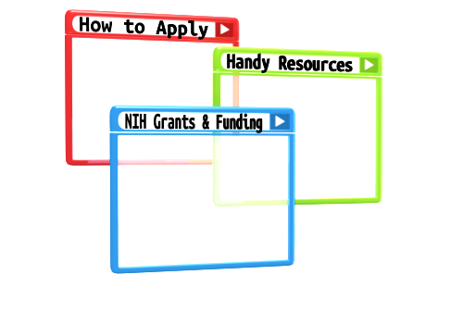
Resources

Slide 32
Help Desks
eRA Service Desk
Grants.gov Contact Center
Web: https://www.era.nih.gov/need-help
Phone: 1-866-504-9552
Hours : Mon-Fri, 7a.m. to 8 p.m. ET (Except Federal Holidays)
Resources: https://www.era.nih.gov/
Web: https://gditshared.servicenowservices.com/hhs_grants
Phone: 1-800-518-4726
Hours : 24x7 (Except Federal Holidays)
Email : support@grants.gov
Resources: https://www.grants.gov/web/grants/support.html

Slide 33
Online Resources & Websites
NIH Grants and Funding https://grants.nih.gov/
How to Apply – Application Guide https://grants.nih.gov/grants/how-to-apply-application-guide.html
Annotated form set https://grants.nih.gov/grants/how-to-apply-application-guide/resources/annotated-form-sets.htm
Preparing Your Application Using ASSIST https://grants.nih.gov/grants/how-to-apply-application-guide/prepare-to-apply-and-register/submission-options/assist.htm

Slide 34
Stay Connected – Subscribe to Listservs https://era.nih.gov/about-era/get-connected.htm
eRA-Information-L
For administrators, principal investigators and the people that support them
Used by NIH to notify the community of information related to eRA Commons, ASSIST and eSubmission
NIH_ESUB_SYS2SYS-L
For technical personnel involved in system-to-system solution development and planning
Used to exchange information related to the implementation of system-to-system solutions for grant application preparation and submission to NIH
ASSIST-Development-L
For ASSIST users willing to share their individual perspectives on proposed ASSIST enhancements and options for addressing identified system issues

Slide 35
Questions?

