Slide 1
NIH Fellowship & Career Development Awards: Essential Information and Tips for First Time and Early Career Investigators

Slide 2
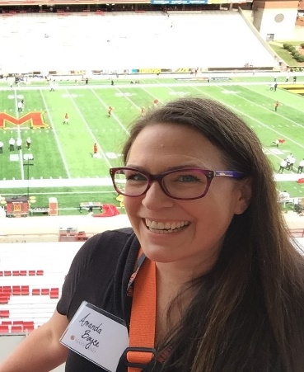
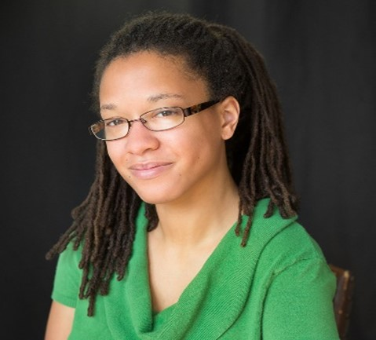
Presenters and Moderators
Ericka Boone, Ph.D.
Director, Division of Biomedical Research Workforce
Office of Extramural Research
ericka.boone@nih.gov
Amanda Boyce, Ph.D.
Program Director
Muscle Development and Physiology Program
National Institute of Arthritis Musculoskeletal and Skin Diseases (NIAMS)
boycea@mail.nih.gov
Teraya Donaldson, Ph.D.
Research Training Policy Officer
Division of Biomedical Research Workforce
Office of Extramural Research
teraya.donaldson@nih.gov
Lauren Hill, Ph.D.
Acting Deputy Director
Office for Disparities Research and Workforce Diversity
National Institute of Mental Health (NIMH)
hillla@mail.nih.gov

Slide 3
Agenda
Deciphering the NIH Alphabet Soup and Finding A Scientific Home – Dr. Ericka Boone
Fellowship Applications: What’s Important to Know? – Dr. Amanda Boyce
Career Development Awards: What You Don’t Know Can’t Help You! – Dr. Lauren Hill

Slide 4
Topic 1
Deciphering the NIH Alphabet Soup and Finding A Scientific Home – Dr. Ericka Boone
Fellowship Applications: What’s Important to Know? – Dr. Amanda Boyce
Career Development Awards: What You Don’t Know Can’t Help You! – Dr. Lauren Hill

Slide 5
Who Are We? The NIH!

Slide 6
FY 2021 Operating Budget: ~$41B
Training: $886,806
Career: $844,348
Total: $1,731,154
NIH Budget Office: http://officeofbudget.od.nih.gov/index.htm

Slide 7
NIH: 27 Institutes & Centers
Office of Extramural Research
Division of Biomedical Research Workforce (DBRW)
Office of the Director
Office for Scientific Workforce Diversity
Office Intramural Training and Education
National Institute
on Aging
National Institute
on Alcohol Abuse
and Alcoholism
National Institute
of Allergy and
Infectious Diseases
National Institute
of Arthritis and
Musculoskeletal
and Skin Diseases
National Cancer
Institute
National Institute
of Child Health
and Human
Development
National Institute on
Deafness and Other
Communication
Disorders
National Institute
of Dental and
Craniofacial
Research
National Institute
of Diabetes and
Digestive and
Kidney Diseases
National Institute
on Drug Abuse
National Institute
of Environmental
Health Sciences
National Eye
Institute
National Institute
of General
Medical Sciences
National Heart,
Lung, and Blood
Institute
National Human
Genome Research
Institute
National Institute
of Mental Health
National Institute
of Neurological
Disorders and
Stroke
National Institute
of Nursing Research
National Center
for Complementary
and Integrative
Health
Fogarty
International
Center
National Center
for Advancing
Translational
Sciences
National Library
of Medicine
National Institute of
Biomedical Imaging
and Bioengineering
National Institute on
Minority Health and
Health Disparities
Clinical Center
Center for
Information
Technology
Center for
Scientific Review

Slide 8
ONE NIH, 27 Cultures
Each IC has its own mission
Each IC has its own budget
Each IC has its own activities
Each IC has its own way of doing business
So, how do you figure out WHERE to start?? Here’s some advice!

Slide 9
Interacting with NIH As An Early Career Investigator
NIH Staff
Program
Officer
Scientific Review Officer
Grants Management Officer
Scientist & Administrator
Identifies areas of scientific need
Communicates NIH priorities to investigators and others
Manages grants
Communicates with IC Leadership about the science
Scientist & Administrator
Manages grant reviews
Appoints members to review groups & panels
Prepares summary statements
Implements the funding process
Oversees the budget
Ensures grantee compliance with NIH policies & regulations

Slide 10
Who Should I talk to? When? And About What?
NIH Staff
Program
Officer
Scientific Review Officer
Grants Management Officer
Before applying discuss
Concept paper aims & fit with NIH priorities
Appropriate funding mechanism
Responsiveness to review criteria
After Review to discuss next steps
After application is assigned to a review committee until review is complete to discuss:
Review committee selection
Missing info
Supplemental info
Before or after review to discuss:
NIH grants policy
Budget
Change of institutions
Grant start dates

Slide 11
Normalize the ‘Reaching Out’…
Contact POs via email - WELL BEFORE YOUR DEADLINE
No dissertations, please
Include a 1-2 Page concept
Research Project Grants (RPG)
Include brief background, significance of the problem or question being addressed and specific aims
Training (e.g., F30, R36, F31, F32) and Career Development Grants (e.g., K01, K08, K23)
Brief background, significance of the problem or question the project will address, specific aims; training goals; mentoring team and their current funding and a CV or NIH Biosketch
Follow-up as needed – email piles are deep

Slide 12
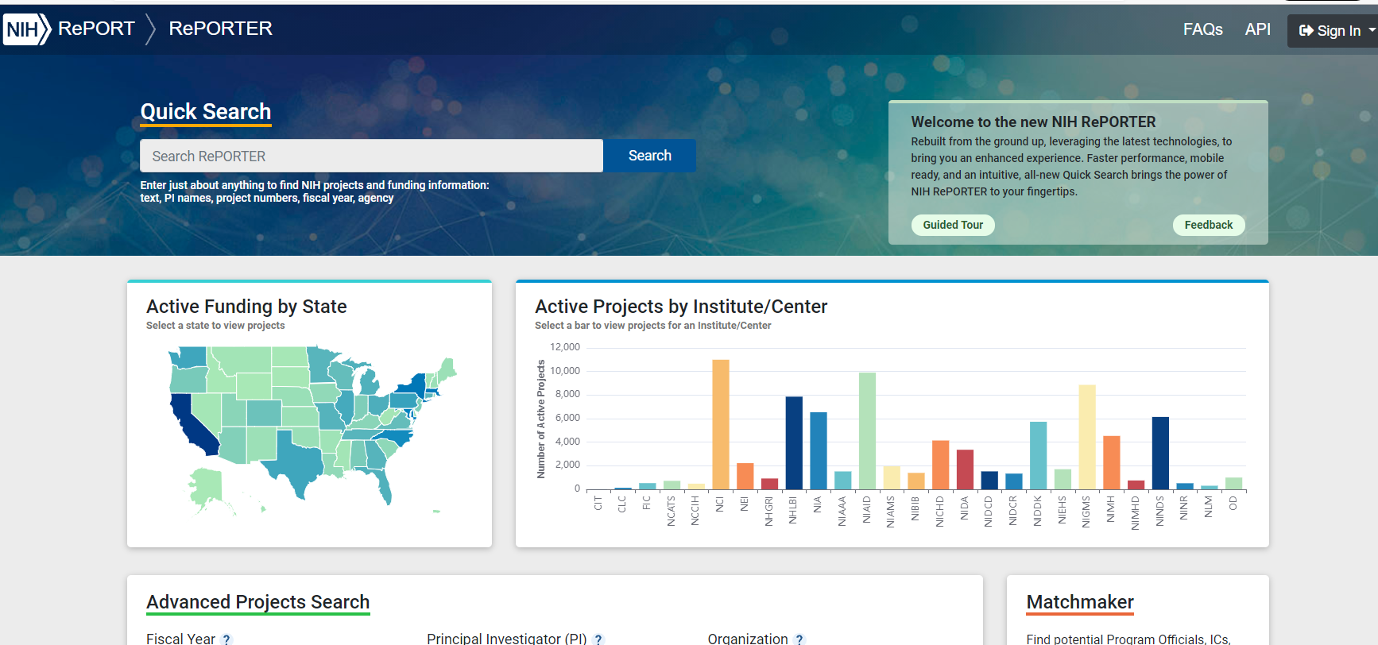
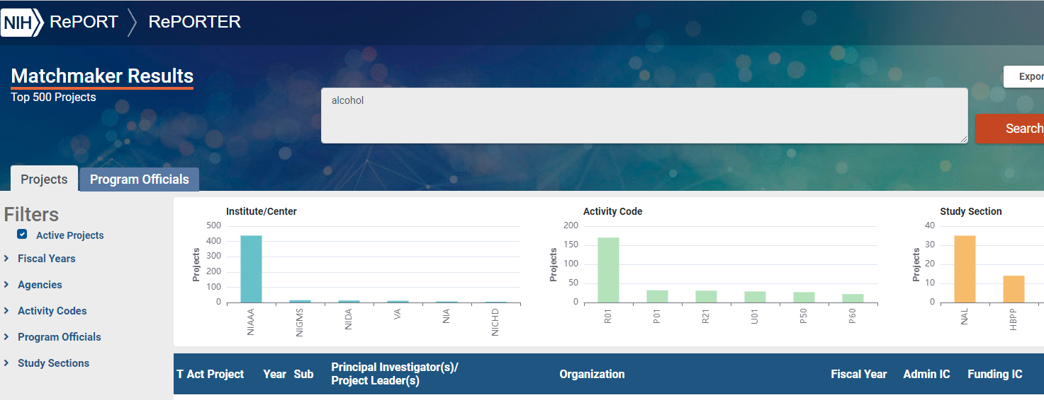
Use These Resources to Find the Right IC and PO
Talk to mentors and colleagues
Search NIH RePORTER for funded projects
Search NIH MATCHMAKER for similar projects and their POs
Review IC webpages, missions, strategic plans, & research priorities
Review funding opportunity announcements (FOAs)
Grants.gov
NIH Guide for Grants and Contracts
https://reporter.nih.gov
https://reporter.nih.gov/matchmaker
Insert search term or abstract here!

Slide 13
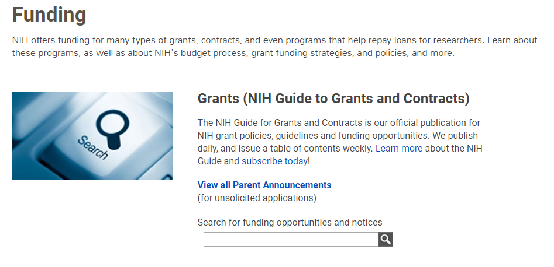
Funding Opportunity Announcements (FOAs) are Found in “The Guide”
Find Grant Funding | grants.nih.gov

Slide 14
Types of Funding Opportunity Announcements (FOAs)
Type of FOA | Description
Program Announcements (PA, PAR, PAS) | Highlights specific, high-priority areas of scientific focus/interest PAS: PA with set aside funds; PAR: has a special receipt, referral and/or review considerations (described in PA) Usually ongoing (3 years) Often use standard receipt dates (you can control when you apply!) Most (but not all) NIH ICs participate
Requests for Applications (RFA) | Identifies specific scientific areas, amt of set-aside funds, anticipated # of awards Usually, single receipt date IC usually convenes review panel
Parent Announcements | Broad FOAs allowing applicants to submit “investigator initiated” or “unsolicited” research ideas to a specific activity code (e.g., R01, R03) Most apps to NIH = investigator initiated Usually ongoing (3 years); standard receipt dates (you have flexibility)

Slide 15
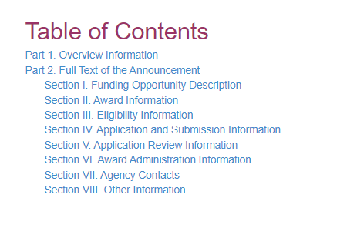
Key Elements in a FOA
Program purpose, goals, etc.
Type of award, activity code
Which NIH ICs participate in the FOA
Due dates
FOA #
Description of funding opportunity
Award information
Application types allowed, new, resubmissions, etc.
Award budget and award period
Salary, stipend information, etc.
Instructions on how to apply

Slide 16
NIH Research Training Website
https://researchtraining.nih.gov

Slide 17
Top Three Tips…well maybe Four…
Review IC priorities and goals (they can differ by IC and programs)
Also review IC Division webpages and take a look at strategic plans and open Council meetings
Learn the NIH application & review process & study successful grant applications
Normalize reaching out!
Make early contact with program officers
Stay connected with your mentors & collaborators
Sign up for FOA alerts
Helps you to stay current and know what’s available

Slide 18
Funding Opportunities by Career Phase
Expected Training Outcomes:
Scientific knowledge, creativity, basic research skills, clinical research skills, technical writing, grantsmanship, publications, collaborations, mentorship
Undergraduate Graduate/ Clinical Training
Postdoctoral Training/Clinical Residency
Early Research Career
Established Investigator
T34, R25
T32, T35
T32
K01*, K07, K25
K08, K23
R03, R21*, DP2
R01, R35
R01*, R35
P01, P50
F99, K00, F32, DP5
R38 (K38), R25, K12
K22 K22
K99* R00 *
F30, F31*,
R36*
F32, DP5
K02, K24
Loan Repayment Programs
https://www.lrp.nih.gov/
Diversity Supplements : PA-20-166
Re-Entry Supplements: NOT-OD-20-054
Notes:
This is a well-seen representation of NIH funding opportunities by career stage. Outlined here are general programs and those that are diversity-targeted. While it seems that the pathway from training to career development to independence is well-prescribed, the biomedical research career trajectory from trainee to independence is anything but linear
Chart:
Undergraduate Graduate/Clinical Training: T34,T32, T35 as well as F30, F32, F36
Postdoctoral Training/Clinical Residency: T32, F99, K00, F32, DP5, R38 (K38), R25, K12, K01, K07, K25
Early Research Career: K08, K23, K22, R00, R03
Established Investigator: R21, DP2, R01, R35, P01, P50, K02, K24
Loan Repayment Programs: https://www.lrp.nih.gov/
Diversity Supplements: PA-20-166
Re-Entry Supplements: NOT-OD-20-054

Slide 19
Topic 2
Deciphering the NIH Alphabet Soup and Finding A Scientific Home – Dr. Ericka Boone
Fellowship Applications: What’s Important to Know? – Dr. Amanda Boyce
Career Development Awards: What You Don’t Know Can’t Help You! – Dr. Lauren Hill

Slide 20
Ruth L. Kirschstein National Research Service Awards (NRSA) Fellowships: F30, F31, F32
“Flagship” NIH research training program
Awarded to predoctoral and postdoctoral fellows working with mentors.
Training can be at domestic or foreign institutions.
Must be a citizen, non-citizen national, or lawfully admitted for permanent residence.
Opportunities in basic and clinical research.
Does not allow applicants to lead an independent clinical trial but does allow them to obtain research experience in a clinical trial led by a mentor or co-mentor
Important Tip: Please note that not all ICs participate in all fellowship FOAs.
Imperative to talk to a program officer BEFORE applying to get tips and helpful suggestions
Allowable costs (including stipend levels) are released in a yearly NOT.

Slide 21
Predoctoral Fellowships: F30 and F31
There are 2 Parent F30 FOAs, one for institutions with NIH-funded MSTP programs and one for institutions without NIH-funded MSTP programs!
F31 Predoctoral Individual National Research Service Award:
Applicants must be enrolled in a formal PhD program.
Important Tip: Limited to 5 years of combined predoctoral NRSA time.
F31 Individual Predoctoral Fellowship to Promote Diversity in Health-Related Research:
Applicants must be enrolled in a formal PhD OR formal dual degree program.
Time limits are same as above.
F30 Individual Predoctoral NRSA for MD/​PhD and other Dual Degree Fellowships:
Applicants must be enrolled in a formal dual degree program.
Important Tip: Allowed 6 years of support, at least 50% of which must be used for research.
Requires a full-time research commitment (40 hours/week).
Includes a stipend, institutional allowance, and 60% tuition reimbursement.

Slide 22
Postdoctoral Fellowships: F32 and F99
F32 Postdoctoral Individual National Research Service Award:
Supports postdoctoral research for clinicians and PhDs (limited to 3 years combined postdoctoral NRSA time).
Requires a full-time research commitment (40 hours/week) and “payback” for the first 12 months.
Includes a stipend, institutional allowance, and limited tuition reimbursement.
F99/K00 Individual Predoctoral to Postdoctoral Fellow Transition Award
Supports up to 5 years combined support (both phases), including 2 years for F99 fellowship and 3 years in K00 career development phase (see announcement for variations).
Important Tip: Citizenship requirements vary (some require citizenship/green card, others allow non-citizens with valid visas to apply).
Requires 40 hours/week for the F phase and 75% research effort for the K phase.
Budget:
F99 phase includes a stipend, institutional allowance, and limited tuition reimbursement.
K00 phase, budget allowances include salary, benefits, research and career development support, indirect costs (see FOA for specifics). Indirect costs reimbursed at 8%

Slide 23
Fellowship Application: Major Sections
Biographical Sketch (5 pages)
Reference Letters (3-5)
Fellowship Applicant Section
Applicant's Background and Goals for Fellowship Training (6 pages)
Research Training Plan Section
Specific Aims (1 page)
Research Strategy (6 pages)
Respective Contributions (1 page)
Selection of Sponsor and Institution (1 page)
Sponsor(s), Collaborator(s), and Consultant(s) Section
Sponsor/Co-Sponsor Statements (6 pages)
Letters of Support from Collaborators, Contributors, and Consultants (6 pages)
Institutional Environment and Commitment to Training Section
Description of Institutional Environment and Commitment to Training (2 pages)

Slide 24
Five Core Review Criteria: What to Know!
Fellowship Applicant
Sponsors, Collaborators, and Consultants
Research Training Plan
Training Potential
Institutional Environment & Commitment to Training

Slide 25
Fellowship Applicant
Your potential based on your academic achievements, research productivity, and letters of reference.
Publications? There’s No magic #!
Include all your publications, including from undergrad (shows commitment and trajectory).
Helpful Tip: If you are building your publication record, include a plan in your research training plan
Describe any podium or poster presentations.
Include all relevant awards and achievements.
Letters of reference
Enthusiastic, detail your intelligence, creativity, drive & commitment to scientific research, not generic.
Helpful Tip: Provide referees with your CV and provide suggestions on what to focus on in your letter
Helpful Tip: Letters should link your research and professional trajectory and growth
This is not the time to be modest with your achievements!

Slide 26
Sponsors, Collaborators, and Consultants
Expertise in the scientific topic of the proposed research project and experience and success in training scientists.
Think about who makes up your mentoring team and why they are present on YOUR team!
Mentors should possess:
Topic-area expertise (should have an extensive publication record)
Success in obtaining peer-reviewed grants
Experience with mentoring people who go on to become independent scientists
Note: clinicians working with a PhD may want a clinician-scientist as career mentor
Mentor biosketches should focus on training experience as well as science.
Helpful Tip: Letters of support should clearly define the roles of the mentors and collaborators in the training plan.

Slide 27
Research Training Plan
A project that will result in publications, provide you with new skills, advance the scientific field, and “launch” your career.
Develop a strong, coherent training plan with your mentor, making sure it’s related to, but NOT a ‘copy and paste’ from, your mentor’s funded grants.
The plan should be appropriate to your level of experience and career goals.
Propose a clear hypothesis that is based on a solid rationale and supportive preliminary data.
Include potential pitfalls, alternative approaches, data interpretation, statistical analysis, and future studies.
Helpful Tip: There is no expectation that the research plan be particularly innovative/risky, as reviewers would prefer a plan that’s likely to succeed/lead to publications.
State specific, realistic milestones, with associated timelines.

Slide 28
Training Potential
New skills and training that will expand upon your previous training.
Helpful Tip: The training activities should match your career goals and make you competitive for the next phase of your career.
Describe individualized training that addresses your specific training needs.
Include in your plan:
Additional coursework as needed.
Opportunities for written and oral communication (e.g., via courses, workshops, and presentations at local and national seminar series and conferences.
Include opportunities to train more junior students.
It helps to include a formal mentoring/thesis committee to monitor progress.
28

Slide 29
Institutional Environment & Commitment to Training
Facilities and resources, as well as institutional programs like career development workshops
Describe the resources and facilities available to successfully complete the proposed experiments.
Describe seminar series that bring in external leaders in the field.
Describe opportunities for collaborations and interactions.
Include seminars and workshops that focus on career development, grant application writing, starting a lab, etc.

Slide 30
Additional Fellowship Review Criteria & Considerations
Additional Review Criteria (contribute to score)
Protection for Human Subjects
Inclusion of Women, Minorities, and Children
Vertebrate Animals
Biohazards
Resubmissions
Additional Review Considerations (can delay funding)
Training in the Responsible Conduct of Research
Applications from Foreign Organizations
Select Agents Research
Resource Sharing Plans
Budget & Period of Support

Slide 31
Three (or Five!) Take-Home Tips
Start months in advance.
Make sure all application components tell the same, cohesive story.
Pay careful attention to details: fonts, clarity of data, error bars, spelling, etc.
Ask to see successful F awards.
Write the application yourself with your mentor’s guidance.
Want to see sample applications and forms?
Samples: Applications, Attachments, and other Documents | grants.nih.gov
Sample Applications & More

Slide 32
Topic 3
Deciphering the NIH Alphabet Soup and Finding A Scientific Home – Dr. Ericka Boone
Fellowship Applications: What’s Important to Know? – Dr. Amanda Boyce
Career Development Awards: What You Don’t Know Can’t Help You! – Dr. Lauren Hill

Slide 33
Career Development Awards
Career Development Awards, also known as CDA or "K" awards designed for:
Individuals with a doctoral degree who have demonstrated independent research accomplishments
Need additional experience to establish or sustain an independent research program.
K awards provide up to five years of salary support and guarantee substantial protected time to engage in research and related activities.
Not every NIH IC participates in every K mechanism
ICs may have specific policies for K awards
View current K funding opportunities - https://researchtraining.nih.gov/programs/career-development

Slide 34
K-Awards are Intended for Those Who…
Are in initial phase of research career
Initial phase of research can vary across ICs.
At NIMH – this is no more than 6 years of post-doctoral experience at time of initial submission or resubmission
Require supervised career development beyond post-doc
Aim to soon become an independent scientific investigator

Slide 35
Examples of Mentored Early Career “K” Awards
K01
Mentored Research Scientist Career Development Award
K08
Mentored Clinical Scientist Research Career Development Award
K23
K99/R00
Mentored Patient-Oriented Career Development Award
Mentored Pathway to Independence Award

Slide 36
K-Award Eligibility
U.S. Citizen, Non-Citizen National, or Permanent Resident (except K99)
Research Doctoral Degree: K01
Clinical Doctoral Degree: K01, K08, K23
Ineligible if current or former PI of Public Health Service (PHS) Career Development (K) or certain Research (R) Awards

Slide 37
Characteristics of a Mentored K-Award
K01
K08
K23
K99/R00
Duration: K99 (up to 2 years) + R00 Independent Investigator Phase (up to 3 years)
Duration: 3-5 years (4 is the default maximum)
Minimum Research Effort: 75%
Renewability: None
Support: Salary (up to $100K) + Research (up to $50K)
Support During K99: Salary (up to $75K) + Research (up to $20K)
R00 Phase:
Requires full-time tenure track position (or equivalent)
Advancement to R00 Phase is not automatic
Ks can and do differ by Institute.
Speak to a Program Officer!

Slide 38
K Award Review Criteria
Candidate
Previous training, productivity, letters of recommendation, potential for independence
Research Plan
Important problem, keeping up/advancing the field, well designed, provide a platform/pilot data for RPG, feasible
Career Development Plan
Expand current skill set, well-integrated with research project, too generic? too much? right elements?
Mentors, Consultants, & Collaborators
Scientific expertise, mentoring track record, level of commitment
Institutional Commitment

Slide 39
K Award Tips – What Should You Absolutely Do?!
Make Sure The Application Is Cohesive
Career Development Plan, Mentors, and Research Plan should hang together to tell a story of how they move candidate forward towards research independence.
Turn Training Gaps into Training Opportunities
Important Tip: No ‘shell games’, don’t try to hide areas of relative weakness/additional training needs Reviewers will see them.
Be specific about how the K award will provide career development needed to achieve research independence.
Mentors should be Mentoring!!
The mentors’ expertise and commitment to the candidate should be evident.
Mentor biosketches should be tailored to the K.
Mentoring team should have complementary skills well matched to candidate
career development plans
Mentors should have strong research and strong mentoring track records.
EXAMPLE PLAN DR. K. | MENTORS | DIDACTICS | PROJECT | PUBS/OTHER
School MH Services
Implementation Trials
Mixed Methods

Slide 40
Q & A?

