Slide 1
NIH Grants Process Primer: Application to Award
Part Two | November 14, 2024

Slide 2
NIH GRANTS PROCESS PRIMER Part Two: An Interactive Opportunity
AGENDA
1st Segment
New to NIH: Recap and Terminology
Plan to Apply:
RePORT
Find and Understand a Notice of Funding Opportunity (NOFO)
Write the Application
Intermission
2nd Segment
Review: Get to Know the Summary Statement
Award: NoA and Supplements
Monitoring and Reporting Overview
Lightning Round: Final Tips from NIH Program Officials
MODERATOR
Megan Columbus
Director
Division of Communications and Outreach
Office of Extramural Research (OER), NIH

Slide 3
New to NIH
Part One Recap
Terminology
PRESENTERS
Megan Columbus
Director
Division of Communications and Outreach
Office of Extramural Research (OER), NIH
Sheri Cummins
Communications Strategist
Division of Communications and Outreach
Office of Extramural Research (OER), NIH
Image: NIH Building 1
(Home of NIH leadership)

Slide 4
NEW TO NIH: Recap
Recap of Day 1
Systems involved in the NIH Grants Process
Terminology

Slide 5
Systems involved in the NIH Grants Process

Slide 6
NIH Grants Process: Recap (Q1)
Plan to Apply
Write Application
Submit
Review
Award
Monitoring and Reporting
What federal systems do applicant organizations need to be registered in to submit a grant application to NIH?

Slide 7
NIH Grants Process: Recap (A1)
Organization Registrations
System for Award Management (SAM)
Needed to do business with the U.S. government
Requires annual renewal
Grants.gov
Required to submit grant applications
eRA Commons
Required to do business with NIH
Small Business Administration (SBA)
Required for applications to NIH Small Business Technology Transfer (STTR), Small Business Innovation Research (SBIR), and Commercialization Readiness Pilot (CRP) programs
Learn more: Organization Registration

Slide 8
NIH Grants Process: Recap (Q2)
Plan to Apply
Write Application
Submit
Review
Award
Monitoring and Reporting
What is NIH’s official system used to post notices of funding opportunities, policies, guidelines, and grants administration information?

Slide 9
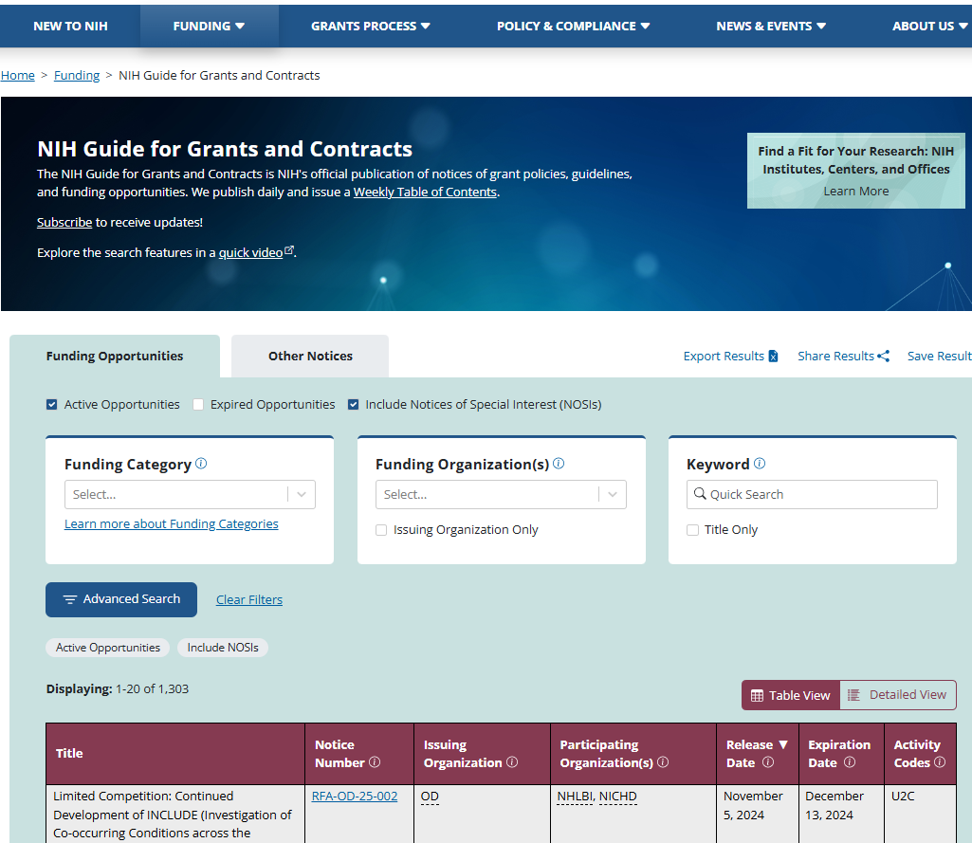
NIH Grants Process: Recap (A2)
NIH Guide for Grants and Contracts

Slide 10
NIH Grants Process: Recap (Q3)
Plan to Apply
Write Application
Submit
Review
Award
Monitoring and Reporting
What systems are available to access, prepare, and submit grant application forms to NIH?

Slide 11
NIH Grants Process: Recap (A3)
Available submission options to access prepare and submit applications to NIH
NIH ASSIST
Grants.gov Workspace
Organization’s System-to-System (S2S) Submission Solution
Work with your organization’s grants administrators to determine which one is best for you.
Note: Regardless of option, your application will be:
Subject to the same registration requirements
Completed with the same data items
Routed through Grants.gov using the same application forms package
Validated against the same agency business rules
Assembled in a consistent format for review consideration
Tracked in eRA Commons
Learn more: Submission Options

Slide 12
NIH Grants Process: Recap (Q4)
Plan to Apply
Write Application
Submit
Review
Award
Monitoring and Reporting
What system can applicants use to help identify a potential scientific review group?

Slide 13
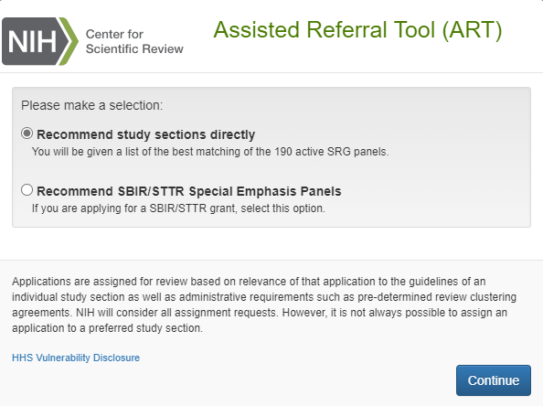
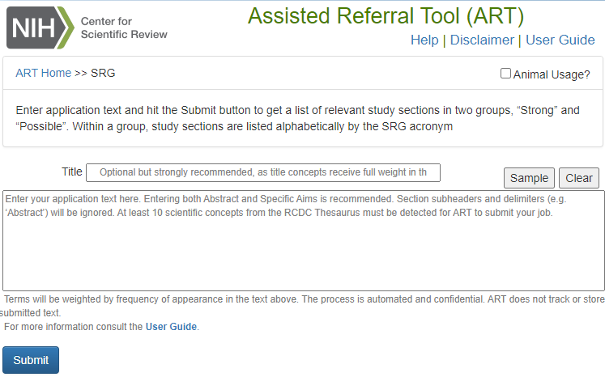
NIH Grants Process: Recap (A4)
The Center for Scientific Review’s Assisted Referral Tool (ART)

Slide 14
NIH Grants Process: Recap (Q5)
Plan to Apply
Write Application
Submit
Review
Award
Monitoring and Reporting
After submission, what system is used to exchange information between NIH staff and applicants/recipients?

Slide 15
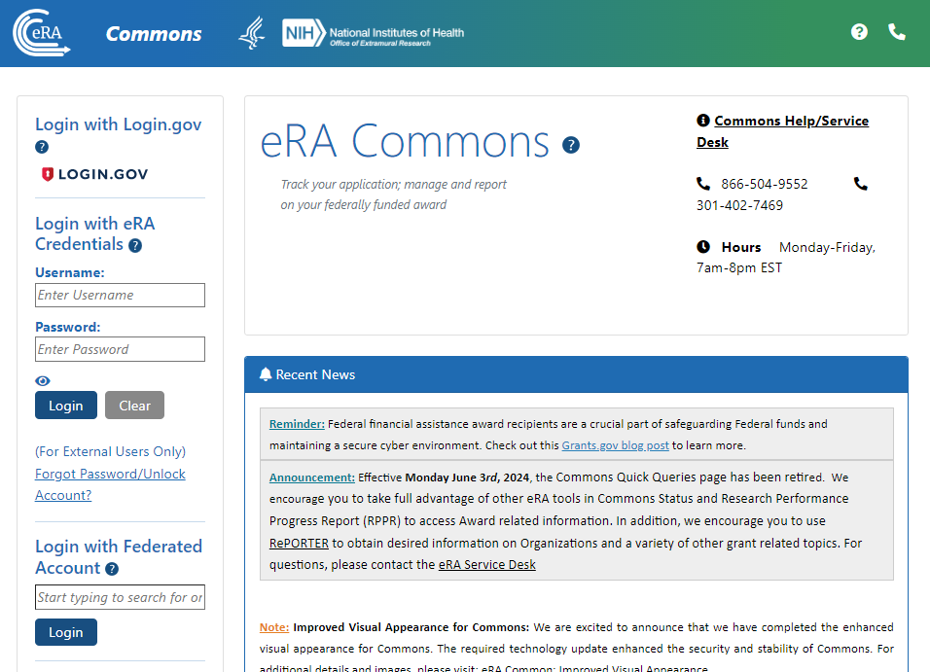
NIH Grants Process: Recap (A5)
eRA Commons
Track application status
View review assignments
View review outcomes
Submit just-in-time (JIT) information
View notice of award (NoA)
Submit progress and financial reports
Closeout grant

Slide 16
NIH Grants Process: Recap (Q6)
Plan to Apply
Write Application
Submit
Review
Award
Monitoring and Reporting
What system is used to explore awarded NIH data?

Slide 17
NIH Grants Process: Recap (A6)
Research Portfolio Online Reporting Tools (REPORT)
RePORTER
Matchmaker
Awards by Location
Categorical Spending
NIH Data Book

Slide 18
terminology

Slide 19
NIH Terminology: Recap (Q1)
What do we call an individual with signature authority who can legally bind their organization to the terms and conditions of awards?
Answer:
Authorized Organization Representative (AOR) in Grants.gov
Signing Official (SO) in eRA Commons

Slide 20
NIH Terminology: Recap (Q2)
What do we call the designated individual with the authority and responsibility to direct the program or project supported by an award?
Answer:
Project Director/Principal Investigator (PD/PI)
Holds the role of PI in eRA Commons

Slide 21
NIH Terminology: Recap (Q3)
Who at NIH would you reach out to for scientific guidance pre- and post-award?
Answer:
Program Official (PO)
Responsible for the programmatic, scientific, and/or technical aspects of a grant or cooperative agreement.

Slide 22
NIH Terminology: Recap (Q4)
Who at NIH would you talk to discuss review assignments or other review concerns?
Answer:
Scientific Review Officer (SRO)
Responsible for managing peer review meetings, evaluation procedures, and the determinations and management of conflicts of interest during review.

Slide 23
NIH Terminology: Recap (Q5)
Who at NIH would you reach out to for help understanding NIH policies and requirements?
Answer:
Grants Management Officer (GMO)
Responsible for the business management aspects of awards, including evaluation of administrative compliance with requirements, negotiating awards, and interpretation of policies and provisions. Works closely with Program Official (PO)

Slide 24
NIH GRANTS PROCESS: PLAN TO APPLY
RePORT, RePORTER,
& NIH Data Book
PRESENTER
Cindy Danielson, Ph.D.
Associate Director, Systems Integration
Office of Research Reporting and Analysis
Office of Extramural Research (OER), NIH

Slide 25
PLAN TO APPLY: RePORT
Use RePORT to help target your application and find key contacts at NIH
What is the NIH already funding in my research area?
What results came out of those projects?
Which Institutes and Centers have priorities that align with my research ideas?
How can I find a relevant point of contact at NIH to discuss my research ideas?
What are my chances of getting funded?
Live demonstrations
Walkthrough of RePORTER and Matchmaker tools
Application/award trends and other statistics in NIH Data Book
25

Slide 26
RePORT: One-Stop Shop for Data on NIH Programs
The Research Portfolio Online Reporting Tools (RePORT) website provides access to reports, data, and analyses of NIH research activities
Part of NIH’s commitment to public accountability in carrying out its scientific missions
Goals are to
Gather all NIH data and reports
Make these data easily accessible to the public
Highlight the links between NIH funding and research results
Access at https://RePORT.nih.gov
Support at RePORT@mail.nih.gov

Slide 27
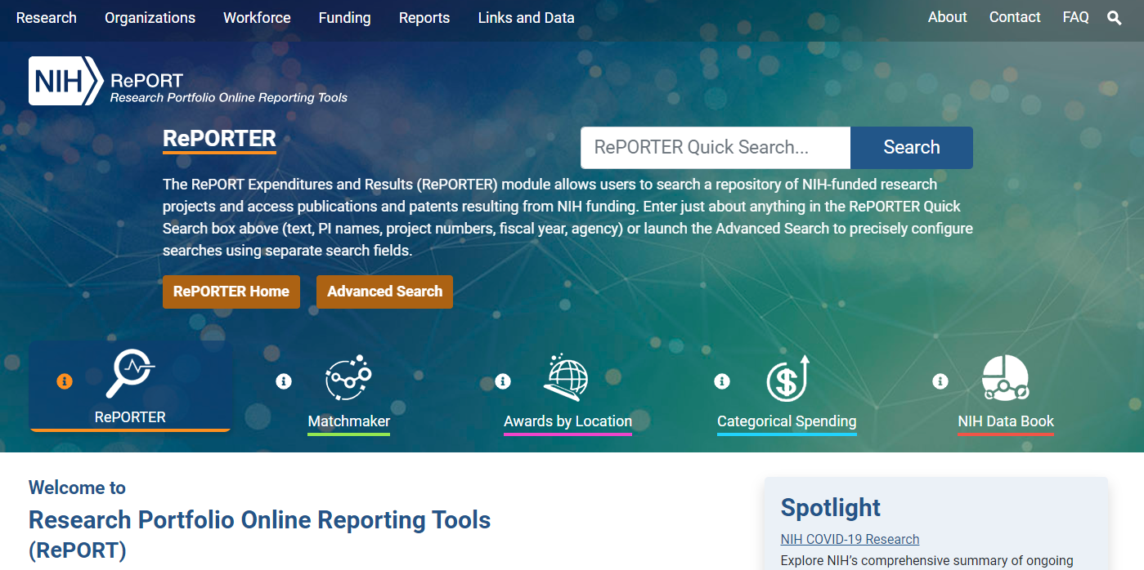
Multiple Tools on the RePORT Website

Slide 28
Using RePORTER to Help With Your Application
Find funded research projects in areas similar to your
Identify potential collaborators
Find projects awarded earlier under similar funding opportunities
RePORTER = Expenditures and Results
Updated weekly with newly funded grants
Patents, publications, and other research outcomes
Information is included from
NIH, extramural and intramural since FY 1985
Projects supported by other components of the Department of Health and Human Services (HHS) and Veterans Affairs (VA)

Slide 29
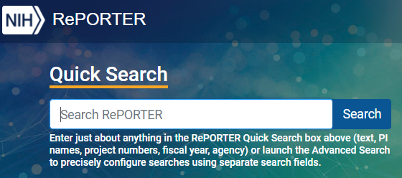
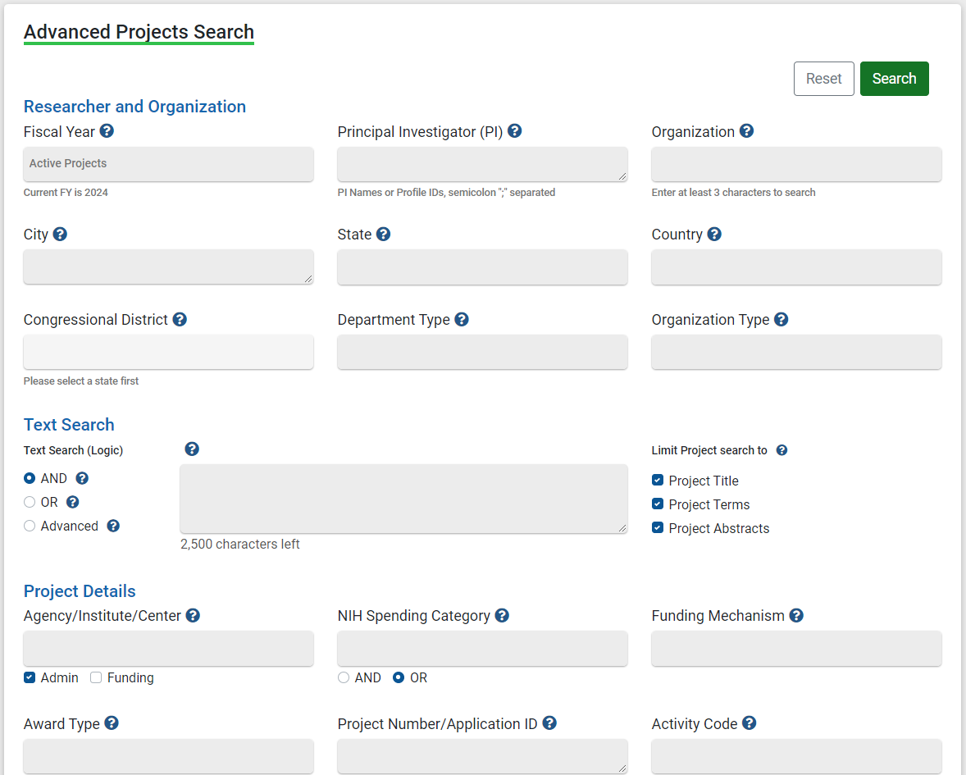
Multiple Ways to Search RePORTER
Quick Search automatically looks across multiple search fields, returning relevant results for common queries
Interactive charts let you jump into active projects based on location or Institute/Center
Advanced Projects Search allows you to precisely define search fields

Slide 30
RePORTER Activity: How Many Projects?
LET’S POLL!
Go to https://reporter.nih.gov
Decide whether you will use Quick Search, interactive charts, or Advanced Projects Search to find the following information…
Zoom poll:
How many active NIH projects are awarded to organizations in California? What search strategy did you use to find this information?
How many active projects are administered by the National Institute of Nursing Research (NINR)? What search strategy did you use to find this information?

Slide 31
RePORTER Question 1: Projects in California
LET’S POLL!
Question: How many active NIH projects are awarded to organizations in California?
1,573
4,669
7,705
10,905
Other
None: could not complete activity

Slide 32
RePORTER Question 2: Search Strategy
LET’S POLL!
Question: What search strategy did you use to find the number of active NIH projects in California?
Quick Search
Interactive charts
Advanced Projects Search
Other
None: could not complete activity
There are multiple valid approaches

Slide 33
RePORTER Question 3: Awards at the National Institute of Nursing Research
Question: How many active projects are administered by the National Institute of Nursing Research (NINR)?
3,371
1,463
439
297
Other
None: could not complete activity
LET’S POLL!

Slide 34
RePORTER Question 4: Search Strategy
LET’S POLL!
Question: What search strategy did you use to find the number of active projects administered by the National Institute of Nursing Research (NINR)?
Quick Search
Interactive charts
Advanced Projects Search
Other
None: could not complete activity
Again, these are both valid approaches

Slide 35
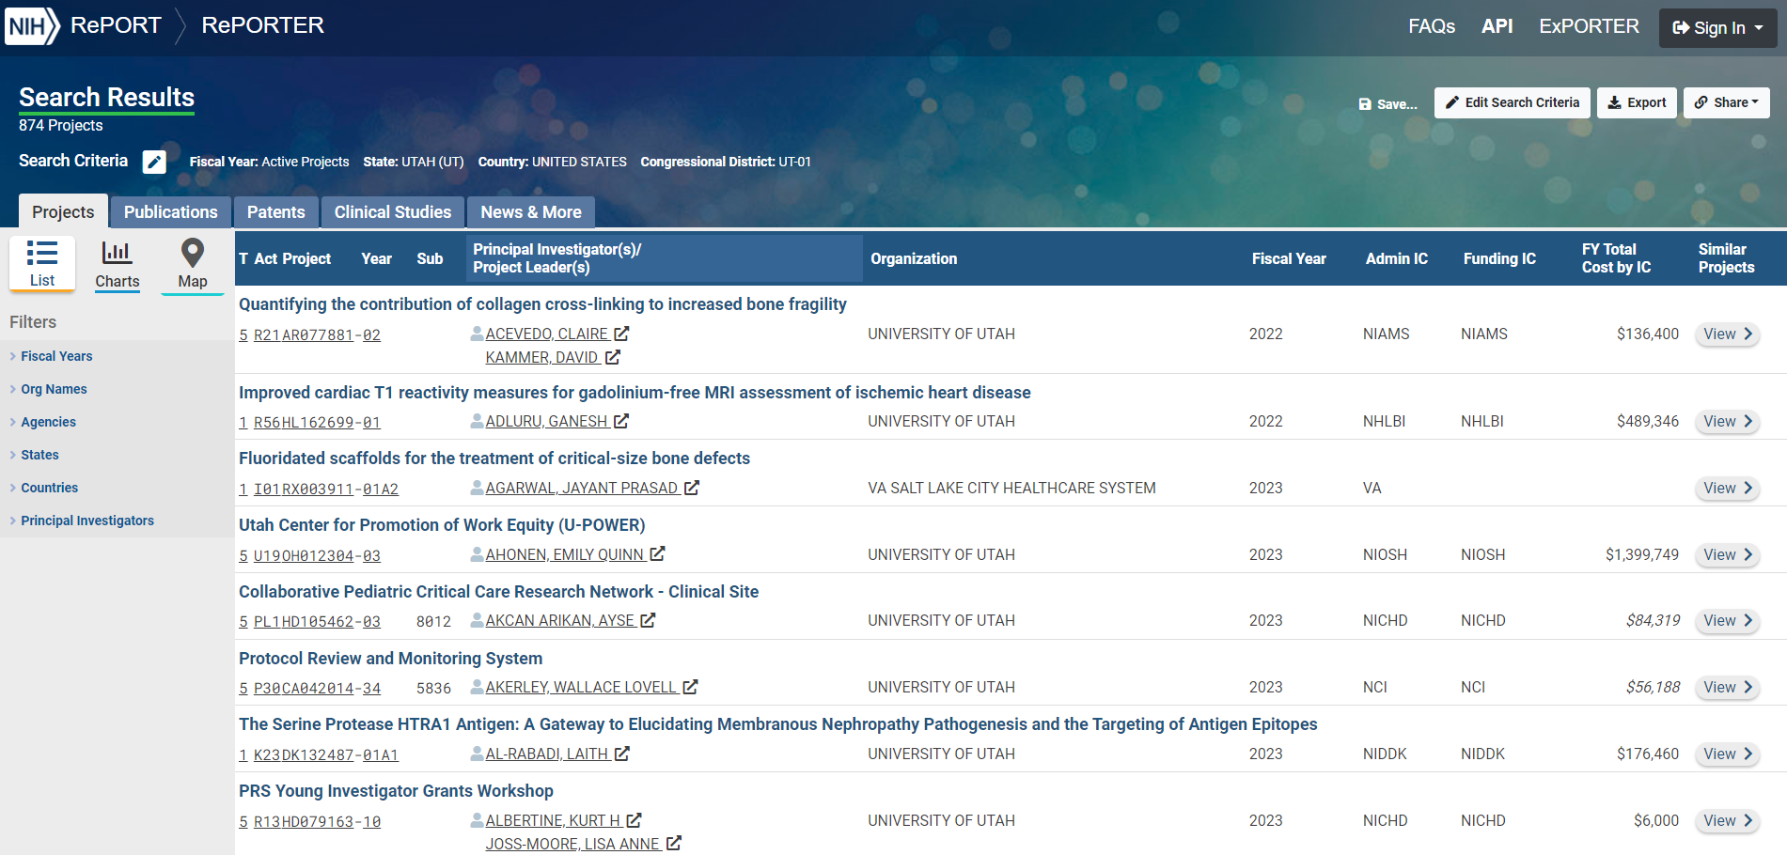
RePORTER Search Results – Projects, Publications, and More
Explore projects, publications, and more
“Share” URL for latest results or MyRePORTER account to save searches and set weekly email alerts

Slide 36
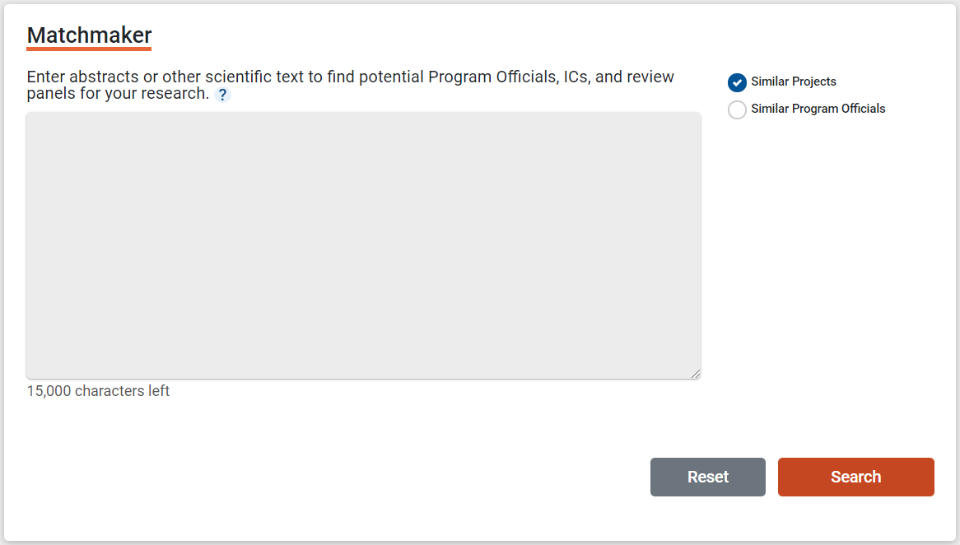
Matchmaker: What Projects Like Mine Have Already Been Funded?
Find similar projects or NIH Program Officials in a particular research area
Research Interests: HIV science from a cell biology approach, supplemented with molecular biology, biochemistry, and genetics to study various aspects of HIV from virus entry and assembly, to defining the earliest steps of the sexual transmission of HIV; microscopic imaging; fluorescent labeling of HIV particles or viral proteins and the identification of infected cells; HIV prevention science, including vaccine and microbicide research. Use of cell biology approaches to study HIV providing images and movies of HIV interacting with cells and tissues. For the past 25 years, research has focused on HIV Cellular Virology. More recently, this focus has expanded to HIV related mucosal immunology, HIV transmission and HIV Prevention Science. Lab utilizes a series of imaging based tools to define key viral and host players of the earliest days of the transmission event in the physiologically relevant context of anatomy and physiology of live animals and human tissues. The lab uses several approaches to allow the efficient identification of foci of SIV mucosal infection. HIV/SIV particles, mucosal tissue barriers, host target or effector cells and infected cells can be directly visualized. Lab can leverage these imaging capabilities to

Slide 37
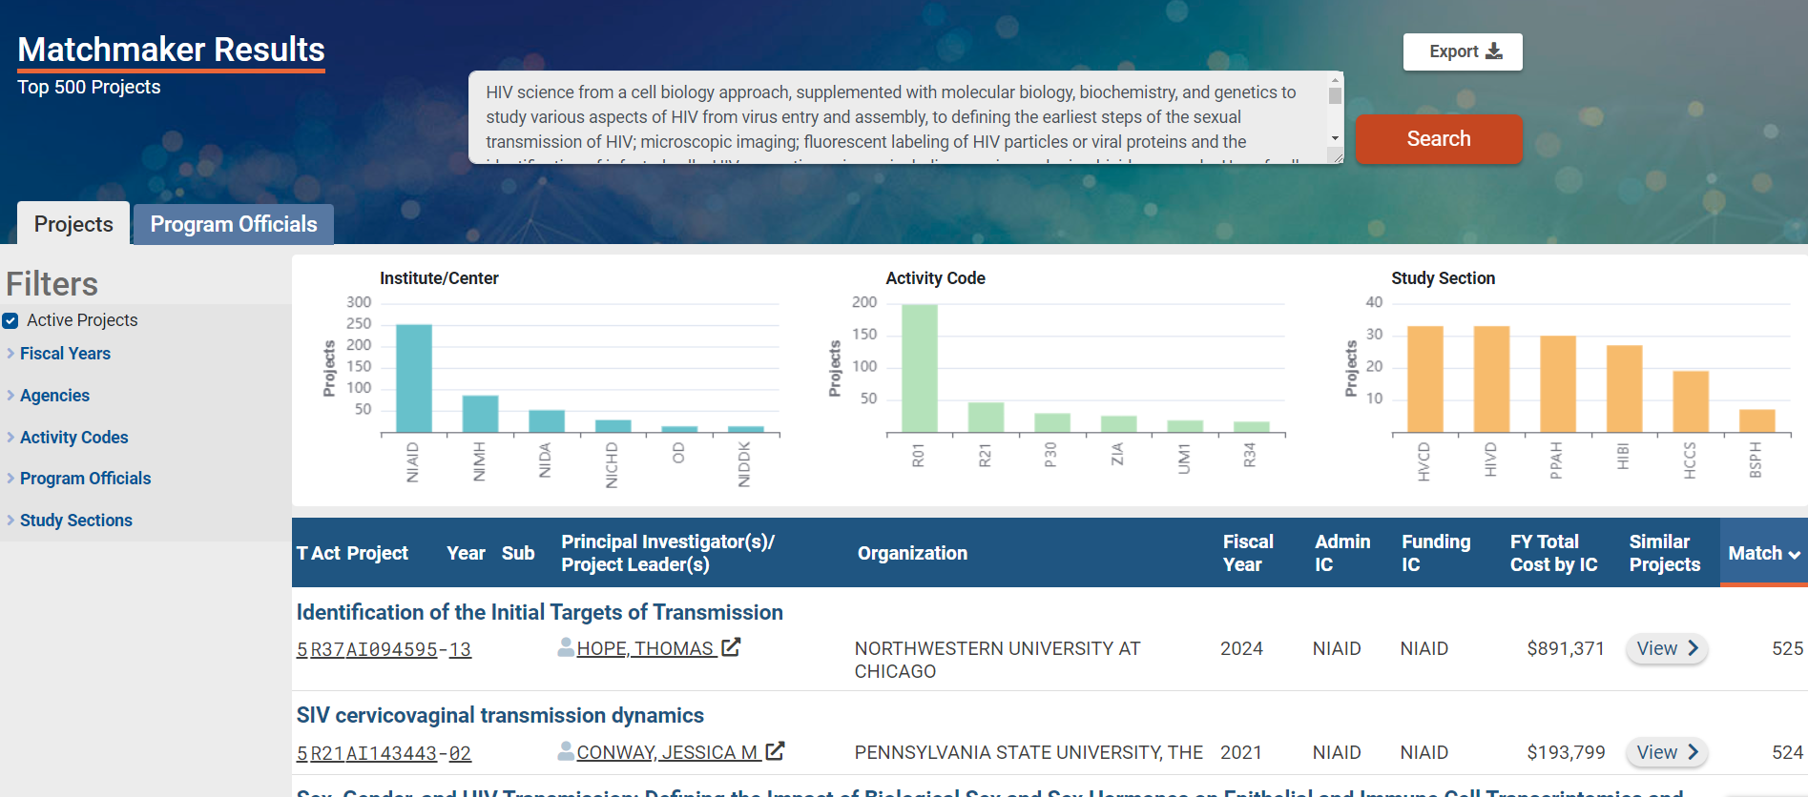
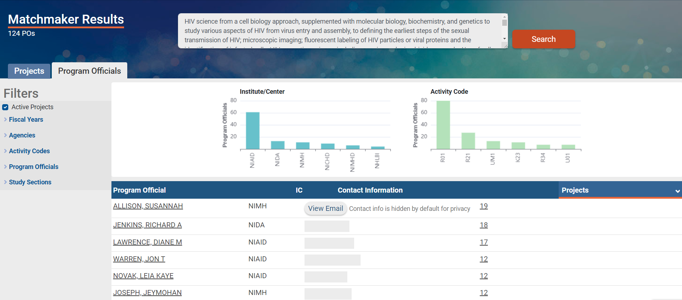
Matchmaker: Who Can I Contact to Discuss My Ideas?
Matchmaker summarizes the projects by Institute or Center, activity code, review panel, and Program Official

Slide 38
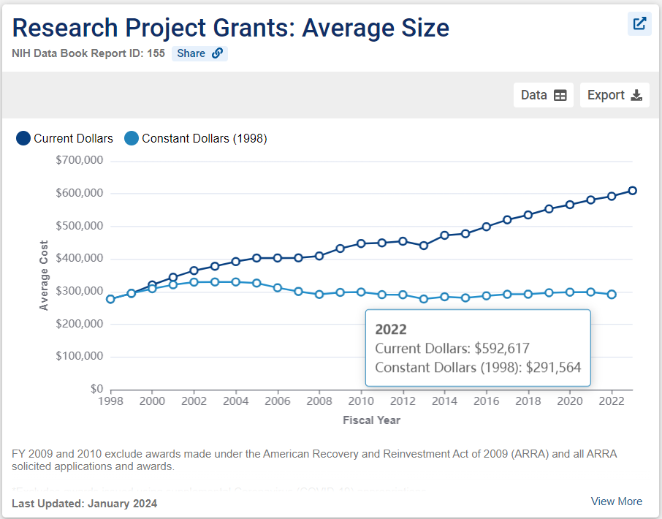
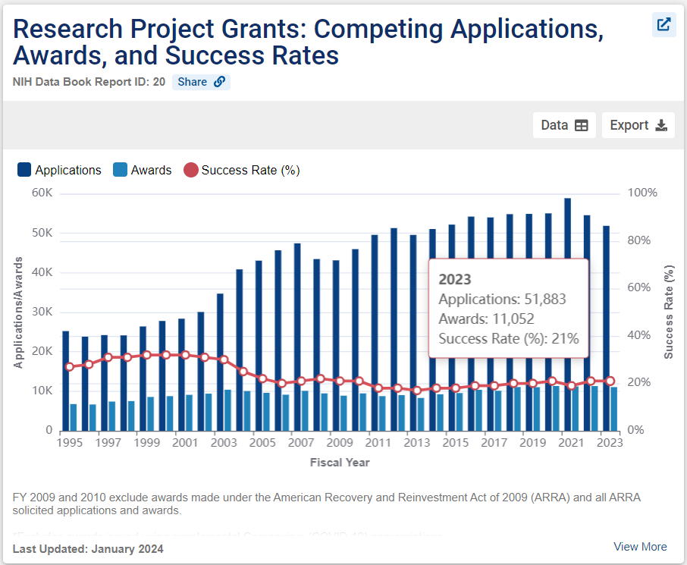
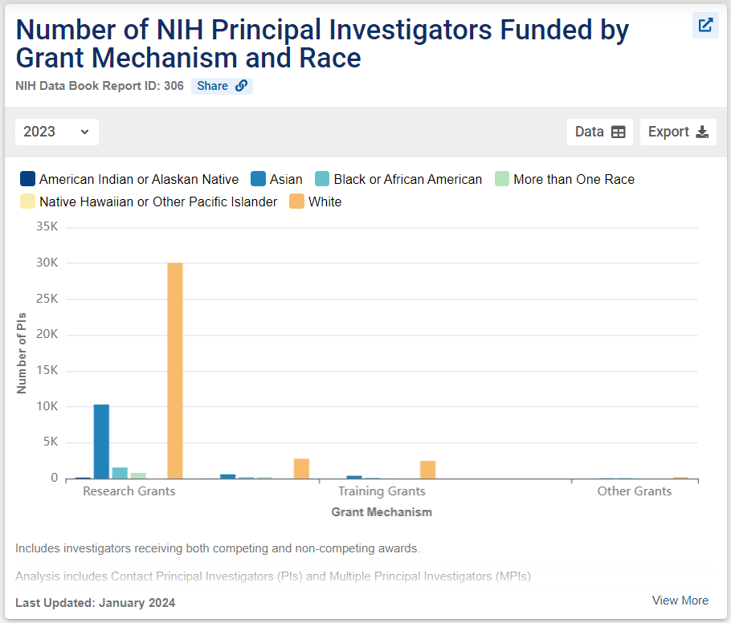
NIH Data Book: Statistics and Trends in NIH Funding
The NIH Data Book summarizes answers to the most commonly asked questions about the NIH budget and extramural programs
Success and Funding Rates
NIH-Funded Workforce
And more…
Data are updated annually

Slide 39
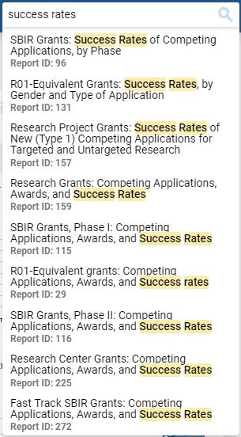
NIH Data Book Activity: Success Rate for R01-Equivalent Grants
Go to https://report.nih.gov/nihdatabook
Navigate by category (Success Rates) or use the search box to find the success rate for R01-equivalent grants in FY 2023
Respond to Zoom poll:
What was the success rate for R01-equivalent grants in FY 2023?
Which “Report ID” contained this information?
LET’S POLL!

Slide 40
Data Book Question 1: Success Rates
LET’S POLL!
Question: What was the success rate for R01-equivalent grants in FY 2023?
18%
20%
22%
24%
Other

Slide 41
Data Book Question 2: Report IDs
LET’S POLL!
Question: Which “Report ID” contained this information?
Report ID 29
Report ID 30
Report ID 131
Report ID 136
Other

Slide 42
Thank You
Need Help? RePORT@mail.nih.gov
Websites
RePORT: https://report.nih.gov
RePORTER: https://reporter.nih.gov

Slide 43
Q&A: Report
MODERATOR
PRESENTER
Megan Columbus
Director
Division of Communications and Outreach
NIH Office of Extramural Research (OER), NIH
Cindy Danielson, Ph.D.
Associate Director, Systems Integration
Office of Research Reporting and Analysis
Office of Extramural Research (OER), NIH

Slide 44
NIH Grants Process: Plan To Apply (NOFO)
NIH GRANTS PROCESS: PLAN TO APPLY
Find and Understand the Notice of Funding Opportunity (NOFO)
PRESENTER
Laurie Roman, Ph.D., MBA
Acting NIH Guide Officer
Office of Extramural Research (OER), NIH

Slide 45
PLAN TO APPLY: Find & Understand a NOFO
Find an Opportunity
Walk-through of a Notice of Funding Opportunity
Engage with this Knowledge Check (poll)

Slide 46
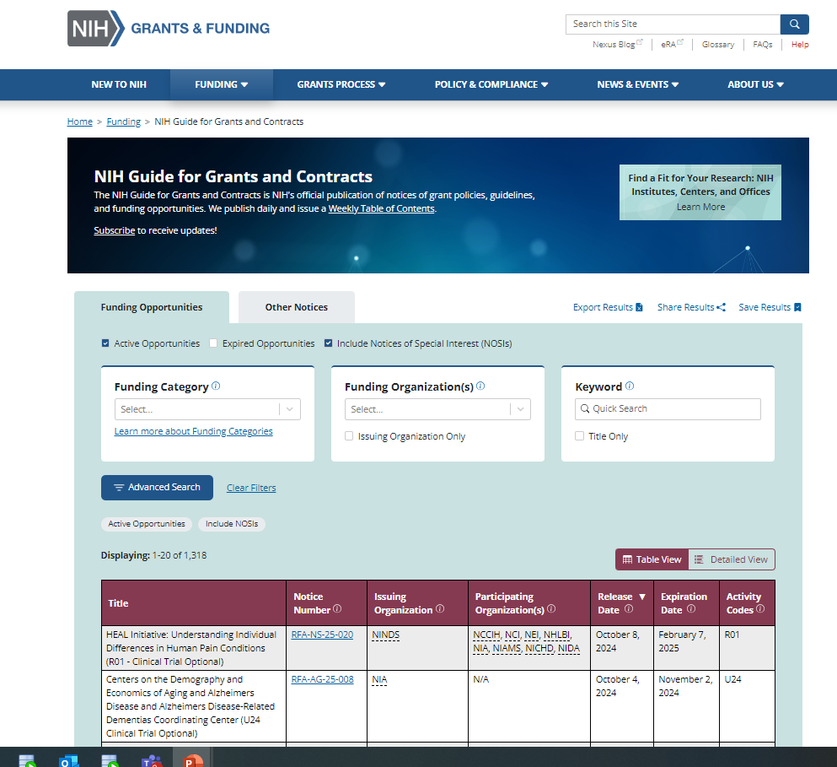
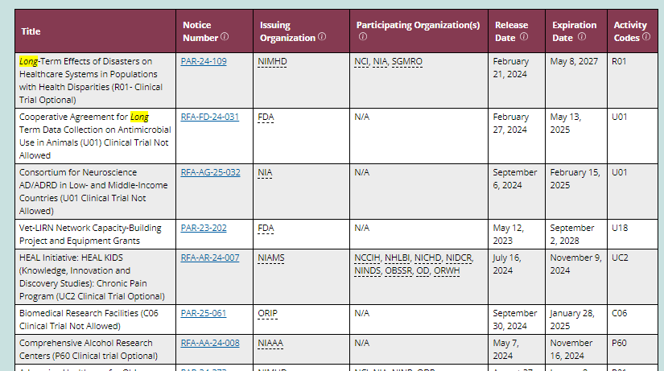
Find an Opportunity
Use the Chat Box to Share Your Answer!
research., training, etc.
Scientific terms e.g. long COVID
Resource: NIH Guide to Grants and Contracts

Slide 47
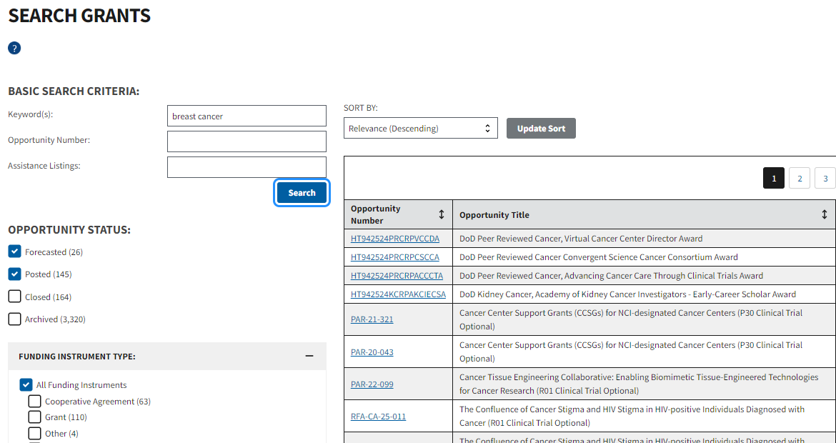
Grants.gov
https://www.grants.gov/

Slide 48
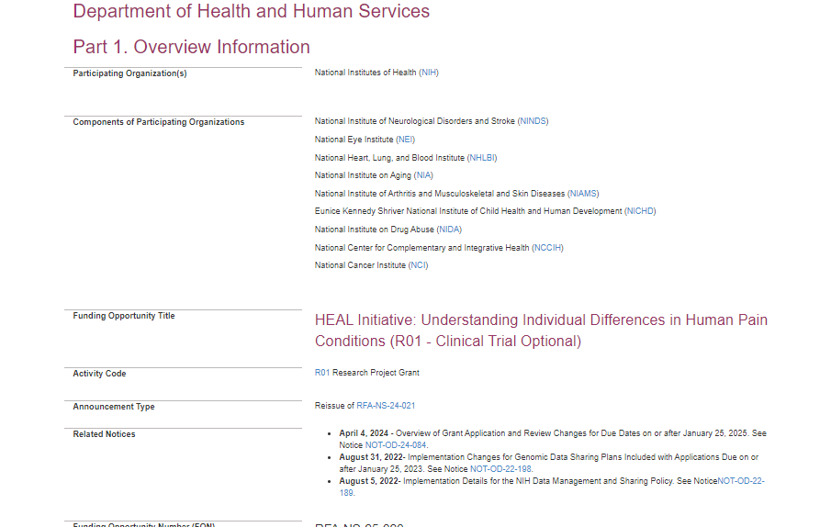
Notice of Funding Opportunity – Part 1
Carefully read full announcement
Participating Institutes
Check for updates in Related Notices

Slide 49
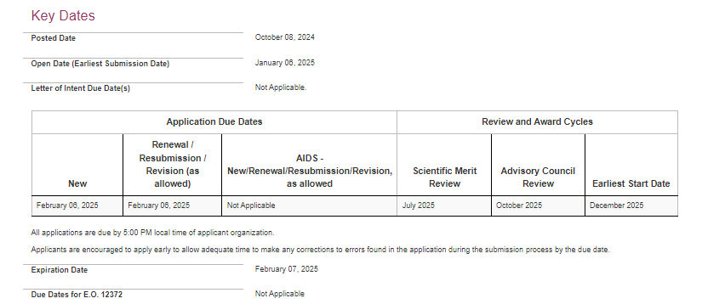
Notice of Funding Opportunity – Key Dates
Due Dates section links to standard dates web page or lists specific due dates

Slide 50
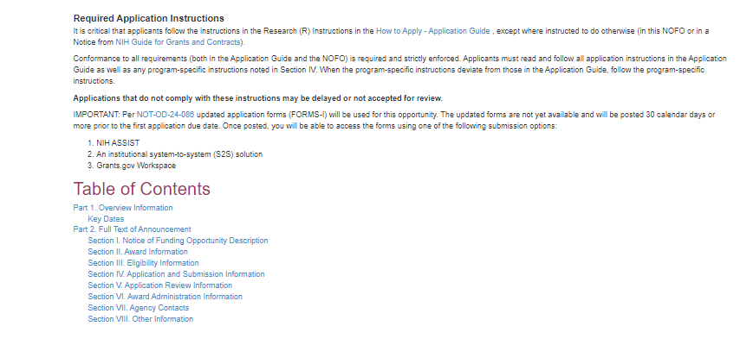
Notice of Funding Opportunity – Contents
NOFO-specific
The forms that must be completed prior to submission are associated with the NOFO. NIH will be transitioning to a new form set for applications due on or after 1/25/2025. If the due date specified on the NOFO is on or before 1/24/2025- use FORMS-H. If the due date is on or after 1/25/2025, use FORMS-I.

Slide 51
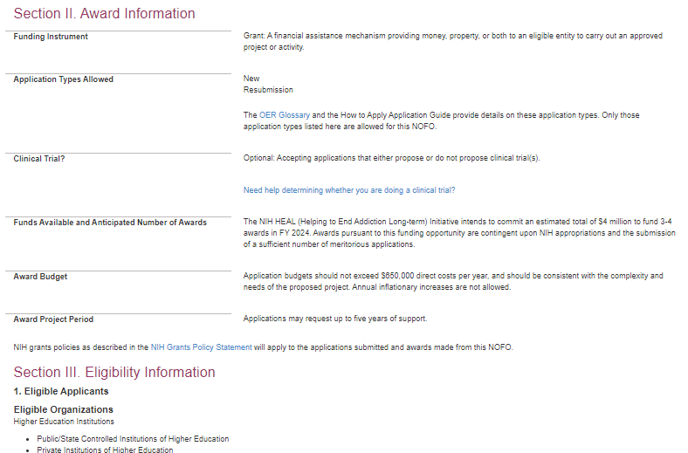
Notice of Funding Opportunity – Sections 2 and 3
Application Types

Slide 52
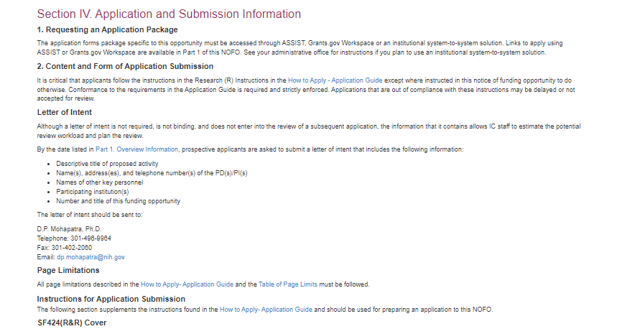
Notice of Funding Opportunity – Section 4
Section VII lists individuals at the ICO(s) to contact with questions

Slide 53
Sometimes We Make a Mistake or are Less than Crystal Clear…
Address the issue by publishing a corrective notice
What instructions to follow
How to Apply-instruction guide< NOFO <Notice
Poll: Arrange the following in order of importance to the instructions when applying: Notice, NOFO, instruction guide
Notice
NOFO
Instruction guide
LET’S POLL!

Slide 54
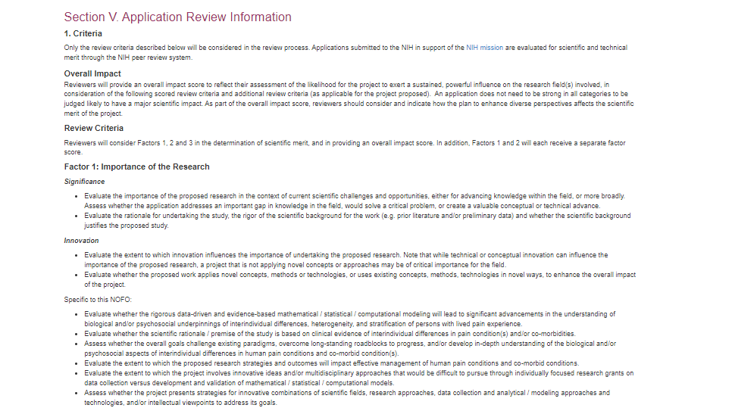
Notice of Funding Opportunity – Section 5
NIH is implementing a simplified review framework (SRF) for the peer review of the majority of competing research project grants (RPG) applications, beginning with due dates on or after 1/25/2025. The simplified framework aims to better facilitate the mission of scientific review- the identification of the strongest, highest impact research.

Slide 55
Check for Fit … Before You Submit!
Program description
NOFO Part 2, Section I Funding Opportunity Description
Participating institutes/centers/offices
NOFO Part 1, Participating Organizations & Components of Participating Organizations
Type of application – New, Resubmission, Renewal, Revision
NOFO Part 2, Section II Award Information
Clinical trial status
NOFO Part 2, Section II Award Information
Eligibility
NOFO Part 2, Section III Eligibility

Slide 56
Q&A: find & Understand A NOFO
MODERATOR
PRESENTER
Megan Columbus
Director
Division of Communications and Outreach
NIH Office of Extramural Research (OER), NIH
Laurie Roman, Ph.D., MBA
Acting NIH Guide Officer
Office of Extramural Research (OER), NIH

Slide 57
NIH GRANTS PROCESS: WRITE THE APPLICATION
Top Writing Tips and More!
PRESENTER
LeShawndra Price, Ph.D.
Director
Office of Research Training and
Special Programs (ORTSP)
National Institute of Allergy and Infectious Diseases (NIAID), NIH

Slide 58
WRITE THE APPLICATION: Top Writing Tips
Understand the application sections
Find tips for preparing specific components
Request a specific scientific review group

Slide 59
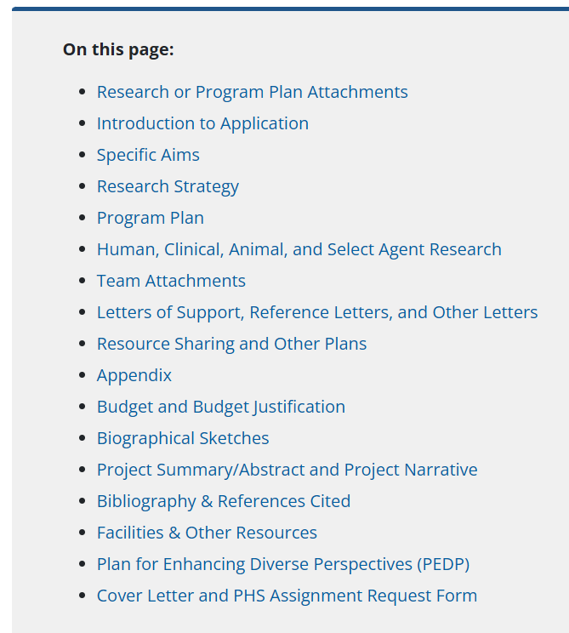
Application Tips
A lot goes into an NIH application…
How can you make sure it’s as strong as it can be?
Let’s talk about a few critical application areas.
Resource: Advice on Application Sections

Slide 60
Specific Aims: What is it?
The Specific Aims page is your first chance to wow your reviewers
Question: What’s the purpose of the Specific Aims page?
Use the Chat Box to Share Your Answer!

Slide 61
Specific Aims: The Elevator Pitch
The ideal Aims will collectively answer your overall scientific question and address interesting and significant issues in your field.
We recommend that your Aims focus on your project goals, anticipated outcomes, and the resulting overall impact on your field.
You can mention major experiments. However, we advise against merely describing your experiments as Specific Aims. You will detail the experiments and their relation to your Aims in the Research Strategy section.
Resource: Advice on Application Sections - Specific Aims

Slide 62
Research Strategy: What is it?
The Research Strategy is your chance to give the why, what, and how of your proposed research.
Question: What three sections should you always include in the Research Strategy?
Professional Experience
Significance of the research
Organizational support
Scientific approach
Scientific background
Past publications
Innovation of the project
LET’S POLL!

Slide 63
Research Strategy: The How and Why
Typically, you’ll want to discuss:
The significance of the research (why and how will it have an impact on the field or public health?)
The innovation of the project (what sets your idea apart?)
The approach you plan to take (is the project feasible and have you considered every angle?)
…But remember, it’s up to you how to organize everything.
Resource: Advice on Application Sections - Research Strategy

Slide 64
Research Strategy: What to Be Thinking About
Question: What things should you keep in mind when you’re developing your Research Strategy?
Making sure the science is reproducible and rigorous
How your preliminary data supports the project’s central hypothesis
Explaining exactly how your research adheres to human subjects research and clinical trial guidelines
A detailed budget
1 and 2
2 and 4
1, 2, and 3
LET’S POLL!

Slide 65
Research Strategy: Make Sure the Research is 💪
Describe how your project reflects principles of scientific rigor, reproducibility, and transparency.
Consider including Tables, Charts, and Figures to help summarize data, clarify key elements of your research, illustrate the flow of your planned experiments, and boost visual interest.
If your project proposes Human Subjects or Clinical Trial, refer readers to your Human Subjects and Clinical Trials Information form
Resource: Advice on Application Sections - Research Strategy

Slide 66
Letters: Not Just for Fellows
Most NIH applications will require at least one kind of letter.
Question: What is the difference between each of these letters?
LET’S POLL!
Letter of Support
Required for most applications, provided by your organization, team, and any consortium/contractual individuals or organizations write these to document their role and commitment to your project.
Letter of Intent
Required for fellowships, mentored career awards, and a few other programs. These are provided directly by the referee and not the applicant
Reference Letter
Typically optional, sometimes required by the notice of funding opportunity
Cover Letter
Requested by some notices of funding opportunity to help staff gauge the potential review needs of your application

Slide 67
Letters: They Tell Different Stories
Letters of Support are typically required:
Your organization, team, and any consortium/contractual individuals or organizations write these to document their role and commitment to your project. Include the rate or price for any contracted services.
Include the letters of support in your application.
Reference Letters are required for fellowships, mentored career development awards, and a few other programs.
Do not include these letters in your application. Your referees must provide these reference letters directly to NIH by the due date.
Follow instructions on the main Reference Letters page and in your funding opportunity notice.
An optional Letter of Intent is requested in some funding opportunity notices.
This letter is not required, binding, or considered during peer review.
A letter of intent helps NIH staff estimate the potential review workload and recruit reviewers with the expertise needed to review your application.
A Cover Letter is typically optional. Learn more in the Cover Letter and PHS Assignment Request Form section.
Learn more at Advice on Application Sections - Letters

Slide 68
Budget and Budget Justification
Crafting a budget can be time consuming…
Question: Where can you find information to get yours started?
Use the Chat Box to Share Your Answer!

Slide 69
Budget and Budget Justification: A Lot to Think About
Check your funding opportunity to confirm what type of budget is required.
Understand the various components of the budget, working with your organization’s Office of Sponsored Research and department administrator.
Contact the financial/grants management contacts listed in your funding opportunity if you have questions on allowability and other budget topics.
Remember: You’ll need to request prior approval from NIH officials if you request more than $500,000 in direct costs
Resource: Advice on Application Sections - Budgets

Slide 70
Biographical Sketches
All applicants are required to provide a biographical sketch as part of their application.
The biosketch is an opportunity to tell NIH about your professional accomplishments, education, and publishing record.
Question: What tools are available to help you develop your biosketch?
ORCID
SciENcv
Biosketch format pages
All of the above
LET’S POLL!

Slide 71
Biographical Sketches: Tell Us About Yourself
We’ve tried to make it easy for your to develop a biosketch
ORCID (Open Researcher and Contributor ID) is an open-source personal identifier that links your bibliography to your eRA Commons account as well as many journals
SciENcv (Science Experts Network Curriculum Vitae) is an NIH application that will help you build your biosketch
Format pages, instructions, and samples are available on the NIH Grants site
Tip: Changes are coming to NIH biosketches in May 2025

Slide 72
How to Request a Specific Scientific Review Groups
Resource: Assignment Request Form

Slide 73
Application Guide: PHS Assignment Request Form

Slide 74
PHS Assignment Request Form

Slide 75
Q&A: Write the Application
MODERATOR
PRESENTER
Megan Columbus
Director
Division of Communications and Outreach
NIH Office of Extramural Research (OER), NIH
LeShawndra Price, Ph.D.
Director
Office of Research Training and
Special Programs (ORTSP)
National Institute of Allergy and Infectious Diseases (NIAID), NIH

Slide 76
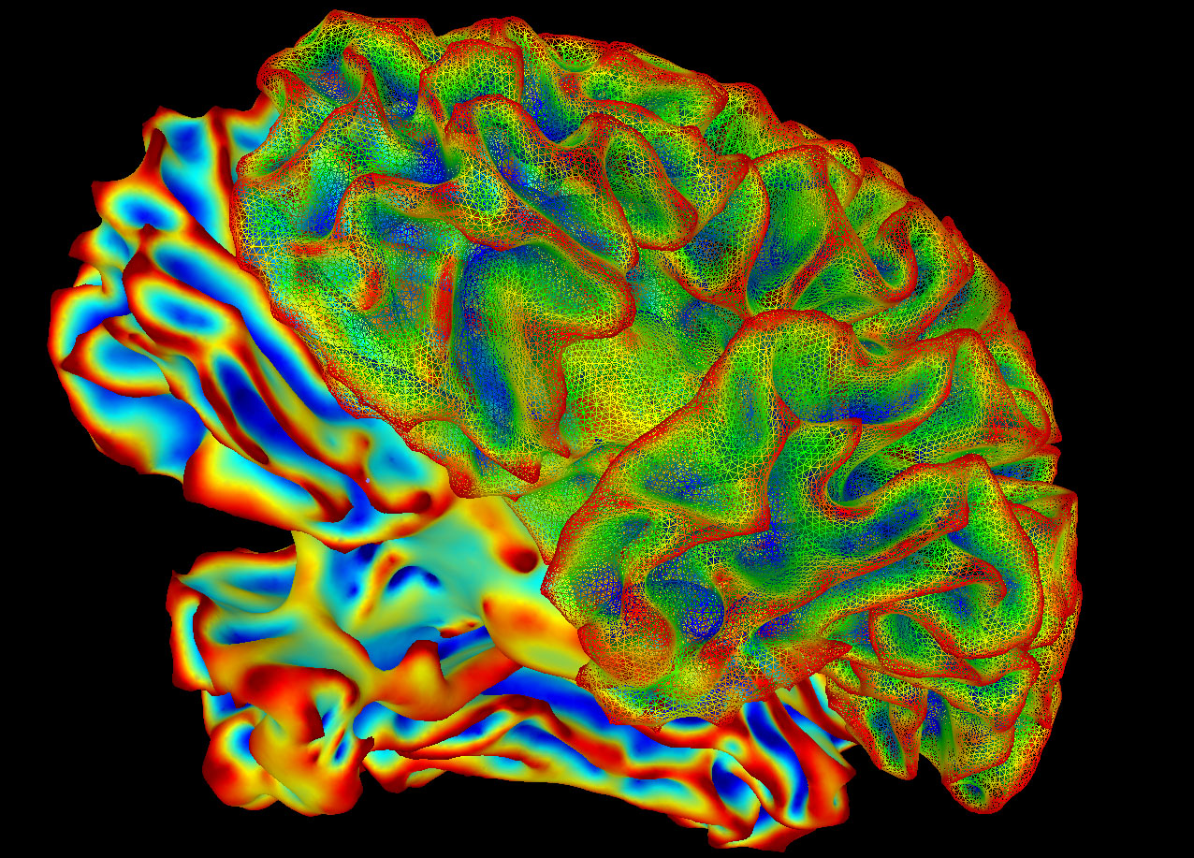
INTERMISSION
SumaLateral Whole Brain Image
Check out more NIH images at https://www.flickr.com/photos/nihgov/albums/
The next segment will begin
What’s Coming Up?
Submit Your Application: eRA Commons
Walk-Through of a Summary Statement
Writing Your Application
Highlights of the Notice of Award
Monitoring and Reporting Overview
Top Tips from NIH Program Experts
The final PowerPoints, recordings, and transcripts for this two-part event will be available on the On-Demand Event Resources web page at https://grants.nih.gov/news-events/on-demand-event-resources.
Interested in future virtual events and resources, visit the News & Events Page on the Grants & Funding Website at https://grants.nih.gov/news-events.

Slide 77
Welcome Back
AGENDA (2nd Segment)
NIH GRANTS PROCESS PRIMER Part Two: An Interactive Opportunity
Submit Your Application: eRA Commons
Walk-Through of a Summary Statement
Writing Your Application
Award: Walk-through of a Notice of Award (NoA)
Monitoring and Reporting Overview
Top Tips from NIH Program Officials
MODERATOR
Megan Columbus
Director
Division of Communications and Outreach
NIH Office of Extramural Research (OER), NIH

Slide 78
NIH GRANTS PROCESS: SUBMIT
PRESENTER
Laurie Roman, Ph.D. MBA
Acting NIH Guide Officer
Office of Extramural Research (OER), NIH

Slide 79
AGENDA: Submit
Organizational Registrations
Application Submission Options
Plan
Finalize and Submit
Track

Slide 80
Organizational Registrations
Your organization must be registered in multiple systems to submit.
Start early – can take 6 weeks!
SAM- (System for Award Management)- need to do business with the government (requires annual renewal) UEI
Grants.gov- required to submit grants
eRA Commons- required to do business with NIH (individuals are affiliated to organization)
SBA- Small Business Administration)- required for SBIR/STTR applications
Resource: Organization Registrations

Slide 81
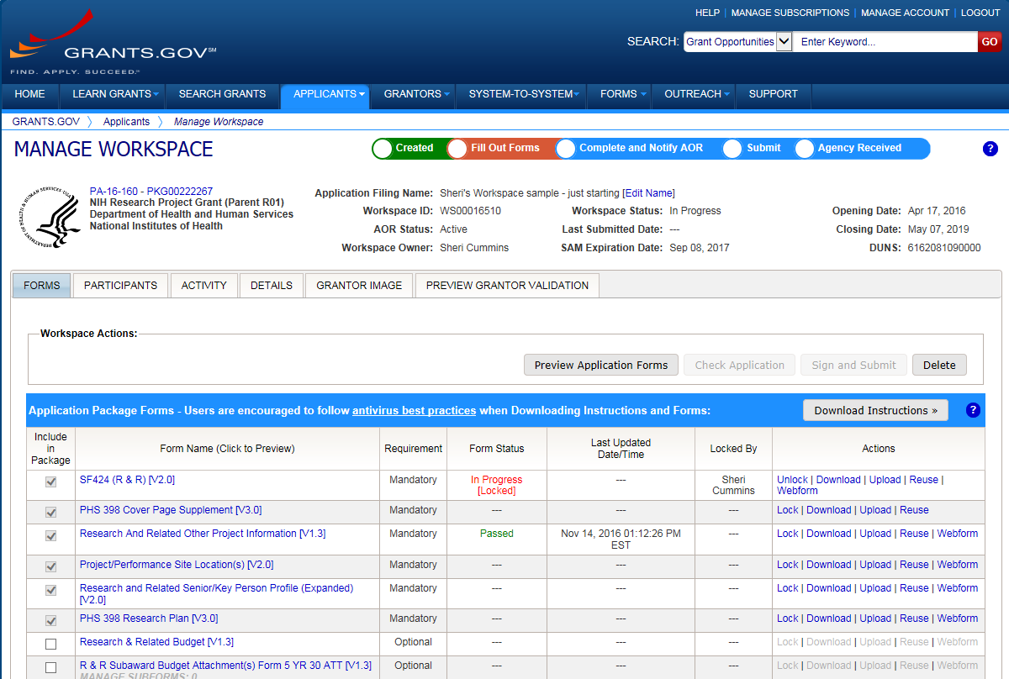
Application Submission Options
ASSIST
System-to-System
Workspace
Regardless of the method selected…
Subject to the same registration requirements
Completed with the same data items
Routed through Grants.gov
Validated against the same NIH business rules
Assembled in a consistent format for review consideration
Tracked in eRA Commons
Check with your sponsored research office before starting
Resource: Choose a Submission Option

Slide 82
Comparison of Submission Options
NIH ASSIST
Grants.gov Workspace
Managed by NIH
Multi-user access
Leverages eRA Commons accounts
Pre-population from eRA Commons profiles
Pre-submissions validations
Pre-submission preview in agency format
Track application status in a single system
Copy data to different application package
Supports all NIH competing applications
Pull study information from ClinicalTrials.gov
Integrated NIH messaging (tips, system alerts)
Managed by Grants.gov
Multi-user access
Requires additional registration
No pre-population from profiles
Pre-submissions validations
Pre-submission preview in agency format
Must track application status in multiple system
Copy data to different application package
Supports NIH single project competing applications

Slide 83
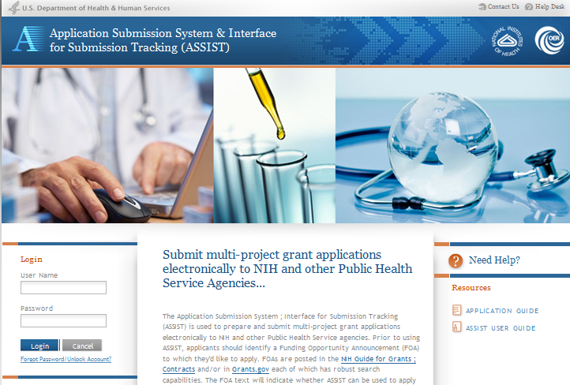
Access Application Forms via ASSIST
Excerpt from single-project NOFO in NIH Guide…
You can also access from:
eRA Commons
Googling NIH ASSIST

Slide 84
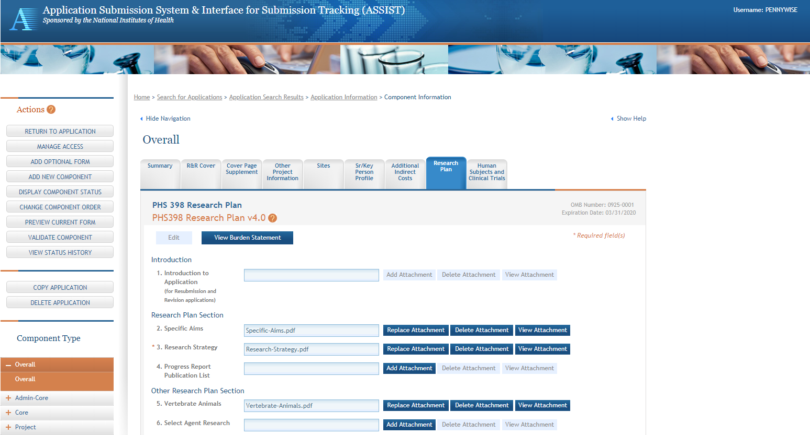
ASSIST Screen – Single-project

Slide 85
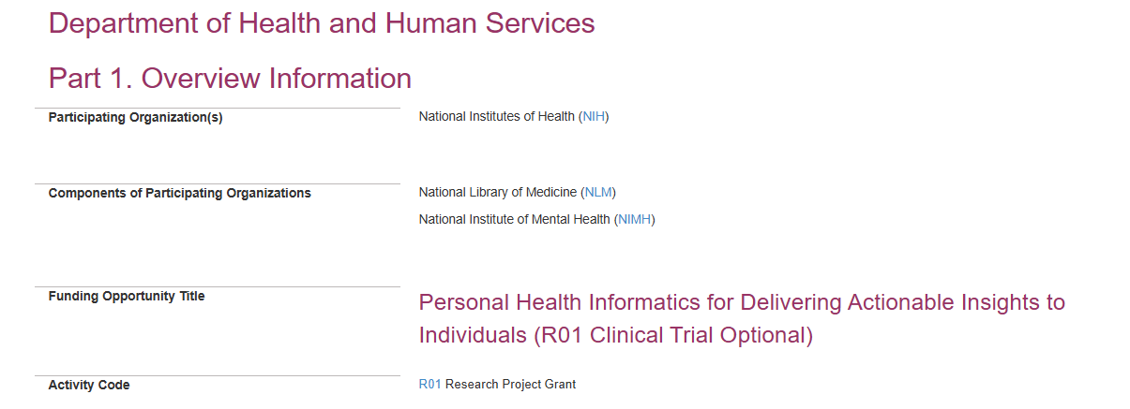
Plan for Your Submission
Identify a Notice of Funding Opportunity
Identify Team Members
Verify registrations are in place AND active
All individuals listed on Sr Key Form must have an eRA Commons ID
Confirm submission method
Determine responsibilities
Prepare budgets, data entry, support letters etc.
Internal review and approval processes
Post-submission responsibilities- application image, errors/warning

Slide 86
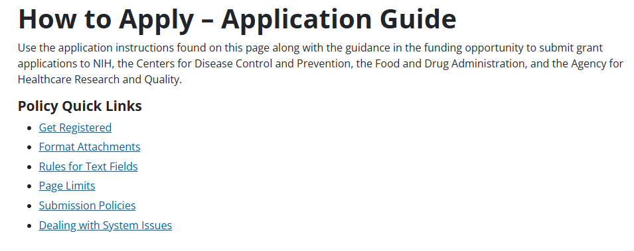
Enter Data
Helpful Resource: Annotated Form Set
Follow instructions
Notices in NIH Guide for Grants & Contracts
Funding Opportunity Announcement
Section IV. Application and Submission Information
How to Apply - Application Guide
Precedence / Importance

Slide 87
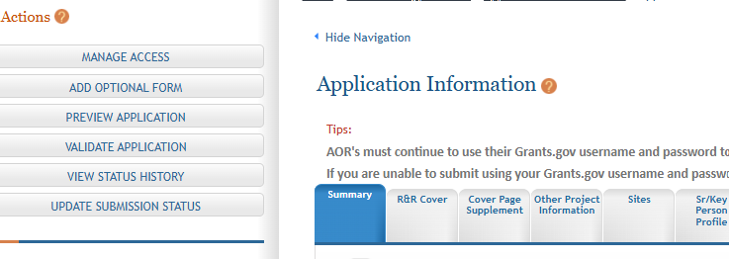
Finalize Your Application
Action | Navigation
Run a pre-submission validation check | Validate Application
Generate a pre-submission image of your assembled application in the NIH format | Preview Application
Take any additional steps needed to prepare for submission | Update Submission Status to “Ready to Submit”

Slide 88
Submit Your Application
Follow steps for your submission method
Only an individual with Grants.gov AOR (Authorized Organization Representative) credentials can submit
All NIH applications route through Grants.gov
Your Grants.gov timestamp is used to determine “on time” submission
Grants.gov Tracking #
Time Stamp
eRA Commons accession number

Slide 89
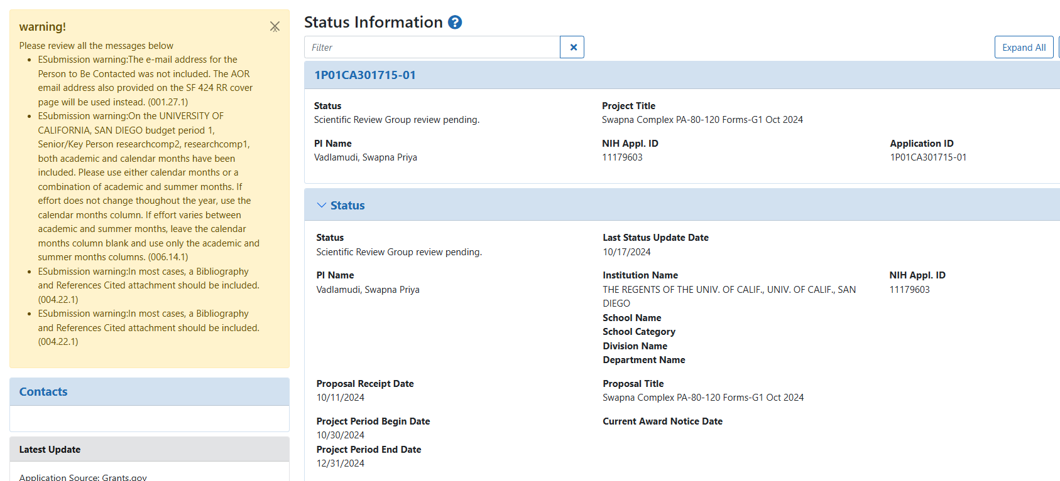
Status

Slide 90
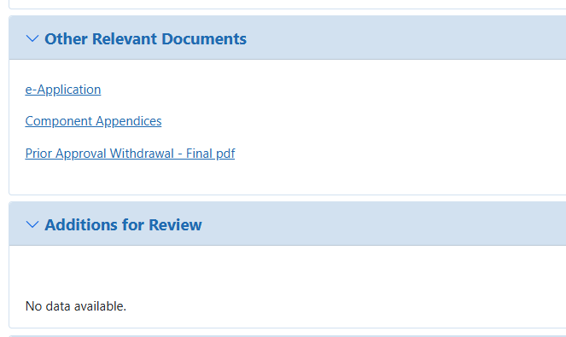
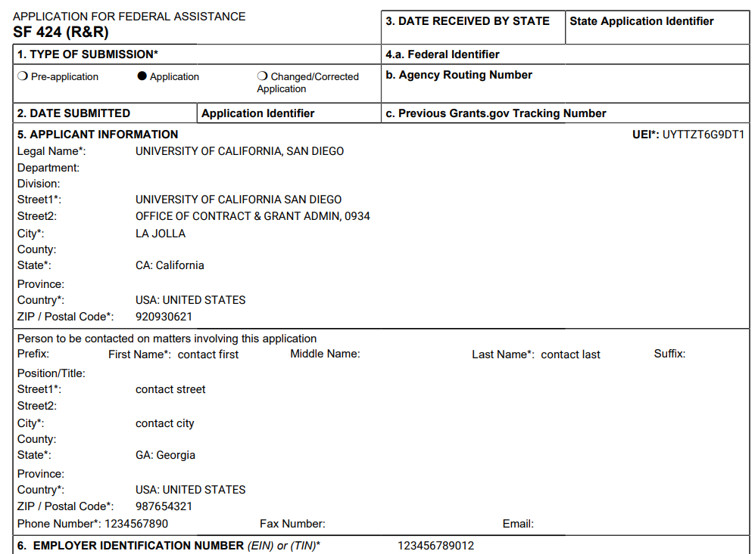
SF 424 (R&R) – e-Application

Slide 91
On Time Submission
Deadlines = 5 p.m. local time of the submitting organization on the due date
All registrations must be in place (includes SAM renewal) at time of submission
Applications must be free of all federal system-identified errors (Grants.gov and NIH)
NIH does not allow corrections to be made after the deadline
NIH recommends submitting early to allow time to correct errors or submission issues
LET’S POLL!
POP QUIZ: The appropriate measure for an early application submission is
1) minutes; 2) hours; or 3) days?
Measure early on a calendar, not a clock!

Slide 92
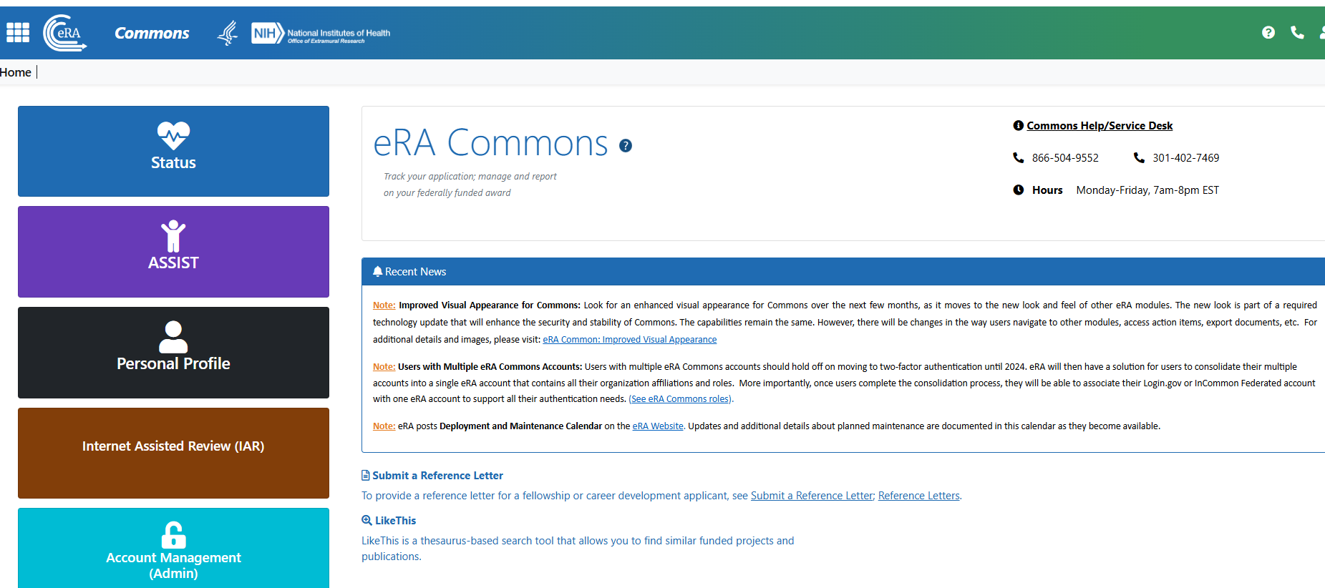
eRA Commons Status
eRA Commons status is an integral part of your submission
Applications submitted to Grants.gov, and pass validations are pulled down by eRA, subjected to validations, assembled into an image (add headers and foots, pages etc), and placed in the grant folder
Authorize users can check eRA Commons Status for processing results
Signing officials (SO), administrative officials (AO), Principal Investigators (PIs), Delegated Assistants (ASSTs)
Notifications sent

Slide 93
Proactively Track Your Application
Many email notifications are sent out through out the process
Do not depend solely on email notifications
It is your responsibility to proactively check the status of your applications in Commons
Corrective actions MUST be made BEFORE the submission deadline
Errors stop application processing and must be corrected
Warning do not stop processing and correction is up to your discretion based on your circumstances

Slide 94
Correcting Errors Found After Submission
To correct system-identified errors:
Make corrections to local copy of the application
Update SF424 (R&R) form
Check “Changed/Corrected” as “Type of Submission”
Enter “Previous Grants.gov Tracking ID” (e.g., GRANT12345678) in field 4c
Submit the entire Changed/Corrected application back through Grants.gov before the deadline
Track submission through to eRA Commons

Slide 95
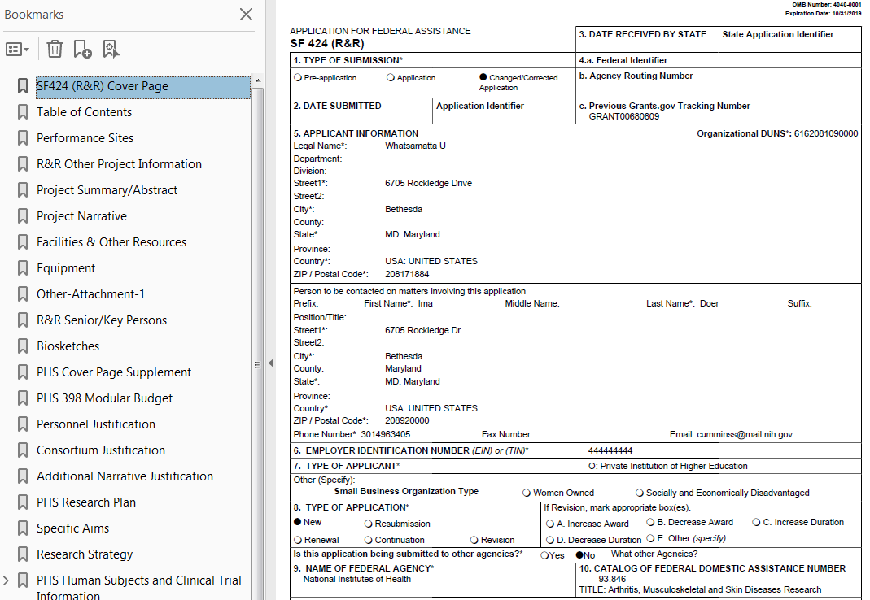
View Application Image (e-Application)
The e-Application in eRA Commons is the same document seen by NIH staff and reviewers.
If you can’t VIEW it …
We can’t REVIEW it …
and
We sure can’t FUND it!

Slide 96
Sample Validations
Grants.gov | eRA Systems | Agency Staff
Active SAM registration | Fields required by agency but not required fed-wide Credentials for PD/PI and everyone on Sr Key form Biosketch for all Sr Key UEI for primary performance site | Fits the mission of NIH/ICO
Submitter has AOR role for UEI on application | Attachments in PDF format | Eligibility and adherence to instructions
Submission to an active opportunity and form packet | Adherence to page limits | On-time
Virus check | All appropriate attachments included | No “overstuffing” or scientific overlap with another active submission
Filenames include appropriate number of characters |  | Font and margins

Slide 97
Avoid the Pitfalls
Start early
Read the entire NOFO- contact the IC to talk about “fit” (section VII of the NOFO)
Confirm submission method, and registrations in place (sponsored research office)
All attachments must be flattened pdf and filename < 50 characters (how to apply)
Run pre-submissions validations and view image
Have a submission plan
Submit early (calendar not clock)
Track the status of the application in ASSIST/Commons status
If something goes wrong- call the eRA Service desk

Slide 98
Q&A: Submit the application
Q&A: Submit the application
MODERATOR
PRESENTER
Megan Columbus
Director
Division of Communications and Outreach
NIH Office of Extramural Research (OER), NIH
Laurie Roman, Ph.D., MBA
Acting NIH Guide Officer
Office of Extramural Research (OER), NIH

Slide 99
NIH GRANTS PROCESS: Review
PRESENTER
Sudha Veeraraghavan, Ph.D.
Scientific Review Officer
Center for Scientific Review (CSR), NIH

Slide 100
REVIEW
Recap of the two-stage review process
Summary statement walkthrough
Questions – Whom to contact and when?

Slide 101
The Center for Scientific Review (CSR)
Manages Peer Review
Snapshot (Fiscal Year 2024 numbers)
35,739 (95%)
NIH R01s
23%
7,757 (95%)
NIH SBIRs-STTRs
67,039 (77%)
of all NIH applications
67,039 (77%)
5,525 (85%)
NIH Fellowships
NIH
CSR
CSR does not fund research.

Slide 102
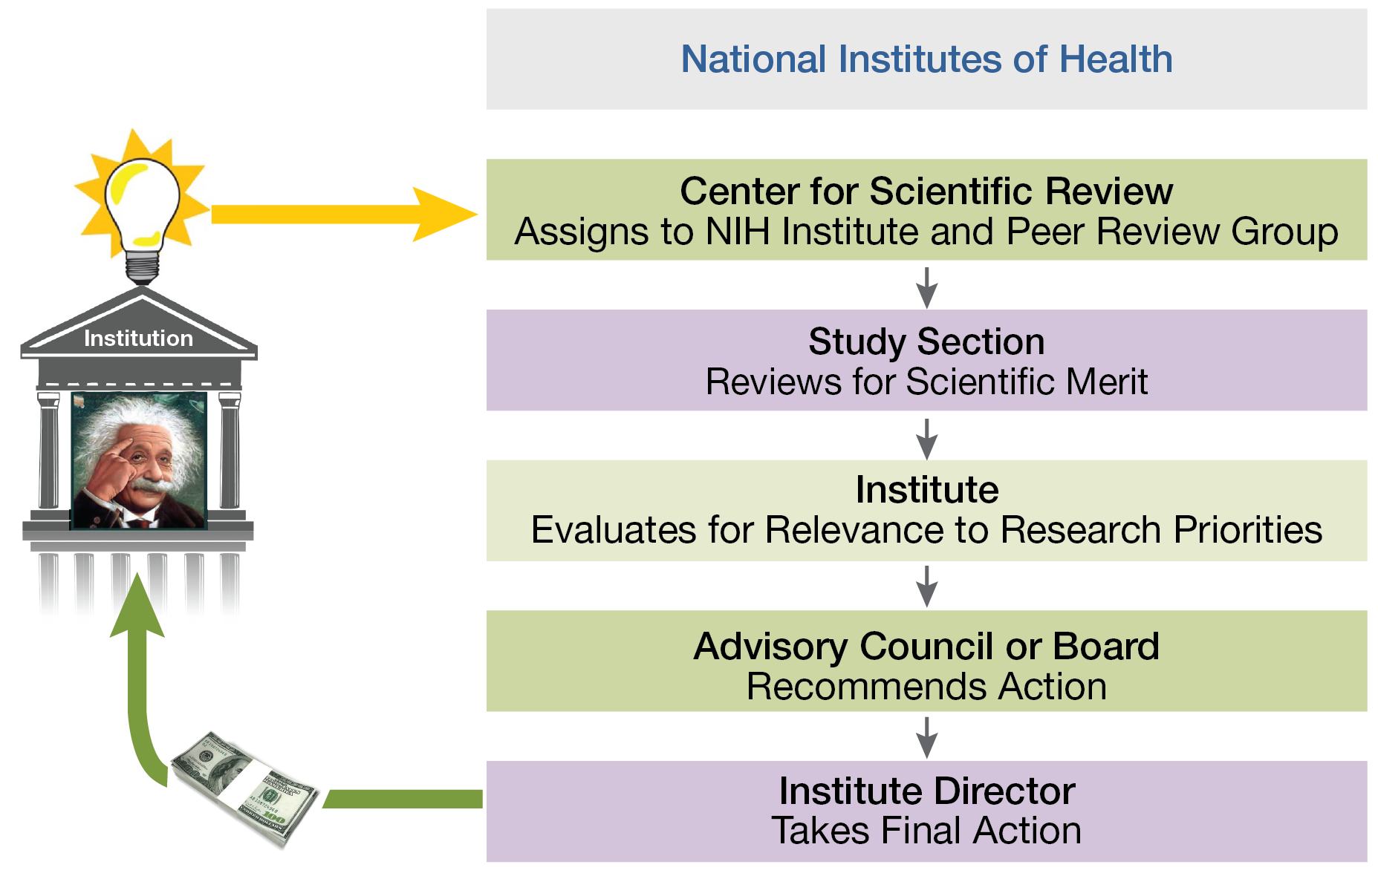
NIH Uses Two-Stage System of Peer Review
Submit
Division of Receipt and Referral
CSR’s RB Chief & SRO
1
Evaluation of
scientific merit
IC’s Program Staff
2
Funding & IC priorities
Uses peer review outcomes to make recommendation for funding, advice on programmatic priorities
How to be a savvy applicant ...

Slide 103
Before Applying
Check- Does the targeted NIH institute or center (IC) participate in the Notice of Funding Opportunity (NOFO)?
The #1 reason for withdrawal – targeted IC does not participate in the NOFO
If we cannot assign a funding IC - your application will not move forward
Contact- the institute or center (IC) program officer (PO)
Fit of the topic to the IC
Check your eligibility to apply. e.g., NOFOs for early-stage investigators.

Slide 104
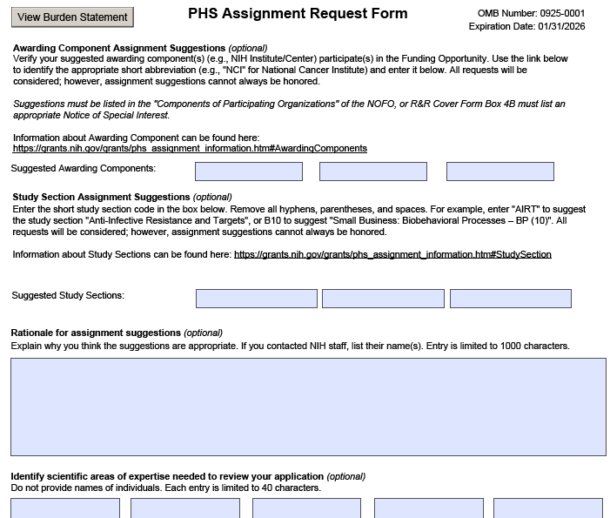
Submit with Your Application
Suggest IC and SRG on Assignment Request Form (ARF): Use -
https://reporter.nih.gov/matchmaker
https://public.csr.nih.gov/ForApplicants/ArtHome
https://public.csr.nih.gov/StudySections
Rationale for IC and SRG selections – e.g. I discussed this project with PO, Dr. Pat Fine at NINDS and SRO Dr. Sam Nice, of ABZ section.
Suggestions are considered, but not guaranteed.
Conflicts: Speak freely - reviewers and program staff do not see this form.
IC 1 IC 2 IC 3
ICs with interest in the diseases or scientific areas of your research
SRG 1 SRG 2 SRG 3

Slide 105
Review Process
Typically, 3 reviewers are assigned to each application. They provide written critiques and preliminary scores.
Other reviewers on the panel provide additional expertise.
The 3 assigned reviewers start the discussion. But all committee members who are not in conflict participate in the discussion.
Review outcome (final score) is a committee decision.
Scientific Review Group (SRG) Roster: Available 30 days before the meeting
https://public.era.nih.gov/pubroster/rosterIndex.era
Notice of NIH Policy to All Applicants: Meeting rosters are provided for information purposes only. Applicant investigators and institutional officials must not communicate directly with study section members about an application before or after the review. Failure to observe this policy will create a serious breach of integrity in the peer review process, and may lead to actions outlined in NOT-OD-22-044, including removal of the application from immediate review.

Slide 106
After the meeting
Summary Statement is the Product of That Discussion
Summary statement release can take about 30 calendar days after the meeting
Summary Statement
After the Meeting
Purpose: To inform program staff of the application’s scientific / technical merit
Shows: Major score-drivers that led to the final overall impact score
PI gets a copy of the summary statement, as a matter of transparency
Discussed
An overall impact score and, in most cases, a percentile
Resume & Summary of Discussion
Assigned Reviewers’
Scores for the review criteria
Written critiques
Administrative notes, if any
Not Discussed
An overall impact score and, in most cases, a percentile
Resume & Summary of Discussion
Assigned Reviewers’
Scores for the review criteria
Written critiques
Administrative notes, if any

Slide 107
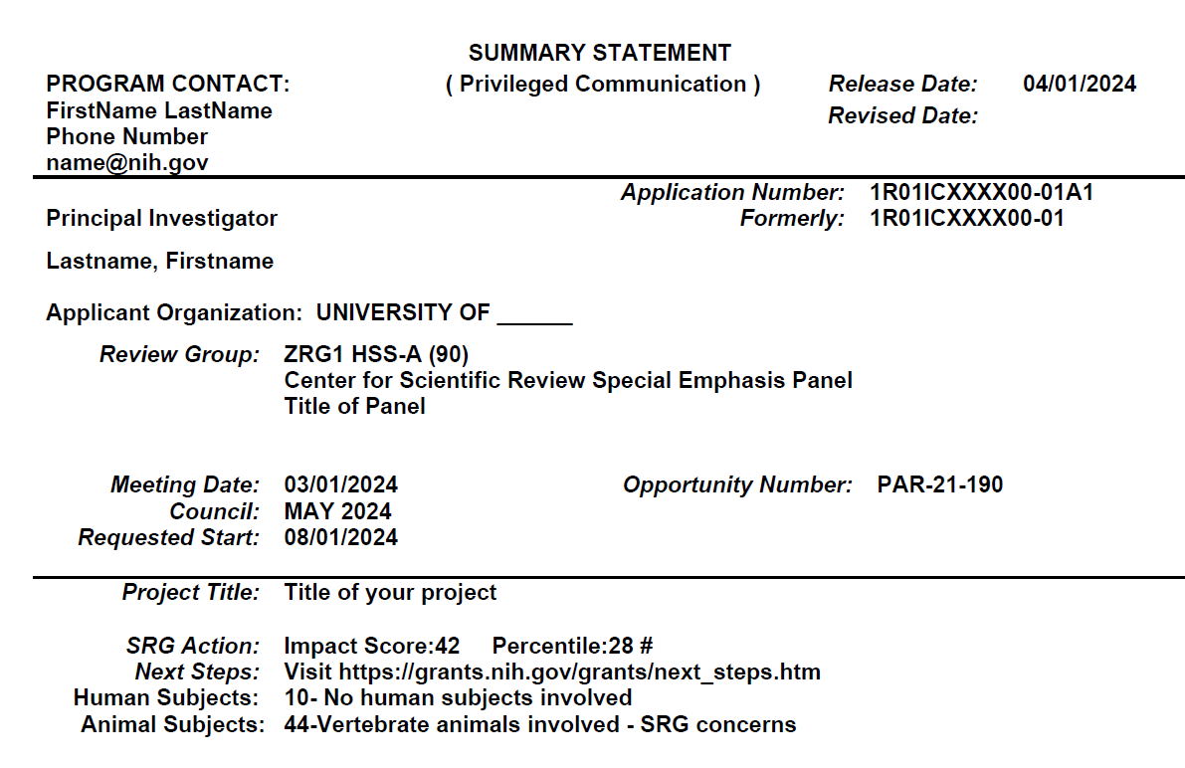
Summary Statement

Slide 108
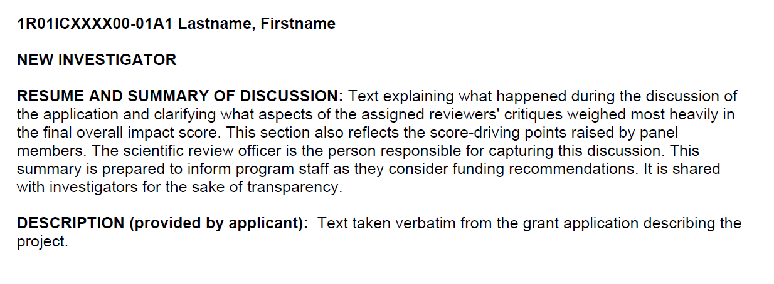
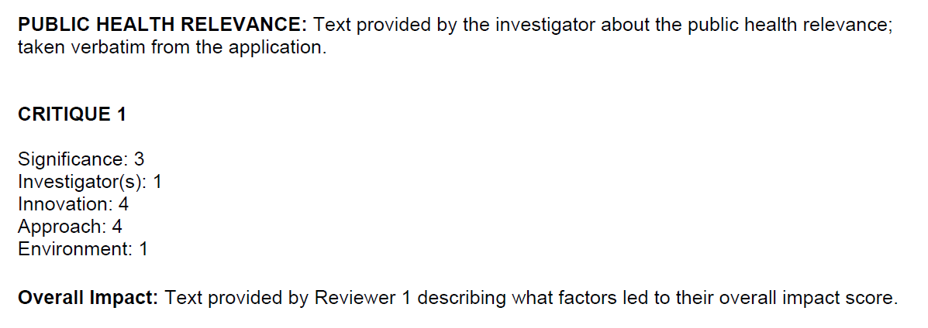
Summary Statement Components
SRO:
PI:
Abstract & Narrative
Rev 1
pre-meeting criteria scores and written evaluations
Final meeting roster is attached

Slide 109
Questions?
Whom to contact and when?
Planning your Submission: IC’s Program Officer
Fit to IC’s mission. Eligibility, responsiveness
Before the review meeting: Scientific Review Officer
About the review panel, post-submission materials, conflicts of interest
After your summary statement is released: Program Officer
Review outcomes, funding, preparing a new application
Other questions:
If you have a concern, please report it promptly so we have a full range of options to address it.
Concerns about the fairness of the review - contact your scientific review officer or send a message to reportbias@csr.nih.gov. CSR investigates all concerns. If we find the review was compromised and, if possible, we will re-review the application in the same council round.
Concerns about review integrity - report to csrrio@mail.nih.gov.
These email addresses can also be found in the signature line of all CSR staff and on CSR study section description pages.

Slide 110
Poll Question 1: Whom to contact and when?
I want my application to be assigned to:
IC (Component): NCI, NIGMS, NIAID
SRG (Study Section): CCB, ATA , MSFC
Program Officer
Assignment Request Form
Cover Letter
Division of Receipt and Referral
LET’S POLL!
Scientific Review Officer

Slide 111
Poll Question 2: Whom to contact and when?
My research is about ... Is this research suitable for funding by your IC?
Program Officer
Assignment Request Form
Cover Letter
Division of Receipt and Referral
LET’S POLL!
Scientific Review Officer

Slide 112
Poll Question 3: Whom to contact and when?
Conflicts of Interest: Please don’t assign to ---- due to ----
Program Officer
Assignment Request Form
Cover Letter
Division of Receipt and Referral
LET’S POLL!
Scientific Review Officer

Slide 113
Poll Question 4: Whom to contact and when?
I am checking to see if study section XXX is appropriate for my application?
Program Officer
Assignment Request Form
Cover Letter
Division of Receipt and Referral
LET’S POLL!
Scientific Review Officer

Slide 114
Poll Question 5: Whom to contact and when?
I requested study section YYY, but my application has been placed in ZZZ. I am a standing member of YYY. (Member conflict SEP)
Program Officer
Assignment Request Form
Cover Letter
Division of Receipt and Referral
LET’S POLL!
Scientific Review Officer

Slide 115
Poll Question 6: Whom to contact and when?
My resubmission application (A?) is missing the Introduction section. Can we add it now?
Program Officer
Assignment Request Form
Cover Letter
Division of Receipt and Referral
Scientific Review Officer
LET’S POLL!

Slide 116
Poll Question 7: Whom to contact and when?
I am an Early Stage Investigator (ESI) and would like to serve on a study section. What should I do?
Program Officer
Assignment Request Form
Cover Letter
Division of Receipt and Referral
Scientific Review Officer
LET’S POLL!
Resource: Early Career Reviewer program

Slide 117
Poll Question 8: Whom to contact and when?
My recently reviewed application did not get a score. Will I get a summary statement?
Program Officer
Assignment Request Form
Cover Letter
Division of Receipt and Referral
LET’S POLL!
Scientific Review Officer

Slide 118
Poll Question 9: Whom to contact and when?
The score for my application is ---. Can we speak to discuss if it can be funded?
Program Officer
Assignment Request Form
Cover Letter
Division of Receipt and Referral
LET’S POLL!
Scientific Review Officer

Slide 119
Poll Question 10: Whom to contact and when?
I have an NSF CAREER award and would like to apply for R01 funding from NIH. Am I eligible to apply?
Program Officer
Assignment Request Form
Cover Letter
Division of Receipt and Referral
Scientific Review Officer
LET’S POLL!

Slide 120
Poll Question 11: Whom to contact and when?
My application was withdrawn. What options do I have?
Program Officer
Assignment Request Form
Cover Letter
Division of Receipt and Referral
Scientific Review Officer
LET’S POLL!

Slide 121
Poll Question 12: Whom to contact and when?
I served as an ad hoc reviewer/standing member. Can I submit my own application late?
Please consider my late application ...
Program Officer
Assignment Request Form
Cover Letter
Division of Receipt and Referral
Scientific Review Officer
LET’S POLL!

Slide 122
Poll Question 13: Whom to contact and when?
When can I expect my summary statement?
Program Officer
Assignment Request Form
Cover Letter
Division of Receipt and Referral
Scientific Review Officer
LET’S POLL!

Slide 123
Helpful NIH Sites:
eRA Commons: https://www.era.nih.gov/
NIH Center for Scientific Review (CSR): https://public.csr.nih.gov/
Division of Receipt and Referral (DRR): csrdrr@mail.nih.gov
Standard Due Dates:
https://grants.nih.gov/grants-process/submit/submission-policies/standard-due-dates
NOT-OD-15-039: Simplifying the NIH Policy for Late Application Submission
OER: https://olaw.nih.gov/guidance/vertebrate-animal-section.htm
https://grants.nih.gov/policy-and-compliance/policy-topics/human-subjects
Post-submission materials: NOT-OD-19-083 & NOT-OD-23-106
SRG Rosters: https://public.csr.nih.gov/StudySections/StandingStudySections
https://public.era.nih.gov/pubroster/rosterIndex.era
First Level Peer Review: https://grants.nih.gov/grants-process/review/first-level

Slide 124
Q&A: REVIEW
MODERATOR
PRESENTER
Megan Columbus
Director
Division of Communications and Outreach
NIH Office of Extramural Research (OER), NIH
Sudha Veeraraghavan, Ph.D.
Scientific Review Officer
Center for Scientific Review (CSR), NIH

Slide 125
NIH GRANTS PROCESS: Award
PRESENTERS
Notice of Award Walk-Through and Supplements!
Crystal Wolfrey
Chief Grants Management Officer
Office of Grants Administration
National Cancer Institute (NCI), NIH
Sean Hine
Deputy Chief Grants Management Officer
Office of Grants Administration
National Cancer Institute (NCI), NIH

Slide 126
AWARD: NoA & Supplements
A walk-through of the NIH Notice of Award (NoA)
Interested in requesting more $ on an Award?

Slide 127
A Walkthrough of the Notice of Award (NoA)
Cover Page
Detailing the critical sections and parts of the NIH NoA

Slide 128
Poll Time
But First ….
LET’S POLL!
Question:
Have you seen an NIH grant award in the past 3 years?”
Yes
No

Slide 129
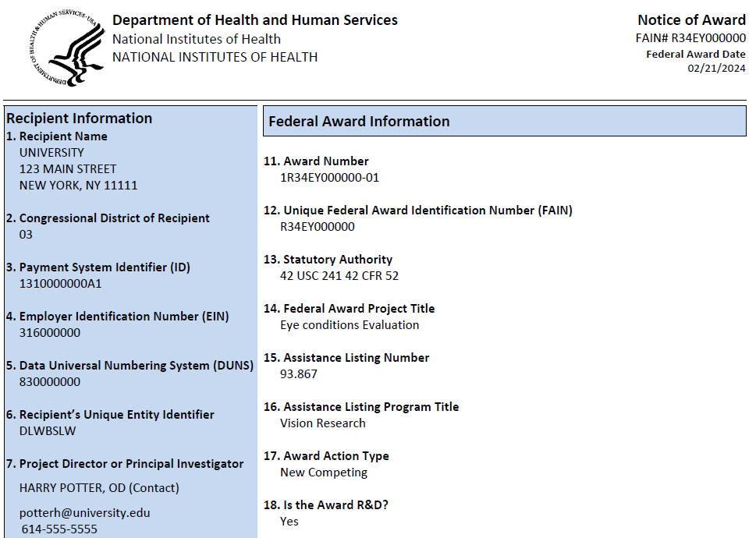
Cover Page of the Notice of Award – Top Half
Identifying Recipient Name – this is you, right?
Identifying the recipient’s EIN which is where the money goes – check this!
Grant # - refer to this in all communications!
Research Title – as provided from the application & will be reported

Slide 130
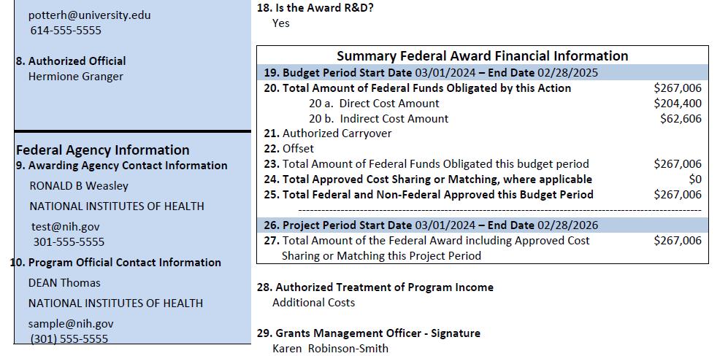
Cover Page – Bottom Half
Specifies the budget period
NIH Grants & Program Official Information
Specifies the Full Period of Anticipated Support

Slide 131
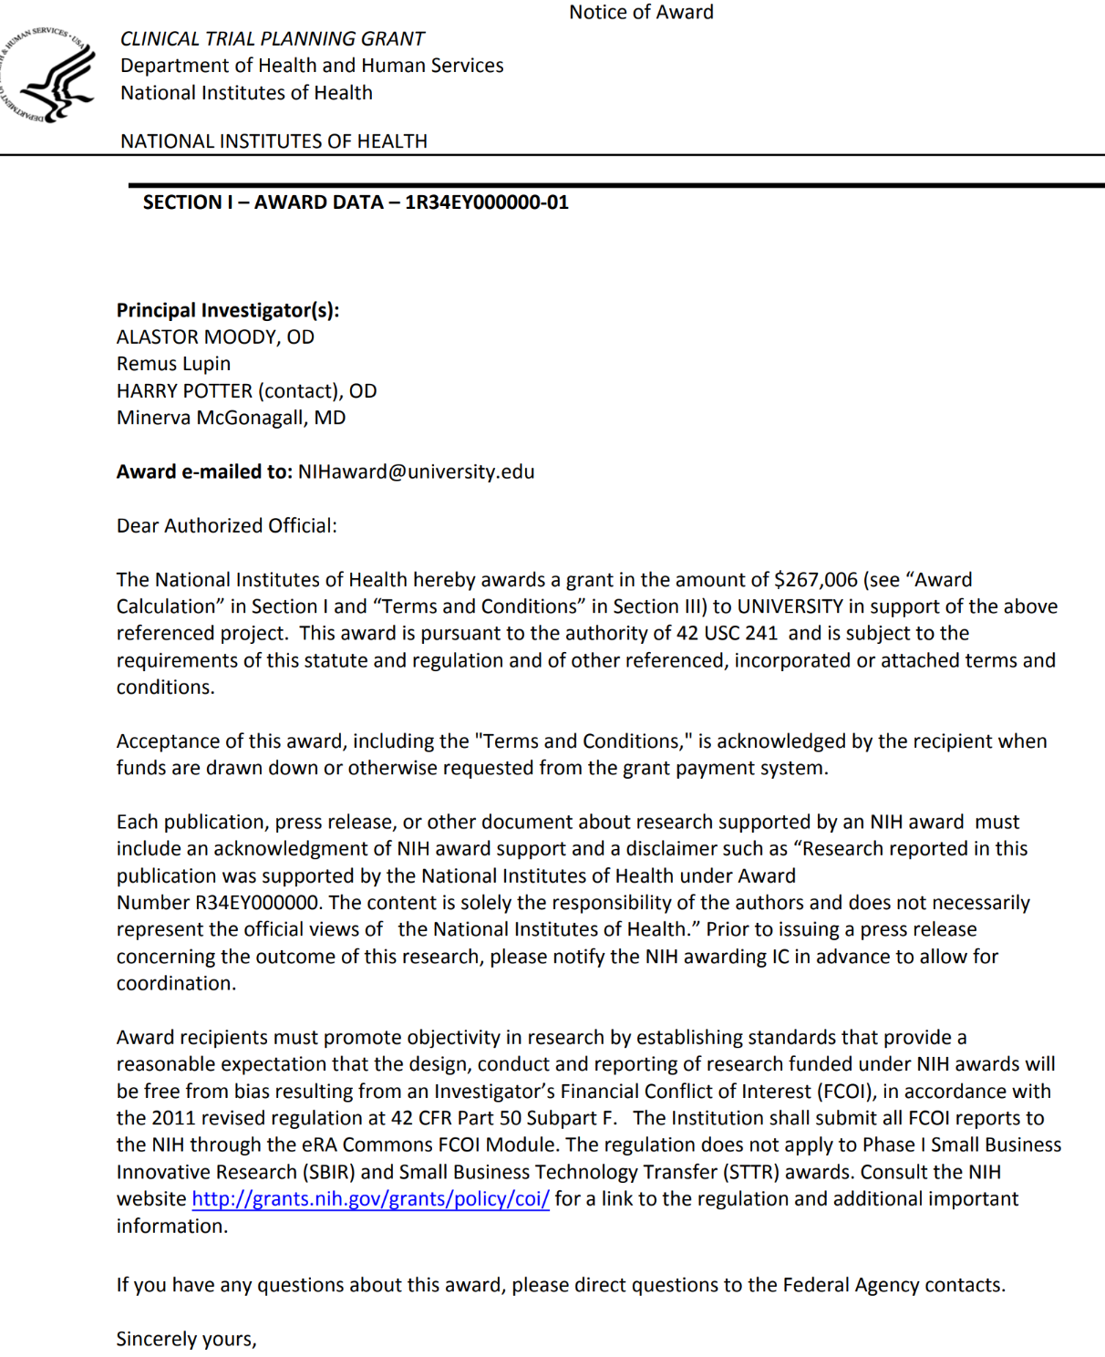
Highlights of the NoA – NIH portion
Lists all the named PD/PIs – double-check these!
Award is available in the Commons – and emailed to the address provided by the recipient
Indication of how the award is accepted
Want to talk about the award? Read this!!

Slide 132
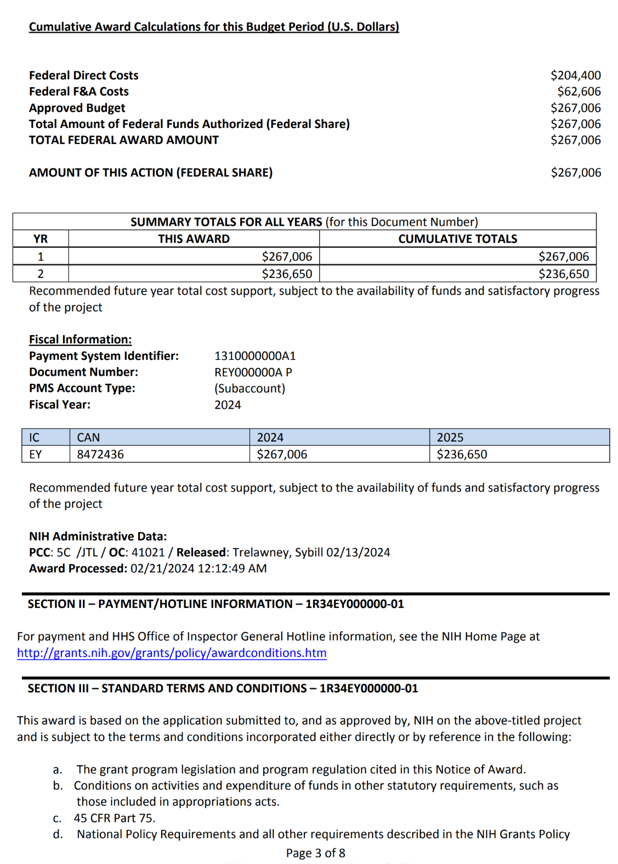
Highlights of the NoA
Funds authorized for this year for you to spend
Breaking down the costs included in this year’s award
New $ provided through this action
Statement of future year commitments
Notice – future years is dependent!
Good info for new applicants – how to get the $$!
The beginning part of the Standard Terms & Conditions – take time to understand all here!

Slide 133
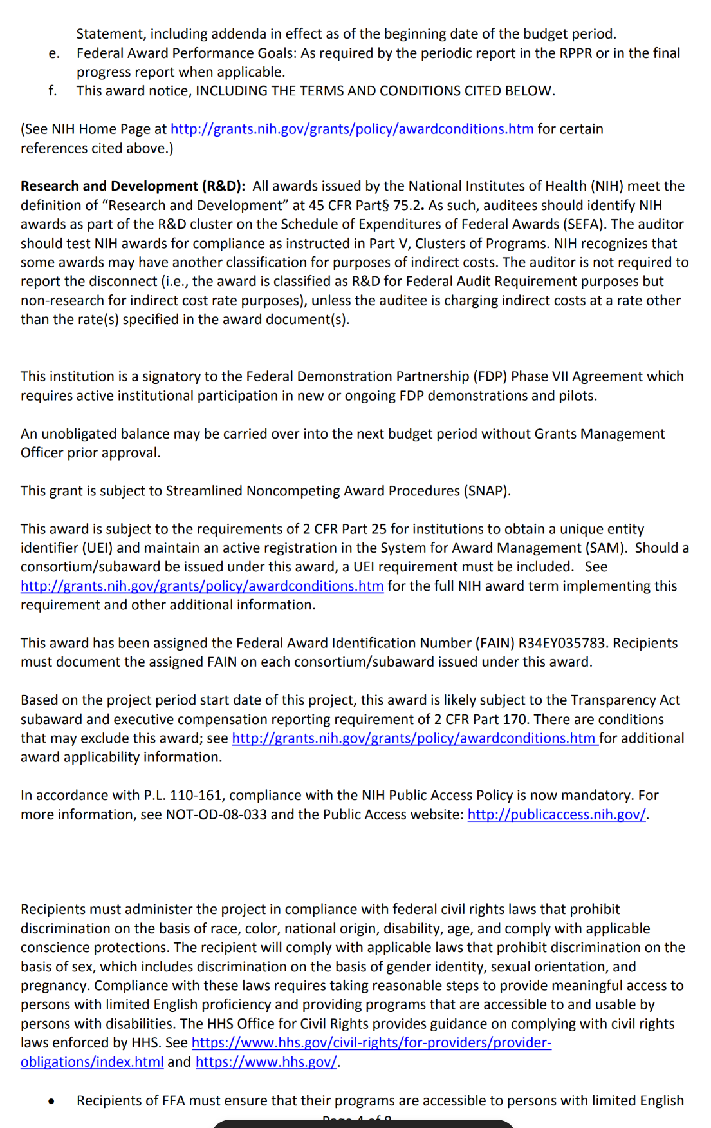
Highlights of Standard T&Cs
States whether the grant has carryover authority – very important!
Identifies whether the grant is SNAP – therefore, what must be included in the annual report and when it is due!
NIH Public Access Policy reminder – can’t make another award without compliance

Slide 134
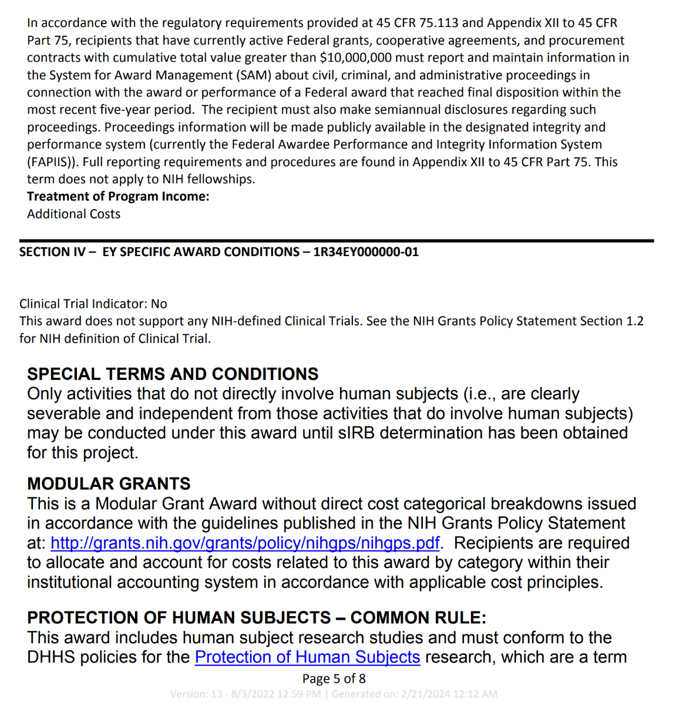
Section IV – Specific Award Conditions
This is where the awarding NIH Institute/Center includes specific T&C that they want to stated
Carefully read through these terms…keep an eye out for restrictions, requirements, etc.

Slide 135
More on Terms & Conditions
There are a lot of policies incorporated into Section III
The Specific Award Conditions – added by the awarding NIH Institute/Center – are specialized and change based on:
The awarding NIH Institute/Center’s methodologies
The type of grant/cooperative agreement
Particulars to this grant such as including human subjects research
Anything that needs to be specified for the grant program, if applicable
Restriction(s) on any funds or areas of research
IMPORTANT – the recipient is responsible for understanding it ALL!

Slide 136
Poll Time: Notice of Award
LET’S POLL!
Question: Where would you find in the Notice of Award that you have restricted funds?
Section II
Section III
Section IV

Slide 137
One More Poll: How About Something Else??
LET’S POLL!
Post-award Item – Administrative Supplements!
Question: Have you requested an administrative supplement from NIH?
Yes
No

Slide 138
Supplements on NIH Awards
Providing additional funding to a currently funded grant
Necessary to meet new, unforeseen costs
MUST BE within the scope of the approved project
Can take a variety of appearances
NIH driven through a Notice of Funding Opportunity
Applicant driven – example: need to hire additional staff to meet increased needs
MUST submit the request electronically (NOT via email)
Resource: Administrative Supplements

Slide 139
Pitfalls for Supplements??
Miss the deadline
Did not read the eligibility
Not sufficient time left in the project period
Outside of the scope
Existing award has a large unobligated balance and/or experience progress issues

Slide 140
Q&A: Award
Q&A: AWARD
MODERATOR
PRESENTER
PRESENTER
Megan Columbus
Director
Division of Communications and Outreach
Office of Extramural Research (OER), NIH
Sean Hine
Deputy Chief Grants Management Officer
Office of Grants Administration
National Cancer Institute (NCI), NIH
Crystal Wolfrey
Chief Grants Management Officer
Office of Grants Administration
National Cancer Institute (NCI), NIH

Slide 141
NIH GRANTS PROCESS: MONITORING and Reporting
What to Expect Post-Award
PRESENTER
Jason Wan, Ph.D.
Director, Mineralized Tissue
Physiology Program
National Institute of Dental and Craniofacial Research (NIDCR), NIH

Slide 142
MONITORING & REPORTING: What to Expect Post-Award
Monitoring
Reporting
Federal Financial Reporting
Audit Requirements
Closeout

Slide 143
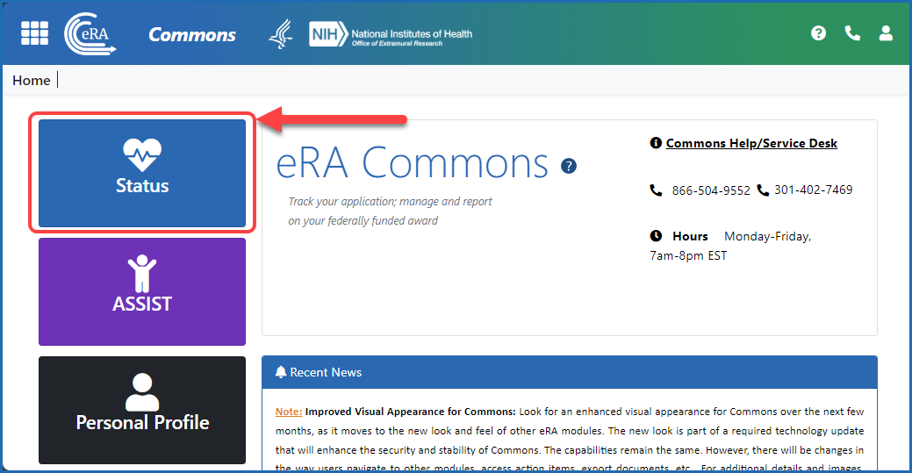
Monitoring
Active monitoring is accomplished through review of reports and correspondence from the recipient, audit reports, site visits, and other information available to NIH
Reporting
NIH requires that recipients periodically submit financial and progress reports
Failure to submit complete, accurate, and timely reports may indicate the need for closer monitoring by NIH or may result in possible award delays or enforcement actions, including withholding, removal of certain NIH Standard Terms of Award, or conversion to a reimbursement payment method

Slide 144
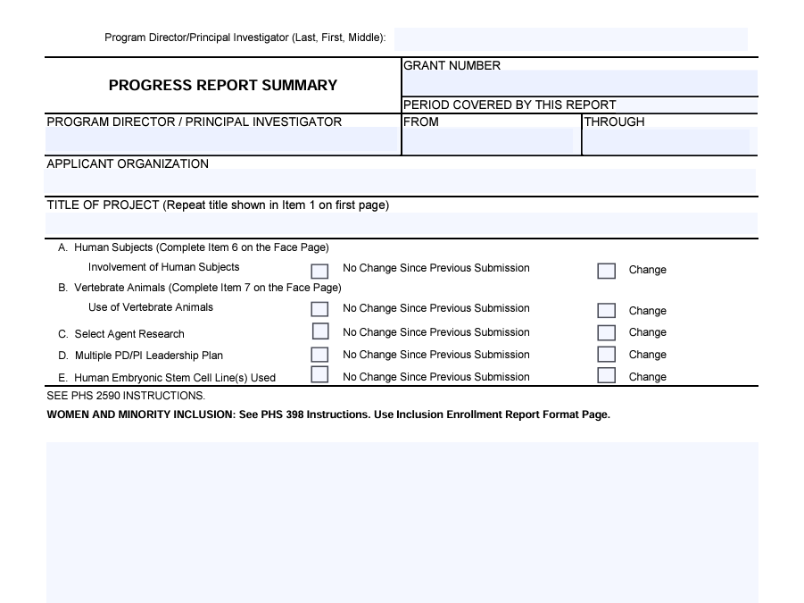
Knowledge Check: Reporting
What reporting is required?
Progress
Financial
Inventions, Products
Human Subjects
All of the above
LET’S POLL!

Slide 145
Reporting
Research Performance Progress Reports (RPPRs) usually are required annually as part of the non-competing continuation award process.
Other Reporting
Invention Reporting
PD/PIs and recipient organizations are expected to make the results and accomplishments of their activities available to the research community and to the public at large.
Trainee Diversity Report
Human Subjects System (HSS) Reports
Extramural Trainee Reporting and Career Tracking (xTRACT)
Financial Conflict of Interest (FCOI) Reports
RPPR module in the eRA Commons
Resource: Streamlined Non-Competing Award Process

Slide 146
Federal Financial Reporting (FFR)
FFR can be required on an annual basis or can be required more frequently
Beginning April 1, 2022, recipients are no longer required to submit quarterly cash transaction reports 30 days after the end of each calendar quarter.
NIH requires all financial expenditure reports to be submitted using the Payment Management System.

Slide 147
Audit Requirements
In general, institutions are required to have an annual audit by a public accountant or a Federal, State, or local governmental audit organization.
An audit is a systematic review or appraisal made to determine whether internal accounting and other control systems provide reasonable assurance.
NIH and its recipient institutions share responsibility for compliance and oversight to ensure good stewardship of Federal funds.

Slide 148
Closeout
Recipients must submit a final FFR, Final RPPR, and Final Invention Statement and Certification within 120 calendar days of the end of the period of performance (project period).
As part of the F-RPPR recipients will be required to report on Project Outcomes. This section will be made publicly available.
Failure to submit timely and accurate closeout documents may affect future funding to the organization.

Slide 149
Knowledge Review: Closeout
For Closeout, how many days does a grantee have to submit the Final FFR, Final RPPR, and Final Invention Statement and Certification? ( e.g., 45, 90, 120 days)
Use the Chat Box to Share Your Answer!

Slide 150
FINAL TIPS FROM NIH PROGRAM EXPERTS: LIGHTNING ROUND
MODERATOR
Megan Columbus
Director
Division of Communications and Outreach
NIH Office of Extramural Research (OER), NIH
NIH PROGRAM OFFICERS
Lanay Mudd, Ph.D.
Deputy Branch Chief, Clinical Research,
Complementary and Integrative Health Branch
National Center for Complementary and Integrative Health (NCCIH), NIH
LeShawndra Price, Ph.D.
Director, Office of Research Training and Special Programs (ORTSP)
National Institute of Allergy and Infectious Diseases (NIAID), NIH
Tracy Rankin, Ph.D.
Program Director
National Institute of Diabetes and Digestive and Kidney Diseases (NIDDK), NIH
Jason Wan, Ph.D.
Director, Mineralized Tissue
Physiology Program
National Institute of Dental and Craniofacial Research (NIDCR). NIH

Slide 151
NIH GRANTS PROCESS: PART TWO - WrAP UP
MODERATOR
Megan Columbus
Director
Division of Communications and Outreach
Office of Extramural Research (OER), NIH

Slide 152
Stay Informed … Get Connected!
Final PowerPoint, Recording, and Transcript
Available in 7-10 business days after the event
Upcoming Events and New Resources in 2025:
Subscribe and Follow!
NIH Grants Events ListServ
Nexus
Social Media (Follow us on X and LinkedIn & more!)
Grants & Funding Website
New to NIH
Grants Process
News & Events (Calendar of Events, On-demand event resources, YouTube, Podcast, etc.)
Topic pages

Slide 153
Final Tips!
Utilize the resources provided during this event
PowerPoint
Resource List
Stay connected through listservs, events, and websites (e.g., grants.nih.gov, csr.nih.gov, as well as Institute and Center funding pages)
Reach out to NIH staff
Take each step knowing you have a partner in the process!
THANK YOU

