Slide 1
Updates to NIH Training Grant Applications
Public Webinar | June 5, 2024
Updated: February 25, 2025

Slide 2
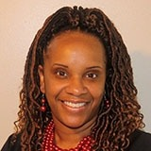
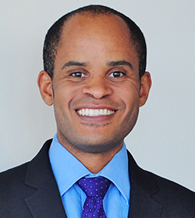
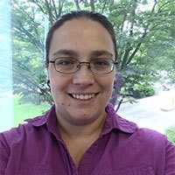
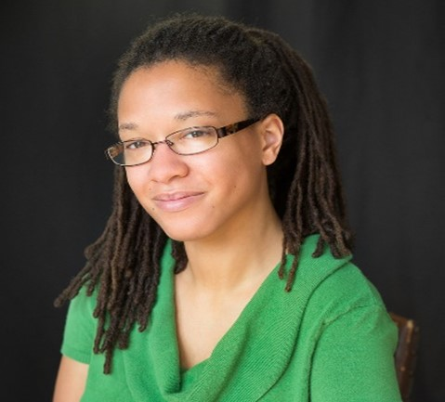
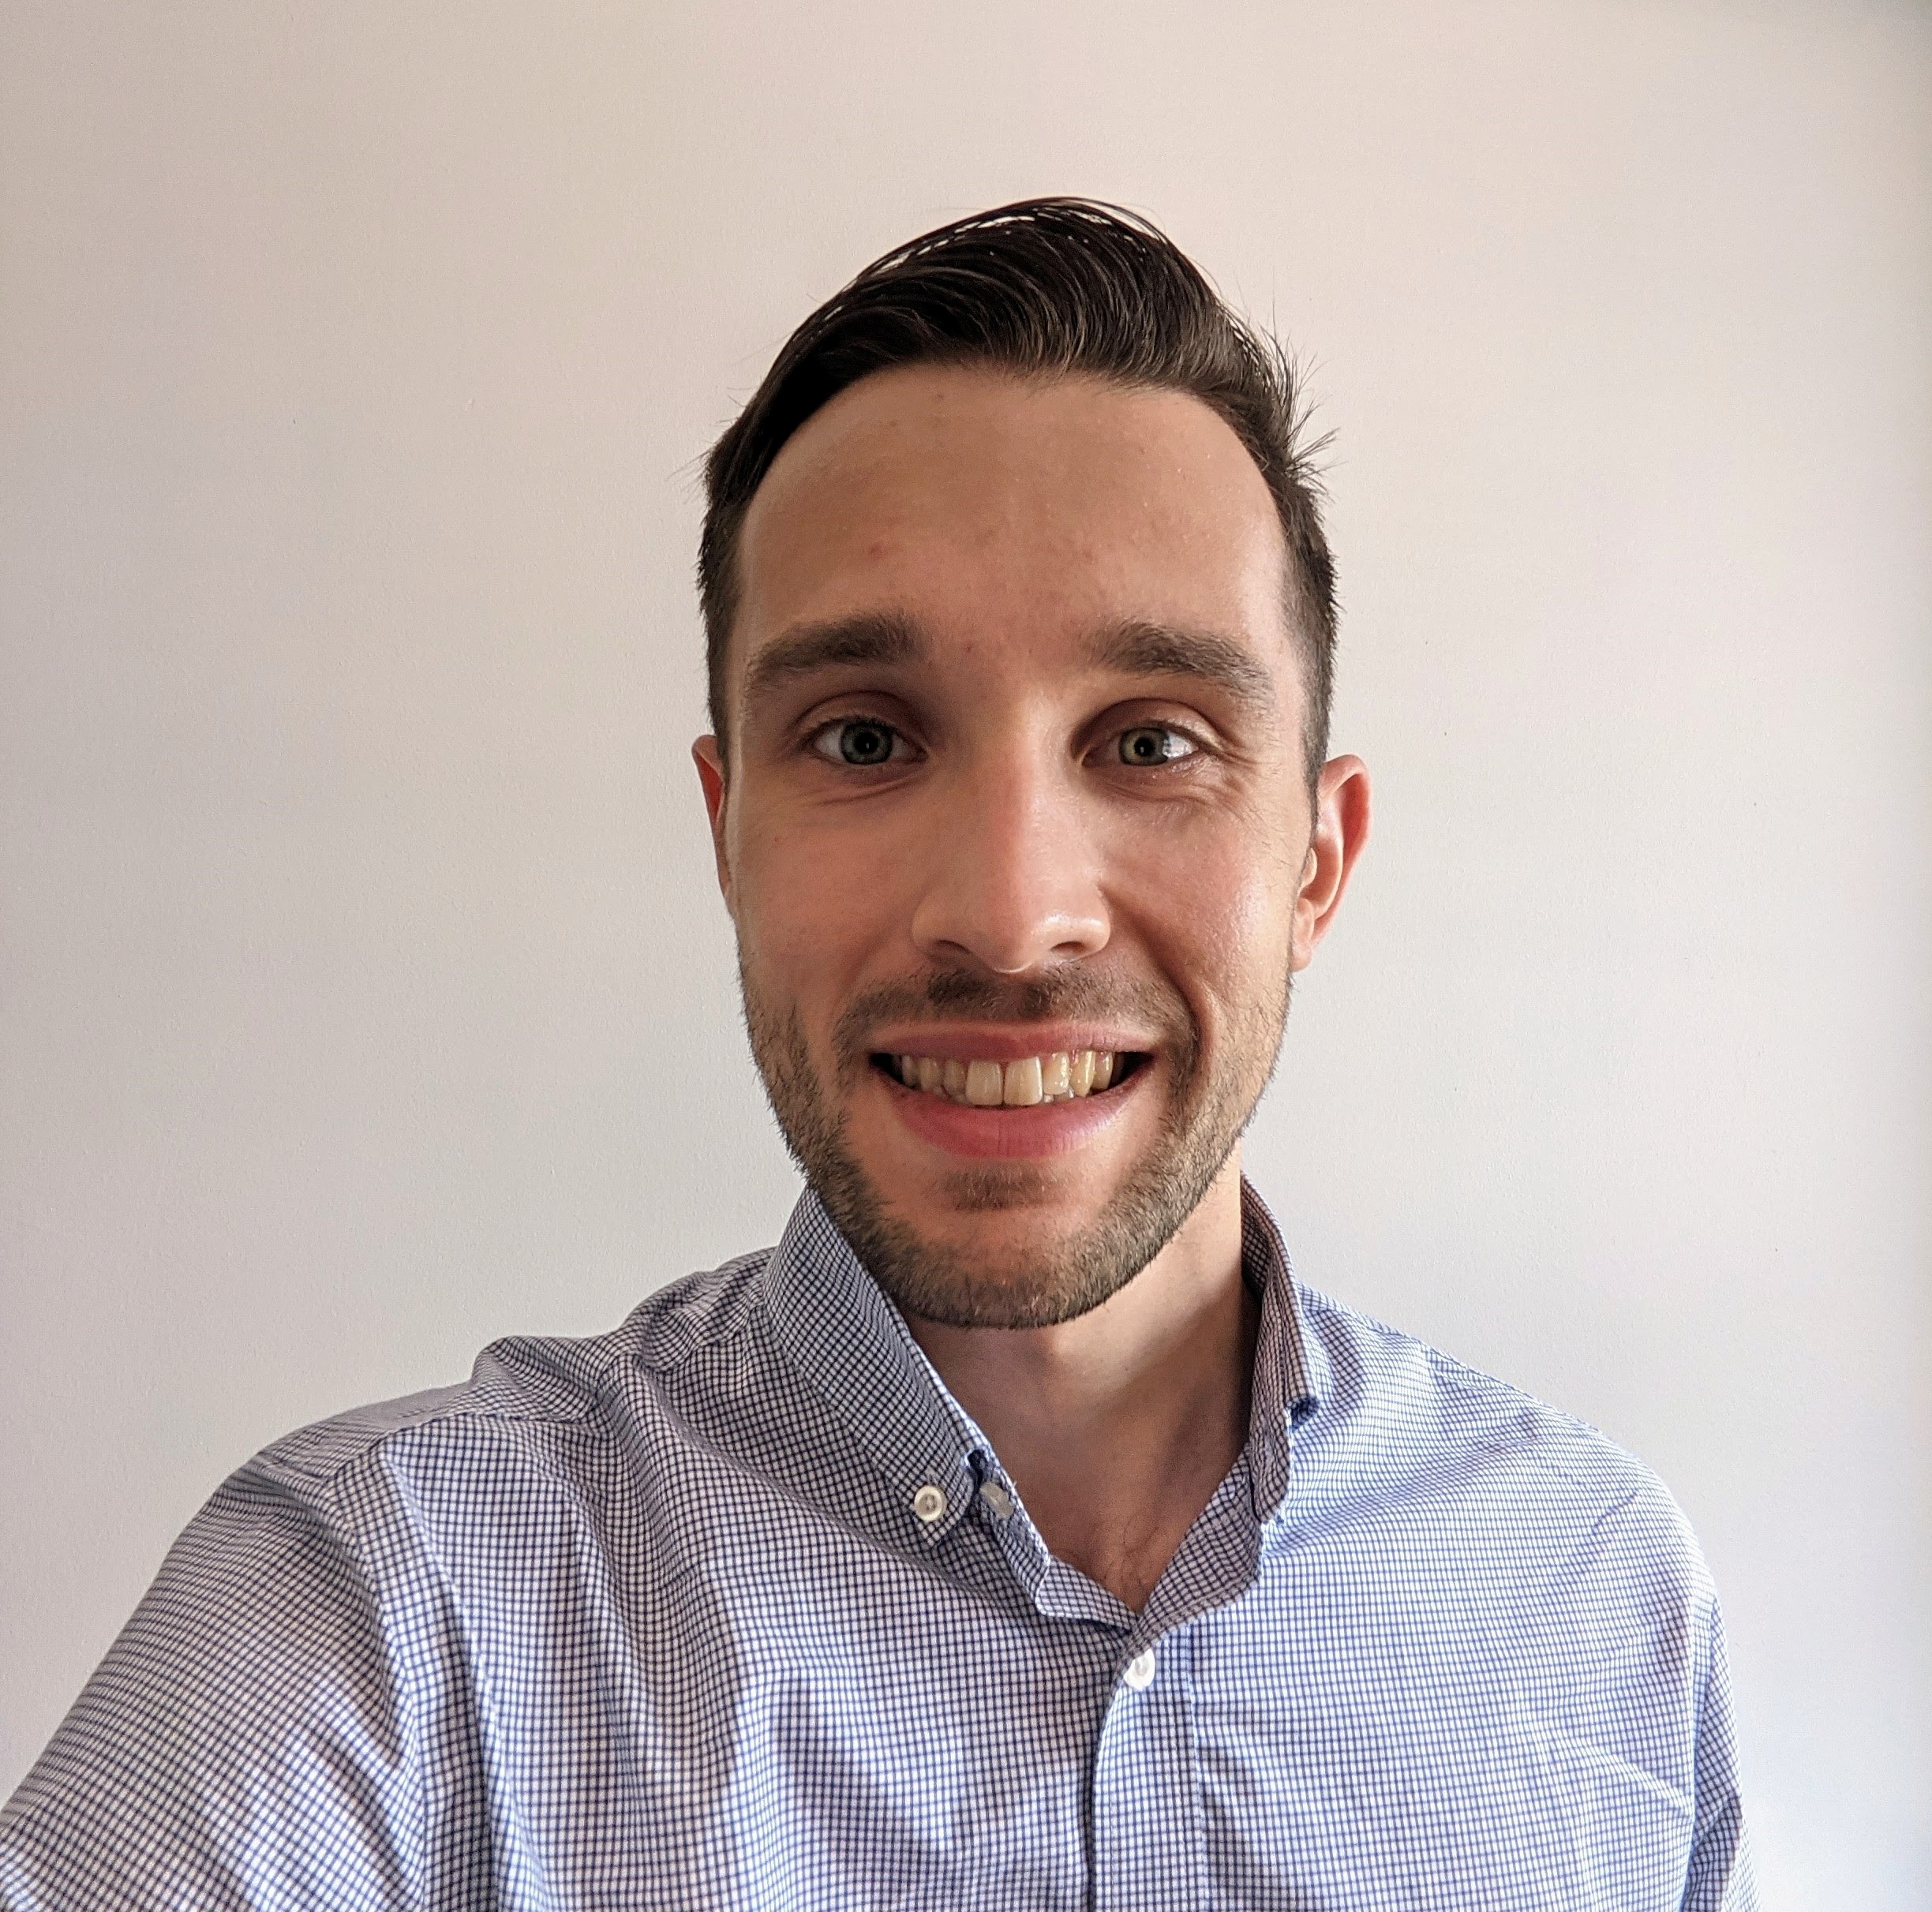
Meet the Team
Moderator
Presenter
Presenter
Anissa Brown, PhD
Chief, Research Training & Career Development Program
National Institute of Dental and Craniofacial Research (NIDCR), NIH
Ericka Boone, PhD
Director, Division of Biomedical Research Workforce (DBRW)
Office of Extramural Research (OER), NIH
Training Co-Chair
Kenneth Gibbs, Jr., PhD
Chief, Undergraduate and Predoctoral Cross-Disciplinary Training Branch National Institute of General Medical Sciences (NIGMS), NIH
Training Co-Chair
Q&A
Q&A
Q&A
Anastasiya Hardison
eRA Customer Relationship Manager
Office of Extramural Research (OER), NIH
Teraya Donaldson, M.S., PhD
Health Scientist Administrator
Division of Biomedical Research Workforce, Office of Extramural Research (OER), NIH
Ben Roberts, PhD
AAAS Fellow
Division of Communication and Outreach,
Office of Extramural Research (OER), NIH

Slide 3
Today
Background and Motivations for Changes
Changes to the NIH Training Grant Applications
Implementation Plans
Learn More

Slide 4
Background and Motivation for Change Dr. Ericka Boone (oer) Director, Division of biomedical research workforce (dbrw)

Slide 5
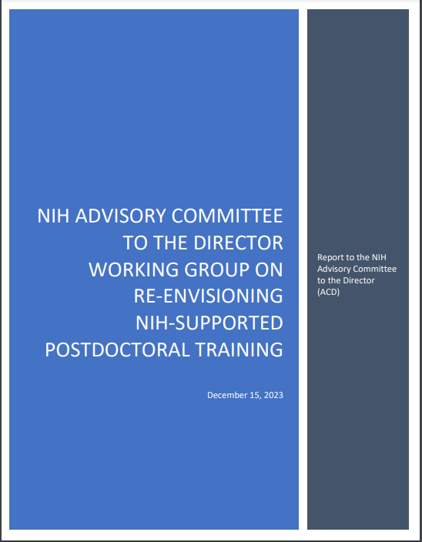
Strengthening the Biomedical Research Workforce
Re-Envisioning NIH Supported
Postdoctoral Training
Broadening Experiences in Science Training

Slide 6
Goals and Scope of Training Grant Updates(1)
Reduce applicant and reviewer burden.
Further support the development of a biomedical research workforce that will benefit from the full range of perspectives and experiences needed to advance discovery.
Scope: Applications that use the Training (T) Instructions in the SF424 (R&R) Application Guide or the Research Training Data Tables, including:
Institutional Training – T series, e.g., T15, T32, T34, T35, T37, T90/R90, TL1, TL4.
Institutional Career Development – K12, KL2.
International Institutional Training – D43, D71, U2R.
Guide Notice
NOT-OD-24-129

Slide 7
Process (1)
2022 - 2023
Staff working group charged to update Parent T32 NOFO and identified additional changes needed in SF424 Instructions and Data Tables.
Working group: Bettie Graham (NHGRI), Maria Carranza (NIA), Anissa Brown (NIDCR), Kenneth Gibbs (NIGMS), Jamie Lahvic (OD/NIA).
Present recommendations across NIH and receive additional input.
Incorporate lessons and themes from updates to fellowship application and review and ACD Working Group on NIH-supported Postdoctoral Training.
Approval from NIH leadership.

Slide 8
Process (Continued)
2024
Working with OER to:
Operationalize approved changes (e.g., updating systems, forms, etc.)
Develop communication and training resources for NIH staff and applicants
2025
Implement for applications with due dates on/after January 25, 2025.

Slide 9
overview of updates to the NIH Training grant applications dr. Kenneth Gibbs (NIGMS) chief, Undergraduate and cross-disciplinary training branch division of training and Workforce development

Slide 10
Overview of Updates
Parent T NOFOs
Add language regarding mentor training expectations and career outcomes.
Peer Review
“Training in Responsible Conduct of Research” will contribute to overall impact score.
NRSA Data Tables
Update to reduce burden and promote consistent information collection.

Slide 11
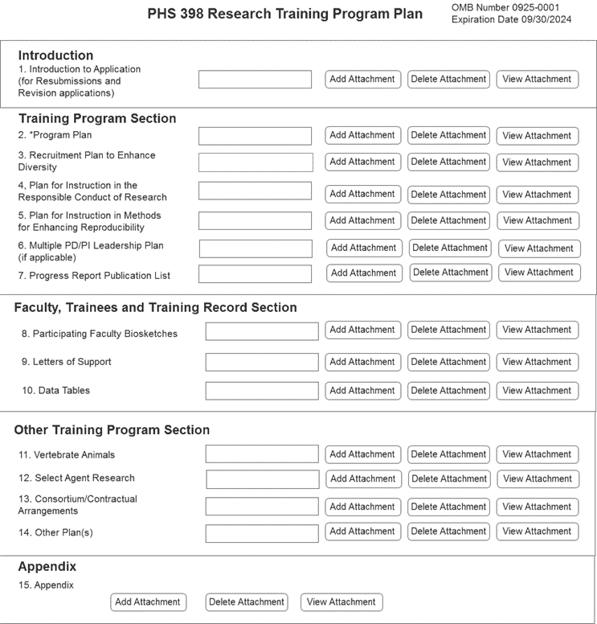
PHS 398 Research Training Program Plan Form - Current
The Recruitment Plan to Enhance Diversity will no longer be considered by reviewers
Program Plan (25-Page Limit)
Background
Program Plan
Plan for Instruction in the Responsible Conduct of Research
Plan for Instruction in Methods for Enhancing Reproducibility
Multiple PD/PI Leadership Plan (if applicable)
Progress Report (for Renewal applications)
https://grants.nih.gov/grants/how-to-apply-application-guide/forms-h/training-forms-h.pdf

Slide 12
Mentor Training Expectations
Formal training in effective, evidence-informed mentoring practices improves the knowledge and mentoring skills of research mentors across career stages.
Access to high-quality mentoring through structured training programs has been linked to enhanced trainee productivity and commitment to a research career.
Planned Updates: Mentor Training language will be included in Parent T32 Program Considerations, Program Plan Instructions, and Review Criteria.
NASEM (2019): The Science of Effective Mentoring in STEMM

Slide 13
Parent T32: Mentoring Training Language – Program Considerations
Funded training programs are expected to support effective mentorship by ensuring all program faculty complete formal mentor training and periodic refreshers.
Aligning expectations.
Maintaining effective communication.
Fostering independence.
Assessing scholars’ understanding of scientific research.
Enhancing professional development.
Articulating your mentoring philosophy and plan.
Programs should consider the following as potential mentor training components and adapt to program and trainee needs.

Slide 14
Parent T32: Mentor Training Language – Program Plan and Review
Program Plan (Program Faculty) will be updated so applicants describe both the faculty participants and planned mentor training and oversight.
The planned strategy and administrative structure to oversee and monitor the program and ensure appropriate and timely trainee progress.
How the participating faculty are trained to ensure the use of evidence-informed mentoring practices that promote trainee development.
Peer Review: NIH will incorporate additional questions into the review criteria to align with these changes.

Slide 15
Parent T32: Trainee Career Development – Program Plan and Review
Program Plan (Proposed Training) will be updated to incorporate instructions on program activities to promote trainee career development, for example:
Training for careers in the biomedical research workforce, that is, the breadth of careers that sustain the biomedical research enterprise (which includes, but is not exclusive to, careers as independent NIH-funded investigators).
How the program will provide appropriate learning opportunities (for example, informational interviews, shadowing, internships) to allow trainees to develop the professional skills and networks to transition into careers in biomedical research workforce.
Peer Review: NIH will incorporate additional questions into the review criteria to align with these changes.

Slide 16
Data Tables
Overall, updates to reduce burden and promote consistency in requested information.
Table 1 (Census of Participating Department or Interdepartmental Programs)
Currently, T32 applicants provide information on predoctorates and postdoctorates, regardless of the training stage of the proposed program.
Planned update:
Applicants will be required to provide data only relevant to the training stage(s) in the proposed program.
Undergraduate training programs (T34) will include this table (standardize information collection).
Table 8: Program Outcomes
Currently, asks T32 grantees to include “Clearly associated” trainees.
Planned Update: Remove “Part II. Those Clearly Associated with the Training Grant” – encourage to report in Program Plan Section or RPPR narrative.

Slide 17
Table 5 – Publications of Those in Training
Currently oriented around the training faculty as opposed to trainee outcomes.
Planned updates
Re-align table to focus on outcomes for trainees supported by the grant.
Allow inclusion of interim research products (such as preprints) only when final publication not available.
Similar to what happens for R, F, and K applications.
Undergraduate: Can include external, published conference abstracts.

Slide 18
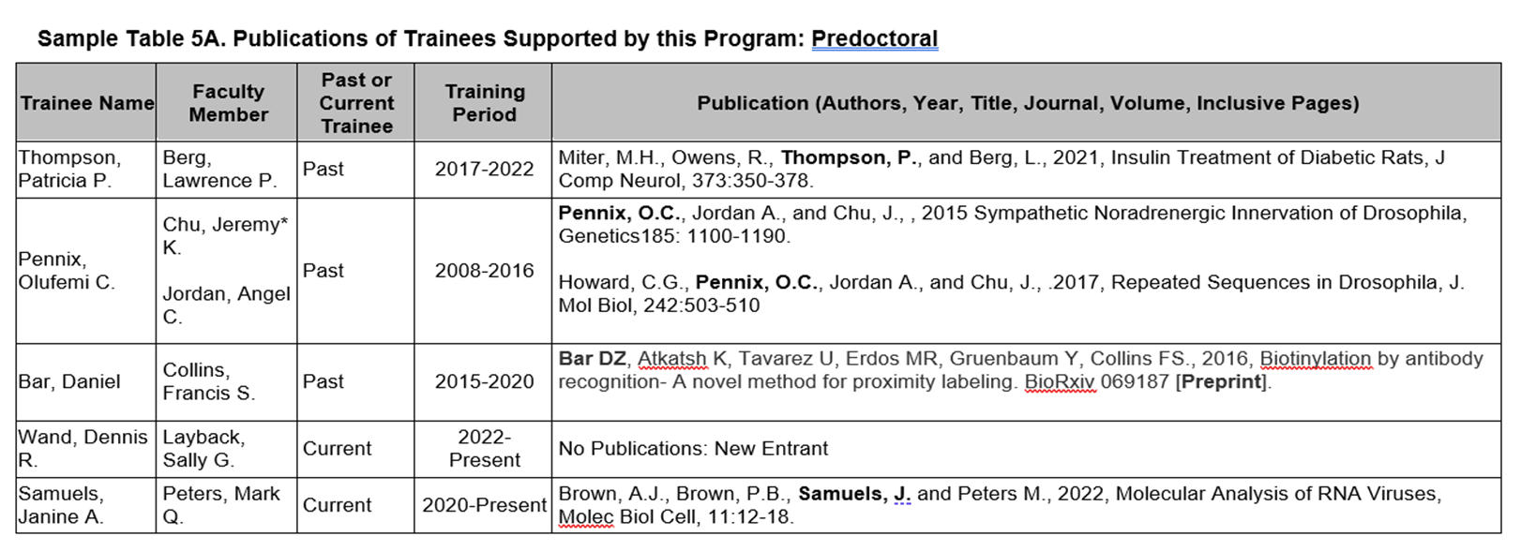
Updated Table 5 – Predoctoral Example
List trainees first (followed by PI); trainees will match those listed on Table 8 (up to 10 years)
Can add co-mentor and denote former trainers (*)

Slide 19
Table 6 - Applicants, Entrants, and their Characteristics for the Past Five Years
Currently, T32 applicants collect detailed trainee characteristics on anyone who applied to and entered the training program.
Predoc: Mean months of prior research experience, prior institution, and GPA.
Postdoc: Mean number of publications (total and first author), prior institutions.
Program admissions is the applicant’s responsibility – NIH wants to focus on post-appointment outcomes.
Planned update: Remove above referenced trainee characteristics.

Slide 20
Updated Table 6 – Predoctoral Example

Slide 21
Peer Review Updates
Training grants will retain the five scored criteria (note, training grant application updates are not part of simplifying review efforts).
Planned Update: The “Training and the Responsible Conduct of Research” will become an additional review criteria and contribute to the overall impact score (currently a post score consideration).

Slide 22
Implementation plans Dr. Ericka Boone

Slide 23
Implementation
Effective for receipt due dates on or after January 25, 2025
For applications that use the Training (T) Instructions in the SF424 (R&R) Application Guide or the Research Training Data Tables, including:
Institutional Training – T series, e.g., T15, T32, T34, T35, T37, T90/R90, TL1, TL4.
Institutional Career Development – K12, KL2.
International Institutional Training – D43, D71, U2R.

Slide 24
Implementation Timeline
Mid to late Summer 2024
Intend to publish updated data tables.
Early Fall 2024
Updated Parent T32 NOFO published (ideally no later than October 25, 2024).
Affected NOFOs reissued at least 60 days prior to due date.
Reminder: Changes effective for due dates on/after January 25, 2025.

Slide 25
Learn More

Slide 26
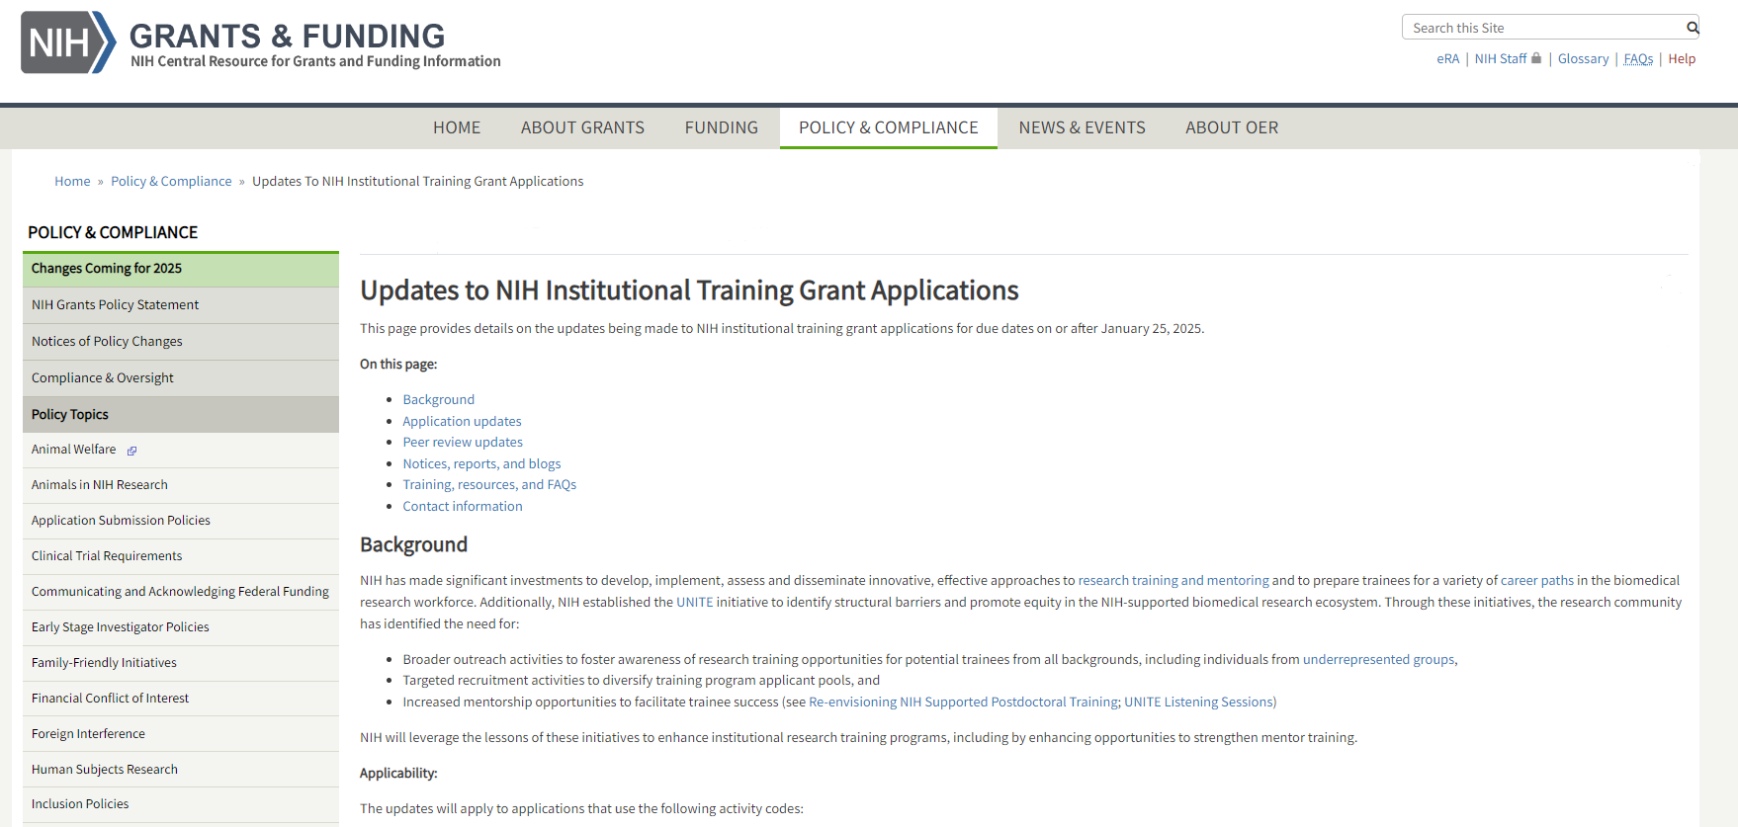
Public Page for Updates to Training Grants – Live!
Link: grants.nih.gov/policy/changes-coming-jan-2025/updates-to-training-grants.htm

Slide 27
Resources
NIH Research Training Website: https://researchtraining.nih.gov/
Updates to NIH Training Grants: https://grants.nih.gov/policy/changes-coming-jan-2025/updates-to-nrsa.htm
NIH Data Tables: https://grants.nih.gov/grants/forms-g/data-tables.htm (Updates forthcoming)
Relevant NIH ICO Contacts
Program Officer: Application requirements, relevance to ICO priorities.
Review Officer: Peer Review related questions.
Grants Management: Budget related questions.
eRA Service Desk: https://www.era.nih.gov/need-help (technical aspects of NIH systems like xTrain and xTract)

Slide 28
THANK YOU!
NRSA Tables: Susan Lim (NCI), Mercedes Rubio (NIGMS), Sonia Ortiz-Miranda (NIGMS), Michael Reilly (NHLBI), Isaah Vincent (NIGMS), Teraya Donaldson (OER), Laurie Stepanek (NIGMS), Marie Harton (NIGMS), Lameese Akacem (NIGMS), Andrew Miklos (NIGMS).
Advisors and Implementation: Greg Bissonnette (NIGMS), Erica Brown (NIGMS), Latarsha Carithers (NIGMS), Megan Columbus (DCO), Stephanie Constant (Review Policy), Alison Gammie (NIGMS), Kasima Garst (OPERA), Anastasiya Hardison (eRA), Ben Roberts (DCO), Laurie Roman (Guide).

Slide 29
Thank You
LEARN MORE
grants.nih.gov/policy/changes-coming-jan-2025/updates-to-training-grants.htm
EMAIL US AT
T32updates@mail.nih.gov

