Slide 1
Revisions to the Fellowship Application and Review Process
An Overview of the Changes | September 19, 2024

Slide 2
Meet the Presenters
ERICKA BOONE, Ph.D.
ALISON GAMMIE, Ph.D.
LYSTRANNE MAYNARD-SMITH, Ph.D.
BRUCE REED, Ph.D.
Director, Division of Biomedical Research Workforce (DBRW)
NIH Office of Extramural Research (OER), NIH
Executive Implementation Committee co-chair
Director, Division of Training, Workforce Development, and Diversity (DTWD)
National Institute of General Medical Sciences (NIGMS), NIH
Executive Implementation Committee
co-chair
Deputy Director, Center for Scientific Review (CSR), NIH
Executive Implementation Committee co-chair
Scientific Review Officer (SRO) and Reviewer Training Coordinator within the Center for Scientific Review (CSR)
*Moderator of today’s event

Slide 3
Today
Background and Motivations for Change
Changes to the NIH Fellowship Application and Review Process
Preparing for Implementation
Q&A

Slide 4
Background and motivations for change dr. Bruce REED Deputy Director Center of Scientific Review

Slide 5
Background
NRSA fellowships support intensive research training for individual predoctoral and postdoctoral trainees
NIH receives ~6,500 fellowship applications annually; CSR reviews >80%
In the last several years, applicants and reviewers alike voiced concerns that fellowship reviews may disadvantage some applicants who are in fact highly qualified
CSR is committed to “implement changes to the peer review process to make it more fair, effective and efficient” – CSR Strategic Plan, 2022-2025
CSR reviews 84% of NIH NRSA fellowship applications

Slide 6
How we Arrived at The Revisions (Sept. 2021)
September 2021
A Center for Scientific Review (CSR) Advisory Council Working Group (CSRAC WG) was convened to evaluate the fellowship review process and making recommendations to make it as effective and fair as possible for all
Late 2021-Summer 2022
CSRAC WG gathered data, public input, NIH input, including through a blog and content analysis, and presented interim reports to NIH grants policy committees

Slide 7
CSR Content Analysis: Main Themes from Public Blog
Concerns about bias
Review favors big name sponsors and schools, well-funded labs
Disadvantages early career sponsors, non-elite schools, women and under-represented minorities
Requests to change the information base in the application
Eliminate the requirement for undergraduate grades
Reduce emphasis on publications
Concerns about the application/burden of review
The application is too long, cumbersome, duplicative, and not well aligned with review criteria
Requests for enhanced training
Mandate bias awareness training
Train reviewers to give constructive feedback and avoid demoralizing comments

Slide 8
Data: Fellowship Applications Not Evenly Distributed Among Institutions
Submissions highly concentrated amongst a few institutions
Applications from schools that submit more applications do better in review

Slide 9
Working Group Conclusions
NIH is potentially leaving out highly promising young scientists because the NRSA review process favors elite institutions, well-known scientist sponsors, and over emphasizes traditional markers of early academic success.
Revise the review criteria
Better focus reviewers on key assessments
Define criteria to give less advantaged applicants a better chance—without disadvantaging others
Reduce bias in review by reducing inappropriate consideration of sponsor and institutional reputation
Revise the fellowship application
Align the application with the review criteria
Shorten it, reduce redundancy, make clear where information should appear
CSR AC Fellowship Review WG Final Report
https://public.csr.nih.gov/sites/default/files/2022-11/CSRAC_Fellowship_review_WG_report_September_2022_final.pdf

Slide 10
How We Arrived at The Revisions
September 2022
CSR Advisory Council endorses the final report and recommendations
Recommendations presented to major NIH leadership groups
Fall 2022
December 2022
Institute Directors approve major recommendations and NIH leadership directs their implementation
NIH issues RFI asking for feedback on proposed changes
April 2023

Slide 11
Results of April 2023 Request For Information
Solicited input via a NIH Guide Notice, blogs, social media, staff outreach, and direct messages to educational institutions generating responses from:
147 individuals
10 scientific societies
7 universities
Public input helpful:
General agreement that restructuring the criteria would result in a fairer review process and supported the proposed restructuring of the application
Suggested a need to clarify some aspects of the review criteria
Suggested clarifying what information should be provided in the various application sections
In response, revisions were made to the review criteria and application.

Slide 12
overview of changes to the NIH Fellowship Application and Review Process dr. Alison gammie (NIGMS) director, division of training, Workforce development and diversity

Slide 13
Objectives of the changes
Focus reviewer attention on three key assessments: the fellowship candidate’s preparedness and potential, research training plan, and commitment to the candidate.
Ensure that a broad range of candidates and research training contexts can be recognized as meritorious by clarifying and simplifying the language in the application and review criteria.
Reduce bias in review by emphasizing the commitment to the candidate, without undue consideration of sponsor and institutional reputation.

Slide 14
Reorganized Fellowship Review Criteria Areas
Current Fellowship Review Headings
New Fellowship Review Headings
Fellowship Candidate
Candidate Preparedness and Potential
Sponsors, Collaborators, Consultants
Research Training Plan
Research Training Plan
Commitment to Candidate
Training Potential
Institutional Environment &
Commitment to Training
No changes to Additional Review Criteria or to Additional Review Considerations
Notes:
No changes to Additional Review Criteria (e.g., Protections for Human Subjects; Inclusion of Women, Minorities and Individuals Across the Lifespan; etc.) or to Additional Review Considerations (e.g., Training in the Responsible Conduct of Research, Resource Sharing Plans, Budget, etc.).

Slide 15
Highlights - Revised Fellowship Application and Review Criteria
Reframed instructions and review criteria
Candidate criteria encompasses a wider range of indicators of scientific potential and preparedness
The research project is framed as a “research training project” to emphasize training potential of the research
Evaluations of the sponsor and institutional environment are framed in terms of their contributions to the candidate’s research training plan
Revised fellowship application
Shortened, more structured, better aligned with the new review criteria
Less emphasis on sponsor track record, more emphasis on training plan and preparedness
Eliminates requirement to submit grades
Better clarifies who should be the author of each section
Updated Reference Letter instructions

Slide 16
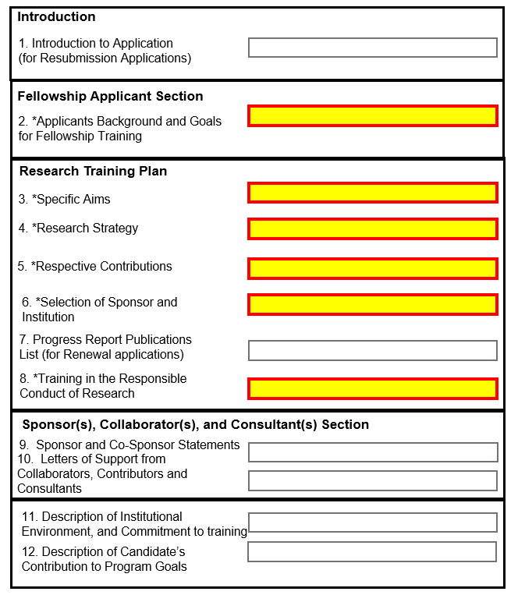
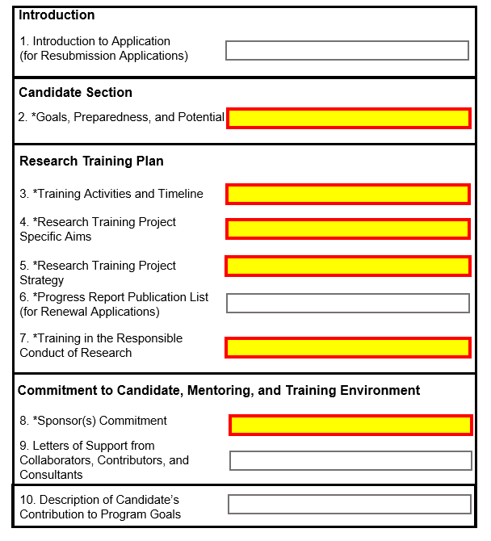
Changes to the Fellowship Application Structure
Current
On or After January 25, 2025
*Highlighted Sections Required

Slide 17
High-Level Application Changes
Simplified and reorganized
Condensed - going from 12 to 10 sections
Revised headings to match review areas
Cut 4 pages from application
Grades no longer required
*Highlighted Sections Required

Slide 18
New Fellowship Application Categories
Candidate’s Goals, Preparedness and Potential
Overall Training Goals
Candidate’s Preparedness
Candidate’s Self-Assessment
Scientific Perspective
Research Training Plan
Training Activities and Timeline
Research Training Project Specific Aims
Research Training Project Strategy
Scientific Foundation and Rationale
Approach
Sponsor(s) Commitment
Mentoring Approach and Candidate Mentoring Plan
Prior Training and Mentoring
Commitment to the Candidate’s Research Training Plan
Research Training Environment
Candidate’s potential

Slide 19
Fellowship Instructions – Components Needed
What: SF424 Application Guide – “Fellowship Instructions for NIH and other PHS Agencies” – for instructions relevant to most fellowship programs
Where: https://grants.nih.gov/grants/how-to-apply-application-guide.html
What: Notice of Funding Opportunity – NOFO - for specific instructions, due dates, institute participation, Related Notices
Where: https://researchtraining.nih.gov/programs - click on fellowship type and “view current funding opportunities”; for Institute specific NOFOs – check on webpages or in NOFO Related Notices section to see if re-issued
SF424 App Guide
NOFO
Related Notices
What: Related Notices – updates after SF424 and NOFO publication
Where: Beginning of each NOFO
Follow the NOFO and SF424 Guide
Follow the NOFO if the instructions differ from the SF424 Guide
Follow the Related Notices if the instructions differ from the NOFO or the SF424 Guide

Slide 20
As a candidate, what can I start on now for a submission on or after January 2025?
Candidate’s Goals, Preparedness, and Potential
Overall Training Goals
Candidate’s Preparedness
Candidate’s Self-Assessment
Scientific Perspective
Research Training Plan
Training Activities and Timeline
Research Training Project Specific Aims
Research Training Project Strategy
Scientific Foundation and Rationale
Approach

Slide 21
Preparing for Implementation dr. Ericka boone (dbrw) director, division of biomedical research workforce

Slide 22
Pause for a Recap
All changes mentioned today are relevant for fellowship applications due AFTER January 25, 2025.
For the December 8, 2024, fellowship deadline, please use current Forms H
Overall, the application contains the same essential elements (so don’t be nervous!)
Revisions intended to better focus review on the needs and goals of the candidate, make the application easier to complete, take less time to complete
No need to wait for new fellowship forms to be ready! Work on core elements required to complete your application:
Define candidate goals, design the research training project, develop training and mentorship goals and plans
Read the application guide, NOFO, & any relevant NOTs; work closely with your mentor.
Have questions or want more information? Reach out to a relevant NIH Program Officer – See NOFO for ‘Table of IC-specific information, requirements and staff contacts’

Slide 23
Key Dates and Scope of Fellowship Funding Announcements Requiring Changes
When will the changes be implemented?
Applications submitted for due dates on or after January 25, 2025
Summer 2025 peer review
October 2025 Advisory Council
Applicability
F30, F31, F32, F33, F99/K00 –
Any fellowship activity code using the F template and SF 424 guide
*Includes A1s even if A0 was reviewed in prior form
Guide Notice NOT-OD-24-107

Slide 24
To Implementation and Beyond
April 2024
Release of Guide Notice NOT-OD-24-107 on the Revisions to Fellowship Application and Review Process
Public webinar on the revisions to fellowship applications and review
November 2024
Fellowship application guide and fellowship form packages become available
All applications due on or after this date will use the revised application and review process
January 25, 2025
September 2024
Late January 2025
Second public webinar for applicants new to NIH Fellowships (registration information forthcoming)
Mid-December 2024
Updated SF424 available after December 8 fellowship deadline
Parent announcements published
Summer 2024
Staff training begins
Spring 2025
Reviewer training will begin prior to the time of first review
Notes:
While we have spent considerable time describing the important changes to fellowship application review post January 25, 2025, I want to mention the steps taken to implement these changes

Slide 25
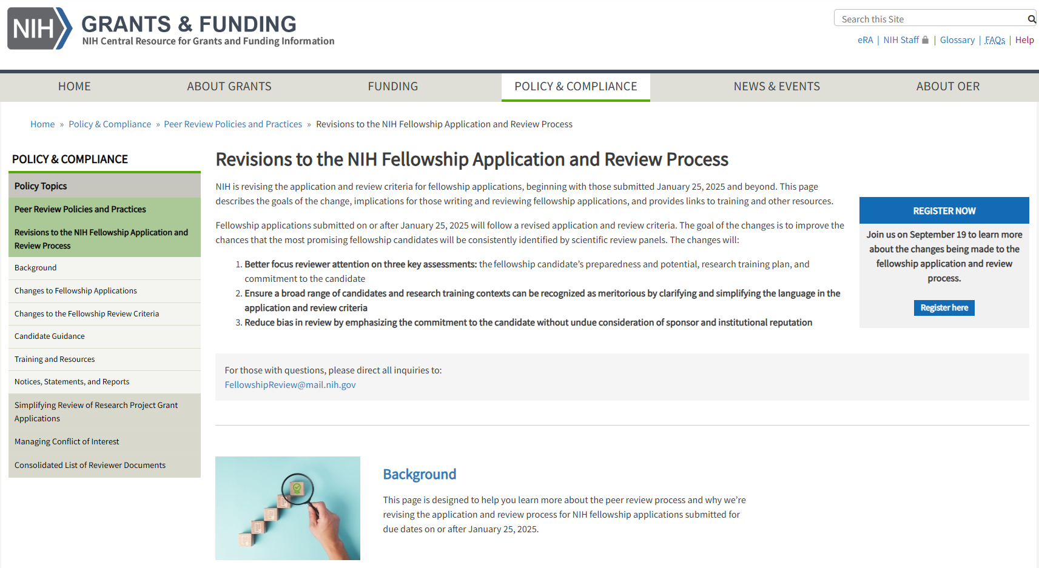
Public Page for Revisions to Fellowships
NIH Grants Page on Fellowship Changes
grants.nih.gov/policy/peer/improving-nrsa-fellowship.htm
Provides:
Background and overview of the changes
Candidate guidance/resources
FAQs
Relevant links and other resources
Notes:
The page has been updated to indicate that a new site with more resources is coming. As a note, we will be adding alert text like that shown here to the current page - prior to the release of the Uber Notice next week

Slide 26
Staying Up to Date on Changes to Funding Opportunities through the NIH Guide
Follow the NIH Guide for Grants and Contracts for notices and funding opportunity reissuances
grants.nih.gov/funding/searchguide/index.html#/
Subscribe to weekly Guide updates:
grants.nih.gov/grants/guide/subscribe.htm
Reminder: always look for most recent version of NOFO before submitting!

Slide 27
How to Avoid Potential Submission Issues
Submit early in case you need to correct any submission errors
Always follow ALL application and submission information in Section IV AND be responsive to ALL review criteria in Section V of the NOFO when writing your application.
Follow NIH communications for funding updates and other applicant guidance
NIH Guide to Grants and Contracts: grants.nih.gov/funding/searchguide/index.html
X: @NIHgrants
LinkedIn: www.linkedin.com/company/office-of-extramural-research/
Additional applicant guidance: grants.nih.gov/policy/peer/revisions-nih-fellowship-application-review-process/candidate-guidance.htm

Slide 28
QuestionS & AnswerS

Slide 29
Thank you for joining us today
grants.nih.gov/policy/peer/revisions-nih-fellowship-application-review-process.htm
WEBSITE
EMAIL
FellowshipReview@mail.nih.gov
X
@NIHGrants

