Slide 1
Simplified Review Framework for Research Project Grants (RPGs)
Implementation and Impact on
New and Existing Funding Opportunities
April 17, 2024

Slide 2
The Presentation Team
Presenters
Moderator
Erica Brown
Director, Division of Extramural Activities, NIGMS
Mark Caprara
Chief, Molecular and Cellular Sciences and Technologies Branch, CSR
Co-Chair
Megan Columbus
Director, Division of
Communication and Outreach, OER
Brian Hoshaw
Chief, Scientific Review Branch, NEI
Co-Chair
Lisa Steele
Chief, Epidemiology and Population Health Review Branch, CSR
Co-Chair
Kristin Kramer
Director, Communications and Outreach, CSR
Sheri Cummins
Communications Strategist
Division of Communication
and Outreach, OER

Slide 3
Agenda
Background of the changes
Overview of the simplified review framework
Preparing for and tracking changes to funding opportunities
Tips for applicants
Communication and training
Thinking ahead

Slide 4
Background

Slide 5
Peer Review at NIH
First Level of Review
By scientific peers in a standing or special emphasis panel
Second Level of Review
Advisory Council
(funding institute/center)
The Simplified Review Framework will improve how peer reviewers evaluate research project grants.
Scope: *Most RPGs (e.g., R01, R21 etc.)
In effect for applications received on or after January 25, 2025
*R01, R03, R15, R16, R21, R33, R34, R36, R61, RC1, RC2, RC4, RF1, RL1, RL2, U01, U34, U3R, UA5, UC1, UC2, UC4, UF1, UG3, UH2, UH3, UH5, (including the following phased awards: R21/R33, UH2/UH3, UG3/UH3, R61/R33)
Notes:
Peer Review at NIH:
First Level of Review
By scientific peers in a standing or special emphasis panel
Second Level of Review
Advisory Council
(funding institute/center

Slide 6
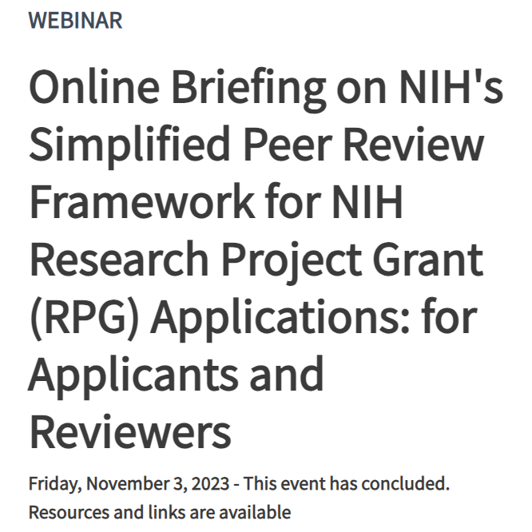
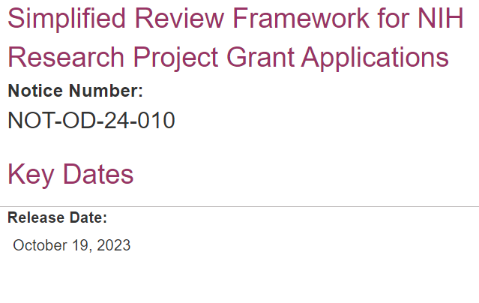
Previous Communications on the Simplified Review Framework
October Guide Notice:
grants.nih.gov/grants/guide/notice-files/NOT-OD-24-010.html
November Webinar:
grants.nih.gov/learning-center/simplified-peer-review-framework

Slide 7
How We Got Here-Community Input and NIH Partnership with Extramural Scientists
February 2020
May 2020 – April 2021
Center for Scientific Review (CSR) Advisory Council Working Groups develop initial recommendations
July 2021 – Sept. 2022
Recommendations refined and approved by Institute/Center Directors and the Acting NIH Director
Dec. 2022 – March 2023
Community input solicited on Simplifying Review to provide foundational data
Request for Information published and over 800 responses from individuals and societies received largely supporting the proposed changes.
October 2023
NIH publicly announces the Simplified Review Framework for most research project grants
Notes:
February 2020
Community input solicited on Simplifying Review to provide foundational data
May 2020 – April 2021
Center for Scientific Review (CSR) Advisory Council Working Groups develop initial recommendations
July 2021 – Sept. 2022
Recommendations refined and approved by Institute/Center Directors and the Acting NIH Director
Dec. 2022 – March 2023
Request for Information published and over 800 responses from individuals and societies received largely supporting the proposed changes.
October 2023
NIH publicly announces the Simplified Review Framework for most research project grants

Slide 8
Overview of the Simplified Review Framework

Slide 9
Goals for the Simplified Review Framework
Enable peer reviewers to better focus on answering the key questions necessary to assess scientific and technical merit
Mitigate the effect of reputational bias
Reduce reviewer burden
See the October 2023 Guide Notice, Open Mike and Review Matters Blogs for more information

Slide 10
Approach to the Simplified Review Framework
Enable reviewers to improve review by:
Focusing their attention on three main questions via reorganizing the five review criteria
Factor 1: Importance of the Research - “Should it be done?”
Factor 2: Rigor and Feasibility - “Can it be done?”
Factor 3: Expertise and Resources - “Will it be done?”
B. Simplify and strengthen review criteria by using conceptual definitions rather than lists of questions.
Shifting away from extensive sets of complex questions encourages thoughtful integration of concepts rather than “yes-no” thinking.

Slide 11
Approach to the Simplified Review Framework (Cont’d.)
2. Modify the criterion definitions for Investigator and Environment in Factor 3 to reduce reputational bias
Reviewers assess the adequacy of investigator expertise and institutional resources with respect to the work proposed as a binary choice: Appropriate or Additional Resources or Expertise Needed
3. Relieve reviewer burden by not requiring peer review of select “additional considerations”.
Considerations not directly related to scientific merit shift to NIH staff administrative review.

Slide 12
Five Criteria Reorganized Into Three Factors​
Current |  | Simplified Framework
Significance - scored Investigator(s) – scored Innovation – scored Approach – scored Environment - scored |  | (all considered in Overall Impact Score) Factor 1: Importance of the Research Significance, Innovation Scored 1-9 Factor 2: Rigor and Feasibility Approach (also include Inclusions for HS and CT Study Timeline) Scored 1-9 Factor 3: Expertise and Resources Investigators, Environment Evaluated as appropriate or additional expertise/resources needed; gaps require explanation No individual score
Notes:
Current:
Significance - scored
Investigator(s) – scored
Innovation – scored
Approach – scored
Environment - scored
Simplified Framework:
(all considered in Overall Impact Score)
Factor 1: Importance of the Research
Significance, Innovation
Scored 1-9
Factor 2: Rigor and Feasibility
Approach (also include Inclusions for HS and CT Study Timeline)
Scored 1-9
Factor 3: Expertise and Resources
Investigators, Environment
Evaluated as appropriate or additional expertise/resources needed; gaps require explanation
No individual score

Slide 13
Reduced Additional Review Considerations
Most Additional Review Considerations removed from first-level peer review; responsibility will shift to awarding institute/center
Current |  | Simplified Framework
Additional Review Considerations (no effect on overall impact score) Applications from Foreign Organizations Select Agent Research Resource Sharing Plans Authentication of Key Biological and/or Chemical Resources Budget and Period of Support |  | Additional Review Considerations (no effect on overall impact score) Authentication of Key Biological and/or Chemical Resources Budget and Period of Support
Notes:
Current:
Additional Review Considerations
(no effect on overall impact score)
Applications from Foreign Organizations
Select Agent Research
Resource Sharing Plans
Authentication of Key Biological and/or Chemical Resources
Budget and Period of Support
Simplified Framework:
Additional Review Considerations
(no effect on overall impact score)
Authentication of Key Biological and/or Chemical Resources
Budget and Period of Support

Slide 14
Community Questions
Expectations:
The quality of review improves: clearer evaluations of the proposed research’s importance, the rigor and feasibility of the approach, and more consistently appropriate evaluation of investigator/environment
Evaluation:
Monitor critiques, discussions, scoring - problems addressed promptly
Reviewers/ staff surveyed regarding review experience and effectiveness
Training:
Program and Review Staff - Guides, FAQs, webinars and workshops - ongoing through 2025.
Reviewers - Training slides, videos, guides to writing critiques in development for 2025 summer review round deployment

Slide 15
Preparing for and tracking changes to notices of funding opportunities (NOFOs)

Slide 16
NOFOs Must Include the Correct Language About How They Will be Reviewed
For impacted RPG NOFOs with due dates on or after January 25, 2025, Section V. Application Review Information will need to be updated with the simplified review framework language

Slide 17
Reissuing Current Funding Opportunities
NOFOs with Due Dates | Expiring before January 25, 2025? | Effect on active funding opportunity
Before January 25, 2025 | Yes | May be extended until reissued with the simplified review framework
On or After January 25, 2025 | No | May expire early and be reissued with the simplified review framework for due dates on or after January 25, 2025

Slide 18
When to Expect Reissued NOFOs
Reissued NOFOs will be published:
As soon as summer 2024
Parent funding opportunities (ex. PA-20-185) will begin to be reissued in the fall of 2024
At least 30-60 days before the first due date on or after January 25, 2025

Slide 19
NIH Moving to Updated Application Forms
Concurrent with implementation of the simplified review framework, NIH is transitioning to updated application forms (FORMS-I)
FORMS-I application forms must be used for applications with due dates on or after January 25, 2025
The updated forms and instructions will be available in the Fall of 2024
See Forms-I Notice (NOT-OD-24-086) for more information

Slide 20
Timing and Availability of Application Forms and Instructions
New and reissued funding opportunities may be initially posted without an application forms package
Application forms and associated application instructions will be added at least 30 days and, frequently 60 days or more, prior to the first due date
Applicants can begin drafting their application attachments using funding opportunity and current (FORMS-H) application guide instructions and adjust as needed once FORMS-I instructions are available.
Application instructions will be posted, once available this fall on:
grants.nih.gov/grants/how-to-apply-application-guide.html

Slide 21
How You Can Track Changes to NOFOs
NIH Guide to Grants and Contracts
Notices of intent to publish
Notices of extension
Related notices in current opportunities
Information in reissued opportunities

Slide 22
Staying Up to Date on Changes to Funding Opportunities through the NIH Guide
Follow the NIH Guide for Grants and Contracts for notices and funding opportunity reissuances
grants.nih.gov/funding/searchguide/index.html#/
Subscribe to weekly Guide updates:
grants.nih.gov/grants/guide/subscribe.htm
Reminder: always look for most recent version of NOFO before submitting!

Slide 23
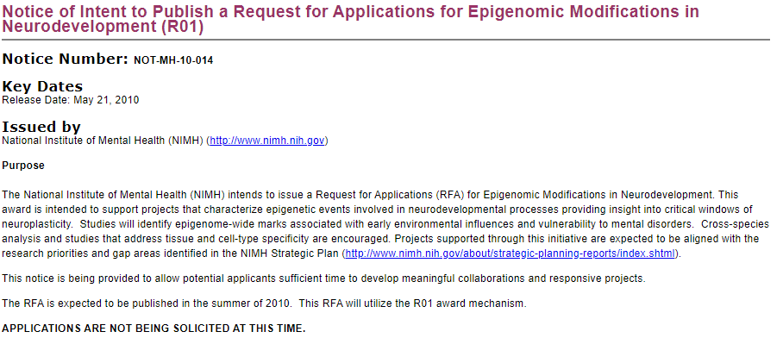
Search for Notices of Intent to Publish
Some Institutes and Centers may issue Notices of Intention to Publish (NOITPs) indicating which NOFOs they plan to reissue
You will be able to find NOITPs under the "Related Notices" heading in associated funding opportunities

Slide 24
Look Out for Notices of Extension
Separate Notices indicating that certain funding opportunities will be extended

Slide 25
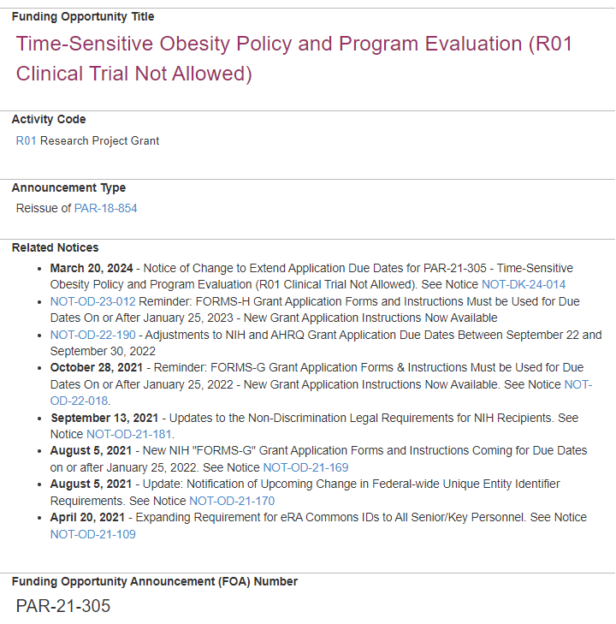
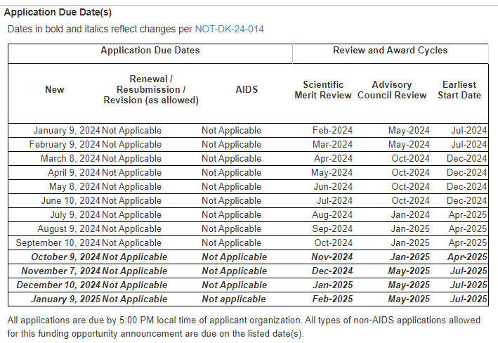
Sample Funding Opportunity Extended with Additional Due Dates
Notice is referenced and additional application due dates added to Key Dates section
Extension Guide Notice added to Related Notices
Expiration Date updated in Key Dates section

Slide 26
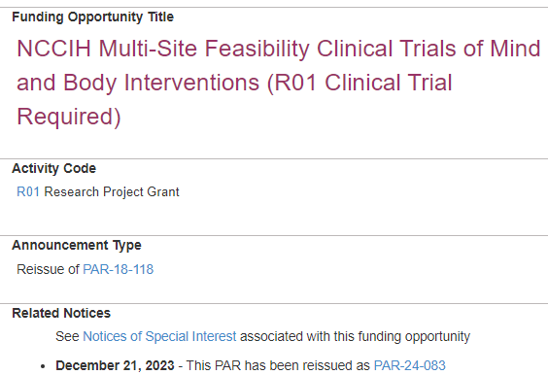
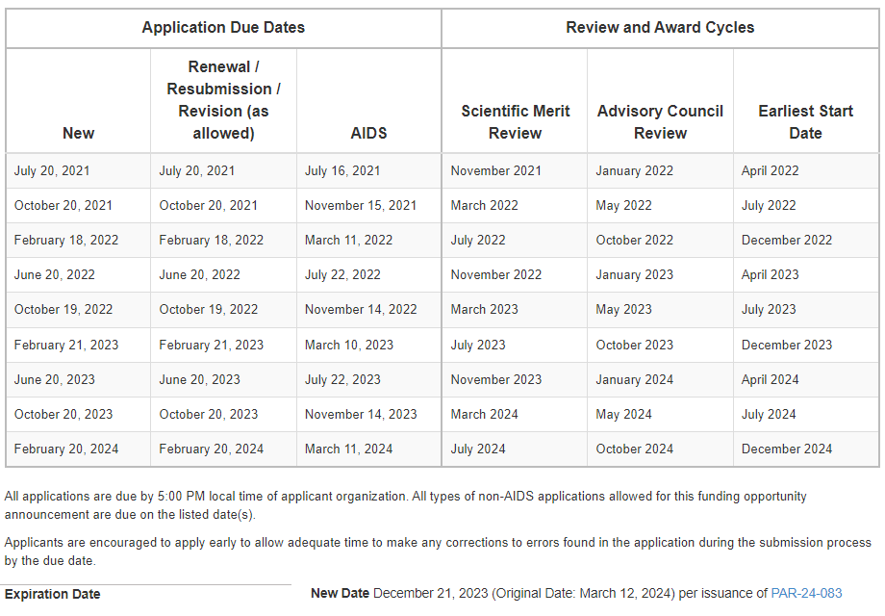
Sample Funding Opportunity Reissue – What You'll See in NOFOs Expiring Early
Pay close attention to Expiration Date. Remaining due dates beyond new expiration date are not removed.
Note regarding reissue and link to new opportunity added to Related Notices
Funding opportunity expired and Expiration Date updated

Slide 27
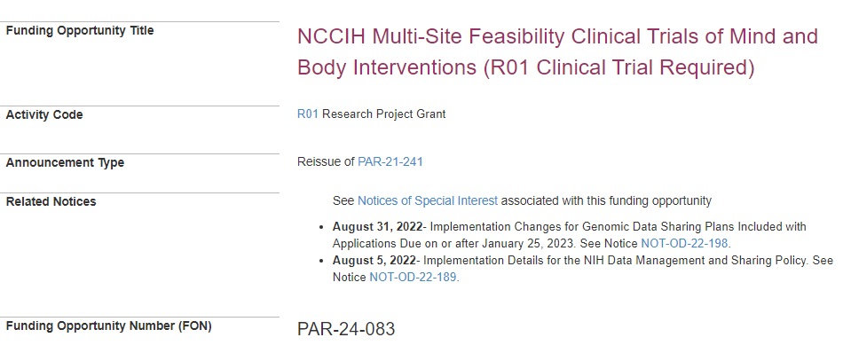
Sample Funding Opportunity Reissue – What You See in Newly Reissued NOFO
In Announcement Type section the opportunity is identified as a reissue with a link back to its predecessor

Slide 28
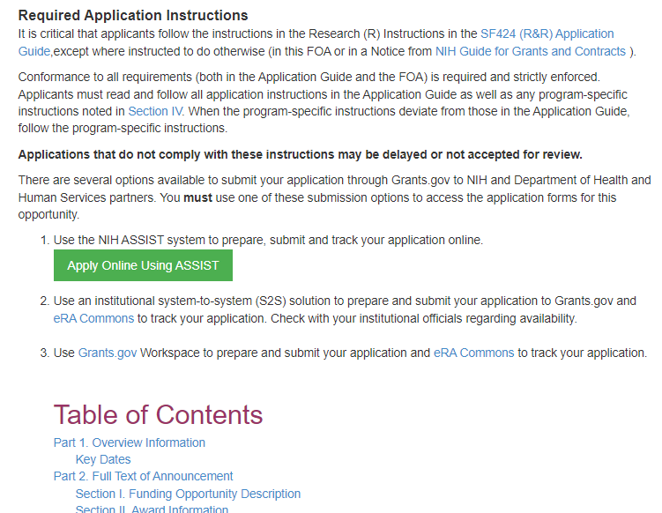
Opportunities without an Application Package
Opportunities initially posted without an application package will include a temporary message in place of the submission option information (between Key Dates and Table of Contents)
IMPORTANT: Per NOT-OD-24-086 updated application forms (FORMS-I) will be used for this opportunity. The updated forms are not yet available and will be posted 30 calendar days or more prior to the first application due date. Once posted, you will be able to access the forms using one of the following submission options:
NIH ASSIST
An institutional system-to-system (S2S) solution
Grants.gov Workspace

Slide 29
We Want to Help You Avoid Any Submission Issues
Submit early in case you need to correct any submission errors
Applying through ASSIST?
A splash screen will remind you which application forms to use for which due dates
Take advantage of pre-submission validation tools to check for errors before you apply
Follow NIH communications for funding updates and other applicant guidance
NIH Guide to Grants and Contracts: grants.nih.gov/funding/searchguide/index.html
X: @NIHgrants
LinkedIn: www.linkedin.com/company/office-of-extramural-research/
Additional applicant guidance can be found on: https://grants.nih.gov/policy/peer/simplifying-review/applicant-guidance.htm

Slide 30
More Tips for applicants

Slide 31
Tips for Preparing Applications
The simplified review framework affects how reviewers evaluate applications and serves to better focus reviewers on scientific and technical merit. It is not expected to change the application materials submitted by applicants.
General advice: Applicants should always be sure to be responsive to both the application and submission information in Section IV and the review criteria in Section V of the NOFO when writing their application.
Resubmission applications will be reviewed as they are presented at the time of receipt using the framework in place for that application due date.
The new review framework will not impact how resubmission applications are written.
Take advantage of copy features in ASSIST, Grants.gov Workspace, and many institutional systems if you find yourself needing to move an existing application draft to a different funding opportunity

Slide 32
Preparing the Community for the simplified review framework

Slide 33
What to Expect Over the Next Year
Changes to NIH systems
Continued guidance for applicants and reviewers
Updating and publishing funding opportunities
Releasing new application packages
Reviewer training
Beginning in November
January 2025
Summer
April
NIH Issues Guide Notice on changes to funding opportunities
Updated funding opportunities begin to appear on Grants.Gov and the NIH Guide
New application packages added to opportunities for due dates on or after January 25
New framework applies to application due dates on or after January 25, 2025
Spring 2025
Reviewer training begins for the simplified review framework
Notes:
April
NIH Issues Guide Notice on changes to funding opportunities
Summer
Updated funding opportunities begin to appear on Grants.Gov and the NIH Guide
Beginning in November
New application packages added to opportunities for due dates on or after January 25
January 2025
New framework applies to application due dates on or after January 25, 2025
Spring 2025
Reviewer training begins for the simplified review framework

Slide 34
Learn More & Stay Informed
Development background
Description of changes
Guidance for reviewers (Coming in 2025)
Guidance for applicants
Training and resources
Notices and reports
FAQs
Contacts
grants.nih.gov/policy/peer/simplifying-review.htm

Slide 35
Thank You
LEARN MORE grants.nih.gov/policy/peer/simplifying-review.htm
EMAIL US AT
simplifiedreview@nih.gov

