Slide 1
NIH Grants Process Primer: Application to Award
Part One | November 13, 2024

Slide 2
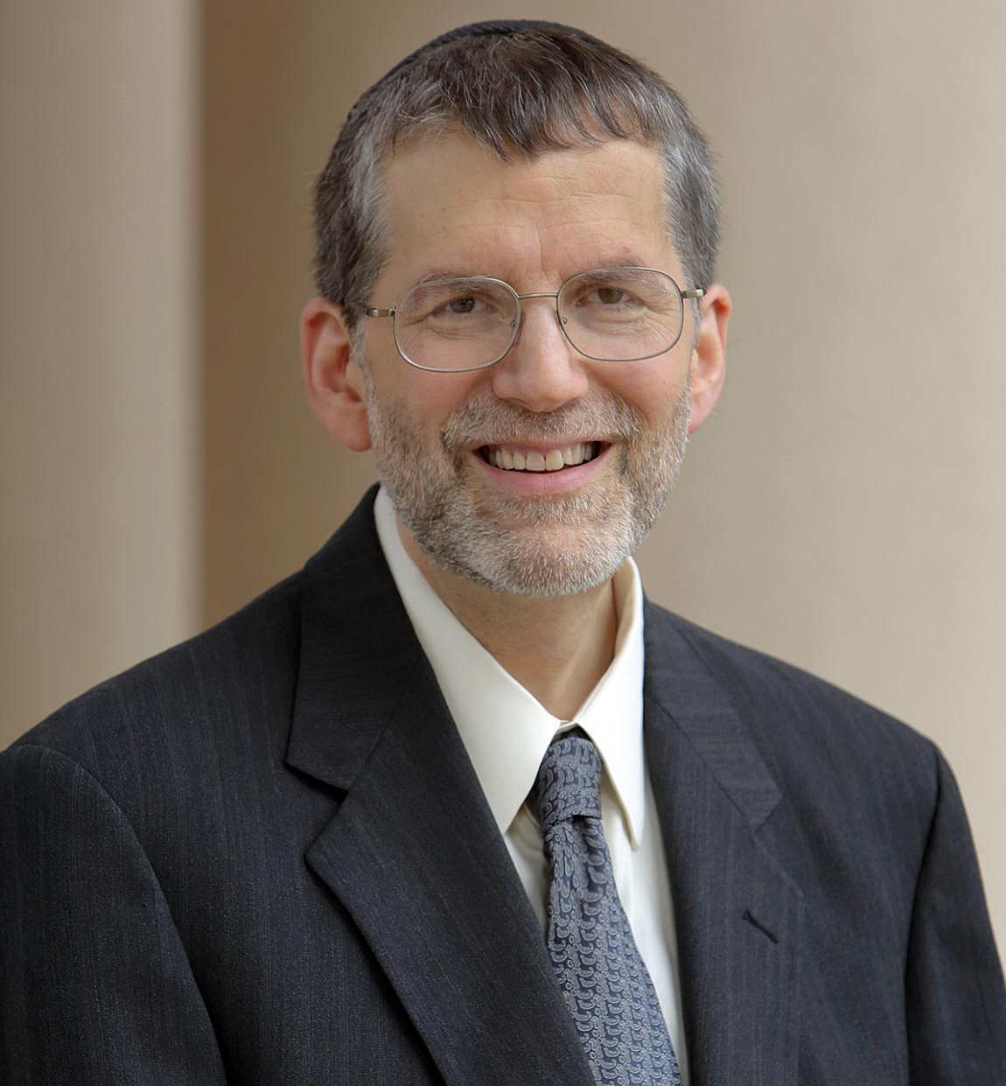
NIH GRANTS PROCESS PRIMER
WELCOME
MESSAGE
Noni Byrnes, Ph.D.
Director, Center for
Scientific Review (CSR), NIH
Michael Lauer, M.D.
NIH Deputy Director for Extramural Research
Director, Office of Extramural
Research (OER), NIH

Slide 3
NIH GRANTS PROCESS PRIMER Part One: An Overview
AGENDA
1st Segment
New to NIH: The Basics
Plan to Apply
Write Your Application
Q&A #1: NIH Expert Panel
Intermission
2nd Segment
Submit
Review
Receipt and Referral
Peer Review
Award
Monitoring and Reporting
Useful Resources
Q&A #2: NIH Expert Panel
MODERATOR
Megan Columbus
Director
Division of Communications and Outreach
Office of Extramural Research (OER), NIH

Slide 4
First Steps on Your Path to Success Working with the NIH
Step 1: Get to Know the NIH
Step 2: Understand the Process
Step 3: Use the Resources
Plan to Apply
Write Application
Submit
Review
Award
Monitoring and Reporting
Learn more: NIH Grants Process

Slide 5
New to NIH
PRESENTER
Sheri Cummins
Communications Strategist
Division of Communications and Outreach
Office of Extramural Research (OER), NIH
Image: NIH Building 1
(Home of NIH leadership)

Slide 6
AGENDA: New to NIH
Building a common understanding of basic concepts
What we do
Where to start
Where is the money
How NIH announces funding opportunities
Who is eligible
Meet the NIH team – staff roles
Registration
Handy reference
New to NIH | Grants & Funding

Slide 7
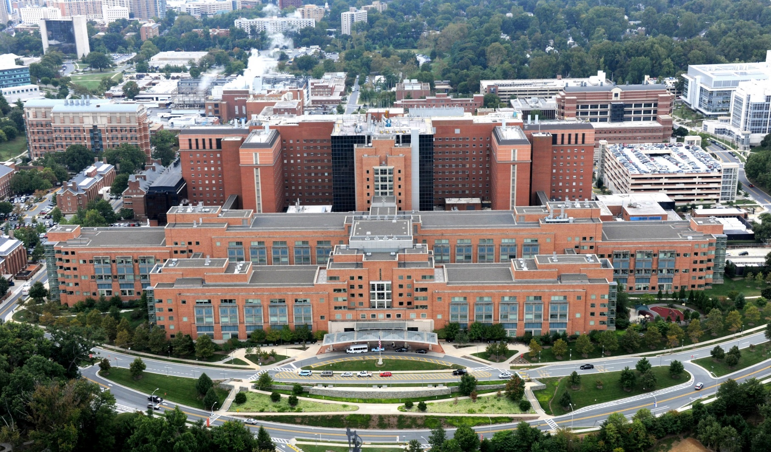
What We Do
NIH is the largest public funder of biomedical research in the world.
Clinical Center (Building 10), NIH Campus

Slide 8
NIH Mission
To seek fundamental knowledge about the nature and behavior of living systems and the application of that knowledge to enhance health, lengthen life, and reduce illness and disability.

Slide 9
Funding Categories
Grants and Cooperative Agreements
x
Research Training and Career Development
Individual Fellowship
F series (F30 …)
Individual Career Development
K series (K01 …)
Institutional Training
T series (T32 …)
Research and Development
R Series (R01, R03, R15, R21 …)
Construction and Modernization
Small Business
Supplemental Funding
Loan Repayment Programs
Contracts
Other Transactions
Challenges and Prizes
Three-character activity codes are used to differentiate the wide variety of research-related programs NIH supports.
Learn more: Funding Categories

Slide 10
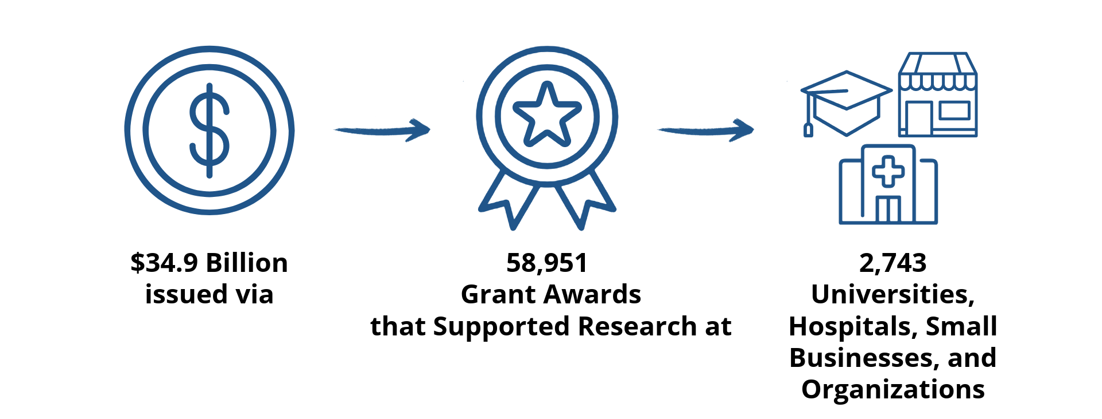
NIH by the Numbers (FY 2023)

Slide 11
Where Do I Start?

Slide 12
NIH Grants & Funding Website
x
Glossary
https://grants.nih.gov/
Funding opportunities
Grants process
How to Apply – Application Guide
Grants policy
NIH Grants Policy Statement (NIH GPS)

Slide 13
Where’s the Money?

Slide 14
National Institutes of Health
Comprised of
27 Institutes and Centers (ICs)
Each has its own mission, priorities, budget, and funding strategy
Office of the Director (OD)
Sets NIH policy
Plans, manages, and coordinates programs and activities across NIH
24 ICs and several offices within the OD post funding opportunities and fund or co-fund awards
Understand which NIH institutes, centers, and offices (ICOs) may be interested in your proposed research

Slide 15
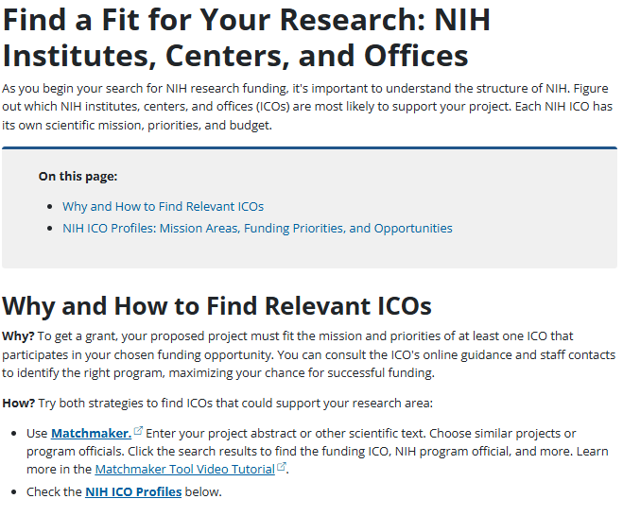
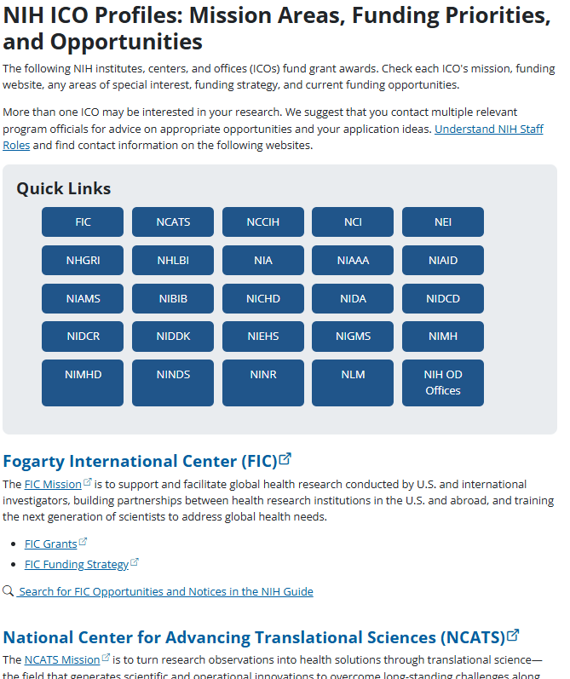
Find a Fit
Explore IC missions, grant pages, and funding strategies.
Use our Matchmaker tool to identify ICs who have funded similar research projects.
Learn more: Find a Fit for Your Research: NIH Institutes, Centers, and Offices

Slide 16
How NIH Announces Funding Opportunities
Notices of funding opportunities (NOFOs)
Centrally-managed parent announcements
ICO-issued program announcements (PAs)
PAS: with set-aside funds
PAR: special receipt, referral, and/or review considerations
ICO-issued requests for applications (RFAs)
Note:
Funding opportunity announcement (FOA) is an old term for notice of funding opportunity (NOFO). You will continue to find FOA used in some resources and announcements while we fully transition to the new term.
Learn more: Understand Funding Opportunities

Slide 17
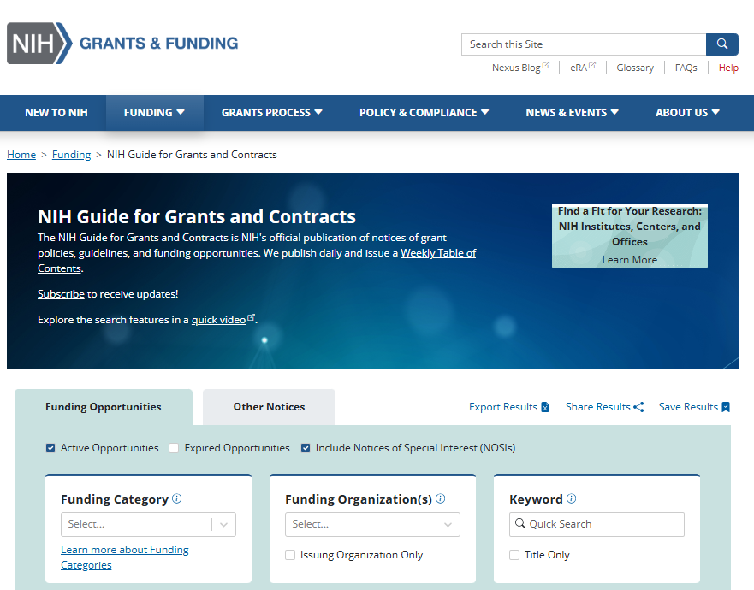
Where to Find Funding Opportunities
NIH Guide for Grants and Contracts
NIH and federal partners
Notices
Notices of special interest (NOSIs)
Policy updates
Changes to NOFOs
Webinars and training events
Grants.gov
All federal grant-making agencies
Institute, center, and office websites
Topic websites (e.g., https://seed.nih.gov/)
Subscribe to receive weekly email of postings!

Slide 18
Investigator-Initiated & Targeted Research
Investigator-initiated or unsolicited research
Research focus originates from your research idea or training need that falls within the NIH mission
Use centrally-managed NIH “parent announcements” or broad ICO-issued funding opportunities
Targeted or NIH-requested research
Applications submitted in response to ICO-issued funding opportunities posted to encourage research in specific areas
Support research in an understudied area
Take advantage of current scientific opportunities
Address a high scientific program priority
Meet additional needs in research training and infrastructure
Use set-aside funds (PASs and RFAs)
Learn more: Find Your Opportunity, Contacts, and Due Dates

Slide 19
NOFOs Include
Opportunity description
Participating institutes, centers, and offices
Due dates
Award information
Eligibility
Submission requirements
Review criteria
Award administration
Agency points-of-contact

Slide 20
Who’s Eligible
NIH recognizes the applicant organization as the recipient , not the principal investigator(s), for most programs
In general, applicant organizations can be
Domestic or foreign
Public or private
Non-profit or for-profit
Check the eligibility section of your funding opportunity for specific requirements

Slide 21
Foreign Eligibility
Not eligible to apply for institutional training, program project, center, resource, small business, or construction grants
In addition to standard review criteria, also assessed on
Whether the project presents special opportunities for furthering research programs using unusual talent, resources, populations, or environmental conditions in other countries that are not readily available in the United States or that augment existing U.S. resources
Whether the proposed project has specific relevance to the mission and objectives of the ICO and has the potential for significantly advancing the health sciences in the United States

Slide 22
Early Stage Investigators
An early stage investigator (ESI) is a Program Director/Principal Investigator (PD/PI) who has
completed their terminal research degree or end of post-graduate clinical training, whichever date is later, within the past 10 years and
who has not previously competed successfully as PD/PI for a substantial NIH independent research award.
NIH is committed to supporting ESIs
Reviewers give early stage investigators special consideration
Applications with meritorious scores may be prioritized for funding
NIH has programs targeted specifically for this population (e.g., Stephen I. Katz Early Stage Investigator Research Project Grant)
Learn more: Early Stage Investigator (ESI) Policies

Slide 23
Meet the NIH Extramural Team
Program Official (PO)
Scientific Review Officer (SRO)
Grants Management Officer (GMO)
Learn more: Understand Staff Roles

Slide 24
Program Official (PO)
Responsibilities
Initiative development
Programmatic and scientific, guidance pre- and post-award
Work in partnership with grants management staff on post-award administration, including review of progress reports
When to contact
To help identify an appropriate grant program
To obtain input on fit within the mission and priorities of IC
To discuss the outcome of review after receiving and reviewing your summary statement
To talk about progress or scientific and administrative issues that arise with the grant post-award
Learn more: Understand Staff Roles - Program Officials

Slide 25
Scientific Review Officer (SRO)
Responsibilities
Review applications for completeness and conformance with application requirements
Ensure fair and unbiased evaluation of scientific and technical merit
Provide a summary of the evaluation in the form of summary statements for applicants
When to contact
To discuss the review assignment
To request permission to send additional/corrective materials after reviewing the post-submission materials policy
To discuss review concerns (e.g., expertise needed on the review panel, conflicts, reviewers that may have bias)
Learn more: Understand Staff Roles - Scientific Review Officer

Slide 26
Grants Management Officer (GMO)
Responsibilities
Evaluate applications for administrative content and compliance with policy
Negotiate awards
Interpret grants administration policies
When to contact
To discuss financial or grants administration issues
For interpretation of grants policies
Learn more: Understand Staff Roles - Grants Management Officer

Slide 27
Organizations: Get Registered!
Can take 6 weeks or more. If not yet in place, get started.
System for Award Management (SAM)
Needed to do business with the U.S. government
Requires annual renewal
Grants.gov
Required to submit grant applications
eRA Commons
Required to do business with NIH
Small Business Administration (SBA)
Required for applications to NIH Small Business Technology Transfer (STTR), Small Business Innovation Research (SBIR), and Commercialization Readiness Pilot (CRP) programs
Learn more: Organization Registration

Slide 28
Individuals: Get Registered!
Some individuals may require accounts in the various systems.
Grants.gov examples (not comprehensive)
Authorized organization representatives (AORs) who sign and submit applications
eRA Commons examples (not comprehensive)
Signing officials (SOs) who sign and submit applications and subsequent grant documents and reports
All senior/key individuals named on a grant application
Application due dates on/after May 25, 2025: Required use of SciENcv to prepare biosketch and other support documents. All senior key named on an application must have an ORCID that is linked to their eRA Commons account. See NOT-OD-24-163: NIH Adoption of Common Forms for Biographical Sketch and Current and Pending (Other) Support.
Learn more: System Accounts for Investigators and Other Users

Slide 29
Key Takeaways
Largest public funder of biomedical research
Provides a variety of federal assistance for research and research-related activities to advance the NIH mission
To seek fundamental knowledge about the nature and behavior of living systems and the application of that knowledge to enhance health, lengthen life, and reduce illness and disability
Funding is made through NIH institutes, centers, and offices (ICOs)
ICOs post notices of funding opportunities (NOFOs) in the NIH Guide for Grants and Contracts (NIH Guide)
NOFOs include or link to all the information needed to apply
NIH Team: program officials (POs), scientific review officers (SROs), and grants management officers (GMOs)
To do business with NIH organizations must register in multiple federal systems and certain individuals may need accounts in eRA Commons and other systems

Slide 30
NIH GRANTS PROCESS: PLAN TO APPLY
PRESENTER
Lanay Mudd, Ph.D.
Deputy Branch Chief
Clinical Research in Complementary and Integrative Health Branch
National Center for Complementary and Integrative Health (NCCIH), NIH

Slide 31
AGENDA: Plan to Apply
Plan Within Your Organization
Consider Your Idea, Resources, and Collaborators
Find Your Opportunity, Contacts, and Due Dates
Follow NIH Application Policies and Requirements
Organize Your Time to Complete the Application
Plan to Apply
Write Application
Submit
Review
Award
Monitoring and Reporting
Notes:
As scientists, I think we can all get behind the idea of planning ahead to avoid the need to try to squeeze things in and “make it work” at the last moment. I’m going to go through these 5 topics to help you appropriately plan for your grant application to NIH.

Slide 32
How Do I Navigate NIH Funding?
Notes:
Understanding and applying to NIH funding opportunities can be confusing and can feel like a tough uphill climb. This is from a hike I did with my dog this winter – we chose the rough and steep trail and he had to pull me up it. Thankfully, there are multiple paths to NIH funding and there are lots of resources to help guide you through the process!

Slide 33
Plan Within Your Organization
It takes a village to develop and submit an application
Get to know your Office of Sponsored Research
Internal processes for grant applications – including internal deadlines!
Help with setting up NIH System accounts
Advice and guidance on how NIH works
Connection to other experienced investigators and administrators
Technical assistance for completing part of your application (e.g., the budget)

Slide 34
Resources to Help You Navigate NIH
NIH All About Grants Podcast: https://grants.nih.gov/news-events/podcasts
Episodes on all the ins and outs of NIH funding
NIH Grants YouTube Channel: https://www.youtube.com/user/NIHgrants
From the Director of the NIH Office of Extramural Research
NIH Fundamentals
Apply for Grant Funding
Advice for New and Early Career Scientists
NIH Policy and Compliance
Peer Review
Small Business
Special Funding Programs
Electronic Research Administration (eRA) Systems
Data Sharing

Slide 35
NIH Research Training Website
https://researchtraining.nih.gov
Launched in 2015,one stop for funding opportunities
Useful resource for trainees, postdocs, potential K award applicants and early-stage faculty
Notes:
If you a re a pre-doc, post-doc or early career, I also want to point you to this page to help you being to plan an application. Lots of resources on this page – including overview of ALL training and career development funding opportunities, contact info and links to training info for each institute and center across the NIH, a matrix of which IC’s participate in different NOFOs, and several other resources.
Career Path tab provides great info graphics that map out programs available to you at different career stages

Slide 36
Consider Your Idea
https://reporter.nih.gov/
Always start with the science
What do you want to study?
Is it unique?
Do a literature search
Use NIH RePORTER
Search clinicaltrials.gov
Have you already submitted it for funding somewhere else?
You cannot submit duplicate proposals to NIH at the same time
NIH will not fund research another organization is already funding
Notes:
Reporter is a great resource – there will be a hands-on demo of how to use it on Day 2. Reporter provides a publicly available database of every grant application funded by NIH. Check here first to see if NIH has already funded the science you want to propose!

Slide 37
Consider Your Resources and Collaborators
What do you need to complete your research?
Equipment
Facilities
Animals, human research participants, cell lines, samples, existing datasets, etc
Other resources
What expertise do you need on your team?
Existing vs. new collaborators
People inside/outside your institution
Community organizations
Start early on Letters of Support
Find potential collaborators and/or mentors on RePORTER using Matchmaker!
Learn more: Advice on Application Sections

Slide 38
Find Your Opportunity
Keep your research question in mind!
Multiple ways to find the right Notice of Funding Opportunity (NOFO)
Search https://grants.nih.gov/funding/nih-guide-for-grants-and-contracts
Utilize a parent NOFO for investigator-initiated research
Find which NIH Institutes, Centers, and Offices (ICOs) fit your research
Make sure the ICO(s) you’re interested in participate in the NOFO you select
Learn about any ICO-specific funding policies for different NOFOs
Make sure the selected NOFO allows the type of application you plan to submit
Learn more: Understand Funding Opportunities
Notes:
More than one ICO may be interested in your research. We suggest that you contact multiple relevant program officials for advice on appropriate opportunities and your application ideas

Slide 39
Finding a “Home” for Your Research
Review the Strategic Plan and Scientific Priorities of different Institutes, Centers, and Offices (IC0s)
Match up your science (may fit more than one)
Explore websites to get an understanding of how different ICOs operate
Specific funding opportunities they do/don’t use
Program staff interests
Funding strategies
IC specific resources, blogs, etc.
Sign up for email updates from ICOs of interest
Learn more: Find a Fit For Your Research - NIH Institutes, Centers, and Offices
Notes:
More than one ICO may be interested in your research. We suggest that you contact multiple relevant program officials for advice on appropriate opportunities and your application ideas

Slide 40
Program Directors are a Resource for Applicants
Don’t be shy – contact us EARLY!
We can provide insight into the NIH funding process
Every NIH Institute, Center, and Office operates differently
Different missions & priorities
Different budgets
Different ways of using NOFOs
Different ways of deciding which applications to fund
Find potential Program Directors to contact by looking up the “Scientific Contacts” in a NOFO of interest
and/or by using Matchmaker in RePORTER!
Notes:
Come to Saturdays session to learn strategies for engaging with NIH staff

Slide 41
Find Your Opportunity - Eligibility
Consider Eligibility
Organization and/or organizational components
Eligible investigators
Foreign Involvement
Some NOFOs do not allow foreign institutions or components
Small business and some fellowship and training grants require the PD/PI to be a U.S. citizen or permanent resident
Funding of a foreign award is unlikely if comparable research can be conducted in the U.S.
Check Section III Eligibility within the NOFO!
Learn more: Foreign Grants

Slide 42
Find Your Opportunity – Key Dates
Check Key Dates
Make sure the NOFO is not expired
Understand Application Due Dates and Review and Award Cycles
Application Due Dates | Review and Award Cycles
New | Renewal/ Resubmission/ Revision (as allowed) | AIDS- New/ Renewal/ Resubmission/ Revision, as allowed | Scientific Merit Review | Advisory Council Review | Earliest Start Date
February X, 2024 | February X, 2024 | March X, 2024 | July 2024 | October 2024 | December 2024
June X, 2024 | June X, 2024 | July X, 2024 | November 2024 | January 2025 | April 2025
Oct X, 2024 | Oct X, 2024 | Nov X, 2024 | March 2025 | May 2025 | July 2025
Learn more: Standard Due Dates

Slide 43
Follow NIH Application Policies and Requirements
You must be aware of and comply with all relevant NIH policies for your applications area of science and award type. For example:
Application Submission Policies (late applications, resubmissions, disasters, etc.)
NIH Scientific Data Sharing requirements
Financial Conflict of Interest and potential Foreign Interference
Scientific Reproducibility through Rigor and Transparency
Be sure to review the NIH Grants Policy Statement
Notices of policy changes are published in the NIH Guide and will be listed in the “Related Notices” section in Part 1 of every NOFO
Learn more: Policy and Compliance
Notes:
based on area of science and award type

Slide 44
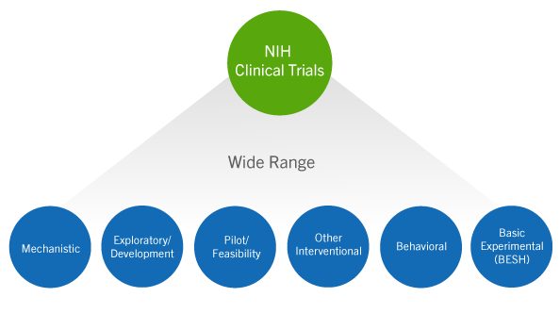
Additional Requirements May Apply
Be aware of additional requirements depending on your type of science, such as:
Human Subjects: Pre- and Post-Award Processes, Inclusion Policies, Single IRB, etc.
Clinical Trial Requirements: Additional reporting requirements
Animal Research: Animal Welfare Assurance, Reporting, etc.
Some applications require NIH’s prior approval before you submit
Large budget requests
Support for scientific conferences
Some ICO-specific opportunities
Notes:
Must select NOFOs that allow you type of science (CT or not)

Slide 45
Organize Your Time
Scientific Timeline
Determine resources
Establish team
Collect preliminary data (if needed)
Draft timeline for study…
Draft Aims and talk to NIH
Find a NOFO
Collaborate with team to write application
Mock review & revise…
Writing Timeline
Notes:
Consider creating two timelines: one for your planned project, another for the application writing and preparation process. Allow plenty of time to draft the application, reread, and revise. Finalize your application well before your organization’s internal deadline
Be aware of internal deadlines!

Slide 46
Key Messages
1) It takes a village
2) Focus on the science
3) Find the right fit
4) Play by the rules
5) It takes TIME
Notes:
Be curious! Organize a vision of your research…
Plan Within Your Organization
Consider Your Idea, Resources, and Collaborators
Find Your Opportunity, Contacts, and Due Dates
Follow NIH Application Policies and Requirements
Organize Your Time to Complete the Application

Slide 47
NIH GRANTS PROCESS: WRITE THE APPLICATION
PRESENTER
LeShawndra Price, Ph.D.
Director
Office of Research Training and
Special Programs (ORTSP)
National Institute of Allergy and Infectious Diseases (NIAID), NIH

Slide 48
AGENDA: Write the Application
How to Apply – Application Guide
Forms Directory
General Grant Writing Tips
Advice on Application Sections
Sample Applications and Documents
Helpful Resource:
Write Application
Plan to Apply
Write Application
Submit
Review
Award
Monitoring and Reporting

Slide 49
How to Apply-Application Guide
Use the Application Guide along with the guidance in the NOFO to submit grant applications to the NIH.
SF424 (R&R)-Version I (due dates on/after 25 January 2025)
Be sure to review the General Instructions and instructions filtered by Activity Code (e.g., R, K, T, etc.)
Learn more: How to Apply-Application Guide

Slide 50
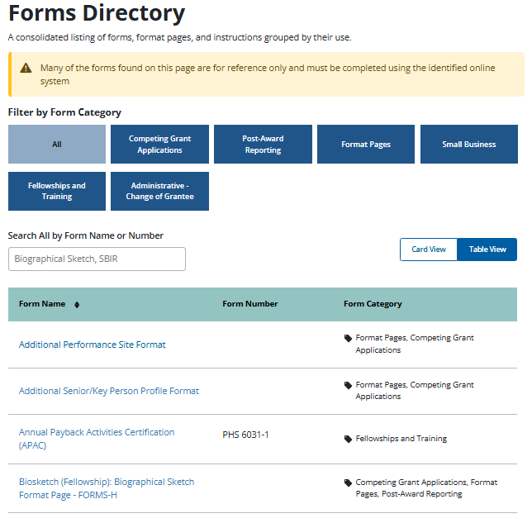
Forms Directory
A consolidated listing of forms, format pages, and instructions grouped by their use.
Searchable by form name or number
Can be viewed as a table or cards
Forms in the directory are for reference only and must be completed using the identified online system.
Learn more: Forms Directory

Slide 51
Format Attachments
NIH has very specific attachment formatting requirements.
Failure to follow these requirements may lead to application errors upon submission or withdrawal of your application from funding consideration.
Pay close attention to formatting.
Helps organize your application
Reduces errors
Preserves document formatting
Provides a consistent reading experience for reviewers and staff
Includes, but not limited to:
Citations
Font, Line Spacing
Figures
Margins
Learn more: Format Attachments

Slide 52
Rules for Text Field and Page Limits
Adhere to Rules for Text Fields
Allowable Characters
Unicode, with UTF-8 encoding
Cutting and pasting
Watch out for proprietary fonts, “smart” or “curly” quotes, formatting that is lost when you copy/paste
Field lengths
Adhere to the allowable character limit
Spaces and punctuation count
Some characters may use up more than one character against your limit
Formatting
No font and margin requirements in text fields
Pay close attention to text fields
Page Limits
ALWAYS follow the page limits, unless otherwise specified in the NOFO or related NIH Guide Notice
NOFO instructions supersede general application guide instructions and NIH Guide notice information supersedes bot the NOFO and the application guide.
If no page limit is listed in Section IV of the NOFO under Page Limitations, or in a related notice, you can assume the attachment does not have a limit.
Admin. Supps follow the appropriate page limits for the activity code of the parent award.
Learn more: Rules for Text Fields
Learn more: Page Limits

Slide 53
General Grant Writing Tips
Tip 1: Make your Project’s Goals Realistic and Clear
Make sure your specific aims are clear
Be Realistic, not overly ambitious
Be Explicit!
Tip 2: Be organized
Be specific and informative
Make sure your application is as easy to read as possible
Tip 3: Write in clear, concise language
Keep sentences clear, simple, and as short as possible
Avoid jargon
Be consistent with terms, writing style, references

Slide 54
General Grant Writing Tips (cont.)
Tip 4: Remember Your Reviewers are your primary audience
Read (and reread) the Review criteria in the NOFO
Emphasize the significance of the proposed project
Include enough background for the reader to understand your project
Use figures, tables, diagrams to summarize data and key, key concepts, project plan
Tip 5: Edit
Edit your application before submitting
Avoid typos, misspellings, grammar errors, disorganization
Be sure to follow instructions in the Application Guide re: formatting
Tip 6: Enlist Help
Ask peers, mentors, collaborators, experienced investigators for help

Slide 55
Specific Aims
The roadmap for your application
Goal: Grab the reader’s attention immediately
Focus on project goals, anticipated outcomes, and the resulting overall impact
State the hypotheses
State the long-term objectives and expected impact
Tell the reviewers what the results will mean
Organize the aims in a sequential, numerical format
Learn more: Specific Aims

Slide 56
Research Strategy
Significance
Answer the “so what” question
Highlight critical gaps that will be addressed by the proposed research
Demonstrate that the questions asked in your project are novel, important, and represent a logical next step in research
Innovation
Show how the proposed research refines, improves, or proposes a new application of an existing concept or method, or
Present a strong case for how the research will shift a current paradigm
Approach
Include preliminary studies/progress, availability of key resources
Show the proposed work is feasible, promising, and has potential impact
Learn more: Research Strategy

Slide 57
Budget and Budget Justification
START EARLY!
Check the NOFO to confirm what type of budget is required
Work with your Office of Sponsored Programs and Research Administrators on the various components of the budget
Contact the Financial/Grants Management Specialist in the NOFO if you have questions about allowable costs, calculating costs, other budget topics, etc.
Explain associated costs in the Budget Justification
If you wish to budget $500,000 or more in direct costs in any year of the project, seek prior approval from the NIH Institute/Center/Office at least 6 weeks before the anticipate submission date
Learn more: Develop Your Budget

Slide 58
Characteristics of Outstanding Grant Applications
Strong Significance, addresses an important problem in public health
IMPACT is high
Investigators have a strong track record (well-qualified applicant, compelling publications related to the proposed project
Clear rationale for the project
Relevant, supporting data
Clear, focused approach
Very organized organization
Careful attention to details (i.e., lack of spelling, grammar, errors, etc.)

Slide 59
Common Reasons Cited in Weak Applications
Weak impact—avoid “descriptive” or “incremental projects
Overly ambitious
Too many unrelated aims, aim dependency, too much stuffed into an application, lack of focus
Investigative team lack appropriate expertise
Lack of sufficient evidence of feasibility
Flawed approach and lack of a convincing description (or no discussion) of pitfalls and alternative approaches
Poor organization, confusing writing, lots of errors in spelling, grammar, typos, densely packed text, small figures, charts, etc.

Slide 60
Sample Applications
Sample Applications are not available for all grant programs. Because many programs have common elements, the samples may be helpful.
Sample Applications and Summary Statements
Sample NIH Formats, Sample Language and Other Examples

Slide 61
Q&A #1: NIH Expert Panel Part 1
Q&A #1: NIH EXPERT PANEL
MODERATOR
Megan Columbus
Director
Division of Communications and Outreach
Office of Extramural Research (OER), NIH
NIH PANELISTS
Sheri Cummins
Communications Strategist
Office of Extramural Research (OER), NIH
Lanay Mudd, Ph.D.
Deputy Branch Chief
Clinical Research in Complementary and Integrative Health Branch
National Center for Complementary and Integrative Health (NCCIH), NIH
LeShawndra Price, Ph.D.
Director, Office of Research Training and
Special Programs (ORTSP)
National Institute of Allergy and Infectious
Diseases (NIAID), NIH

Slide 62
INTERMISSION
Can you guess what this image is?
If you said a zebrafish larva, you are correct.
NIGMS/NIH Gallery: https://images.nigms.nih.gov/pages/DetailPage.aspx?imageid2=5881
The next segment will begin at 2:35 p.m. ET.
What’s Coming Up?
Submit, Track and View Your Application
Peer Review
Notice of Award
Monitoring & Reporting Overview
Useful Resources
Q&A Panel
We hope you’ll join us tomorrow, November 14, 2024, from 1:00 – 4:00 P.M. ET for interactive activities and demos focused on pre-award resources, tools, and systems.
In the meantime, check out the newly redesigned NIH Grants & Funding Website at https://grants.nih.gov.

Slide 63
NIH GRANTS PROCESS PRIMER Part One: An Overview
AGENDA (2nd Segment)
Submit, Track, and View Your Application
Peer Review
Award
Monitoring and Reporting
Useful Resources
Q&A Expert Panel
MODERATOR
Megan Columbus
Director
Division of Communications and Outreach
Office of Extramural Research (OER), NIH

Slide 64
NIH GRANTS PROCESS: SUBMIT
PRESENTER
Michelle Timmerman, Ph.D.
Associate Director &
Guide Liaison Officer
Division of Receipt and Referral (DRR)
Center for Scientific Review (CSR), NIH

Slide 65
AGENDA: Submit
Submission and systems
Checking for completeness: What computers check and what people check
Submission policies
Helpful Resource:
Submit | Grants & Funding (nih.gov)
Plan to Apply
Write Application
Submit
Review
Award
Monitoring and Reporting

Slide 66
On Time Submission
Final, error-free submission must be submitted by 5:00 PM local time on the due date
There is no error correction window
Submit early to use the 2-day viewing window to correct problems before the deadline
Late submission policy applies in few situations, NOT-OD-15-039
Document Federal systems issues with eRA Service Desk, before the due date/time even if the problem is with a non-eRA system
Federal systems issues are rare
Computer frustrations are less rare and do not qualify for late submission

Slide 67
Submit, Track, and View
Submit through ASSIST, Grants.gov Workspace, or your organization’s system-to-system solution
#SubmitEarly. Measure “early” on a calendar, not a clock.
Track your application in Grants.gov and eRA Commons
Don’t rely on email notifications
Grants.gov validates a few Federal-wide issues
Commons validates NIH-specific issues
View the assembled application image at eRA Commons
This is the exact application NIH receives
There is no error correction window

Slide 68
Validations Enforce Some, Not All, Requirements
Errors
Electronic bar to submission
Application was not accepted
eRA Commons Warnings
Flag high risk topics
Application was received, but staff, not systems, must check something
Application might be withdrawn

Slide 69
Many Checks are Done by NIH Staff Only
NOFO-specific requirements are not validated
NOFO-specific instructions apply to that NOFO only
Content of attachments is not validated
The presence of unallowed, extra attachments or material is not validated
Application instructions state what is allowed; no other items are allowed
Full instructions

Slide 70
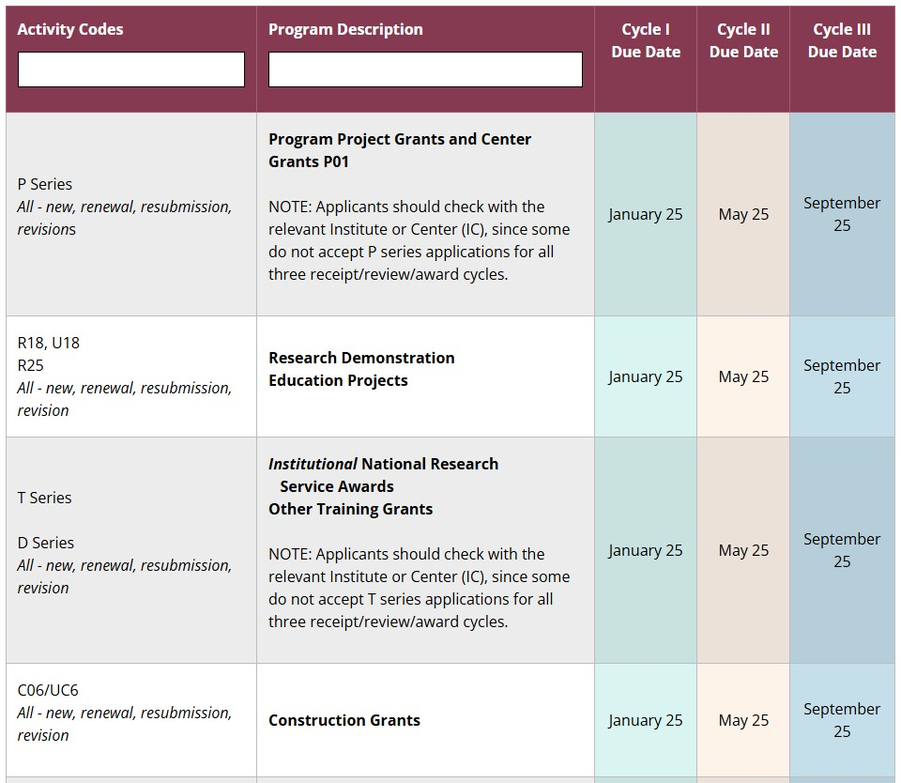
NIH GRANTS PROCESS: Review
RECEIPT AND REFERRAL
PRESENTER
Michelle Timmerman, Ph.D.
Associate Director &
Guide Liaison Officer
Division of Receipt and Referral (DRR)
Center for Scientific Review (CSR), NIH

Slide 71
AGENDA: Review (Receipt & Referral)
Application referral
Institute/Center and review group assignments
Assignment Request Form
Helpful Resources:
Application Receipt and Referral
Assignment Process
Plan to Apply
Write Application
Submit
Review
Award
Monitoring and Reporting

Slide 72
Referral Assigns Applications to Institute/Center and Review Group
Scientists progressively sort an application by topic to assign review group and IC, concurrently
At each level, the topics are progressively more focused
Procedures vary but ~4 scientists consider each application
CSR review groups and ICs have lists of topics for applications

Slide 73
Information is Shared in eRA Commons
Information is updated throughout the pre-review period
Assignments are usually visible within 2 weeks
IC assignment, full grant number (1 R01 IC 654321-01), review group, Scientific Review Officer, Program Officer
Official communications are linked in eRA Commons
Email can be unreliable
Meeting date and roster are provided
Do not contact reviewers

Slide 74
Institute/Center Assignments
ICs delineate assignment of topics of shared interests
RePORTER Matchmaker helps identify ICs and Program Officials
Applications that can’t be assigned to an IC on the NOFO (or NOSI) are withdrawn

Slide 75
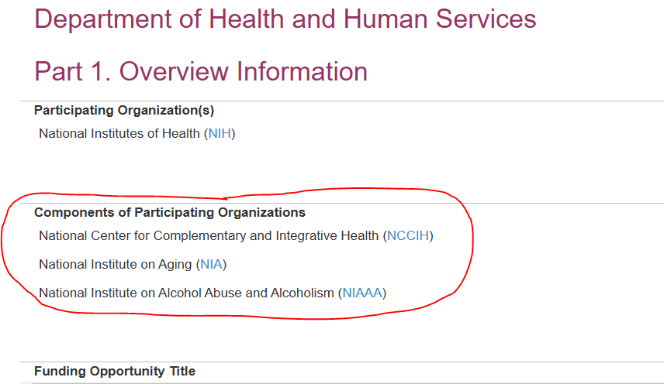
Verify the IC Participates in the NOFO
Check “Components of Participating Organizations” for your intended Institute/Center, unless following a NOSI

Slide 76
Review Group Assignments
Many PDs/PIs share review group suggestions
Applications are not withdrawn due to review assignment issues
Assisted Referral Tool helps identify CSR review groups
Contact NIH SROs, not reviewers
Some NOFOs have special review assignments, including review by ICs
These NOFOs list a Peer Review Contact in Section VII Agency Contacts

Slide 77
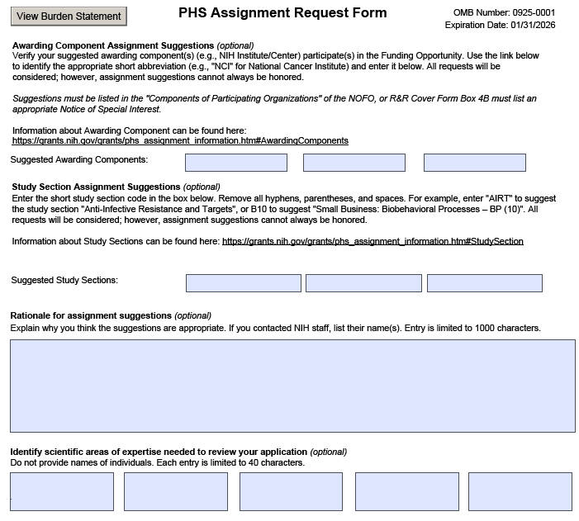
Use Assignment Request Form to Suggest ICs and Review Groups
Suggest assignments and provide rationale
Mention discussions with Program Officers
List areas of expertise needed to evaluate the application
DRR makes assignments based on the topics delineated for Institutes/Centers and review groups

Slide 78
NIH GRANTS PROCESS: peer Review
PRESENTER
Stephanie Constant, Ph.D.
Policy Review Officer
Office of Extramural Research (OER), NIH

Slide 79
AGENDA: Peer Review
Overview of the peer review process
1st level review
How are applications evaluated and scored?
2nd level review
What is the purpose of this second level?
Who to ask for questions at each stage
TIPS
Helpful Resources:
Review | Grants & Funding (nih.gov)
Peer Review Policies and Practices | Grants & Funding (nih.gov)
Plan to Apply
Write Application
Submit
Review
Award
Monitoring and Reporting

Slide 80
Which Ideas Should be Funded?
This is a BIG enterprise! In FY24:
84,955 applications
30,854 reviewers
2,408 meetings
Peer Review
NIH typically receives
>80,000 applications per year
Which are scientifically most meritorious

Slide 81
Two Levels of Peer Review are Required
PHS Act 42.USC.289a requires that for a grant award to be made by the NIH:
A written description of the work proposed must be reviewed by a Scientific Review Group (SRG).
The outcome of the SRG review must be provided to the funding Institute/Center (IC) Advisory Council.
Notes:
Sample Content Slide – you may include up to 10 content slides

Slide 82
Level-1: Scientific Review Groups (SRGs)
Evaluate the scientific and technical merit of the work proposed
Legal requirements for SRG panels:
Experts in scientific or technical fields
Encompass broad and diverse scientific views
Balanced representation
Experts can include (amongst others):
Basic/translational research scientists
Clinician scientists
Biotech/entrepreneur researchers
Scientific research mentors, evaluators, modelers, economists…
TIP: SRG rosters are publicly posted – you can check out their membership at NIH Scientific Review Group (SRG) Roster Index
Notes:
Sample Content Slide – you may include up to 10 content slides

Slide 83
Level-1: What Criteria Are Used to Evaluate Applications?
Standard review criteria must be used
Regulations for NIH peer review require that SRGs assess the overall impact that a project could have on the research field, taking into account (for research grants):
Significance of the goals of the project
Qualifications and experience of the investigators
Innovativeness and originality of the proposed research
Adequacy of the approach and methodology proposed
Scientific environment and resources available for the research
Adequacy of proposed protection of human subjects and animals
Adequacy of inclusion plans for gender, minorities, and children
Reasonableness of proposed budget relative to the research
‘Five
Regulatory
Criteria’
TIP: Check Section V of the NOFO for the criteria that will be used to review YOUR application
Notes:
Sample Content Slide – you may include up to 10 content slides

Slide 84
Level-1: How Are the Review Criteria Used?
There are three categories of review criteria
Category | Criterion Scores? | Affect Overall Impact Score?
Scored Review Criteria e.g., Significance, Investigators, etc. | Yes | Yes
Additional Review Criteria e.g., HS and Animal Protections | No | Yes
Additional Review Considerations e.g., Budget | No | No
NIH Scoring Scale: 1 – 9 (1 = best; 9 = worst)
Notes:
Sample Content Slide – you may include up to 10 content slides

Slide 85
Coming Soon: Simplified Review Framework!
For most types of research grants
Refocus review on evaluating scientific/technical merit
Reduce potential for reputational bias in peer review
TIP: Learn more at Simplifying Framework for Peer Review Criteria for Research Grants

Slide 86
Level-1: How Are Applications Actually Evaluated?
Your point of contact is the NIH Scientific Review Officer managing the review of your application
STEP 1: Each application is assigned to ≥ three reviewers:
Score review criteria using 1-9 scale
Provide written critiques of strengths/weaknesses
STEP 2: SRG meets to discuss top >50% scoring applications:
Assigned reviewers present strengths/weaknesses
After discussion assigned reviewers state their final scores
All SRG members provide final scores privately
Non-scorable issues discussed
TIP: To get an idea of how reviewers discuss applications - watch a recorded NIH mock study section at NIH Peer Review: Mock Study Section
Notes:
Sample Content Slide – you may include up to 10 content slides

Slide 87
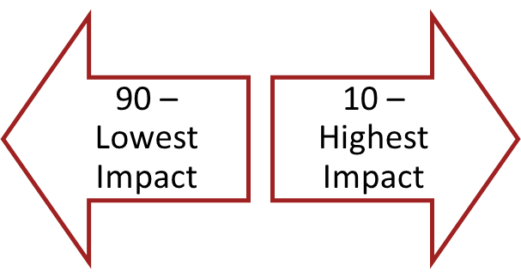
Level-1: Final Impact Scores
Final impact scores reflect the SRG’s assessment of the overall impact that a project could have on the research field
How final impact scores are calculated:
Average of all reviewers’ scores, multiplied by 10
Range from 10 through 90
Percentiled for some activity codes:
Most R01s

Slide 88
Level-1: How Are Review Outcomes Communicated?
Summary statements summarize Level-1 review outcomes
Will include:
final overall impact score
scores for each criteria
reviewers’ comments
[summary of SRG discussion]
Are shared with:
applicant(s)
IC Advisory Council(s)
TIP: NIH staff will present a walk-through of a summary statement on Day 2 of this event

Slide 89
Level-2: NIH National Advisory Councils
Make funding recommendations to Institute/Center (IC) directors based on Level-1 SRG reviews
Broad and diverse membership
includes “public” members
Recommend applications for funding
awards cannot be made without Council approval
Advise IC Director about
research priority areas
policy issues
funding priorities
Notes:
Sample Content Slide – you may include up to 10 content slides

Slide 90
How Do Review Outcomes Translate to Funding?
The IC Director makes the final funding decisions
Based on:
Outcome (score/percentile) of initial peer review
Recommendation of the IC Advisory Council
Mission of the NIH Institute or Center
Program priorities, Congressional mandates
AVAILABLE FUNDS
Notes:
Sample Content Slide – you may include up to 10 content slides

Slide 91
What Should YOU Do Next?
Your point of contact is the NIH Program Official assigned to your application.
If you get a good score / funding a possibility, you may be asked to:
Submit Just-in-Time (JIT) information
Resolve human subject, vertebrate animal, inclusion concerns
If funding is unlikely, consider your options:
Submit a new application
Revise and resubmit your application
Appeal the review outcome (NOT-OD-11-064)

Slide 92
NIH GRANTS PROCESS: Award
PRESENTERS
Crystal Wolfrey
Chief Grants Management Officer
Office of Grants Administration
National Cancer Institute (NCI), NIH
Sean Hine
Deputy Chief Grants Management Officer
Office of Grants Administration
National Cancer Institute (NCI), NIH

Slide 93
AGENDA: Award
Just In Time (JIT)
Notice of Award (NoA)
Acceptance of Terms & Conditions of Award
Plan to Apply
Write Application
Submit
Review
Award
Monitoring and Reporting

Slide 94
Just-In-Time (JIT)
Previously, NIH was sending out an automated message for JIT to all applicants to a set score
Now, this process has been changed – the individual NIH Institutes/Centers (ICs) will be sending out requests for JIT

Slide 95
Received a JIT request?? Time to celebrate, right?

Slide 96
Not to be a “Debbie Downer”…
This is good news – the NIH IC is considering your application further
The JIT information is needed to continue the review and potential negotiations
A JIT request is NOT a notification of a forthcoming Notice of Award!

Slide 97
So, what is asked for in the JIT request?
It MUST include:
Complete Other Support for all key personnel
The AS APPLICABLE items:
If human subjects research involved – IRB approval date and human subjects research education documentation
If animal subjects research involved – IACUC approval date
Human Embryonic Stem Cells (hESCs)
Genomic Data Sharing Institutional Certification
SBIR/STTR application?
Must also include the Foreign Disclosure Form and SBIR or STTR Funding Agreement Certification
Resource: NIH Grants Policy Statement: Just-In-Time Procedures

Slide 98
When and how?
Technically, the JIT link is available shortly after the application score is published
However, applicants should only provide JIT when a notification to submit is received
Submission should be done through the eRA Commons
At times, the NIH IC may request an email submission
Learn more: Submit Just-In-Time

Slide 99
Want to hear about some JIT issues??
Common JIT pitfalls…
Other Support totals to more than 12 Calendar Months (active support plus the grant under consideration)
Other Support is not signed correctly
IRB or IACUC approval dates are too old
For Small Businesses – forgetting to include the foreign disclosure document!

Slide 100
Ok, JIT is In… NIH IC has Completed Its Review… So…
Now it’s time to celebrate, right?

Slide 101
Notice of Award (NoA)
Legally binding document
Identifies, among other things:
Grant #
Recipient Information, including Employer Identification Number
PI/PD
Federal Agency Information
Federal Award Information
Communicates the transmission of $ - direct and indirect costs – and anticipated period of support
Provides the contact info for the assigned NIH Grants Management Specialist and Program Official
Resource: NIH Grants Policy Statement - The Notice of Award

Slide 102
What else to know about the NoA?
Payment information is provided
Cumulative budget approved by the NIH Awarding IC
Anticipated future-year commitments (if applicable)
Indirect cost rate that was used for purposes of cost calculation
Sent to the identified e-mail address as provided in the “NoA Email” field in the eRA Commons
This is maintained by the recipient – not NIH
Available for viewing in the eRA Commons
And … provides the Terms & Conditions…more on that!

Slide 103
Terms & Conditions of Award
The NoA also sets forth the Terms & Conditions of Award
There are Standard Terms & Conditions (Section III) that are included on all NIH NoAs, which include:
Reminder that the award is based on the application submitted and as approved by NIH
Incorporates other statutory requirements, 45 CFR Part 75, the NIH Grants Policy Statement, NIH Public Access Policy, federal civil rights laws
Includes whether an unobligated balance may be carried over with or without Grants Management Officer prior approval.
States whether the grant is subject to the Streamlined Noncompeting Award Procedures (SNAP)

Slide 104
More Terms & Conditions
NIH IC Specific Award Conditions (Section IV) – these are established by the awarding IC for this award. Examples included:
Human Subjects and/or Animal Subjects research-specific requirements
Designation of other personnel as Key, and therefore, incorporates prior approval requirements
Any funding-specific information such as funding level, NIH Guide Notice enforcement (ex. Funding under a Continuing Resolution)
Restriction of funds for a specified purpose
Special grant- or program-specific requirements, such as:
Additional reporting
Milestones
Minimum effort for PI/PD and/or identified key personnel

Slide 105
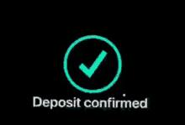
Accepting the Terms & Conditions?
Recipient accepts an NIH award by drawing funds!
Resource: Accepting the Award

Slide 106
NIH GRANTS PROCESS: MONITORING and Reporting
PRESENTERS
Crystal Wolfrey
Chief Grants Management Officer
Office of Grants Administration
National Cancer Institute (NCI), NIH
Sean Hine
Deputy Chief Grants Management Officer
Office of Grants Administration
National Cancer Institute (NCI), NIH

Slide 107
AGENDA: Monitoring and Reporting
Post-Award Requirements (An Overview)
Managing Changes to the Award
Data Management & Data Reporting Requirements
Plan to Apply
Write Application
Submit
Review
Award
Monitoring and Reporting

Slide 108
Now That You Have the Award… What’s Next?
Lots of post-award monitoring and reporting is required
Monitoring the award:
Day-to-day monitoring is the responsibility of the recipient!
NIH monitors through reporting and ad hoc technical assistance if potential problems arise
Reporting requirements, a few to consider:
Progress reporting through the Research Performance Progress Reports (RPPR) through the eRA Commons at least annually
Invention reporting (if applicable) – inventions must be reported through the Interagency Edison (iEdison) system and reported in the RPPR
NIH Public Access Policy applies throughout the performance period
Human subjects and/or clinical trial-specific reporting (as applicable)
Closeout Reporting Requirements

Slide 109
Changes to the Award: Prior Approval Requirements
First, check the NIH Grants Policy Statement to see whether you have the authority or need prior approval
https://grants.nih.gov/grants/policy/nihgps/html5/section_8/8.1.2_prior_approval_requirements.htm
If you need prior approval, send it through the NIH eRA Prior Approval Module
https://www.era.nih.gov/erahelp/commons/commons/prior_approval%20module/prior_approval.htm)
Remember! The official response to any prior approval request MUST come from the NIH Grants Management Officer!

Slide 110
Before We Go … Data Management and Reporting
For most applications submitted now (receipt dates on/after January 25, 2023), the NIH Data Management & Sharing Policy applies
Check the policies to see if the DMS Policy applies to your application
Under this policy, NH expects that investigators and institutes:
Plan and budget for managing and sharing of data
Submit a DMS plan for review when applying for funding
Comply with the approved DMS plan
Learn More: Data Management and Sharing Policy
Be sure to check the individual NIH IC requirements as well: NIH Institute and Center Data Sharing Policies

Slide 111
Questions?
Have more questions on your application and award?
Reach out to your NIH Grants Management Specialist and/or Program Official!

Slide 112
NIH GRANTS PROCESS: USEFUL RESOURCES
PRESENTER
Sheri Cummins
Communications Strategist
Division of Communications and Outreach
Office of Extramural Research (OER), NIH

Slide 113
AGENDA: Useful Resources
NIH Grants & Funding site
How to prepare to apply (sites, registration)
RePORT
ASSIST

Slide 114
NIH Grants & Funding
https://grants.nih.gov/
Help
Glossary
FAQs

Slide 115
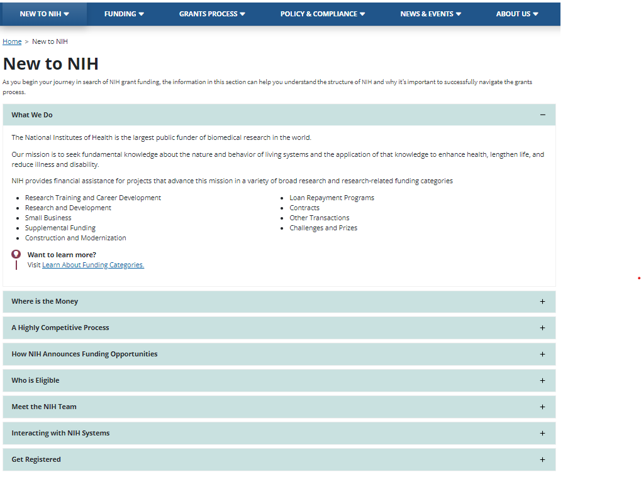
New to NIH
Key concepts with links to dig deeper into each topic
Registration information

Slide 116
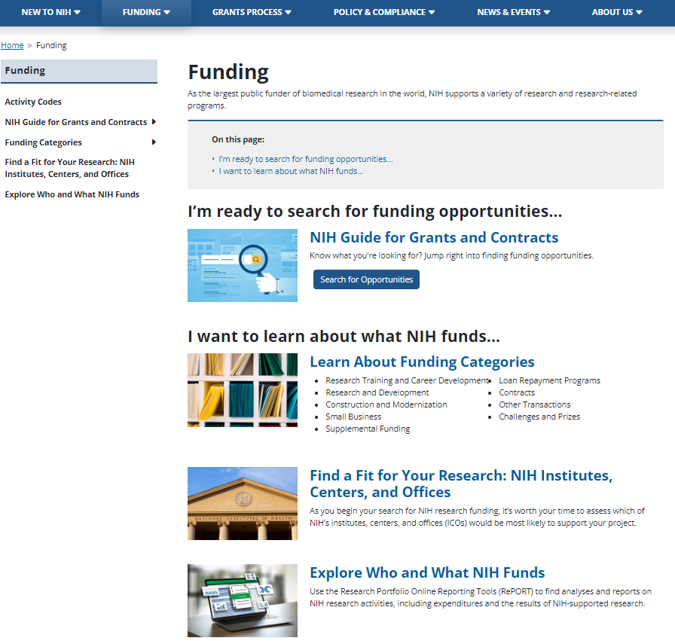
Funding
NIH Guide for Grants and Contracts
Learn about funding categories and the grant programs within them
Find a Fit: ICOs
Explore who and what NIH funds
RePORT

Slide 117
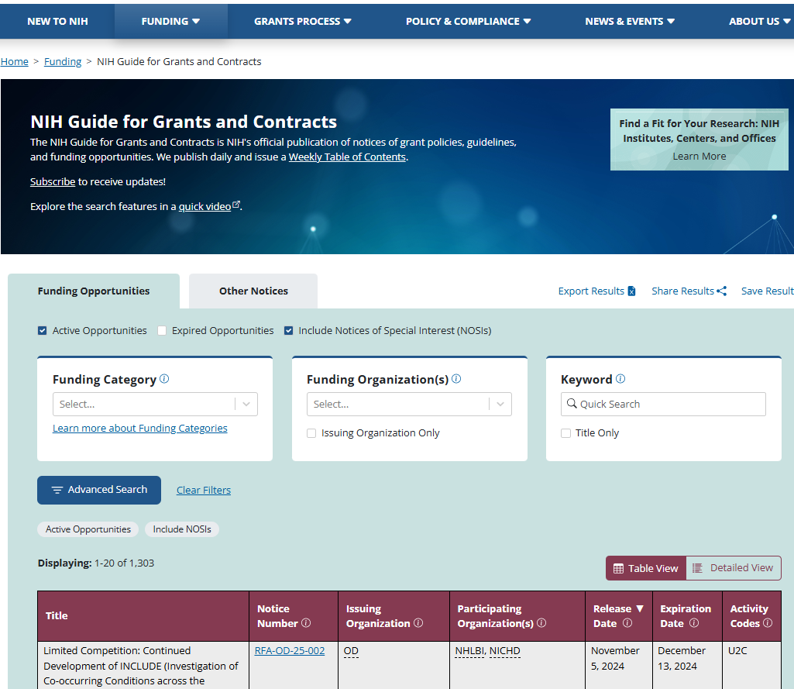
NIH Guide for Grants and Contracts
Take a quick video tour of our updated NIH Guide system.
Check out tomorrow’s session:
Finding the Right Opportunity

Slide 118
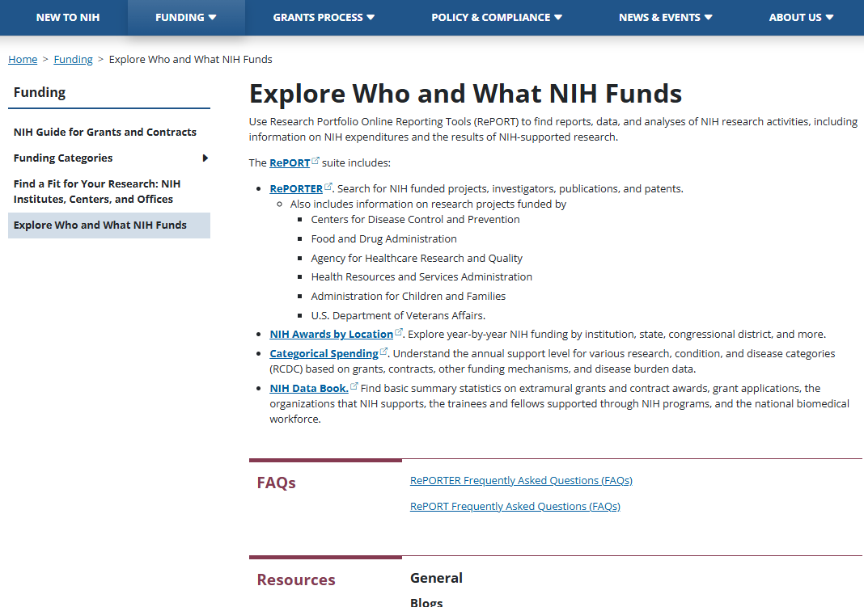
Explore Who and What NIH Funds
Research Portfolio Online Reporting Tools (RePORT) suite of tools
Check out tomorrow’s session:
RePORT, RePORTER, and NIH Data Book
RePORT

Slide 119
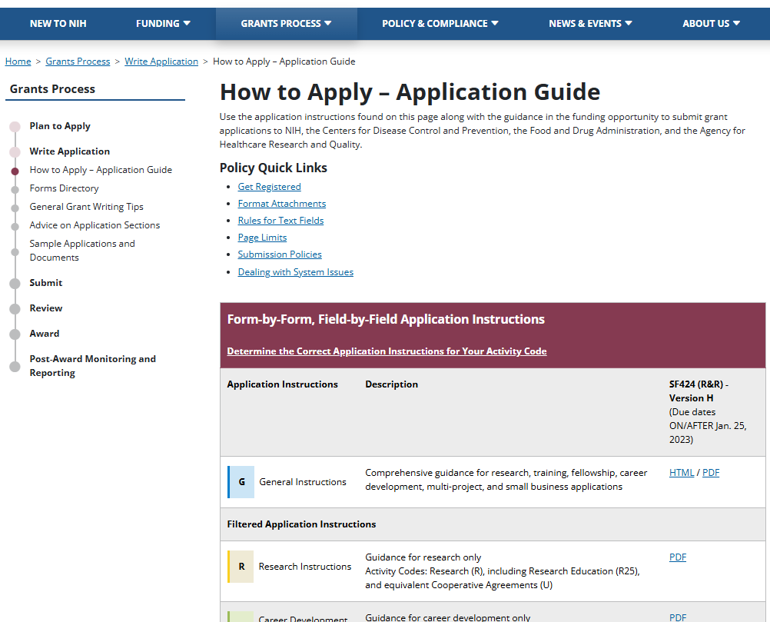
Grants Process
Plan to Apply
Write Application
Submit
Review
Award
Post-Award Monitoring and Reporting
How to Apply – Application Guide

Slide 120
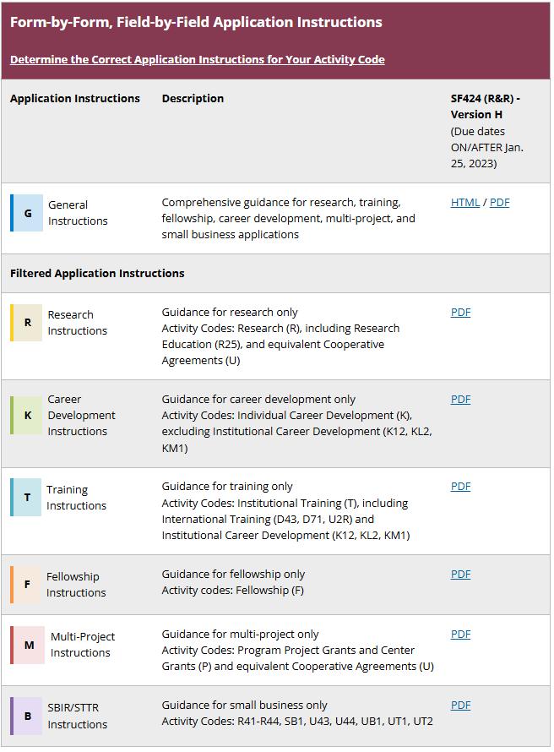
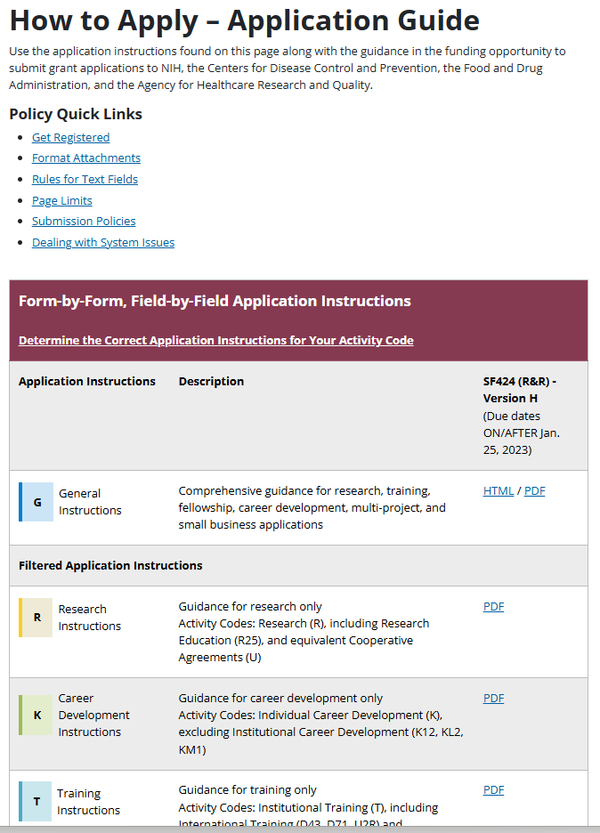
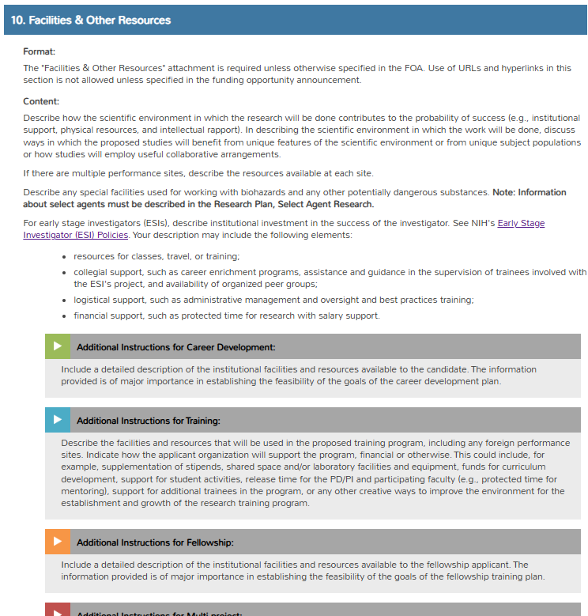
How to Apply – Application Guide
The General Instructions include basic instructions for all forms and all additional program-specific instruction call-outs.
Excerpt from General Instructions
Basic instructions
Call-outs for additional program-specific instructions

Slide 121
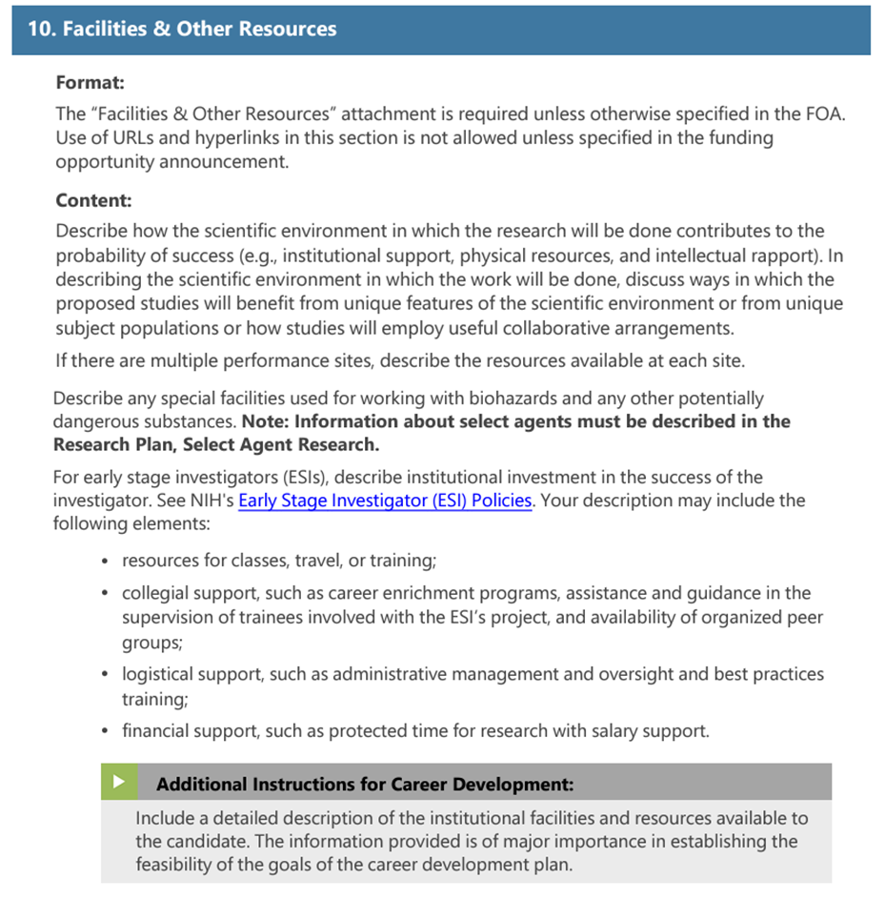
How to Apply – Application Guide (cont’d)
The Filtered Instructions include only the forms, basic instructions, and additional instruction call-outs for the specific program.
Excerpt from filtered Career Development Instructions
Basic instructions
Additional instruction call-out for Career Development only

Slide 122
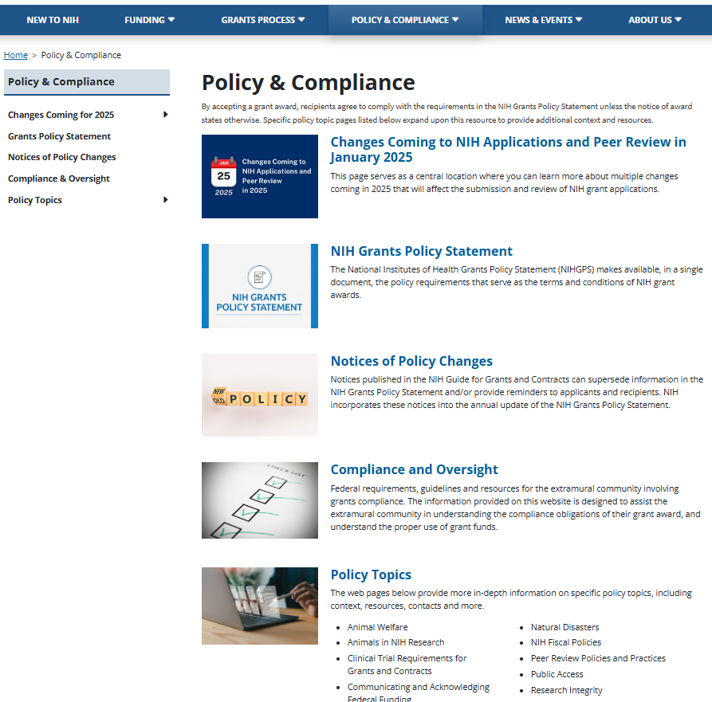
Policy & Compliance
Changes coming in 2025
Grants Policy Statement
Policy notices posted in the NIH Guide
Compliance & Oversite
Policy Topics

Slide 123
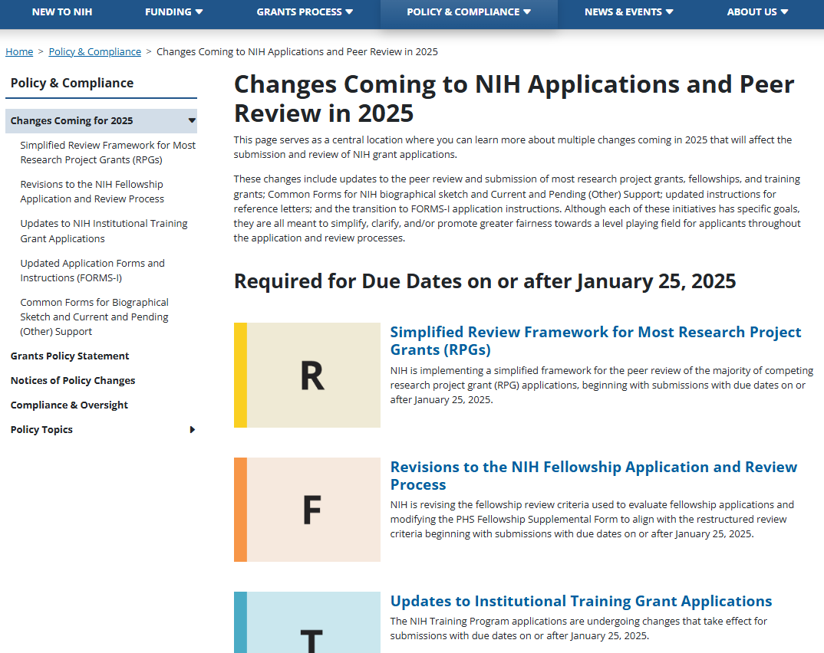
Changes in 2025
Central location to learn about multiple changes coming in 2025 that will affect the submission and review of grant applications.

Slide 124
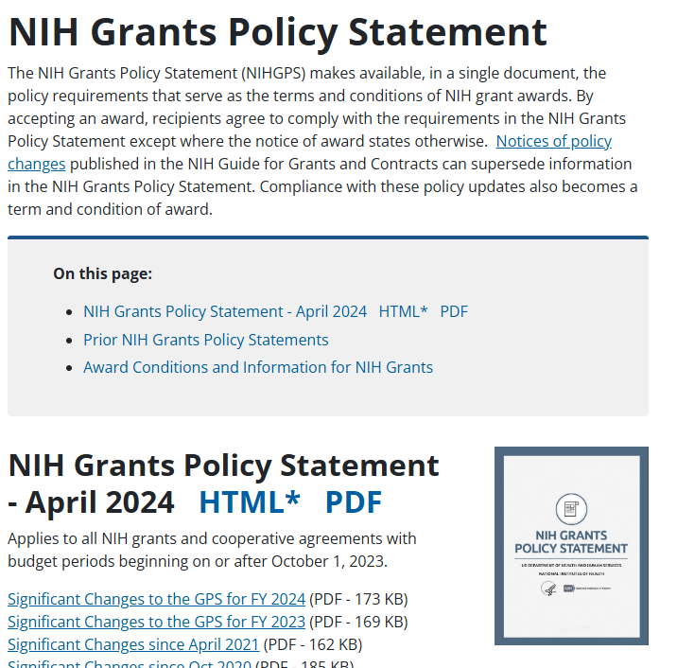
NIH Grants Policy Statement
Visit: NIH Grants Policy Statement
Visit: Notices of NIH Policy Changes

Slide 125
News & Events
Grants Administration News
Upcoming and past events and resources
Social media
Podcasts
Open Mike blog and Extramural Nexus newsletter

Slide 126
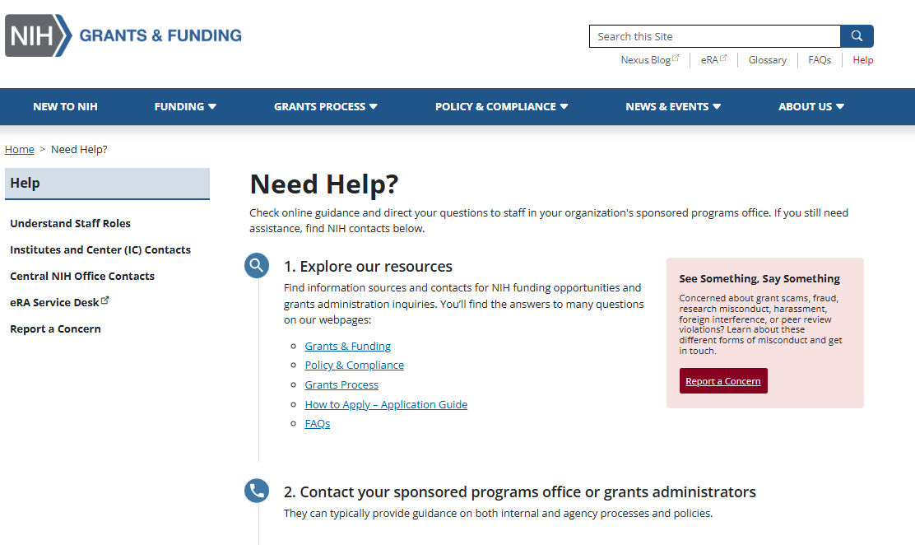
Need Help?
Help utility link.
Contacts to report grant scams, fraud, research misconduct, harassment, foreign interference, and peer review integrity violations.

Slide 127
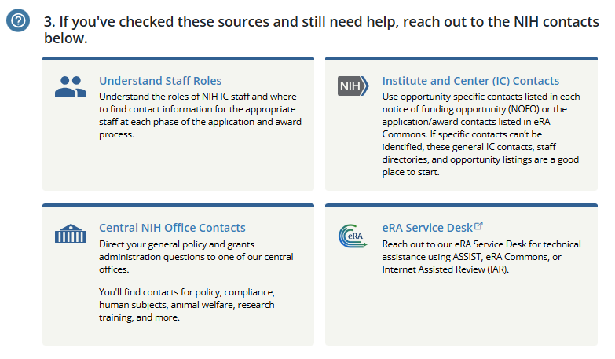
Still Need Help?

Slide 128
Q&A #2: NIH EXPERT PANEL
MODERATOR
Megan Columbus
Director
Division of Communications and Outreach
Office of Extramural Research (OER), NIH
NIH PANELISTS
Stephanie Constant, Ph.D.
Policy Review Officer
Office of Extramural Research (OER), NIH
Sheri Cummins
Communications Strategist
Office of Extramural Research (OER), NIH
Sean Hine
Deputy Chief
Grants Management Officer
Office of Grants Administration
National Cancer Institute (NCI), NIH
Michelle Timmerman, Ph.D.
Assoc. Director & Guide Liaison Officer
Division of Receipt and Referral (DRR)
Center for Scientific Review (CSR), NIH
Crystal Wolfrey
Chief
Grants Management Officer
Office of Grants Administration
National Cancer Institute (NCI), NIH

Slide 129
NIH GRANTS PROCESS: PART ONE WrAP UP
MODERATOR
Megan Columbus
Director
Division of Communications and Outreach
Office of Extramural Research (OER), NIH

Slide 130
You’ve Taken the First Steps to Success!
Today: Part One
You’re here!
Overview of the NIH
Basics of the NIH Grants Process
Useful resources
Tomorrow: Part Two
Recap with a dive into terminology
Walk-through of systems and resources throughout the process
RePORTER
Notice of Funding Opportunity (NOFO)
Application Writing Tips
Summary Statement
Notice of Award (NoA)
Engage with Knowledge Checks
THANK YOU!

