Slide 1
Including Diverse Populations in NIH-funded Clinical Research Dawn Corbett, MPH NIH Inclusion Policy Officer Division of Human Subjects Research, Office of Extramural Research December 7, 2022
2022-2023 NIH Grants Pre-Conference Event

Slide 2
Timeline of NIH Inclusion Policies
1986
1994
1998
NIH encourages inclusion of women
NIH requires inclusion of women and racial and ethnic minorities
NIH requires inclusion of children
NIH changes child definition to under 18
2015
2017
2019
New Phase 3 reporting requirements
NIH requires inclusion of individuals of all ages
2
2
2

Slide 3
NASEM Report on Improving Representation in Clinical Trials Research
Full report at https://nap.nationalacademies.org/read/26479/chapter/1

Slide 4
Inclusion of Women and Members of Racial and Ethnic Groups
Women and members of racial and ethnic minority groups must be included in all NIH-funded clinical research studies unless there is a compelling rationale for exclusion
Additional requirements for NIH-defined phase 3 clinical trials
Analysis of primary outcome by sex/gender, race and ethnicity
Status/results reported in progress reports/RPPR Project Outcomes
If applicable clinical trial (ACT) must report results of analyses in Clinicaltrials.gov
Policy Notice: NOT-OD-18-014

Slide 5
Inclusion Across the Lifespan
Individuals of all ages must be included in NIH human subjects research unless there are scientific or ethical reasons not to do so
Requires submission of individual-level participant data in progress reports
Sex or Gender
Race
Ethnicity
Age at Enrollment
Policy Notice: NOT-OD-18-116

Slide 6
Knowledge Check 1 – Policy
Cost is an acceptable reason to exclude women from an NIH clinical research study
FALSE

Slide 7
Knowledge Check 2 - Policy
Children may be excluded from a study on Alzheimer’s disease because the condition does not occur in children
TRUE

Slide 8
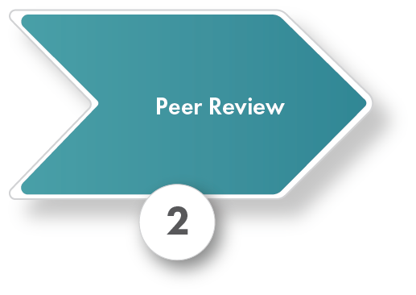
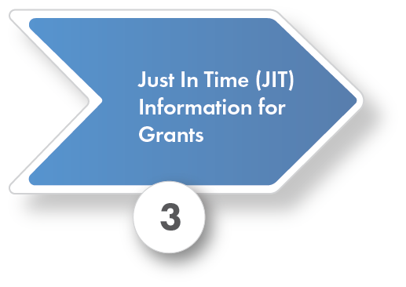
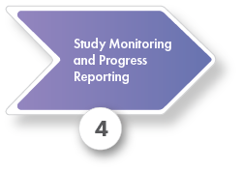
Inclusion in the NIH Funding Process
Inclusion plans
Inclusion enrollment report
Information requested by NIH staff
Cumulative enrollment progress
Progress/reporting on valid analyses

Slide 9
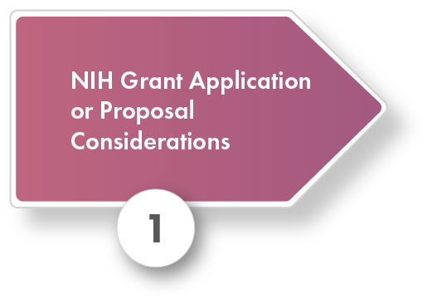
What’s Required When Applying for Funding?
Inclusion Plans
Women and Racial and Ethnic Minorities
Individuals Across the Lifespan
Min/Max Age Limits
Inclusion enrollment report

Slide 10
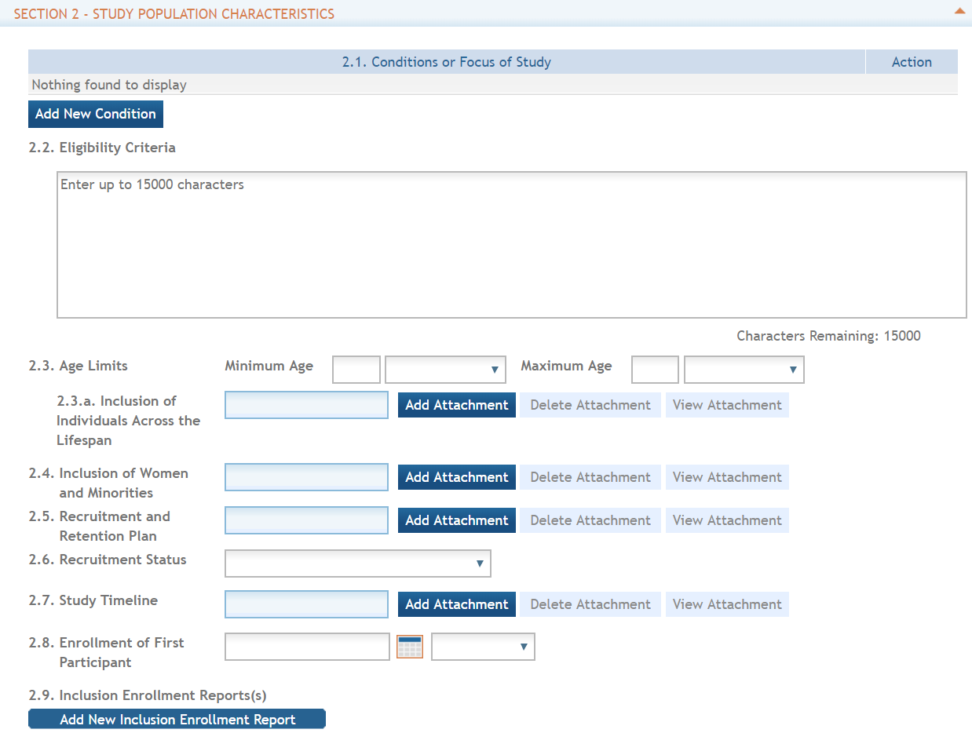
PHS Human Subjects and Clinical Trials Form
See the Application Guide for detailed information
PHS HS/CT Information Form
Study Record
Basic information
Study Population Characteristics
Protection and Monitoring Plans
Protocol Synopsis
Other Clinical Trial-related Attachments

Slide 11
What’s Included in the Inclusion of Women and Minorities Plan?
Description of planned distribution by sex or gender, race, and ethnicity
Rationale for the selection
Justification for any exclusions
Proposed outreach programs for recruitment
For NIH-defined Phase 3 trials, plans for analysis by sex or gender, race, and ethnicity

Slide 12
What’s Included in the Inclusion Across the Lifespan Plan?
Rationale for age distribution, including how it will contribute to analysis
Justification for any exclusions
Description of study team expertise and appropriateness of facilities for included age groups

Slide 13
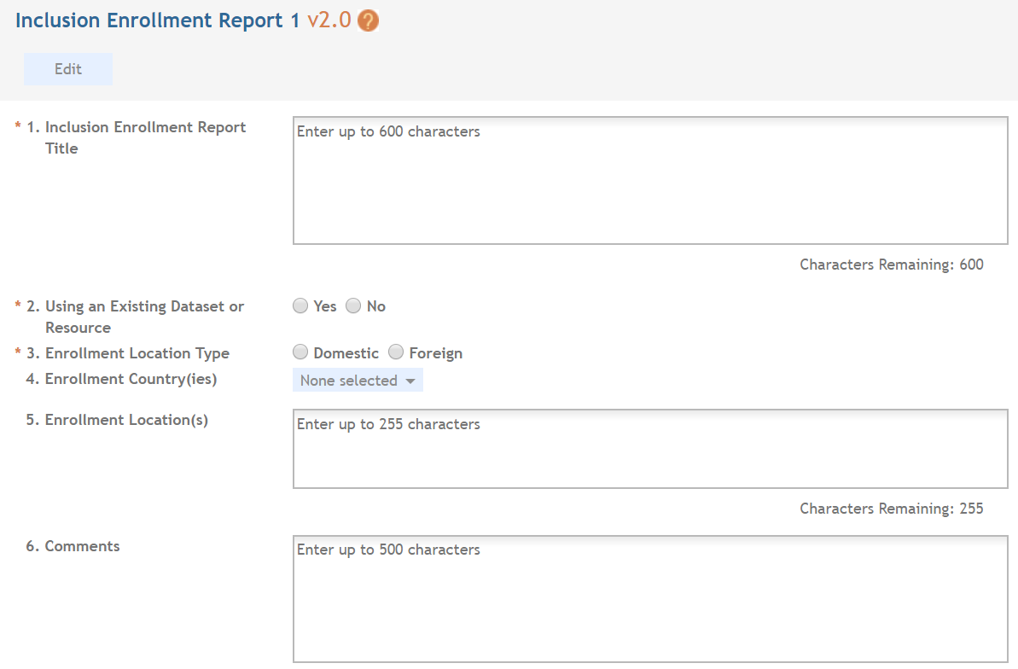
Inclusion Enrollment Report
Inclusion Enrollment Report Title
Specify whether Existing Dataset or Resource will be Used
Include Separate Tables for Domestic/Foreign Populations

Slide 14
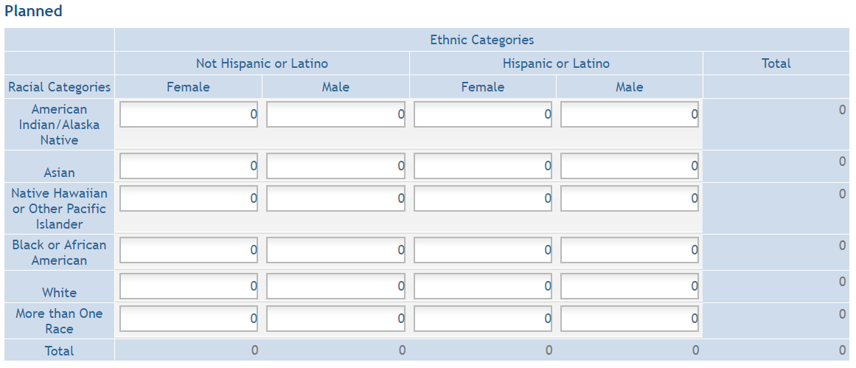
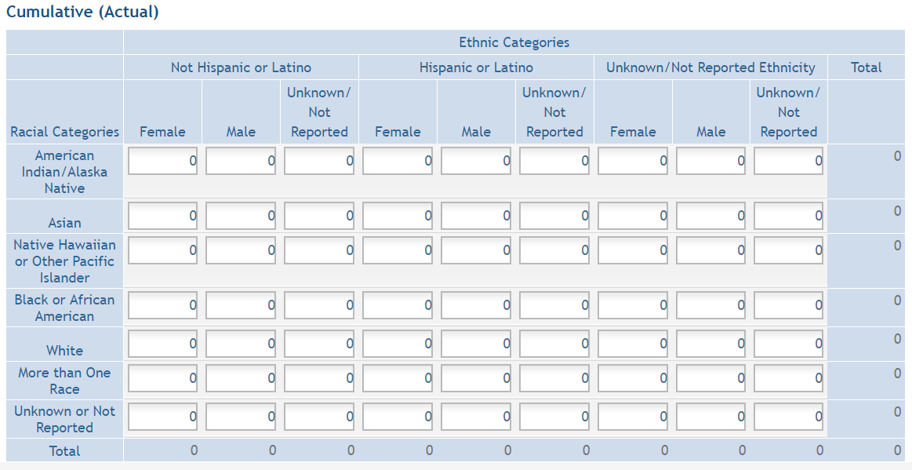
Planned and Actual Enrollment

Slide 15
Knowledge Check - Application
In the justification section of my Inclusion of Women and Minorities plan, I should explain that the distribution of participants is based on local demographics
FALSE…UNLESS ADDITIONAL INFORMATION IS PROVIDED

Slide 16
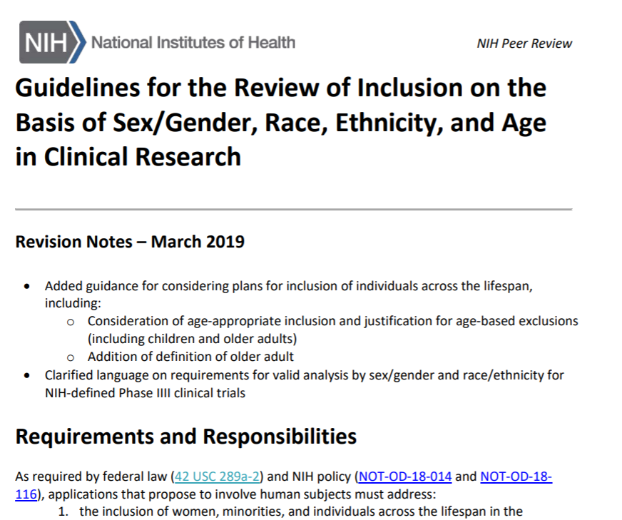
Peer Review of Inclusion
Guidelines available at https://grants.nih.gov/grants/peer/guidelines_general/Review_Human_Subjects_Inclusion.pdf

Slide 17
Summary Statement
SUMMARY STATEMENT
PROGRAM CONTACT: (Privileged Communication) Release Date: 08/11/2020
Jane Doe
240 111-5555
janesmith@od.nih.gov
____________________________________________________________________________________
Application Number: 1 R01 IC12345-01
Principal Investigator
DOE, JOHN
Applicant Organization: ABC SCHOOL OF MEDICINE
Review Group: ZRG1 ABC-D(50)
Center for Scientific Review Special Emphasis Panel
Program for Collaborative Biomedical Research
Meeting Date: 07/20/2020 RFA/PA: IC 20-006
Council: OCT 2020 PCC: M51B B
Requested Start: 12/01/2020
Project Title: An Excellent Research Project
SRG Action: Impact Score: 24
Next Steps: Visit http://grants.nih.gov/grants/next_steps.htm
Human Subjects: 30- Human subjects involved
Animal Subjects: 30-Vertebrate animals involved - no SRG concerns noted
Gender: 1A-Both Genders, scientifically acceptable
Minority: 5A-Only foreign subjects, scientifically acceptable
Age: 3U-No children (only adults and older adults), scientifically unacceptable. Clinical Research - not NIH-defined Phase III Trial
Notes:
17

Slide 18
Knowledge Check – Peer Review
For my R01 application, peer review will consider my inclusion plans under “Approach” and “Additional Review Criteria”
TRUE

Slide 19
Just-in-Time Requirements
Unacceptable applications must resolve inclusion concerns prior to funding
Work with Institute/Center staff
Provide requested documents or revisions
Missing/corrected inclusion enrollment report
Revisions due to peer review and/or programmatic adjustments
19

Slide 20
After the Award…Now What?
Cumulative actual inclusion enrollment data
Special situations
NIH-defined Phase III Clinical Trials
Status/results of analyses by sex or gender, race, and ethnicity
ACTs, report these results in Clinicaltrials.gov
Delayed onset studies
Provide full PHS Human Subjects and Clinical Trials Information Form once study can be described

Slide 21
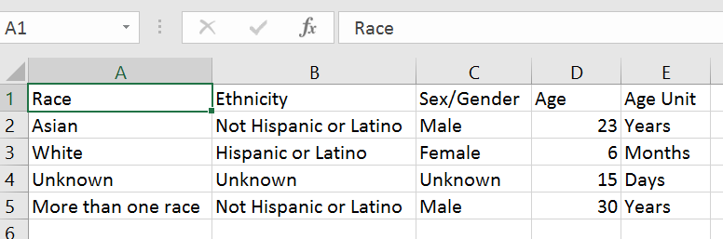
Individual-level Participant Data

Slide 22
Knowledge Check – Post-Award
Which of the following participant characteristics does NIH require to be reported in progress reports? Select All that Apply.
Sex or gender
Disability status
Race
Ethnicity
Primary language
Age at Enrollment

Slide 23
Case Study #1
A researcher proposes a study investigating risk factors for eating disorders that will exclude males because the prevalence of eating disorders is lower in males than in females.

Slide 24
Case Study #2
A researcher proposes a study for a new drug that will exclude individuals over 60 because of the likelihood of hypertension in this age group.

Slide 25
Case Study #3
A researcher proposes a study of glycemic control in adolescents and young adults ages 13-24. Other ages will be excluded because the study will target individuals in a unique developmental stage with higher risk of poor glycemic control than other age groups.

Slide 26
Inclusion Across the Lifespan II Workshop
Recurrent Themes
Limiting inclusion/exclusion criteria
Weighing risks of exclusion vs. participation
Minimizing participant and caregiver burden
Considering diversity within populations
Assessment and adjustment of recruitment/retention
Researcher training and resources
September 2, 2020
Report available on Inclusion Across the Lifespan website https://grants.nih.gov/policy/inclusion/lifespan.htm
26

Slide 27
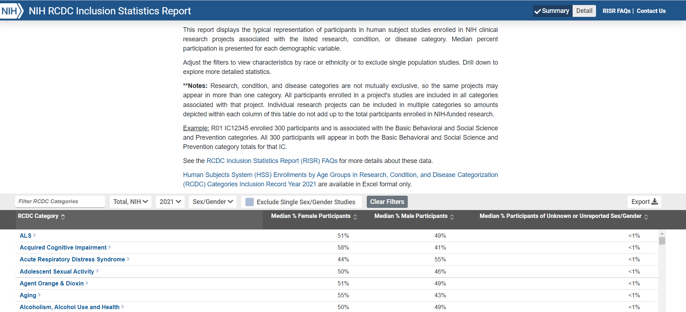
NIH Inclusion Data
Data available on the RePORT website at https://report.nih.gov/RISR/#/
27

Slide 28
Resources
WEB
Inclusion of Women and Racial and Ethnic Minorities
https://grants.nih.gov/grants/funding/women_min/women_min.htm
Inclusion Across the Lifespan
https://grants.nih.gov/grants/funding/lifespan/lifespan.htm
Available Resources on the Recruitment and Retention of Women, Racial and Ethnic Minorities, and Individuals Across the Lifespan
https://grants.nih.gov/sites/default/files/Resources_Recruitment_and_Retention_WM%2CIAL_final508c.pdf

