Slide 1
NIH Research Enhancement Award (R15)… What You Need to Know!
Academic Research Enhancement Award
(AREA)
Research Enhancement Award Program
(REAP)
June 15, 2023

Slide 2
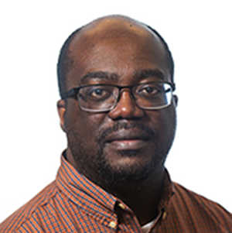
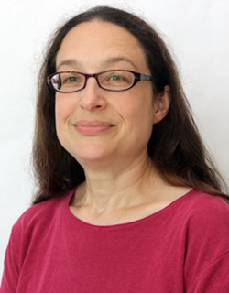
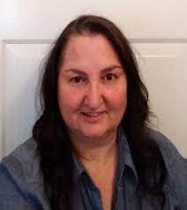
Meet Your Presentation Team
MODERATOR
PRESENTERS
Charles Ansong, Ph.D.
Program Director
National Institute of General Medical Sciences (NIGMS)
Anne Gershenson, Ph.D.
Program Director
National Institute of General Medical Sciences (NIGMS)
Liz Perruccio, Ph.D.
Program Director
National Institute of Nursing Research (NINR)

Slide 3
In today’s session, you will learn…
The answer to the question “What is the NIH R15 Program?”
Differences between the R15 and the R01
Specifics of the R15 Notices Of Funding Opportunities (NOFOs)
How to determine eligibility for the R15 program
Differences between the Academic Research Enhancement Award (AREA) and Research Enhancement Award Program (REAP)
Some strategies for success

Slide 4
What is the goal of the R15 program?
Credit: iStock
Support meritorious, small scale research grants at institutions that do not receive substantial NIH funding
Provide research opportunities to students who might not otherwise have access to them
Strengthen the overall research environment at the institution

Slide 5
R15 landscape: Active awards across NIH
NICHD 8.0%
NCI 8.0%
NHLBI 7.3%
NIAID 6.5%
NINDS 6.1%
NIA 5.3%
NIMH 5.2%
23 participating NIH Institutes/Centers
>1100 active
projects

Slide 6
How is the R15 different from an R01?
R15 | R01
Impact: Publishable, disseminated, and important scientific contribution to the research field(s) involved | Impact: A sustained, powerful influence on the research field(s) involved
Scope: Could be limited due to limitations of facilities and personnel | Scope: Broader, could extend across one or multiple fields
Must describe research opportunities for students | Not relevant
Must describe how the award will strengthen the research environment of the institution | Not relevant
Foreign Institutions: Non-domestic (non-US) entities and non-domestic (non-US) components of US organizations are not eligible but foreign components are allowed | Foreign Institutions: Non-domestic (non-US) entities and non-domestic (non-US) components of US organizations are eligible

Slide 7
Key features of the R15
Makes an important scientific contribution to the research field(s) involved; not a training grant
3-year project period
Provides up to $300,000 in direct costs over 3 years
Includes a 12-page research strategy
Same scored review criteria as R01 with added emphasis on student engagement
Can have multiple PIs if all PIs are eligible for the same R15 NOFO
Renewable
Credit: iStock

Slide 8
R15 Notices Of Funding Opportunities (NOFOs)
Academic Research Enhancement Award (AREA) for Undergraduate-Focused Schools
Research Enhancement Award Program (REAP) for Health Professional and Graduate Schools
PAR-21-154 (Clinical Trial (CT))
PAR 21-155 (no CT)
PAR-21-357 (CT)
PAR-22-060 (no CT)
Some institutions may be eligible for BOTH the AREA and REAP programs

Slide 9
Defining Undergraduate-focused schools and Health Professional schools (refer to NOFOs)
Undergraduate-Focused Schools
Confer baccalaureate degrees in biomedical sciences
An undergraduate-focused institution/component is one in which the undergraduate enrollment is greater than the graduate enrollment
Health Professional Schools
Health professional schools and colleges are accredited institutions that provide education and training leading to a health professional degree including but not limited to: BSN, MSN, DNP, MD, DDS, DO, PharmD, DVM, OD, DPT, DC, ND, DPM, MOT, OTD, MS-SLP, CScD, SLPD, AuD, MSPO, MSAT, and MPH
Accreditation must be provided by a body approved for such purpose by the Secretary of Education

Slide 10
Am I eligible for a REAP R15?
Cannot be the PI of another NIH research grant at time of award
Primary appointment in a Health Professional School or Graduate School, including nursing programs/schools
NIH Funding for the institution as a whole cannot exceed $6M/year (in both direct and F&A/indirect costs) in 4 of the last 7 years
For more information: https://grants.nih.gov/grants/funding/R15-Eligibility-Decision-Tree.pdf

Slide 11
Am I eligible for an AREA R15?
Cannot be the PI of another NIH research grant at time of award
Primary appointment is NOT in a Health Professional School or Graduate School
AREA includes engineering and biomedical engineering (BSE & MSE)
Individual school within the parent umbrella institution has a greater undergraduate than graduate student enrollment
NIH Funding for all of the non-health professional components of the institution cannot exceed $6M/year (in both direct and F&A/indirect costs) in 4 of the last 7 years
For more information: https://grants.nih.gov/grants/funding/R15-Eligibility-Decision-Tree.pdf

Slide 12
Determining institution financial eligibility
Utilize NIH RePORT or NIH Awards by Location & Organization to determine organization funding levels for R15 Eligibility
Follow the directions at this link → https://grants.nih.gov/grants/funding/Determing-Organization-Funding-Levels-R15-Eligibility.pdf
For institutions with multiple campuses, eligibility can be considered for each individual campus (e.g., main, satellite, etc.) only if a Unique Entity Identifier (UEI) and NIH Institutional Profile File (IPF) number are established for each campus.
For institutions that use one UEI or NIH IPF number for all campuses, eligibility is determined for all campuses together (see: NOT-OD-21-135)

Slide 13
How do I document institution eligibility?
Oh no, I forgot to upload a signed letter from my Provost or similar institutional official verifying that my institution meets the eligibility criteria!
Credit: iStock
Don’t let this be you!
Your application will be withdrawn

Slide 14
Painted Desert University
College of Arts & Sciences
U>G
(Undergraduate>Graduate) $1M NIH Funding
College of Nursing
U>G
$600K NIH Funding
Lisa
David
School of Public Health
U<G
$200K NIH Funding
Thomas
School of Medicine
G Only
$5M NIH Funding
Cara
College of Engineering & Applied Sciences
U>G
$300K NIH Funding
Non-Health and Health Professional Schools
Marcus
Notes:
School Building images found on Freepik.com

Slide 15
Painted Desert University: NIH Funding
Non-Health Professional Schools: $1.3M → AREA Eligible
College of Arts & Sciences
U>G
(Undergraduate>Graduate) $1M NIH Funding
College of Engineering & Applied Sciences
U>G
$300K NIH Funding
Lisa
Marcus
All Schools & Colleges: $7.1M → NOT REAP Eligible
College of Nursing
U>G
$600K NIH Funding
School of Medicine
G Only
$5M NIH Funding
School of Public Health
U<G
$200K NIH Funding
David
Cara
Thomas
Notes:
School Building images found on Freepik.com

Slide 16
Putting the application together

Slide 17
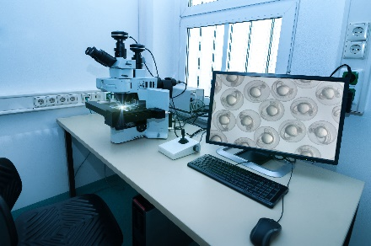
It’s time to put the application together!
Read the NOFO carefully
Sketch out some specific aims
Find out which NIH Institute(s) funds this kind of work
Check NIH RePORTER Matchmaker tool (https://reporter.nih.gov/matchmaker)
See if the Institute(s) participates in the NOFO of interest
Reach out to the Program Officer (PO) listed in the NOFO
Credit: iStock

Slide 18
The art of crafting an R15
Pick a compelling, scientifically meaningful research topic
Clear hypothesis and well justified
Publishable data
Make the plan feasible with
Resources (facility and personnel)
Effort
Students
Environment (institutional support)
Set a realistic/appropriate scope
3-year timeline
Credit: iStock

Slide 19
Writing the Research Strategy
Read the review criteria and program goals
Make sure you address the goals & criteria
Reviewers are asked to comment on these specifically
Include preliminary data where possible
Supports your hypothesis
Shows reviewers that you can do the work
Describe how students will be involved
Credit: Adobe Stock Photos

Slide 20
Writing the Research Strategy – Clinical Trial Required
Must be small scale
Mechanistic and/or minimal risk
Provides clinical trial research experience for undergraduates, health professional and/or graduate students in a controlled environment
Students may:
Participate in experimental design
Collect and analyze data
Develop presentations and publications
Participate in lab/research meetings
Students should be a major component of the research team
Remember – students working on a clinical trial must have clinical trial education, like CITI or similar training
For more information: https://grants.nih.gov/policy/clinical-trials.htm

Slide 21
Student involvement should be meaningful
Number of students
Include thoughts about how to recruit a diverse group of students, including what type of student e.g., undergraduate, graduate students, health professional students
For AREA R15: Number of undergraduate researchers > number of other researchers
For REAP R15: What type of student researchers?
Undergraduates? Graduate students? Health professional students?
Quality of student involvement
It is not sufficient to say “there will also be a couple of students (with an unspecified or insignificant role)”
Student involvement should result in students co-authoring publications!!

Slide 22
Writing the Biosketch
Include experience mentoring undergraduate, health professional and/or graduate students in research in the Personal Statement
Indicate which peer-reviewed publications or other research products involved undergraduate, health professional and/or graduate students under your supervision
Credit: Adobe Stock Photo

Slide 23
Facilities, Data & Resources
Facilities & Resources
A number of R15 specific instructions, e.g., a plan for recruiting students from diverse backgrounds
Data Management and Sharing (DMS) Plan
See https://sharing.nih.gov/
Includes data and metadata sharing – use of established repositories is encouraged
The NIH website has sample DMS Plans
Talk to a Program Officer to discuss your DMS plan and associated costs
Resource Sharing Plan
Some examples of resources that might be developed:
Experimental resources such as model organisms, plasmids, bespoke molecules, etc.
Computational resources such as software (may also be listed in DMS Metadata section if used for data analysis)
Read the NOFO for general and R15 specific directions!

Slide 24
Putting the budget together
R15 is a multi-year funded award
Budget for all years is requested in the first budget year
$300,000 direct cost limit
Can support a range of expenses
Research needs
Student compensation
Collaborator (subawards)
DMS costs
Travel
Credit: @Erin O’Sullivan

Slide 25
Student compensation
Appropriate compensation = commitment
Fixed stipends for undergraduates are not allowed on R15 awards. Stipends are payments made to individuals under fellowship or training awards.
Applicants should describe student compensation explicitly.
Students within the institution should be treated equitably - undergraduate students who are compensated from the R15 grant or other institutional funds should receive at least the national minimum wage.
Compensation through course credit hours towards graduation is allowable but must be justified.
Undergraduate summer salaries!
Read the NOFO for general and R15 specific directions!

Slide 26
Where will my application be reviewed?
R15s are clustered within standing study sections or Special Emphasis Panels (SEPs)
Optional Assignment Request form
Specify scientific areas of expertise needed for application review
Request preferred study section
https://nexus.od.nih.gov/all/2023/01/27/encouraging-use-of-the-phs-assignment-request-form-in-applications/
NIH Center for Scientific Review (CSR) Assisted Referral Tool (ART) recommends potentially appropriate study sections
NIH CSR makes the final call on application assignments!

Slide 27
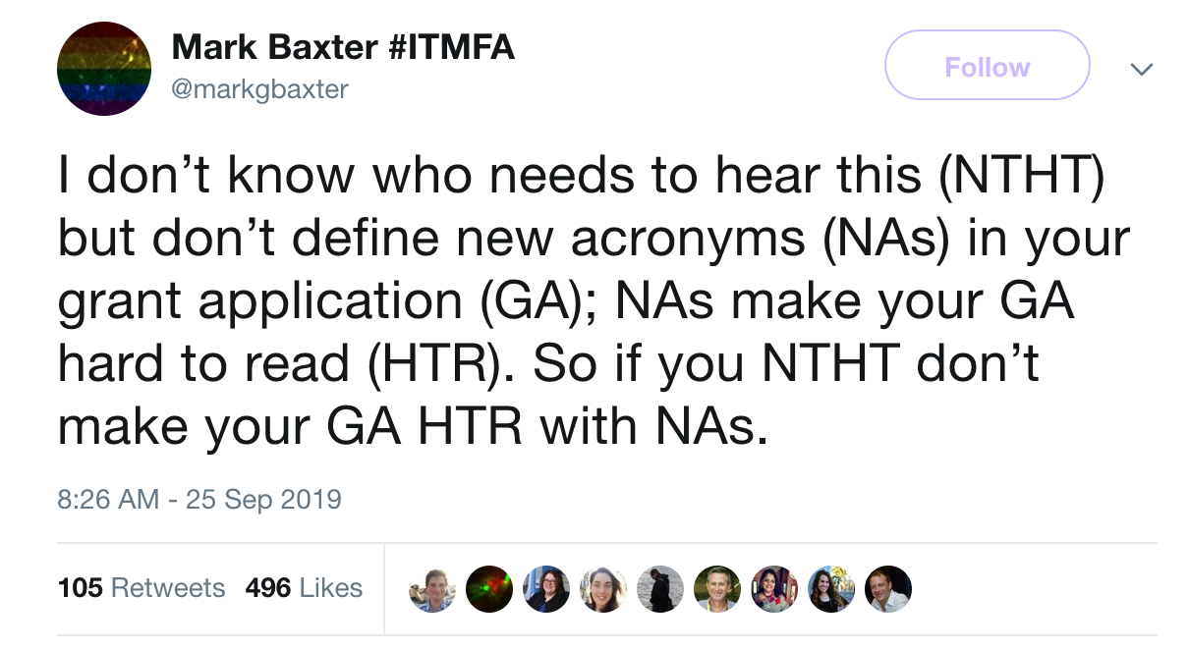
Help your reviewers by writing a great application!
Lay things out logically
Write for a broad audience
Be clear and concise, don’t use jargon
Organize the page
Proofread
Know what the reviewers are looking for and give it to them!

Slide 28
Additional resources & Opportunities

Slide 29
National Research Mentoring Network (NRMN)
Mentoring for Undergraduate & Graduate Students, Post-Docs, Research Scientists, Faculty & Academic Administrators
Provides evidence-based mentorship professional development programming that emphasizes the benefits and challenges of diversity, inclusivity and culture
MyMentor virtual mentoring
MyNRMN social networking
Webinars including grant writing
Mentor training
For more information: https://nrmnet.net/

Slide 30
Support for Research Excellence (SuRE) Resource Center University of Kentucky
FREE Resources
Helps qualifying institutions on their path toward building and sustaining a research infrastructure
Provides grant writing training, consultation, and mentoring to help faculty and staff at SuRE-eligible institutions overcome barriers to secure research funding
For more information: https://www.research.uky.edu/sure-resource-center
Notes:
<$6M total costs from NIH RPGs in last 2 years; Enroll at least 25% undergraduates supported by Pell Grants are an accredited medical/health professional school with a historical mission statement that explicitly states that it was founded to educate students from nationally underrepresented backgrounds. (PI eligibility varies by NOFO but can’t be a PI on a current RPG)
:

Slide 31
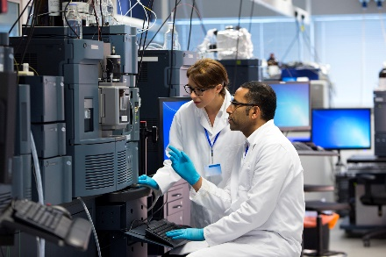
Instrumentation grant program for resource-limited institutions (RLI-S10)
NIH Unite E initiative to support acquisition of modern scientific instruments by resource-limited institutions: PAR-23-138
Credit: iStock
Credit: iStock
Program Goals
Provide instruments for research and teaching
Enhance biomedical research capacity at resource-limited institutions
Program Features
Award Amount: $25,000 to $250,000
Instruments for basic, translational, clinical, or biomedically-related behavioral research
For more information: https://grants.nih.gov/grants/guide/pa-files/PAR-23-138.html
RLI-S10 contact: Dr. Dorothy Beckett dorothy.beckett@nih.gov

Slide 32
Final thoughts on R15s
Visit the NIH R15 website
https://grants.nih.gov/grants/funding/r15.htm
Find and read the relevant notice of funding opportunity (NOFO)
PAR-21-357 (REAP R15 Clinical Trial (CT) required)
PAR 21-154 (AREA R15 CT required)
PAR-22-060 (REAP CT not allowed)
PAR-21-155 (AREA CT not allowed)
Visit the R15 website for the relevant NIH Institute/Center (IC)
Talk to a relevant Program Officer!

Slide 33
Thank you!
You, our audience
All members of the NIH R15 Program Advisory Committee
The NIH Grants Events Team at the Division of Communication & Outreach in the NIH Office of Extramural Research
Cynthia Dwyer, DeRon Turner, Sophie Barry, Kim Biondi, & Marisa Higgins

Slide 34
Contact Us

Slide 35
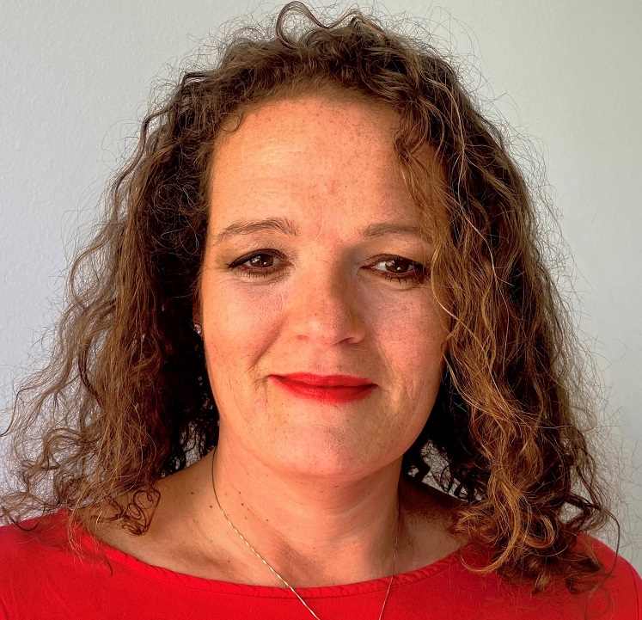
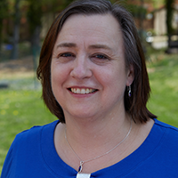
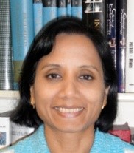
Your NIH Q&A Panel
Charles Ansong, Ph.D.
Program Director,
National Institute of General Medical Sciences (NIGMS), NIH
Anne Gershenson, Ph.D.
Program Director
National Institute of General Medical Sciences (NIGMS), NIH
Liz Perruccio, Ph.D.
Program Director,
National Institute of Nursing Research (NINR), NIH
Carmen Bertoni, Ph.D.
Scientific Review Officer
Center for Scientific Review
(CSR), NIH
Jeanette Marketon, Ph.D.
Receipt and Referral Officer
National Institute on Drug Abuse
(NIDA). NIH
Mahua Mukhopadhyay, Ph.D.
Program Director
Eunice Kennedy Shriver National Institute of Child Health and Human Development (NICHD), NIH

Slide 36
Support for Research Excellence (SuRE) R16 programs
SuRE-First R16: Supports research by faculty investigators who have not been PIs of external research grants ($125K Direct Costs (DC)/yr for up to 4 years, mentored, 6 months of research effort required, not renewable)
SuRE R16: Supports research by faculty investigators with prior research experience and no active NIH Research Project Grant (RPG) funding ($100K DC/yr for up to 4 years, renewable)
Check participating NIH Institutes/Centers
Institutional Eligibility
Award undergraduate (B.S./B.A.) and/or graduate degrees in biomedical sciences
At the time of the application, have received no more than $6 million dollars per year (total costs) from NIH RPGs in each of the preceding two fiscal years
Enroll at least 25% of undergraduate students supported by Pell grants based on the most recent 2 years of data or are an accredited medical/health professional school with a historical mission statement that explicitly states that it was founded to educate students from nationally underrepresented backgrounds.
For more information: https://www.nigms.nih.gov/about/overview/Pages/SuRE.aspx
R16 contact: Dr. Irina N. Krasnova (Irina.Krasnova@nih.gov)
Notes:
SuRE: all faculty with no active NIH RPG, $100K/year for 4 years, renewable
SuRE-First: faculty with no prior RPG funding from any source, 6 person-months effort/year, $125K/year for 4 years, non-renewable
Also support for schools where >= 25% of undergraduates receive Pell grants.

Slide 37
Even more resources
NIH Grants Process
Helpful videos: https://grants.nih.gov/grants/grants_process.htm
NIGMS Grant Writing Webinar Series for Institution Capacity Building: https://nigms.nih.gov/training/Pages/Grant-Writing-Webinar-Series-for-Institutions-Building-Research--and-Research-Training-Capacity.aspx
Notice of Funding Opportunities (NOFOs): The Annotated NOFO
The NIH Application Guide:
https://grants.nih.gov/grants/how-to-apply-application-guide.html
Submitting an Application:
https://grants.nih.gov/grants/forms/submitting-an-application.htm
NIH Peer Review Process
Information for Applicants: Center for Scientific Review

