Slide 1
Simplified Review Framework Research Project Grants (RPG)
An Update| November 3, 2023 | Mark Caprara, CSR; Brian Hoshaw, NEI; Lisa Steele, CSR
Simplifying Framework for Peer Review Criteria for Research Grants

Slide 2
Peer Review at NIH
1
2
First Level of Review
By scientific peers in a standing or special emphasis panel
Second Level of Review
Advisory Council
(Institute/Center)
Evaluation of scientific and technical merit (overall impact)
Recommendation for funding, based on scientific merit, programmatic priorities, administrative considerations
The Simplified Review Framework will improve how peer reviewers evaluate research project grants.
Scope: *Most RPGs (e.g., R01, R21 etc.)
In effect for applications received on or after January 25, 2025

Slide 3
Background

Slide 4
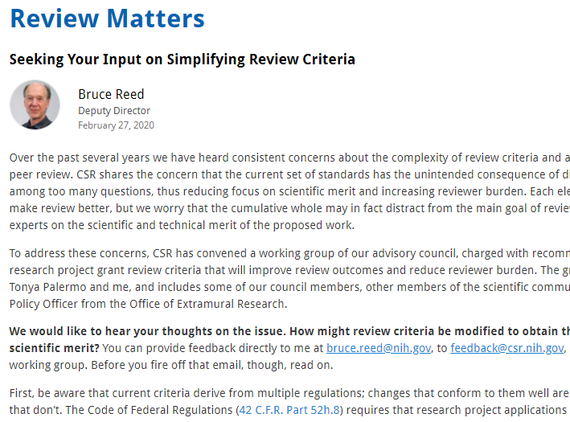
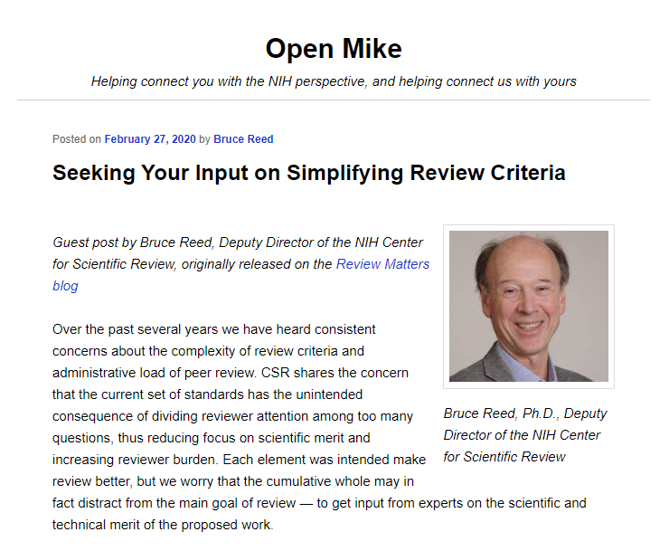
Community Input Initiating the New Framework
Ideas from the external scientific community
Review Matters Blog was released on Feb 27, 2020 and reposted on NIH’s Open Mike
Over 8000 unique page views
Generated > 400 comments and emails from the extramural community
Content analysis of comments provided foundational data for Working Group Recommendations

Slide 5
Concerns from Extramural Community
Increased complexity of NIH’s peer review criteria/Administrative burden: Detracts attention away from the critical, primary role of reviewers to evaluate scientific merit
“All of the yes/no criteria and peripherals such as resource sharing plans … should be evaluated by an administrative panel, not by the primary scientists doing the reviewing”
“A lot of minutiae has crept into the effort that can be taken off of the reviewer’s plate and addressed in JIT. How seriously applicants take the minutiae varies wildly, but the reviewers are required to cover all of it….”
Undue influence of reputation in NIH peer review: well known places/people are given a pass and others treated with more scrutiny
places/people are given a pass and others treated with more scrutiny
`
“If NIH is serious about supporting biomedical research throughout the country, as I know it is, it needs to move ENVIRONMENT from scored criteria to the “Acceptable”/ “Unacceptable” category. It is neither fair nor reasonable to use the perceived “richness” of an institution as a predictor of a potential impact of a specific project.”
“That is exactly what I have seen happening at NIH study sections. A really mediocre proposal gets a good score, because the investigator is “famous”.”

Slide 6
NIH Partnership with Extramural Scientists
Recommendations developed by Working Groups composed of extramural scientists from the Center for Scientific Review (CSR) Advisory Council, ad hocs as well as NIH Leadership (May 2020-April 2021)
NIH Input and Approvals
Working Group recommendations were refined with trans-NIH input via two working groups
Approved Institute/Center Directors and Acting NIH Director
(July 2021 – Sept 2022)

Slide 7
Community Input for Approved Recommendations via Request for Information (RFI) (Dec 2022 – March 2023)
Scientific societies
800 responses
780 individuals
30 scientific societies
23 academic institutions
Majority of respondents were very supportive of proposed framework- not surprising given that the framework was developed with significant input from the extramural community
Recommendations regarding Implementation:
Strong training resources to align reviewers, study section chairs, and SROs
Full report: NIH SRF RFI Content Analyses April 2023 508c.pdf
Academic institutions
Individuals

Slide 8
Overview of Simplified Framework

Slide 9
Goals: Simplified Framework for NIH Peer Review
Enable peer reviewers to better focus on answering the key questions necessary to assess scientific and technical merit
Mitigate the effect of reputational bias
Reduce reviewer burden
Guide Notice NOT-OD-24-010

Slide 10
Simplified Review Framework at a High Level (1 of 2)
Simplify and improve review by focusing reviewer attention on three main questions
“Should it be done?”
“Can it be done?”
“Will it be done?”
By reorganizing the five core review criteria into three factors to align with these questions
Factor 1: Importance of the Research
Factor 2: Rigor and Feasibility
Factor 3: Expertise and Resources
Modify the criterion definitions for Investigator and Environment to reduce reputational bias
By having reviewers assess the adequacy of investigator expertise and institutional resources with respect to the work proposed as a binary choice: Appropriate or Gaps Identified.

Slide 11
Simplified Review Framework at a High Level (2 of 2)
Simplify and strengthen review criteria by using conceptual definitions rather than lists of questions.
Shifting away from extensive sets of complex questions encourages thoughtful integration of concepts rather than “yes-no” thinking.
Relieve reviewer burden by not requiring peer review of select “additional considerations”.
Considerations not directly related to scientific merit shift to NIH staff administrative review.

Slide 12
Five Criteria Reorganized Into Three Factors
Simplified Framework (all considered in Overall Impact Score)
Factor 1: Importance of the Research
Significance, Innovation
Scored 1-9
Factor 2: Rigor and Feasibility
Approach (also include Inclusions for HS and CT Study Timeline)
Scored 1-9
Factor 3: Expertise and Resources
Investigators, Environment
Evaluated as appropriate or gaps identified; gaps require explanation
No individual score
Current
Significance - scored
Investigator(s) – scored
Innovation – scored
Approach – scored
Environment - scored

Slide 13
Examples of Conceptional Review Definitions
Simplified Framework
Factor 1: Importance of the Research
Evaluate the importance of the proposed research in the context of current scientific challenges and opportunities, either for advancing knowledge within the field, or more broadly.
Evaluate whether the proposed work applies novel concepts, methods or technologies or uses existing concepts, methods, technologies in novel ways, to enhance the overall impact of the project.
Guidance to Reviewers is more direct

Slide 14
Reduced Additional Review Considerations
Most Additional Review Considerations removed from first-level peer review; responsibility will shift to awarding institute/center
Current | Simplified Framework
Additional Review Considerations (no effect on overall impact score) Applications from Foreign Organizations Select Agent Research Resource Sharing Plans Authentication of Key Biological and/or Chemical Resources Budget and Period of Support | Additional Review Considerations (no effect on overall impact score) Authentication of Key Biological and/or Chemical Resources Budget and Period of Support

Slide 15
What will my summary statement look like? (1 of 3)
SRG Action: Impact Score:## Percentile:#
RESUME AND SUMMARY OF DISCUSSION:
SRO Text
CRITIQUE 1
Factor 1: score
Factor 2: score
Overall Impact: Reviewer Text
1. Factor 1 Importance of the Research (Significance and Innovation):
Strengths
Reviewer Text
Weaknesses
Reviewer Text

Slide 16
What will my summary statement look like? (2 of 3)
2. Factor 2 Rigor and Feasibility (Approach):
Strengths
Reviewer Text
Weaknesses
Reviewer Text
Inclusion Plans:
Sex/Gender: Distribution justified scientifically
Race/Ethnicity: Distribution justified scientifically
Inclusion/Exclusion Based on Age: Distribution justified scientifically
3. Factor 3: Expertise and Resources (Investigators and Environment):
Appropriate
OR
3. Factor 3: Expertise and Resources (Investigators and Environment):
Gaps Identified
Reviewer Text

Slide 17
What will my summary statement look like? (3 of 3)
Protections for Human Subjects:
Appropriate
Vertebrate Animals:
Not Applicable (No Vertebrate Animals)
Biohazards:
Not Applicable (No Biohazards)
Authentication of Key Biological and/or Chemical Resources:
Appropriate
Budget and Period of Support:
Budget and period of support are appropriate to support the proposed research

Slide 18
NIH Will Continue to Monitor Quality of Peer Review
We expect clearer evaluations of a) the importance of the research b) the rigor and feasibility of the approach, and c) the appropriateness of investigator/environment.
SROs and leadership will continue to:
Monitor critiques and meeting discussions. Trends, positive or negative, are discussed and problems addressed promptly.
Monitor and benchmark scoring distributions against an extensive database.
Monitor reports of bias from reviewers/applicants.
Survey reviewers and NIH staff regarding perceived quality of review and review experience, benchmarked against previous survey data.
Engage with the applicant community for feedback
Note: NIH is committed to improving review on multiple fronts including addressing reputational bias (e.g. CSR Initiatives to Address Bias in Peer Review). Positive changes in the range of institutions or investigators that receive funding, for example, need to be taken in context of these other efforts.

Slide 19
Next Steps: Between Now and January 2025
Over the next year:
Changes to NIH systems
Developing training resources
Updating and publishing funding opportunities
Lots of training/outreach to socialize the change for reviewers, chairs, applicants, staff

Slide 20
Learn More & Stay Informed
Development background
Description of changes
Guidance for reviewers
Guidance for applicants
Training and resources
Notices and reports
FAQs
Contacts
grants.nih.gov/policy/peer/simplifying-review.htm

