Slide 1
NIH Grants Policy Updates: FY2025 Edition
presented by the Office of policy for extramural research administration October 17, 2024

Slide 2
AGENDA
PRESENTERS
UPDATES:
Budget
Policy
System Process
Compliance Updates
Policy Reminders
Resources
Michelle Bulls
Director
Office of Policy for Extramural Research Administration
National Institutes of Health (NIH)
Kristin Ta
Deputy Director
Office of Policy for Extramural Research Administration
National Institutes of Health (NIH)

Slide 3
BUDGET updates

Slide 4
FY25 Budget Updates
On September 26, 2024, President Biden signed the Continuing Appropriations and Extensions Act, 2025 (Public Law 118-83).
This Act (CR) continues government operations through December 20, 2024, at the Fiscal Year (FY) 2024 enacted level, with no reduction.
The following FY 2024 notices remain in effect under this CR:
Legislative Mandates (see NOT-OD-24-110)
Salary Limitation for Grants and Cooperative Agreements (see NOT-OD-24-057)*
Ruth L. Kirschstein National Research Service Award predoctoral and postdoctoral stipend levels and tuition/fees as described in NOT-OD-24-104.
Learn more: NOT-OD-25-10

Slide 5
*Legislative mandates – Salary Limitation
Effective October 1, 2024, the HHS policy on salary rate limitation outlines that the legislative mandate limiting salary to Executive Level II applies to
Direct salaries (individuals working directly on NIH projects) and
Indirect salaries (executive salaries in various cost pools)
This policy change applies to new, competing renewals, non-competing continuations and supplemental awards.
For recipients that do not have an updated or approved indirect cost rate agreement, the HHS salary rate limitation requirement applies, and recipients may not charge or recover funds for salaries above the salary limitation.
Learn more: HHS Grants Policy Statement – October 2024

Slide 6
Childcare Cost Updates for NRSA Fellows and Trainees
Effective in FY 2024 NIH increased the childcare support to $3,000 for applicable NRSA individual fellowships and institutional training awards.
For fellows, each NRSA fellow may request $3,000 per budget period to defray childcare costs.
For trainees, NIH will provide an annual $3,000 per each full-time predoctoral or postdoctoral NRSA trainee appointment slot at the time the new, renewal, or continuation award is made.
Effective in FY2025, NIH intends to provide childcare cost support to individuals supported as full-time recipients of Predoctoral to Postdoctoral Fellow Transition Award (F99/K00) programs during the F99 phase of the award.
Learn more: NOT-OD-24-116

Slide 7
Budget Reminder: Budget Preparation
In general, NIH does not have policy nor instructions on how recipients should request budget escalations that are submitted in an application. Applicants should request the actual costs needed to complete the science for that budget period.
All allowable costs submitted in budget requests must be incurred during the period of performance. Generally, costs beyond the period of performance are not allowable.
Learn more: Develop your Budget

Slide 8
NIH Policy updates

Slide 9
NIH Implementation of 2 CFR Part 200 - Overview
In April 2024, the Office of Management and Budget issued revisions to the Uniform Administrative Requirements for Federal Financial Assistance, located at 2 CFR Part 200.
NIH plans to implement the OMB administrative flexibilities and partially implementing the updated administrative requirements that are outlined throughout 2 CFR Part 200. NIH is working closely with HHS and the other HHS Operating Divisions.
Currently, the Research Terms and Conditions (RTCs) are not being updated. However, NIH is working with other Federal research agencies to update the prior approval matrix and national policy requirements.

Slide 10
Single Audit Requirements for Foreign Recipients and Subrecipients
NOT-OD-24-151 clarified the NIH single audit requirements for foreign recipients and subrecipients.
Effective October 1, 2024, foreign recipients that expend $750,000 (cumulative amount) or more in Federal awards during their fiscal year are required to conduct either a single audit, or program-specific audit (as required by the terms and conditions of award).
A program-specific audit may not be elected unless all the Federal awards expended were received from NIH. The recipient must request prior approval from the funding Institute or Center prior to conducting a program-specific audit.
Learn more: NOT-OD-24-151

Slide 11
Disclosures
Notes:
Poll Question:
When is the effective date of NIH’s adoption of the Common Forms for Biosketch and Current/Pending (Other Support)? Submissions for due dates on or after…
January 25, 2025
May 25, 2025
October 1, 2025

Slide 12
Common Forms for Biographical Sketch and Current and Pending (Other) Support: NIH Implementation
In accordance with the implementation plan submitted to the Office of Science and Technology Policy (OSTP) in May 2024, NIH issued NOT-OD-24-163.
Effective for all applications and RPPRs submitted for due dates on or after May 25, 2025.
NIH will implement the Common Forms without change to any collection fields.
NIH plans to continue collecting three required agency specific data elements
Personal Statement
Contributions to Science
Honors) to assess qualifications
These data elements will be collected separately from the Common Forms on a new NIH Biographical Sketch Supplement.
Learn more: NOT-OD-24-163

Slide 13
Common Forms for Biographical Sketch and Current and Pending (Other) Support: SciENcv/ORCID Implementation
NIH will require the use of Science Experts Network Curriculum Vitae (SciENcv) to complete Common Forms and the NIH Biographical Sketch Supplement to produce digitally certified PDF(s) for use in application submission.
NIH will require all Senior/Key Personnel to enter their ORCID ID into SciENcv in the Persistent Identifier (PID) section of the Common Forms.
NIH will require all Senior/Key Personnel to link their ORCID ID to their eRA Commons Personal Profile.
For information on linking an ORCID ID to the eRA Commons Personal Profile see the ORCID ID topic in the eRA Commons online help.

Slide 14
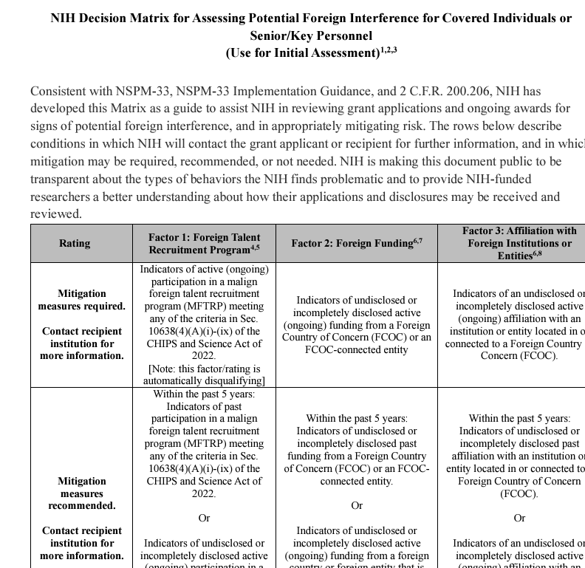
Decision Matrix for Assessing Potential Foreign Interference for Covered Individuals or Senior/Key Personnel
On 8/15/24 NIH published a decision matrix for assessing potential foreign interference.
NIH strongly supports properly conducted and principled international collaborations that are integral for our country to remain competitive.
NIH Decision Matrix

Slide 15
Malign Foreign talent recruitment program

Slide 16
Malign Foreign Talent Recruitment Program (MFTRP) Prohibition – NIH Implementation
OSTP issued Guidelines for Federal Research Agencies Regarding Foreign Talent Recruitment Programs on 2/14/24.
Covered individuals (i.e., senior/key personnel) are prohibited from participating in a federally funded research and development project if they are currently participating in a “malign foreign talent recruitment program.”
Individual as well as institutional certifications are required.
Individual certification is captured on the Common Forms for Biosketch and Current and Pending (Other Support).
NIH intends to incorporate the institutional certification related to MFTRP in its application instructions.
NIH will incorporate the MFTRP definition and the certification requirements in the FY25 NIH Grants Policy Statement.

Slide 17
Research securities
Notes:
Poll Question:
When is the effective date of NIH’s adoption of the Common Forms for Biosketch and Current/Pending (Other Support)? Submissions for due dates on or after…
January 25, 2025
May 25, 2025
October 1, 2025

Slide 18
Research Security Guidelines
On July 9, 2024, OSTP issued Guidelines for Research Security Programs at Covered Institutions.
Covered institutions will be required to certify that their research security programs include elements relating to:
Research Security Training: Institution requires covered individuals to complete research security training and each such covered individual has completed the research security training program.
Export Controls: Institution requires covered individuals who perform R&D involving export-controlled technologies to complete training and that each such covered individual has completed training
Cybersecurity: Institution implements a cybersecurity program consistent with the cybersecurity resource for research institutions described in the CHIPS and Science Act within one year after the National Institute of Standards and Technology (NIST) of the Department of Commerce publishes that resource.
Foreign Travel Security: Institution implements periodic training on foreign travel security and ensure that all such covered individuals take this training at least once every six years.

Slide 19
Research Security Guidelines – Threshold
OSTP defined covered institutions using the following threshold:
A participant in the U.S. R&D enterprise is a “covered institution” if and only if (A) it is an institution of higher education,13 a federally funded research and development center (FFRDC), or a nonprofit research institution; and (B) it receives in excess of $50 million per year, in fiscal year 2022 constant dollars, under (1) the three-year average of federal R&D obligations provided to participants in the U.S. R&D enterprise as reported in the most recent version of the Survey of Federal Science and Engineering Support to Universities, Colleges, and Nonprofit Institutions;14 or (2) the three-year average of federal R&D obligations to FFRDCs as provided in the most recent versions of the Survey of Federal Funds for Research and Development.
Recipients that do not meet this funding threshold will not be required to certify that they have implemented research security programs.
All NIH applicants and recipients, however, must continue to comply with all NIH disclosure policies as these are two different requirements.

Slide 20
Research Security Guidelines – NIH Implementation
NIH continues to participate with OSTP and research agency partners in discussions on streamlined implementation of these certification requirements for institutions.
More information on the implementation will be coming in the next several months.

Slide 21
Data Management and Sharing (DMS)

Slide 22
Federal Demonstration Partnership (FDP) DMS Pilot - Evolution of the DMS Plan Template
Initially, OER developed an optional DMS Plan Format Page that aligns with the recommended elements of a DMS Plan.
Many ICs wanted to issue IC-specific templates.
NIH and the FDP are conducting a pilot with the goal of developing a single NIH template for DMS Plans.
Pilot included testing of two DMS Plan templates, ‘Alpha’ and ‘Bravo.’
Feedback was collected from the applicant community, as well as NIH Program Officials.
NIH and FDP used this feedback to develop a new DMS plan template, ‘Charlie.’

Slide 23
Using Feedback to Develop a New Template
Utilize tables where possible
Helps to ensure the required information is provided for every data type
Facilitates monitoring and reporting
Utilize drop-down menus where appropriate
Standardizes the information provided while also providing guidance on the information expected
Use established lists/terms where possible
Example: using the Trans-NIH BioMedical Informatics Coordinating Committee (BMIC) Subject Areas to capture broad data types
Section for describing limitations arising from consent/privacy considerations only needs to be completed if data derived from humans will be generated
Design question wording to also provide guidance on expectations
Example: requesting different information related to the data sharing timeline to emphasize that there could be differences in deposit versus release timelines

Slide 24
FDP DMS Pilot – What’s next?
NIH is finalizing its plans for the rollout of the Charlie template – stay tuned!
Pilot Phase 2: Cost Policies
Establish common cost principles, identify types of costs required, and determine how to identify additional/unforeseen costs that may be required to meet the spirit of the data sharing policy.
Next steps: Small working group brainstorming steps to catalogue the activities that should be included in a cost/effort calculator.

Slide 25
Reporting DMS Plan Activities in the RPPR
Recipients must address NIH Data Management and Sharing Policy in annual RPPRs due on or after October 1, 2024.
For awards for which the NIH DMS Policy applies, recipients will be asked:
Whether data has been generated to date and what type of data it is;
Whether data has been shared for use by others;
If data has been shared, in what repository and under what unique digital identifiers;
If data has NOT been shared, what is the status of data sharing (e.g., being prepared for submission, submitted to repository, not yet expected to be shared); and
If data has not been generated and/or shared as outlined in an approved DMS Plan, what corrective actions have or will be taken to comply with the approved Plan.
The updated NIH RPPR Instruction Guide is posted to the Research Performance Progress Report (RPPR) page.
Learn more: NOT-OD-24-175 and NIH Scientific Data Sharing

Slide 26
Updated System Processes for Requesting Revisions to an Approved DMS Plan
Under the final NIH Policy for Data Management and Sharing (DMS Policy), NIH requires a recipient to comply with the DMS Plan as approved by the funding NIH Institute, Center, or Office (ICO) as a term and condition of the award.
If DMS Plan revisions are necessary (e.g., new scientific direction, a different data repository, or a timeline revision), Plans should be updated by recipients and reviewed and approved by the NIH ICO.
All requests for NIH awarding ICO prior approval must be submitted by the Authorized Organization Representative (Signing Official (SO) role in eRA Commons) at least 30 days in advance of the requested change, and the currently approved DMS Plan remains in effect for the award until the request is approved by the funding NIH ICO.
Learn more: NOT-OD-24-176.

Slide 27
Updated System Processes for Requesting Revisions to an Approved DMS Plan, Cont’d
The processes for submitting requests and revised DMS Plans depend on where you are in the grant award cycle.
Pre-Award: Just-in-Time
Before the award is made, applicants must use the “Data Management and Sharing Plan (DMSP) Revision” section of the Just in Time (JIT) Screen in eRA Commons, to submit a revised DMS Plan.
Note: SOs must no longer use the ‘Other File’ section in Just-in-Time to submit the revised DMS plan.
Post-Award: At Time of RPPR
For changes being requested after the award is made, at the time of the RPPR (i.e., within 30 days of RPPR submission), in the RPPR Module, recipients must use Section C.5.c to select “Upload Revised Data Management and Sharing Plan” and follow the instructions provided to complete the required entry. Refer to the RPPR Instruction Guide.
Post Award: Off-Cycle Requests
When revisions to the DMS Plans need to be requested off-cycle (other than at the time of the RPPR), recipients must Select “Prior Approval – DMS Request” in the Prior Approval Module to request the change.
Note: SOs must no longer use the ‘Other Request’ type in Prior Approval to submit the plan.
Learn more: NOT-OD-24-176.

Slide 28
Forms-I

Slide 29
Coming Soon: FORMS-I
Effective for applications submitted for due dates on or after January 25, 2025.
FORMS-I will incorporate updates related to multiple NIH initiatives:
Improvements to the NIH Fellowship Application and Review Process.
Updates to NRSA Training Grant Applications.
Adoption of the Common Forms for Biographical Sketch and Current and Pending (Other) Support for submission of applications and RPPRs by May 2025.
FORMS-I application guide and forms packages will be available beginning in October 2024.
Learn more: NOT-OD-24-086.

Slide 30
Simplified review framework
Notes:
Poll question: How many review ‘factors’ are there under the new simplified review framework? (correct answer: three)
Eight
Five
Three

Slide 31
NIH Peer Review – Simplified Review Framework
NOT-OD-24-010, Simplified Review Framework (SRF) for NIH Research Project Grant Applications. Effective for applications with due dates on or after January 25, 2025.
Applies to most research project grant (RPG) activity codes.
Reorganizes the five regulatory criteria into three factors to better focus peer reviewers on the key questions needed to assess the scientific and technical merit of proposed research points.
Factor 1: Importance of the Research (Significance, Innovation), scored 1-9
Factor 2: Rigor and Feasibility (Approach), scored 1-9
Factor 3: Expertise and Resources (Investigator, Environment), to be evaluated for sufficiency.
Learn more: NOT-OD-24-010 and Simplifying Review of Research Project Grant Applications.

Slide 32
Simplified Review Framework (SRF) Updates
On April 4, 2024, NIH issued NOT-OD-24-085, Simplified Review Framework for NIH Research Project Grant Applications - Update and Implementation Plans.
Updates applicable activity codes:
Added: R21/R33, UH2/UH3, UG3/UH3, R61/R33
Removed: DP1, DP2, DP3, DP4, and DP5
No form changes associated with the SRF initiative; however, applicants will need to use FORMS-I packages for applications with due dates on or after January 25, 2025.
New and reissued SRF NOFOs may be initially posted without an application forms package. In these cases, application forms and associated application instructions will be added at least 30 days and, frequently 60 days or more, prior to the first due date. See NOT-OD-24-086.
Learn more: NOT-OD-24-085 and NIH Simplified Review Framework for Research Project Grants (RPGs): Implementation and Impact on Funding Opportunities Webinar.

Slide 33
Changes to the NIH Fellowship Application and Review Process
NIH issued NOT-OD-24-107, Implementation of Revisions to the NIH Fellowship Application and Review Process.
Reorganizes the five current scored review criteria and redefines them in three scored criteria
Updates PHS Fellowship Supplemental Form to align with restructured criteria
Revises instructions for Reference Letters
Effective for application submissions with due dates after January 25, 2025
Applicable to programs using the activity codes: F30, F31, F32, F33, and F99/K00
Learn more: NOT-OD-24-107, Revisions to the NIH Fellowship Application and Review Process, Fellowship Webinar FAQs.

Slide 34
Updates on NIH Institutional Training Grant Applications
NIH issued NOT-OD-24-129, Updates to NIH Institutional Training Grant Applications for Due Dates on or After January 25, 2025.
The Recruitment Plan to Enhance Diversity will be its own attachment in the PHS 398 Research Training Program Plan Form.
Mentor training expectations will be more clearly defined in the parent T32 NOFO.
Institutional Training data tables will be updated to reduce burden and promote consistent information collection across training programs.
Effective for application submissions with due dates after January 25, 2025
Applicable to programs using the activity codes:
Institutional Training – T series, e.g., T15, T32, T34, T35, T37, T90/R90, TL1, TL4
International Institutional Training – D43, D71, U2R
Institutional Career Development – K12, KL2
Learn more: NOT-OD-24-129 , Updates to NIH Training Grant Applications Webinar, FAQs

Slide 35
SBIR/STTR Updates
Notes:
Poll question:
True or false: The NIH foreign risk assessment process applies to all SBIR/STTR applications, regardless of when that application was submitted.
False: The foreign risk assessment process applies to competing SBIR/STTR applications submitted for due dates on or after September 5, 2023. Applications submitted for due dates prior to 9/5/23 do not fall under this updated process.

Slide 36
SBIR and STTR Foreign Disclosure Requirements
NOT-OD-23-139 and NOT-OD-24-029 outline the Implementation of the NIH Small Business Innovation Research (SBIR) Program and the Small Business Technology Transfer (STTR) Foreign Disclosure Pre-Award and Post-Award Requirements.
Due diligence program to assess security risks and denial of award when foreign relationships or commitments with countries of concern pose a significant risk as provided in the SBIR and STTR Extension Act of 2022.
Effective for competing SBIR and STTR applications submitted for due dates on or after September 5, 2023.
Disclosure of all funded and unfunded relationships with foreign countries is required for all owners and “covered individuals”.
Submitted via the “Required Disclosures of Foreign Affiliations or Relationships to Foreign Countries” form during the Just-in-Time process.
Disclosure form is available on NIH’s Required Disclosures of Foreign Affiliations or Relationships to Foreign Countries web page.
Learn more: NOT-OD-23-139; NOT-OD-24-029; SEED Foreign Disclosure and Risk Management; Public Law No: 117-183; and FAQs

Slide 37
New SBIR and STTR Domestic Subaward Requirements
On July 3, 2024, NOT-OD-24-149 implemented a change in policy for domestic subawards for the SBIR Program and the STTR Program.
SBIR and STTR recipients are now required to seek prior approval when adding a new domestic subaward to a project post award, where the arrangement was not originally a part of the peer reviewed and approved application.
If the new subaward results in any changes to the “Required Disclosures of Foreign Affiliations or Relationships to Foreign Countries” form, the recipient must submit an updated form for review.
Reminder: NIH continues to require prior approval when adding a foreign subaward to the project (NIHGPS 8.1.2.10).
Learn more: NOT-OD-24-149

Slide 38
System process updates

Slide 39
Retirement of NIH’s Automated Just-in-Time Email Notification
The automated Just-In-Time (JIT) notification from era-notify@mail.nih.gov was retired effective October 1, 2024.
Email was sent for all applications with an overall impact score of 30 or less.
The official email requesting JIT material(s) will continue to be sent directly by NIH staff from the awarding Institute/Center to those who are required to provide the material(s).
The JIT link to submit materials, when requested, will still be available in eRA Commons until the application is awarded.
Note that either a PI or SO can upload and save Just-in-Time information; however, only the SO can submit it.
Learn more: NOT-OD-24-165

Slide 40
Retirement of Commons Demo and Quick Queries Sites
NOT-OD-25-005: eRA Commons Demo, a sample environment to try out most of the capabilities of eRA Commons, was retired as of October 14, 2024.
The external extramural research community will have the option to use the non-production environment — the User Acceptance Testing (UAT) environment — for practice. See steps to use UAT.
NOT-OD-24-111: eRA Commons Quick Queries, including Grants Pending Closeout, Progress Report Search by IPF number, IPF Number Search, and Issued Notice of (Grant) Award, was retired as of June 3, 2024.
We encourage you to take full advantage of other eRA tools in Commons Status and Research Performance Progress Report (RPPR) to access Award-related information. In addition, we encourage you to use RePORTER to obtain desired information related to organizations along with a variety of other grant related topics.
Learn more: NOT-OD-25-005; NOT-OD-24-111

Slide 41
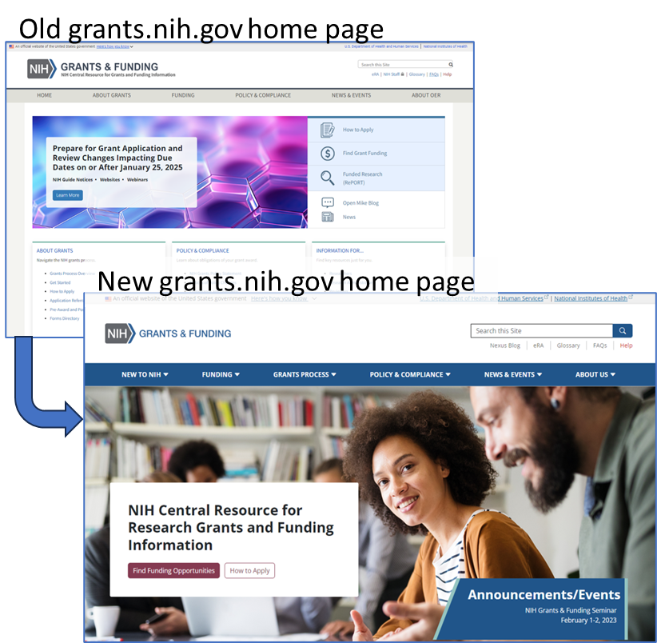
Redesigned NIH Grants & Funding Site
Launched September 24th
Design based on analytics and user feedback
Increased focus on new users
Improved opportunity search
Reorganized grants process content
Stronger integration with How to Apply – Application Guide
Lots of URL changes
Update your bookmarks, websites, and resources!
Redirects in place for at least a year
Learn more: NOT-OD-24-171

Slide 42
Compliance updates

Slide 43
Continued Extension of Certain Flexibilities for BESH studies
On May 6, 2024, NOT-OD-24-118 extended interim registration and results reporting flexibilities for basic experimental studies with humans (BESH).
NIH is extending the period of delayed enforcement for registration and results reporting, for BESH responsive to designated BESH NOFOs with application due dates through September 24, 2025.
Only applicable to BESH submitted to funding opportunities designated as BESH
BESH responsive to designated BESH NOFOs with application due dates on or after September 25, 2025, are expected to register in ClinicalTrials.gov and report summary results information to either ClinicalTrials.gov or Regulations.gov
For BESH projects, NIH continues to expect registration and results reporting, but with the additional flexibility to register and report results on alternative publicly available platforms.
Learn more: NOT-OD-24-118

Slide 44
Unilateral Closeout Reporting
On January 23, 2024, NIH issued NOT-OD-24-055, NIH Enforcement of Unilateral Closeout Reporting in the System for Award Management Responsibility/Qualification.
NIH will initiate unilateral closeout for all awards that fail to meet closeout requirements within one year after the end of the project period end date.
NIH is required to submit Responsibility/Qualification determinations for any entity that does not submit all required closeout reports within one year of the period of performance end date (2 C.F.R. § 200.344(i)).
Recipients may comment on the report displayed on SAM.gov via the Contractor Performance Assessment Reporting System (CPARS) to provide a public statement in response to NIH’s report (2 C.F.R. § 200.341(b)(4)).
The Responsibility/Qualification record will remain in SAM.gov for 5 years.
Learn more: NOT-OD-24-055

Slide 45
Policy reminders

Slide 46
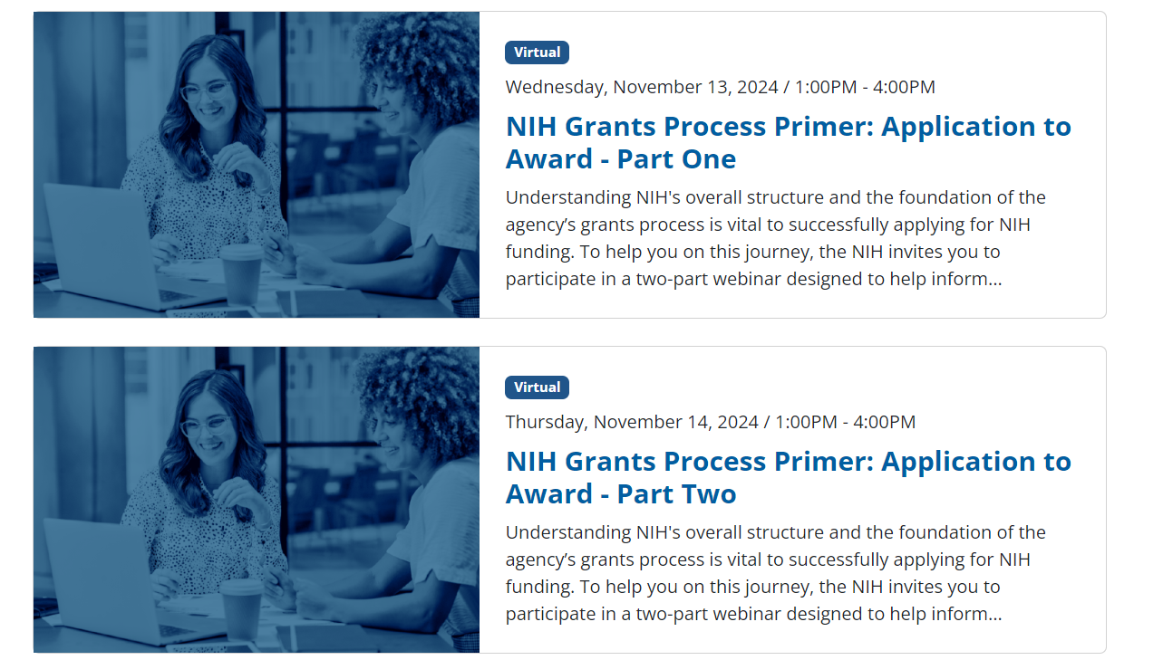
NIH OER Virtual Events
Upcoming NIH Grants Events
Subscribe to NIH Grants Events to keep informed at OER Listservs and RSS Feeds.

Slide 47
Reminder: NIH Policy for Subaward/Consortium Written Agreements
On September 15, 2023, NIH issued NOT-OD-23-182, NIH Final Updated Policy Guidance for Subaward/Consortium Written Agreements.
Effective January 1, 2024:
For foreign subrecipients, the written agreement must include a provision requiring the foreign subrecipient to provide access to copies of all lab notebooks, all data, and all documentation that supports the research outcomes as described in the progress report to the primary recipient with a frequency of no less than once per year, in alignment with the timing requirements for Research Performance Progress Report submission. Such access may be entirely electronic.
The FY2024 NIH Grants Policy Statement (NIHGPS) has incorporated these requirements in NIHGPS Section 15.2.1.
Learn more: NOT-OD-23-182 and Open Mike Blog Post

Slide 48
Reminder: Timely Progress Reports
Annual Research Performance Progress Report (RPPR) Format
Due Dates
Non-SNAP: Approximately 60 days before the start of next budget period
SNAP: Approximately 45 days before start of the next budget period
Multi-Year Funded: on or before award anniversary date

Slide 49
Reminder: Federal Financial Report and Financial Closeout Service Center Updated Guidance for Returning Grant Funds
NIH recipients who need to return funds in the PMS for NIH grant awards that have ended, but funds have not yet expired (e.g., funds obligated from an annual appropriation within 5 years of current fiscal year).
When recipients need to return funds on an NIH grant:
If the refund is $20,000 or greater, NIH recipients must
(1) submit a revised FFR, and
(2) post the refund to the PMS document if the funds have not expired and are reconciled and closed in PMS.
All refunds under $20,000 on closed PMS documents should be sent directly to PMS with instruction to post the funds to Miscellaneous Receipts.
PMS refund instructions may be found at https://pms.psc.gov/grant-recipients/returning-funds-interest.html.
A chart outlining the updated refund process for various scenarios may be found at https://grants.nih.gov/policy/compliance.htm under Compliance Resources.
Learn more: NOT-OD-23-102

Slide 50
Reminder: Invention Reporting
Reporting of inventions through iEdison is mandatory.
Reminder: Management of the iEdison system has transitioned from the NIH eRA to the NIST, U.S. Dept. of Commerce (DOC).
Annually, in the progress report (RPPR Section C.4), identify any inventions, patent applications and/or licenses resulting from the award.
A Final Invention Statement and Certification (HHS 568) must be submitted within 120 calendar days of the project period end date of all awards that support research. The Statement shall include all inventions which were conceived or first actually reduced to practice during the course of work under the grant or award, from the original effective date of support through the date of completion or termination.
Failure to report all inventions may result in your organization’s loss of rights in the invention or other actions as appropriate.
Learn more: NIH GPS 8.2.4 and NIH GPS 8.6.3
About iEdison: NIST FAQ; NIST Training Opportunities; NOT-OD-22-100; NOT-OD-22-158

Slide 51
Reminder: Required Language for Government Support Clauses on Patented Intellectual Property
Per the Bayh-Dole Act, The Government Support Clause is a statement acknowledging federal support of a subject invention that MUST be included in the specification of a U.S. patent application or a U.S. issued patent (35 USC 202(c)(6))
See: NIH Grants Policy Statement, Section 8.2.4 “Inventions and Patents”
As a reminder, the Government Support Clauses must specifically identify “the National Institutes of Health” as the funding agency
Sample: This invention was made with government support under (grant number, including the two-letter institute code and six-digit serial number, e.g., CA012345) awarded by the National Institutes of Health. The government has certain rights in the invention.
Learn more: Section 8.2.4 of the GPS

Slide 52
Reminder: Grant Closeout Requirements
Closeout of an award is the process by which NIH determines that all applicable administrative actions and all required work of an award have been completed by the recipient and NIH.
NIH continues to require and enforce longstanding closeout requirements due within 120 days of the project period end date:
Final Research Performance Progress Report (RPPR)
Final Federal Financial Report (FFR) (SF 425)
Final Invention Statement and Certification (HHS 568)
NIH will initiate unilateral closeout (including potential enforcement actions) if recipients fail to submit final reports on time.
Learn more: NIH Closeout and NIH GPS 8.6 Closeout

Slide 53
Reminder Notifications for Final Federal Financial Reports (FFRs) in Rejected Status
Beginning November 2023, NIH sends reminder email notifications to recipients with Final FFRs in rejected status.
Reminder: Revised Final FFRs must be resubmitted in a timely manner in accordance with NIH GPS 8.6 and 8.6.1 to ensure all administrative and financial closeout requirements are conducted within the required time frames. (See 2 CFR Part 200.344 and NIH GPS 8.6).
Please direct all inquiries to OPERA FFR Reconciliation and Financial Closeout Support Center (ODOPERARejectedFFR@od.nih.gov).
Learn more: NOT-OD-24-017

Slide 54
Resources
TOPIC | LINKS
Application Submission | Grant Application Basics: https://grants.nih.gov/grants/grant_basics.htm Find Grant Funding- NIH Guide for Grants and Contracts: https://grants.nih.gov/funding/searchguide/index.html#/ How to Apply - Application Guide: http://grants.nih.gov/grants/how-to-apply-application-guide.htm Annotated SF424 (R&R) Application Forms: https://grants.nih.gov/grants/how-to-apply-application-guide/resources/annotated-form-sets.htm eRA Training: Video Tutorials: https://www.era.nih.gov/era-training/era-videos.htm How we check for application completeness: https://grants.nih.gov/grants/how-to-apply-application-guide/submission-process/how-we-check-for-completeness.htm
eRA | eRA Commons: https://www.era.nih.gov/ eRA Commons Help & Tutorials: https://www.era.nih.gov/help-tutorials/era-commons/user-guide.htm Self Help Resources and eRA Service Desk: https://www.era.nih.gov/need-help
General | NIH Grants & Funding web page: https://grants.nih.gov/ NIH Grants Policy Statement: https://grants.nih.gov/policy/nihgps/index.htm NIH Extramural Nexus – newsletter for the extramural community: https://nexus.od.nih.gov/all/ NIH Frequently Asked Questions (FAQs): https://grants.nih.gov/faqs#/ Research Portfolio Online Reporting Tools (RePORT): https://report.nih.gov/ RePORT Expenditures & Results (RePORTER): https://reporter.nih.gov/
RPPR | RPPR Webpage, including links to the NIH RPPR Instruction Guide, RPPR Guide Notices, FAQs, Training, and Contacts: https://grants.nih.gov/grants/rppr/index.htm

Slide 55
NIH Listservs
NIH Guide for Grants and Contracts (The official publication for NIH Grant Policies, Guidelines & Funding Opportunities): https://grants.nih.gov/grants/guide/listserv.htm
Office for Human Research Protections (OHRP): https://www.hhs.gov/ohrp/index.html
Office of Laboratory Animal Welfare (OLAW): https://olaw.nih.gov/
eRA News: https://www.era.nih.gov/about-era/get-connected.htm
Virtual NIH Grants Events: https://grants.nih.gov/news-events

Slide 56
Questions
Division of Grants Policy: GrantsPolicy@mail.nih.gov
Division of Grants Compliance & Oversight: GrantsCompliance@mail.nih.gov
Systems Policy Branch: OPERAsystemspolicy@mail.nih.gov
Division of Extramural Inventions and Technology Resources: Inventions@nih.gov
OPERA FFR Center: OPERAFFRInquiries@od.nih.gov

